Slide 1
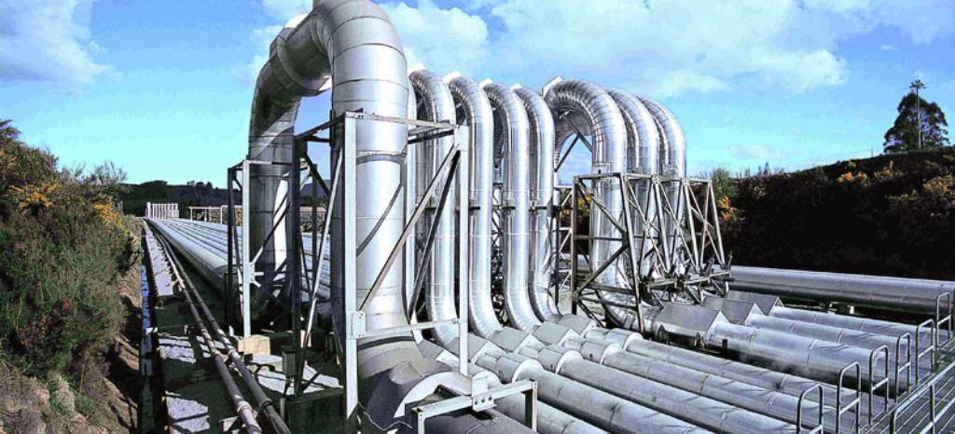
TPL Dataflows
Paralelní zpracování toku dat

Slide 2
Agenda
TPL - Task Parallel Library
TPL Dataflow
Bloky
Linkování, filtrování a paralelistmus
Propagace Complete

Slide 3
TPL – Task Parallel Library
From .NET Framework 4.5 and C# 5.0 (august 2012)
System.Threading.Tasks
Async/Await
ThreadPool, CancellationTokens, TaskScheduler…

Slide 4
TPL Dataflow
System.Threading.Tasks.Dataflow namespace
Implements pipeline pattern
Foundation for message passing and parallelizing CPU-intensive and I/O-intensive applications that have high throughput and low latency.
Consist of DataFlow blocks:
Buffering Blocks
Execution Blocks
Grouping Blocks
Notes:
pipeline consists of a chain of processing elements

Slide 5
Multi-Threaded pipeline
Input
Queue
Output
Queue
Task 1
Task 2

