Slide 1
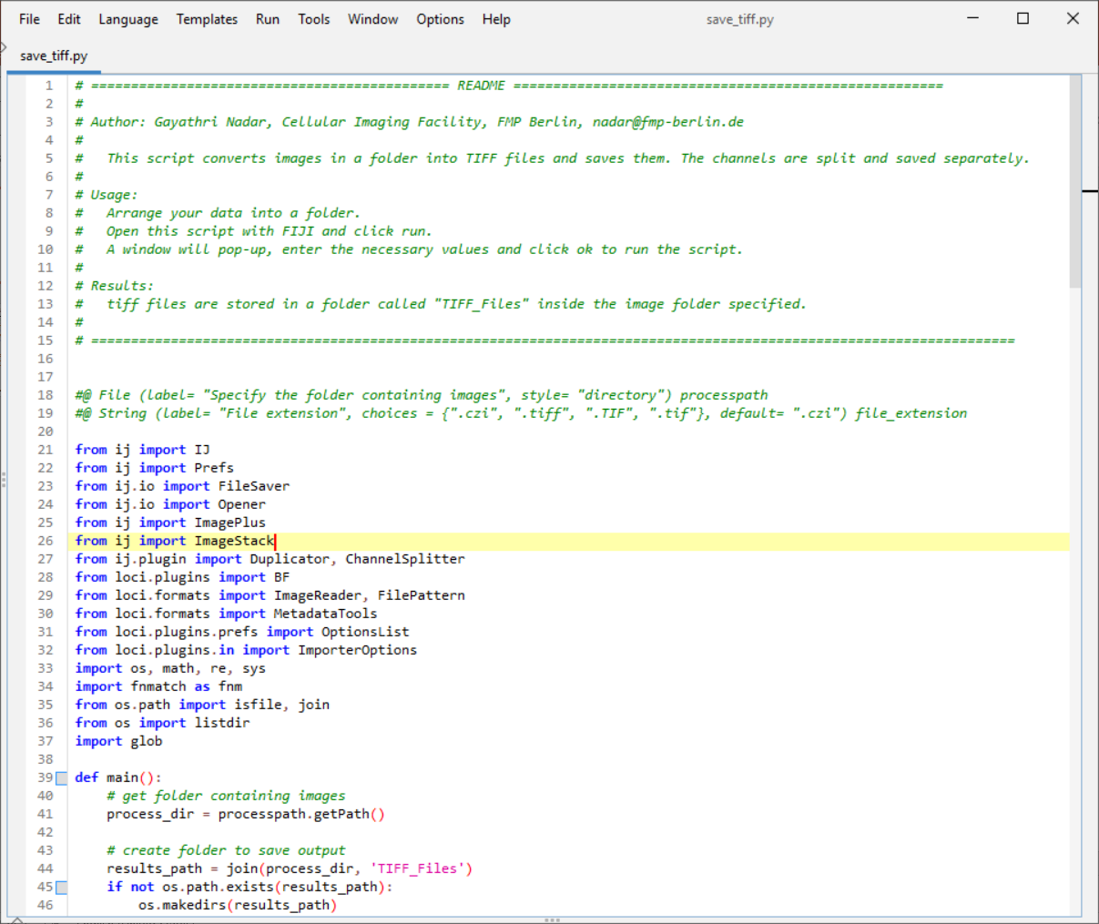
Data Preparation using FIJI Script
Raw data
CZI files with multiple channels
Channel of interest for this project
Cells/Cytoplasm in channel 4
Goal of data preparation
Read CZI image
Split channels
Improve display by adding proper LUTs and adjusting B&C
Save as individual channels with proper naming

Slide 2
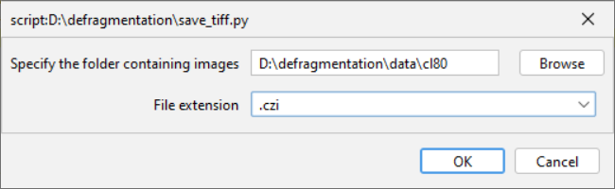
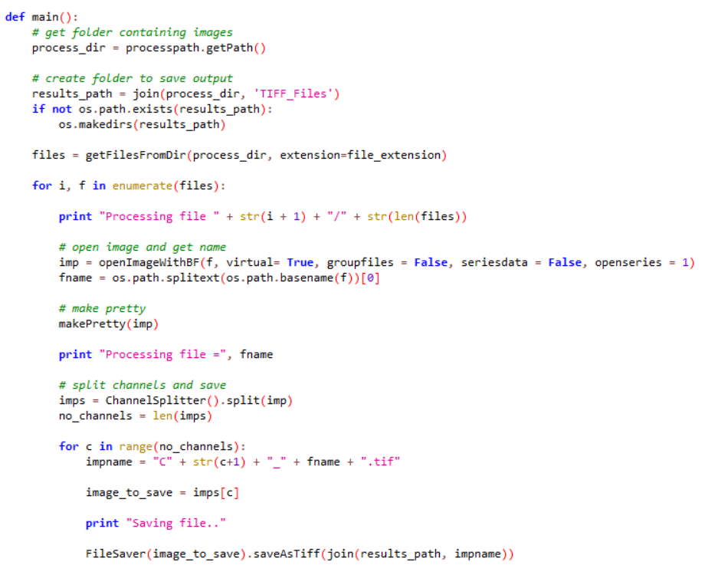
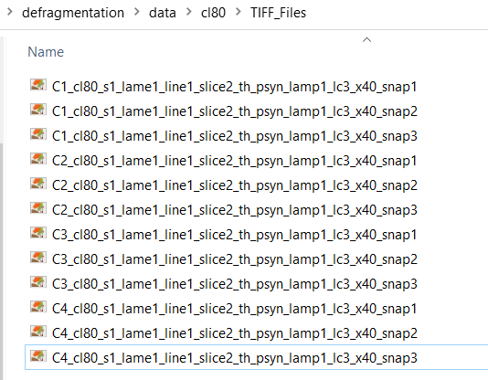
Data Preparation using FIJI Script
Create an output folder next to input folder automatically
Read files from folder and process in a loop. We open the image using Bio-Formats. Custom functions for each step.
Adjust Brightness/Contrast. Does it on each channel. Custom function.
Split channel, name it properly, save to output location.

Slide 3
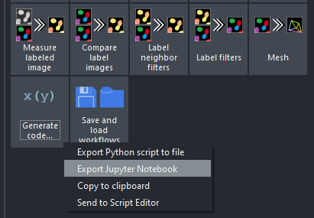
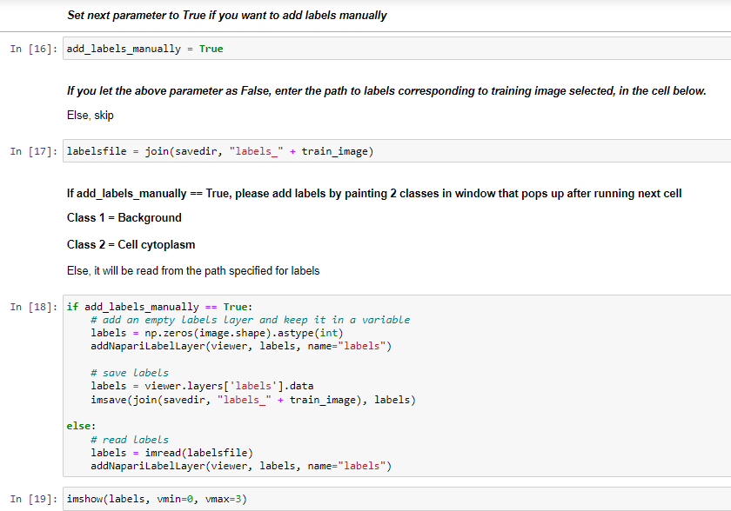

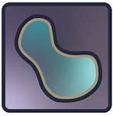
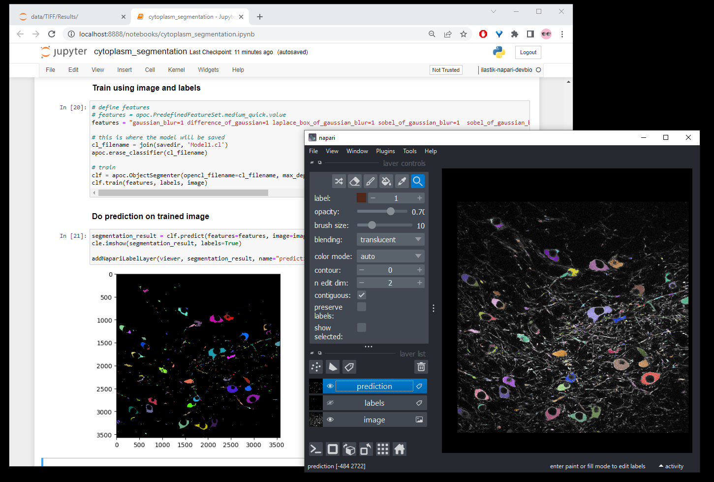
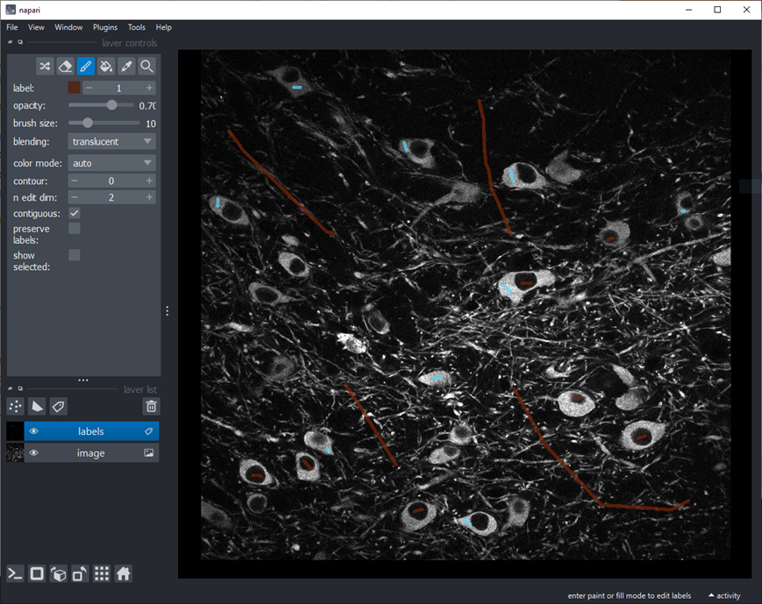
Napari Assistant
Jupyter Notebook
Run locally
Accelerated Pixel and Object Classification workflow
2 labels – background & cytoplasm
Export Jupyter Notebook
Tailored notebook to our data
Custom functions
Add labels interactively by launching napari via jupyter
Train classifier and save to disk
haesleinhuepf/apoc (GitHub)

