Slide 1
Introduction to Image Analysis with FIJI
7. Good Practices & Ethical Guidelines, Further Resources
Noreen Walker, Gayathri Nadar
Scientific Computing Facility, MPI-CBG
3.-7.5.2021
Aim of this session:
Good practices for image analysis
Further resources

Slide 2
Overview
Good practices and ethical guidelines
Further resources

Slide 3
Good Practices

Slide 4

Good practices: General
Scientific work – with images and in general – should be:
Reproducible
Objective and unbiased
Therefore:
Keep the raw data, including meta-data.
Document everything you do.
Experiment and data analysis
Design proper control experiments.
Acquire and analyze images in an unbiased way.
For example: Automatized selection of multiple fields of view
No manual selection of “good data”
Autofluorescence or basal expression?
Image: Taniguchi et al, Science, 2010
Notes:
Fields of view: blind grid, e.g. take every 5th tile

Slide 5
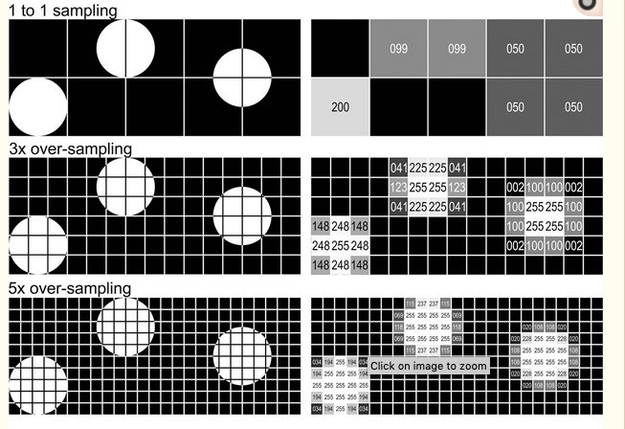
Image acquisition
Good analysis starts with good acquisition:
garbage in, garbage out.
Think about the whole pipeline before acquiring large amounts of data.
Use same acquisition settings for all experiments that will be compared.
Choose appropriate optical resolution and magnification (sampling).
Image sources:
Elena Gromberg, Tanaka Group, CRTD Dresden, and
Cromey: Avoiding Twisted Pixels,
Notes:
Ask IPF and LMF If in doubt

Slide 6
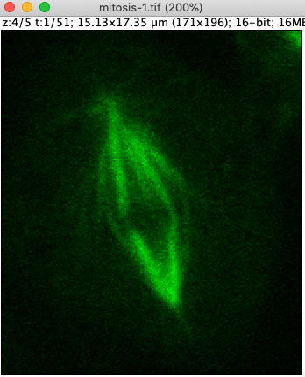
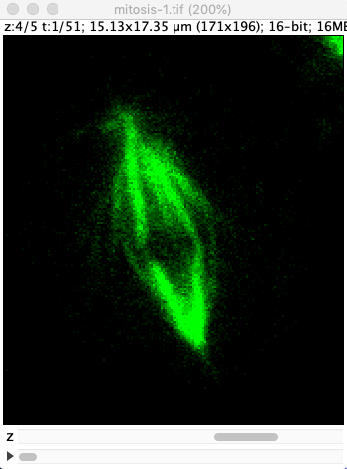
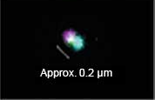
Image acquisition
Use suitable dynamic range during acquisition:
No over-saturation, black level not too high
Avoid bleedthrough between channels.
Avoid chromatic aberration as much as possible.
or measure chromatic shift with multicolor beads.
… and more …
over-saturation
chromatic aberration
Image sources:
ImageJ sample images, and
https://www.olympus-lifescience.com/de/applications/low-chromatic-aberration-objective-scale-optical-confocal-imaging/
Notes:
Ask IPF and LMF If in doubt

Slide 7
Scientific image analysis
Purpose of scientific data visualization and quantitative image analysis:
Report and quantify results in an objective way.
NOT: produce “pretty images”.
Analysis can go wrong unintentionally:
Simply by not knowing the pitfalls, without any bad intentions.
Resources for Ethical Guidelines:
D. W. Cromey: Avoiding Twisted Pixels: Ethical Guidelines for the Appropriate Use and Manipulation of Scientific Digital Images
Used as base for the following slides
Paper: https://www.ncbi.nlm.nih.gov/pmc/articles/PMC4114110/
Graphical summary: https://ori.hhs.gov/education/products/RIandImages/guidelines/list.html
Rossner & Yamada: What's in a picture? The temptation of image manipulation
https://rupress.org/jcb/article/166/1/11/34064/What-s-in-a-picture-The-temptation-of-image

Slide 8
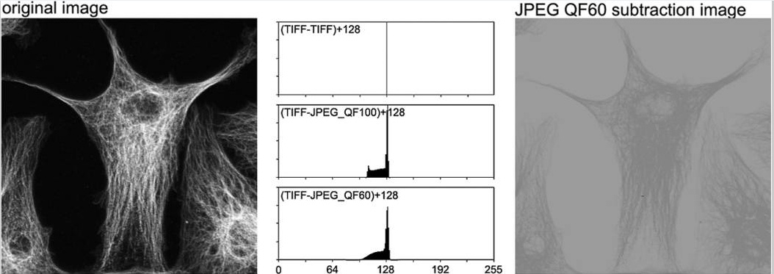
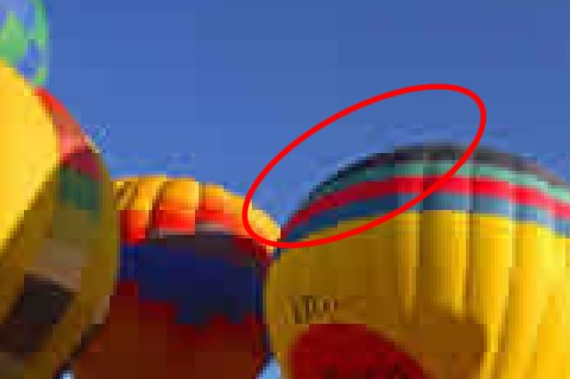
Good practices for image analysis
Keep the original data untouched – always work on a copy of your data.
Don’t use lossy compression like jpg.
tif is the best option, png can work.
Sources:
Cromey: Avoiding Twisted Pixels, and
https://cscie12.dce.harvard.edu/lecture_notes/2007-08/20080312/slide21.html

Slide 9
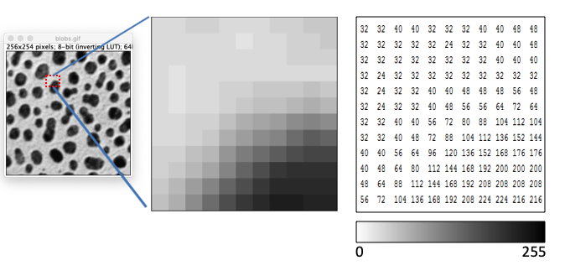
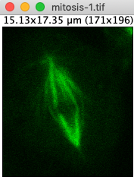
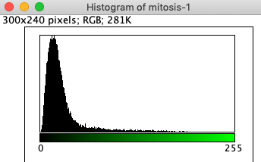
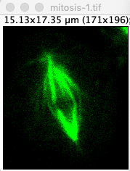
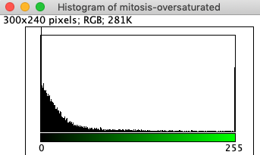
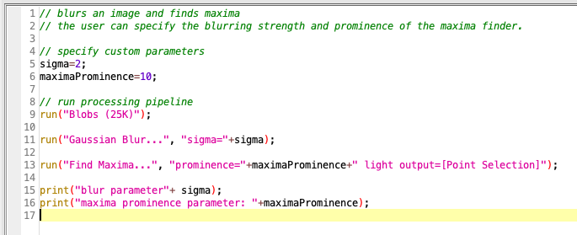
Good practices for image analysis
Treat images as data.
Image processing = applying mathematical functions
Over-processing can deteriorate data.
Don’t process your image partially.
Careful filtering and processing is (usually) ok.
No photoshopping!
But always document your processing steps:
Cropping, blurring, projection, segmentation, …
Also: which software you used
Ideal for reproducibility: IJ macro.
Over-processed: saturation
partly from: Cromey: Avoiding Twisted Pixels
Notes:
Partially = e.g. adjust B&C for part of the image

Slide 10
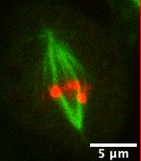
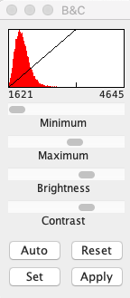
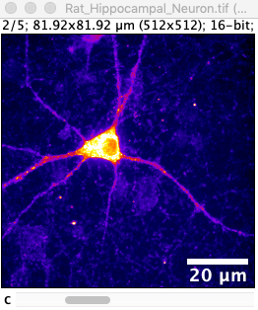

Good practices for image analysis
Process all images of an experiment series the same way.
auto-threshold, blurring parameters, …
Visualization
Add scale bar, figure caption, optionally colorbar
Avoid non-linear gamma if possible – or document it
Same brightness & contrast for image comparisons
Intensity Measurements
Requires uniformly processed data (or unprocessed data)
Flatfield correction, background subtraction, …
Have proper controls
Other processing: ok / not ok ?
Ok: cropping (usually)
Not ok: Remove artifacts with a drawing tool
Not ok: Copy parts of images into each other
Legend: Mitosis. green: XXX, red: XXX
Visualization
The decision what processing is appropriate is not always binary.
Think critically, document and ask for feedback when in doubt.
partly from: Cromey: Avoiding Twisted Pixels
Notes:
Calibration bar: for more exotic LUTs helpful

Slide 11
Further Resources

Slide 12

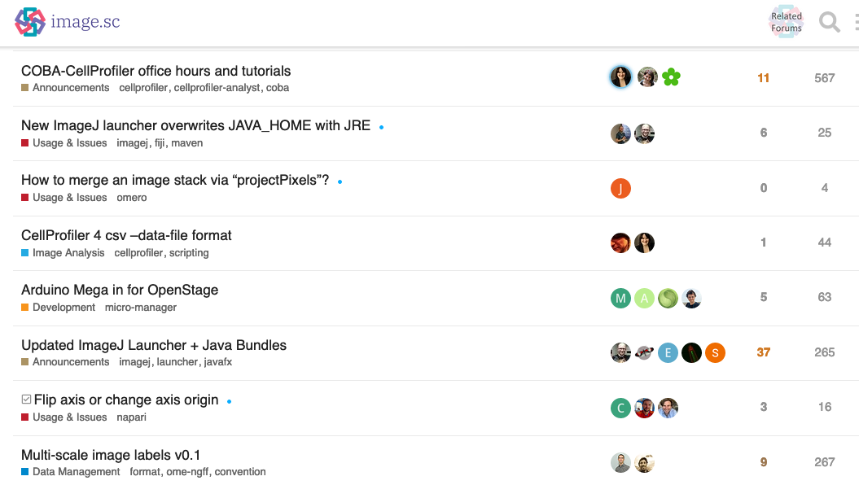
Image.sc Forum: Getting Help
https://forum.image.sc/
Very active forum on image analysis
For all user levels
For conceptual questions, technical issues, announcements etc.
Often you get help very quickly.
Tips:
Be nice – the people who help you are volunteering.
If you know an answer: help others.

Slide 13
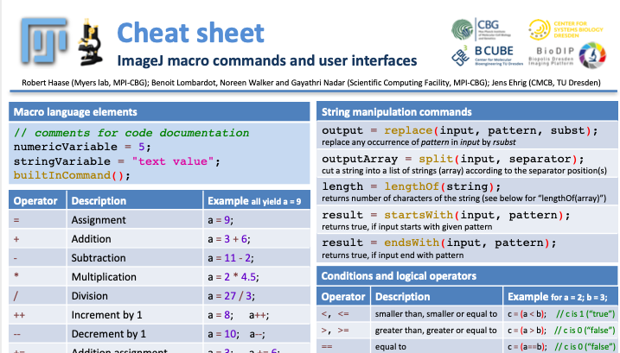
IJ Macro Cheat Sheet
Download: https://git.mpi-cbg.de/scicomp/bioimage_team/coursematerialimageanalysis/-/blob/master/Cheatsheet_IJMacro/ImageJ_macro_cheatsheet.pdf

Slide 14
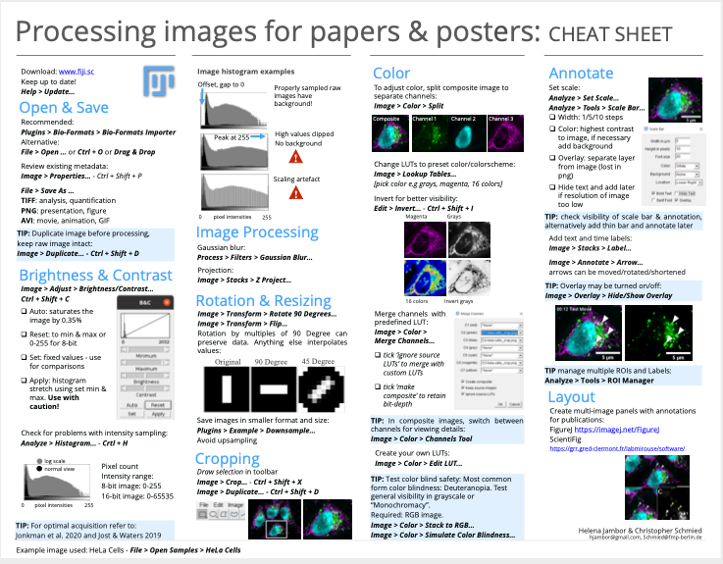
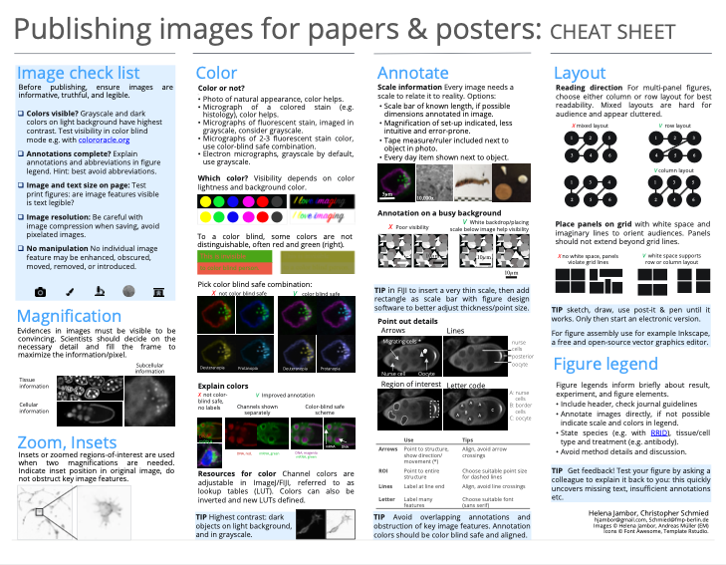
Image Visualization Cheat Sheet
By: Christopher Schmied, Helena Jambor
Paper & download: https://f1000research.com/articles/9-1373

Slide 15
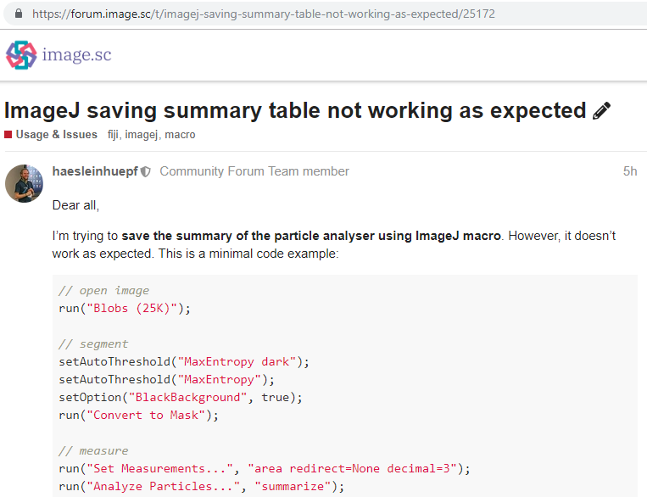
Resources
User Forum:
Use https://forum.image.sc/ to interact with the broader community, asking questions, finding solutions, etc.
Strongly recommended!
Courses and text books:
NEUBIAS training: http://eubias.org/NEUBIAS/training-schools/
EMBL: https://www.embl.de/training/events/index.php
Book by Kota Miura: https://www.imaging-git.com/olympus-website-bioimage-data-analysis
How-to Guides:
From SCF-MPI-CBG: https://mpicbg-scicomp.github.io/ipf_howtoguides/
From Uni of Zurich: https://zmb.dozuki.com/c/Image_Analysis#main
Video lectures
EPFL: image processing and analysis for Life Scientists: https://www.edx.org/course/image-processing-and-analysis-for-life-scientists
Robert Haase: Lecture BioImage Analysis (Dresden): https://www.youtube.com/playlist?list=PL5ESQNfM5lc7SAMstEu082ivW4BDMvd0U
NEUBIAS Academy @Home: https://www.youtube.com/c/NEUBIAS/featured http://eubias.org/NEUBIAS/training-schools/neubias-academy-home/
ImageJ Documentation:
ImageJ user guide: https://imagej.nih.gov/ij/index.html
FIJI website: https://fiji.sc/

Slide 16
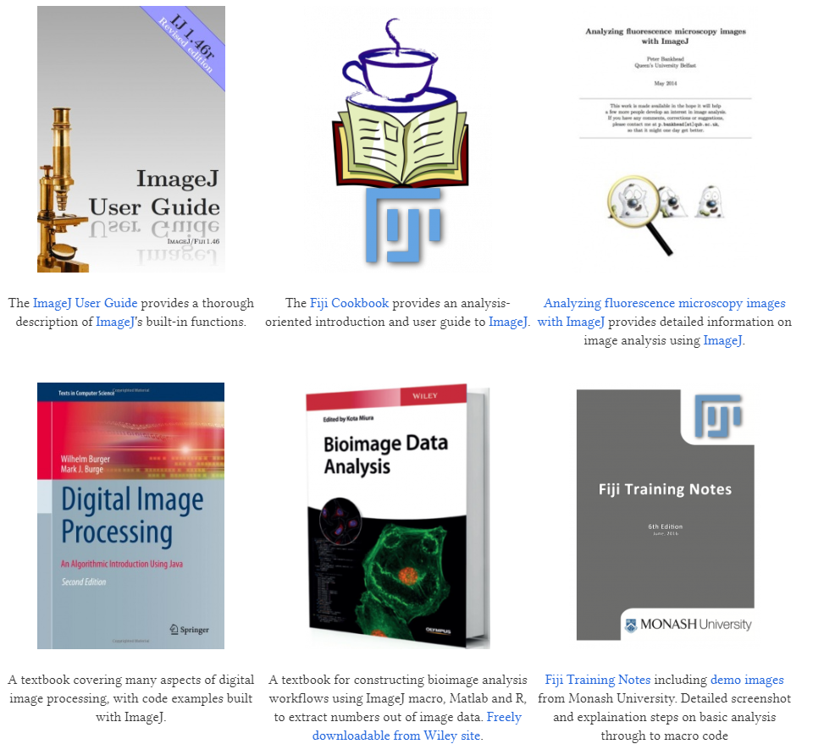
Image analysis – further reading
https://imagej.net/User_Guides

Slide 17
We did it! Thank you for joining!
🏆
Lastly, we‘d love to get your feedback!

