Slide 1
Mini-Project IV Loan Prediction
ML Model Deployment

Slide 2

Hypothesis Generation
Financial institutions can mitigate risks with models which predicts customers that will be able to pay their debt. In addition, they can predict the profit generated lending money.
Feature Engineering
Supervised Learning
Pipelines
Companies are using more services on cloud than in the past
because of all the benefits against on-prem.
Cost Savings
Scalability
Security
Model Persistence
Building Own API
Deployment to Cloud (AWS)

Slide 3




EC 2
Postman
Computer
Deploy Model
Bash
Deployed Model
API
Python:
Pandas
sklearn
pickle
Flask
WebApps
http://ec2-18-117-82-160.us-east-2.compute.amazonaws.com:5555/scoring

Slide 4


Which applicants are more likely to get a loan
- Applicants having a credit history
- Applicants with higher applicant and co-applicant incomes
- Applicants with higher education level
Self_Employed
ApplicantIncome
Dependents
CoapplicantIncome
Gender
Credit_HIstory
Married
LoanAmount
Education
Loan_Amount_Term
Propery_Area

Slide 5

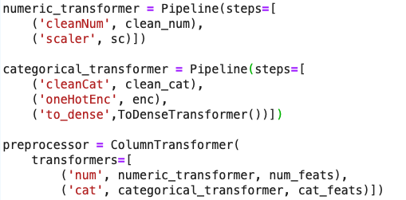
Null Value Replacement
New columns TotalIncome
Scaler
Null Value Reaplacement
One-Hot Encoder
Null Value Reaplacement
One-Hot Encoder
Model training
Model Persistance

Slide 6

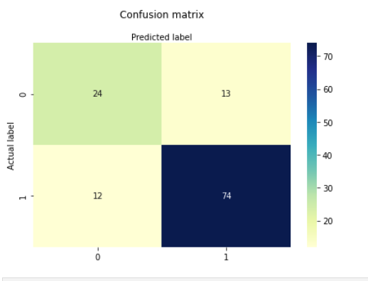
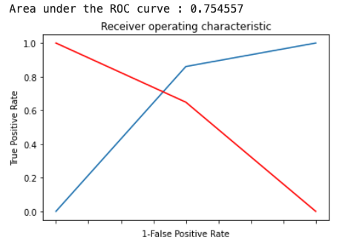
Models:
SVC
Random Forest Classifier
XGBoost Classifier

Slide 7

Postman
Shell: curl command
curl http://ec2-18-117-82-160.us-east-2.compute.amazonaws.com:5555/scoring -H "Content-Type: application/json" -d "{\"Gender\": \"Male\", \"Married\": \"Yes\", \"Dependents\": \"0\", \"Education\": \"Graduate\", \"Self_Employed\": \"No\", \"ApplicantIncome\": 3899, \"CoapplicantIncome\": 0, \"LoanAmount\": 80000,
\"Loan_Amount_Term\": 360, \"Credit_History\": 0, \"Property_Area\": \"Urban\" }"
WebApp

Slide 8


