Slide 1
LAb2 - EZgas

Slide 2
High level, informal description
EZGas is a crowdsourcing application to help drivers find gas at lowest prices (aka Tripadvisor for gas stations)
Drivers report prices (and other characteristics) of gas stations to the application.
Other drivers can monitor prices and select accordingly a gas station to use, in function of closeness, prices, quality.
The application is free to use, and funds itself via advertising attracted by user traffic

Slide 3
Stakeholders
Drivers / car owner
Gas station owner
Administrator
Map and navigation service
Payment service (only if some payment passes through application)
Start up partner
Start up financer (bank, venture capital)
Competitors
Play store / Apple store (security, financial part)
Cloud service for operation

Slide 4
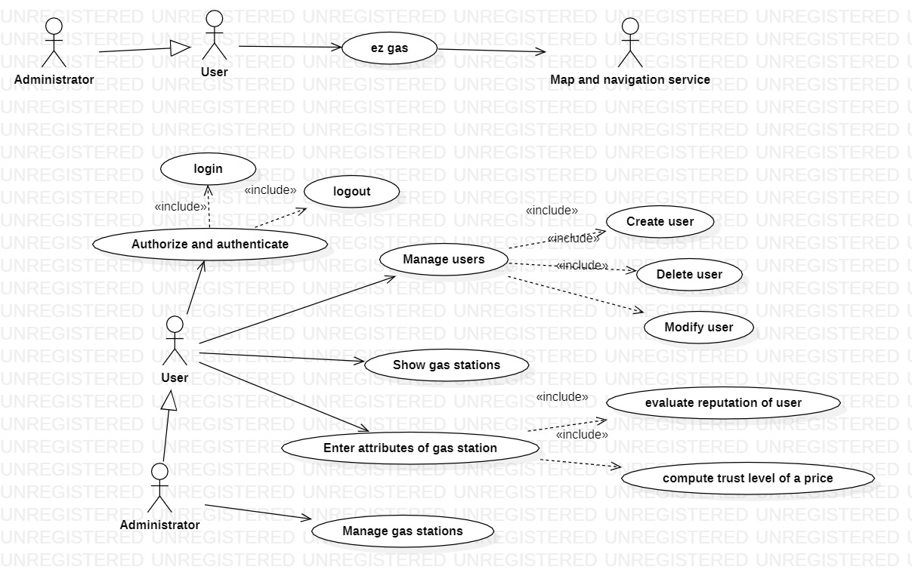
Context diagram
Business decision: gas owner excluded, administrator manages gas stations
Business decision: free application, no payments from users

Slide 5
EZ Gas – use cases
UC1 Manage users
UC2 Manage gas stations
UC3 Show gas stations
UC4 Enter Report of gas station
UC5 Evaluate reputation of users
UC6 Compute trust level of published price
UC7 Authenticate and authorize

Slide 6
UC diagram

Slide 7
UC 1Manage users (CRUD user)
CRUD Create Read Update Delete
Create user
Nominal scenario: precond user U does not exist
post condition: user U in the application
1 user asks to create account
2 application asks for name, surname, email ..
3 user enters name ..
4 application checks if already exists – not exixts
5 application creates account for user
Execption scenario : precond user U already exists
post condition: no change
Delete user
Modify user

Slide 8
UC2 Manage gas stations
CRUD gas stations
Similar to Manage User

Slide 9
UC3 Show gas stations
Precondition : User U is authenticated and authorized
Nominal scenario: 1 user asks for gas stations in an area
2 application reads position P from GPS
3 application shows gas stations in a R radius from location P
Variant: 1,2 same
3 show textual list of gas stations ranked on attribute A (A can be distance, price, ..)
Exceptional: no gas stations in area
all gas stations are closed at the time
no position available

Slide 10
UC4 Enter report of gas station
Specific scenarios follow

Slide 11
UC4.1 (scenario 1)
Precondition: User U is authenticated and authorized Gas station G exists
Postcondition: G.attribute changed
Nominal: 1 U enters new price of fuel for gas station G
2 evaluate reputation of U
3 trust of U is high, G.price changed

Slide 12
UC4.2 (scenario 2)
Attributes are price of fuel, quality of service, waiting time
Precondition: User U is authenticated and authorized Gas station G exists
Postcondition: G.attribute not changed
Variant: 1 U enters new report for gas station G
2 evaluate reputation of U
3 reputation of U is low, G.published price unchanged

Slide 13
UC4.3 (scenario 3)
Precondition: User U is authenticated and authorized Gas station G exists
Postcondition: G.published price not changed
Exception: 1 U enters new report for gas station G
2 price is negative
3 G.published price unchanged

Slide 14
Functional requirements (not complete)
F1 | Manage gas stations
F1.1 | Create a new station, define services offered (gas, fuel electric)
F1.2 | Show stations in a certain area, on map
1,2.1
 | Show stations in a certain area, as a listing ordered by price
F mapping | Retrieve map of a certain area
 | Show a gas station on a map
 | Zoom in / out a map
F2 | Select a station and navigate to it
F3 | Select a gas station and show all its properties (price of diesel, price of gas, quality level, opening times, distance from driver location )
 | Select a station and Input price of fuel for it
 | Select a station and Input quality level for it (by driver only)
F4 | Manage peer reviews
F4.1 | User enters report for a certain gas station (driver)
F4.2 | System computes aggregate report for a station
F4.3 | Select algorithm for aggregating report (administrator)
F4.4 | Recognize report from trolls (how?)
F5 | Manage user and user preferences
 | Create user (account, pwd)
 | Define user preferences (favorite station, favorite fuel or electric, car name and type)

Slide 15
NF requirements
NF
Efficiency | Response time | <0.5 sec for all functions
 | memory | Ram < 0.5Gbyte
 |  | Disk < 10 Gbyte
Reliability | MTBF | < 1 defect per user per year
Privacy |  | No personal data should be disclosed to anyone else except owner and authorized roles (administrator)

Slide 16
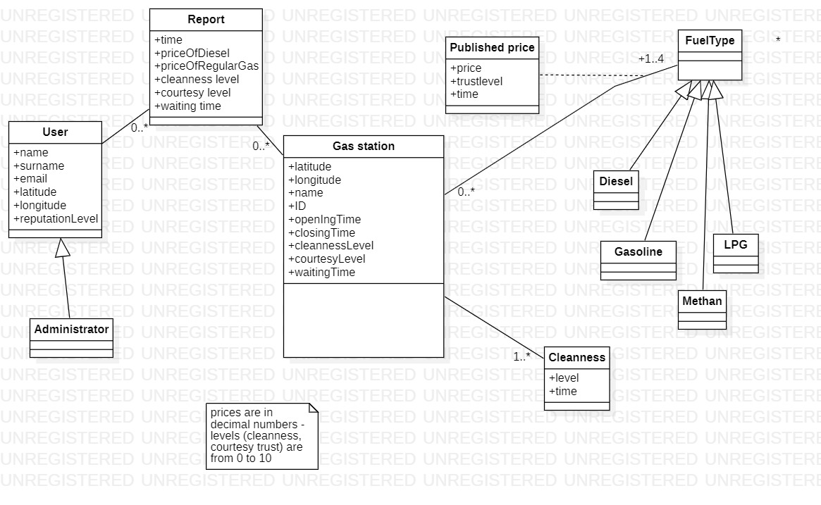
Glossary

Slide 17
Glossary
Report: report from user about a gas station, issued at a certain time. Can be correct or not, due to unwanted, or wanted errors by user (trolls, malicious users willing to undermine business of a station). Contains:
Waiting time: for a user to be served at the gas station
Price: of a certain fuel, as reported by user
(cleanness, service) level: level of service, of cleanness of the gas station, ad reported by user
Published price: price for a fuel that the application associates to a gas station, using the reports from users. Can be correct or not, in function of correctness of reports. Has a time validity, after which becomes obsolete

