Slide 1
Zariski Topology

Slide 2


Zariski topology on affine variety $X$
Closed sets: affine subvarieties of $X$, ie. $V(S)$, $S⊂A(X)$
Subspace topology of $X$ in $Y$, $Y$ affine variety with Zariski topology

Slide 3

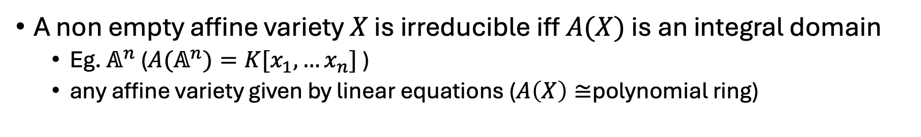
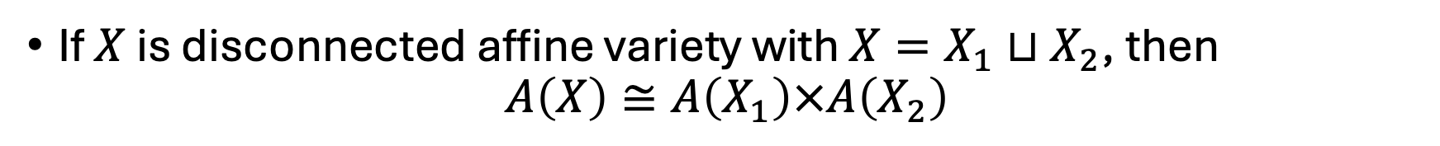
(Dis)connected, (ir)reducible
Disconnected: if $X=X_{1}⊔X_{2}, X_{i}⊊X$, both closed
Reducible: if $X=X_{1}∪X_{2}, X_{i}⊊X$, both closed
If $X$ is disconnected affine variety with $X=X_{1}⊔X_{2}$, then
$$A\left(X\right)≅A\left(X_{1}\right)×A\left(X_{2}\right)$$
A non empty affine variety $X$ is irreducible iff $A(X)$ is an integral domain
Eg. $𝔸^{n}$ (${A(𝔸}^{n})=K[x_{1},…x_{n}]$ )
any affine variety given by linear equations ($A\left(X\right)≅$polynomial ring)
{irreducible affine subvarieties $≠∅$of $Y$} $↔${prime ideals in $A(Y)$}
Notes:
Prove iff

Slide 4
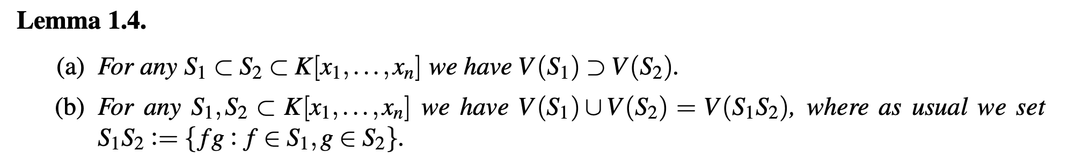
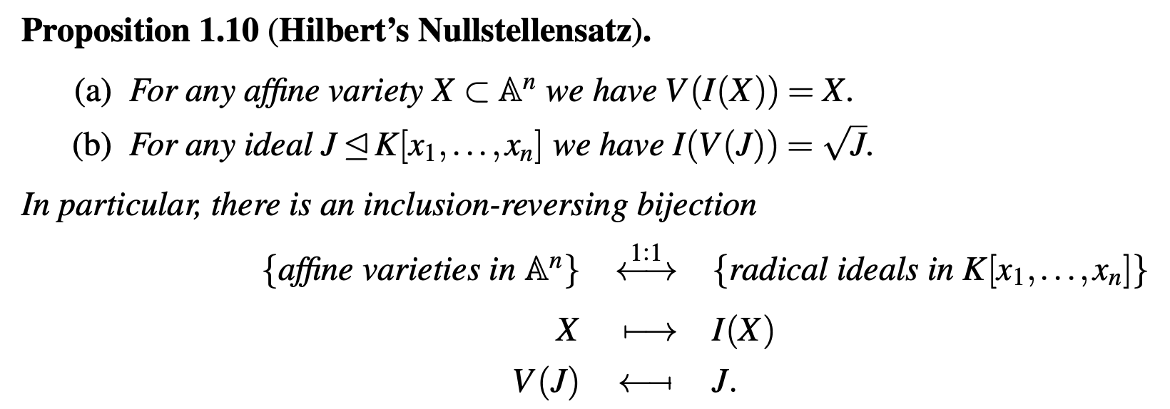
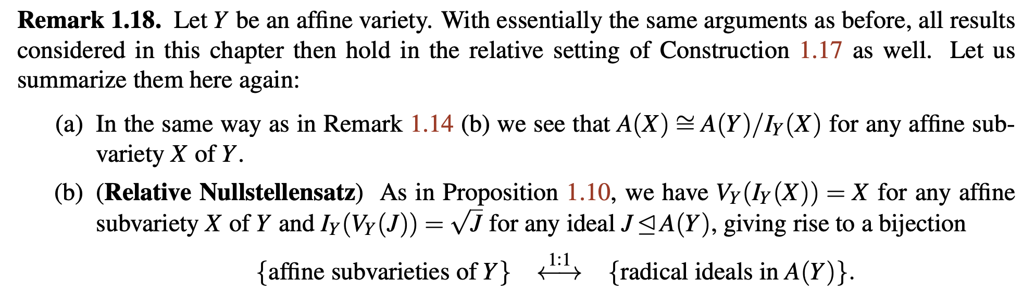

Slide 5
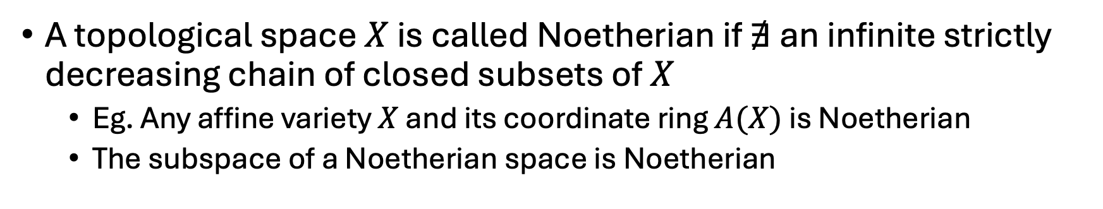
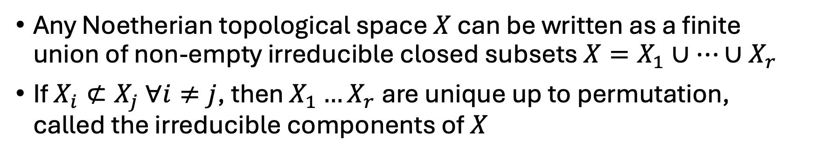
Noetherian topological space
A topological space $X$ is called Noetherian if $∄$ an infinite strictly decreasing chain of closed subsets of $X$
Eg. Any affine variety $X$ and its coordinate ring $A(X)$ is Noetherian
The subspace of a Noetherian space is Noetherian
Any Noetherian topological space $X$ can be written as a finite union of non-empty irreducible closed subsets $X=X_{1}∪…∪X_{r}$
If $X_{i}⊄X_{j} ∀i≠j$, then $X_{1}…X_{r}$ are unique up to permutation, called the irreducible components of $X$
Notes:
Proof, example where can find components directly

Slide 6
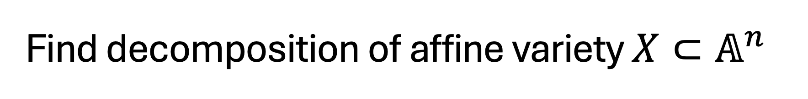
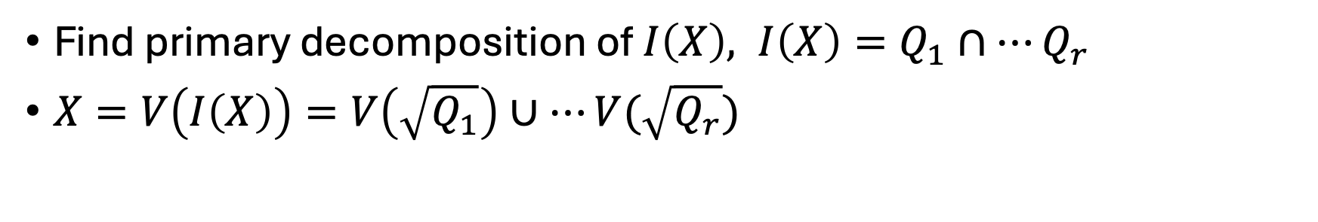
Find decomposition of affine variety $X⊂𝔸^{n}$
Find primary decomposition of $I\left(X\right), I\left(X\right)=Q_{1}∩…Q_{r}$
$X=V\left(I\left(X\right)\right)=V\left(\sqrt{Q_{1}}\right)∪…V(\sqrt{Q_{r}})$
Keep minimal prime ideals, or maximal varieties
{irreducible components of $X$} $↔${minimal prime ideals in $A(X)$}

Slide 7
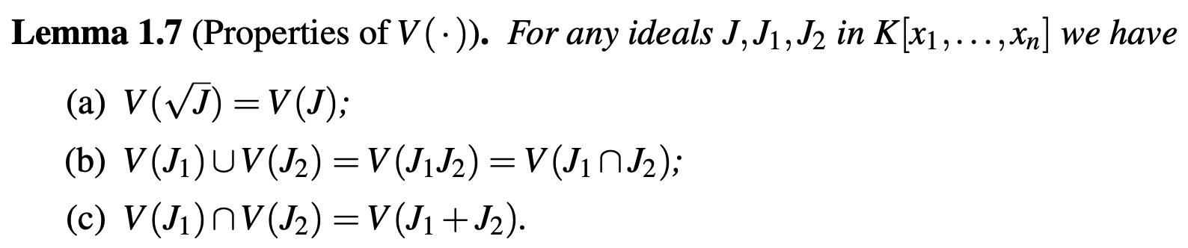
{irreducible affine subvarieties $≠∅$of $Y$} $↔${prime ideals in $A(Y)$}

Slide 8
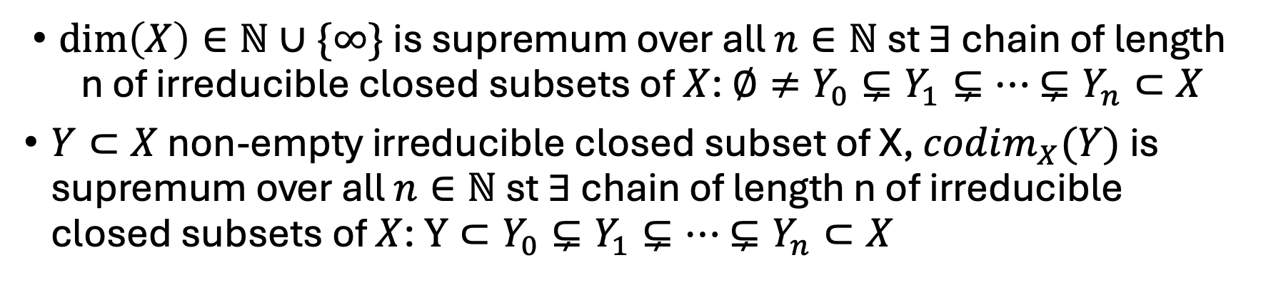
Dimension of a topological space X
Geometrically, number of coordinates needed to describe the space locally around a point
Idea: The closed proper subset of an irreducible space should have smaller dimension
$\dim\left(X\right)∈ℕ∪\{∞\}$ is supremum over all $n∈ℕ$ st $∃$ chain of length n of irreducible closed subsets of $X$: $∅≠Y_{0}⊊Y_{1}⊊…$ $⊊Y_{n}⊂X$
$Y⊂X$ non-empty irreducible closed subset of X, $codim_{X}(Y)$ is supremum over all $n∈ℕ$ st $∃$ chain of length n of irreducible closed subsets of $X$: $Y⊂Y_{0}⊊Y_{1}⊊…$ $⊊Y_{n}⊂X$
Notes:
Dimension of A1, finiteness condition of Noetherian space not related to finite dimension, N with {0,1,2…n} closed set, but dimension of affine variety is finite by commutative algebra

Slide 9
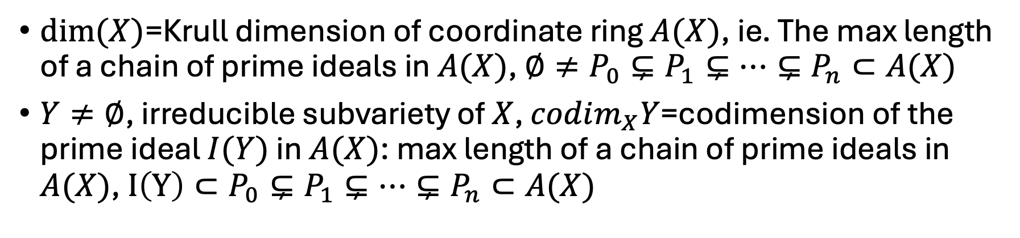
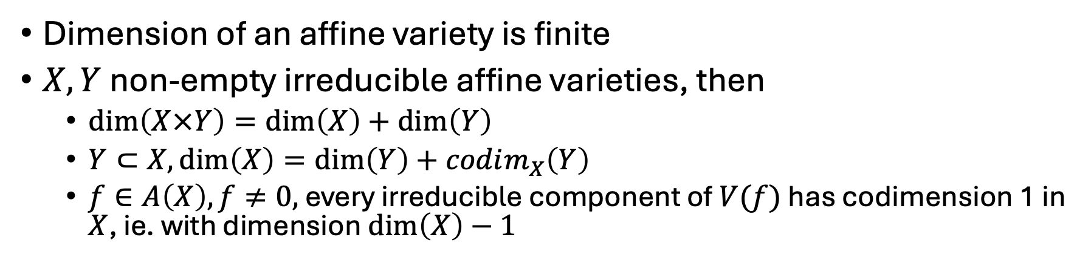
Dimension of an affine variety X
$dim⁡(X)$=Krull dimension of coordinate ring $A(X)$, ie. The max length of a chain of prime ideals in $A(X)$, $∅≠P_{0}⊊P_{1}⊊…⊊P_{n}⊂A(X)$
$Y≠∅$, irreducible subvariety of $X$, $codim_{X}Y$=codimension of the prime ideal $I(Y)$ in $A(X)$: max length of a chain of prime ideals in $A(X)$, $I\left(Y\right)⊂P_{0}⊊P_{1}⊊…⊊P_{n}⊂A(X)$
Dimension of an affine variety is finite
$X,Y$non-empty irreducible affine varieties, then
$\dim\left(X×Y\right)=\dim\left(X\right)+\dim\left(Y\right)$
$Y⊂X,\dim\left(X\right)=\dim\left(Y\right)+codim_{X}\left(Y\right)$
$f∈A\left(X\right), f≠0,$every irreducible component of $V(f)$ has codimension 1 in $X$, ie. with dimension $\dim\left(X\right)−1$
Notes:
Eg. V(x2—x1^2)

Slide 10
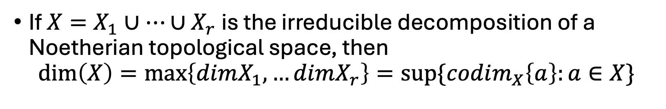
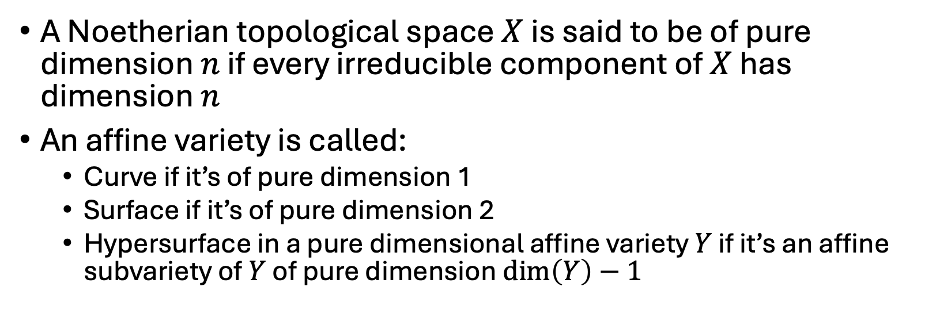
Dimension of a decomposed topological space
If $X=X_{1}∪…∪X_{r}$ is the irreducible decomposition of a Noetherian topological space, then
$$\dim\left(X\right)=\max\left\{dimX_{1},…dimX_{r}\right\}=sup⁡\{codim_{X}\left\{a\right\}:a∈X\}$$
A Noetherian topological space $X$ is said to be of pure dimension $n$ if every irreducible component of $X$ has dimension $n$
An affine variety is called:
Curve if it’s of pure dimension 1
Surface if it’s of pure dimension 2
Hypersurface in a pure dimensional affine variety $Y$ if it’s an affine subvariety of $Y$ of pure dimension $\dim\left(Y\right)−1$
Notes:
Eg. V(x1x3, x2x3)

Slide 11
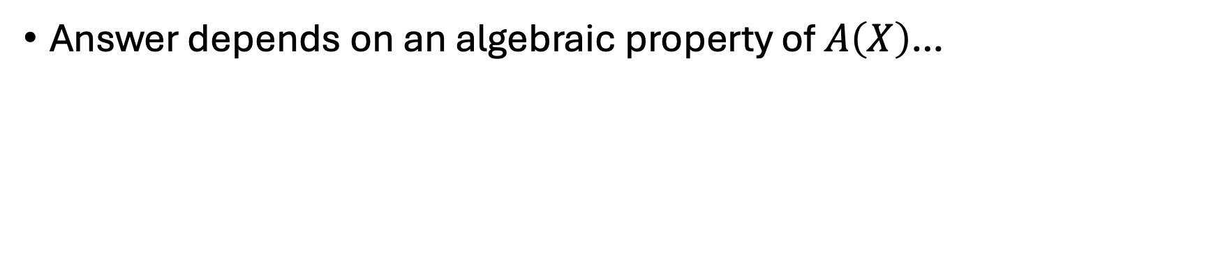
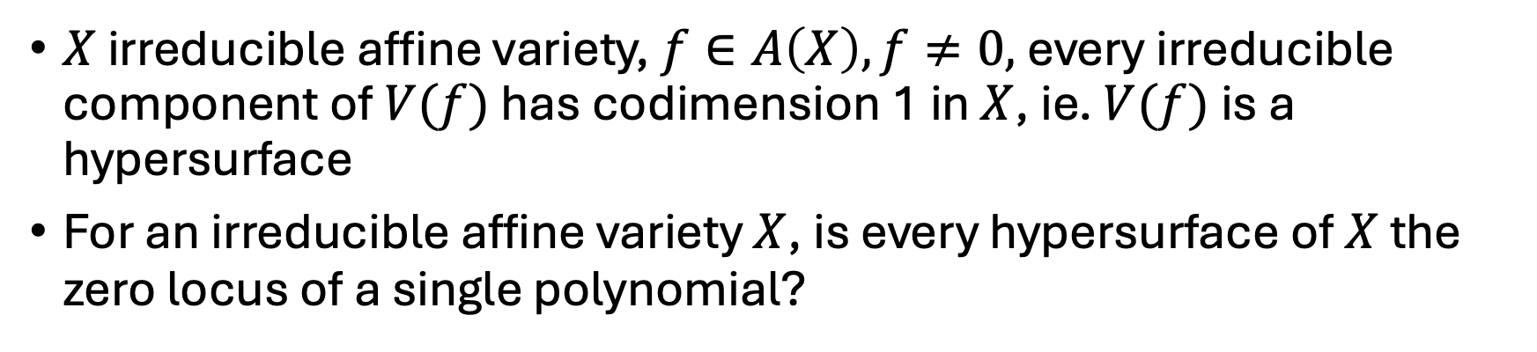
$X$ irreducible affine variety, $f∈A\left(X\right), f≠0,$every irreducible component of $V(f)$ has codimension 1 in $X$, ie. $V(f)$is a hypersurface
For an irreducible affine variety $X$, is every hypersurface of $X$ the zero locus of a single polynomial?
Answer depends on an algebraic property of $A\left(X\right)$…

Slide 12
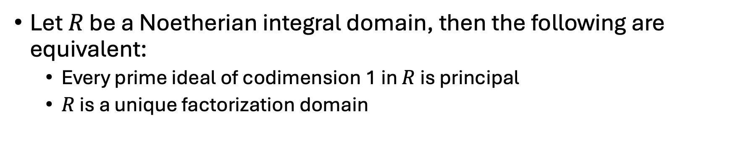
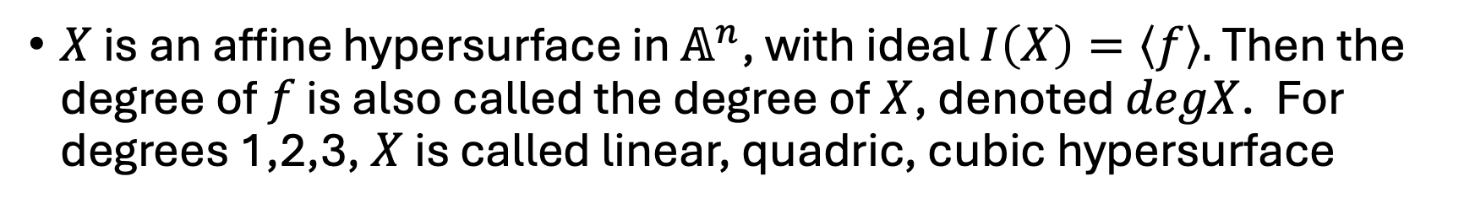
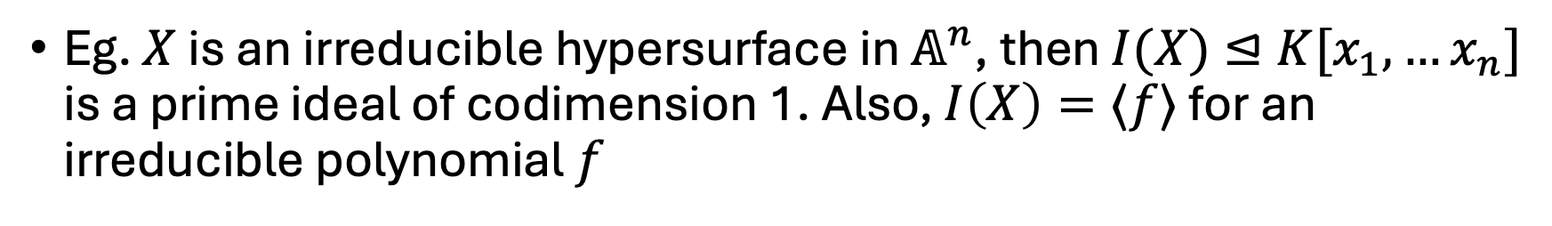
Let $R$ be a Noetherian integral domain, then the following are equivalent:
Every prime ideal of codimension 1 in $R$ is principal
$R$ is a unique factorization domain
Eg. $X$ is an irreducible hypersurface in $𝔸^{n}$, then $I(X)⊴K[x_{1},…x_{n}]$ is a prime ideal of codimension 1. Also, $I\left(X\right)=⟨f⟩$ for an irreducible polynomial $f$
$X$ is an affine hypersurface in $𝔸^{n}$, with ideal $I\left(X\right)=\left\langle f\right\rangle .$ Then the degree of $f$ is also called the degree of $X$, denoted $degX$. For degrees 1,2,3, $X$ is called linear, quadric, cubic hypersurface
Notes:
f is unique up to units

