Slide 1
Morphisms

Slide 2
Motivation
Regular functions: open $U⊂X→K=𝔸^{1}$
Want morphisms to map to other affine varieties

Slide 3
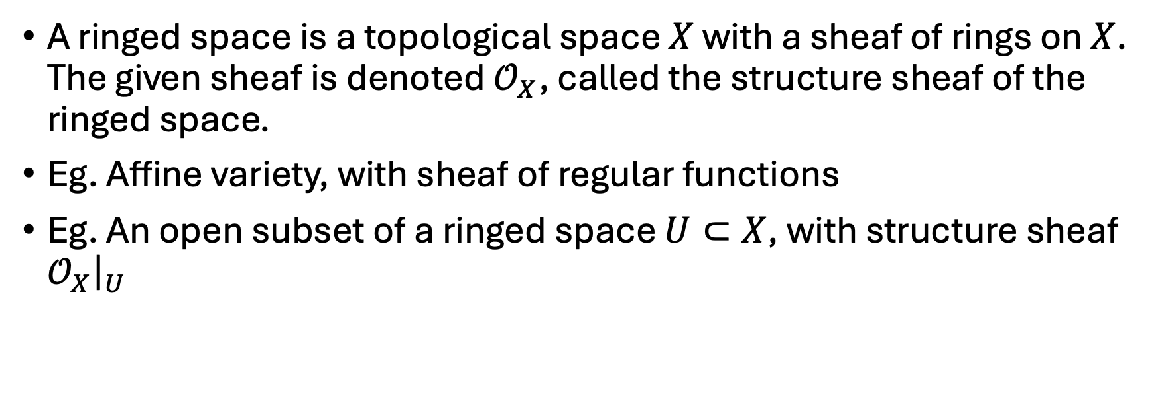
Ringed spaces
A ringed space is a topological space $X$ with a sheaf of rings on $X$. The given sheaf is denoted $𝒪_{X}$, called the structure sheaf of the ringed space.
Eg. Affine variety, with sheaf of regular functions
Eg. An open subset of a ringed space $U⊂X$, with structure sheaf $𝒪_{X}{\left.​\right|}_{U}$
Idea for the morphisms: preserve structure

Slide 4
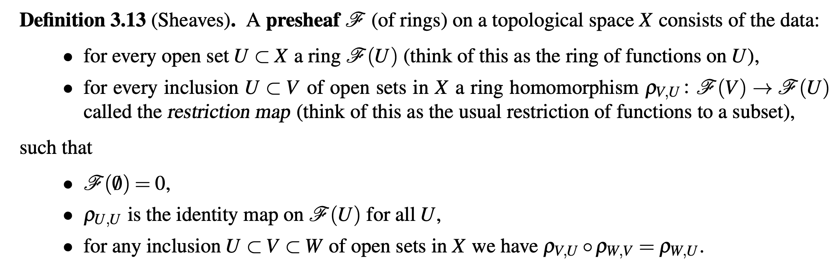

Convention: sheaves of rings = sheaves of $K$-valued functions

Slide 5
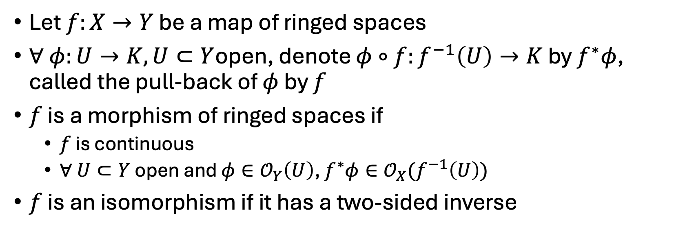
Morphisms of ringed spaces
Let $f:X→Y$ be a map of ringed spaces
$∀ φ:U→K, U⊂Y$open, denote $φ∘f:f^{−1}\left(U\right)→K$ by $f^{∗}φ$, called the pull-back of $φ$ by $f$
$f$ is a morphism of ringed spaces if
$f$ is continuous
$∀ U⊂Y$ open and $φ∈𝒪_{Y}\left(U\right)$, $f^{∗}φ∈𝒪_{X}(f^{−1}\left(U\right))$
$f$ is an isomorphism if it has a two-sided inverse
Properties:
Compositions of morphisms are morphisms
Restrictions of morphisms are morphisms
Gluing property

Slide 6
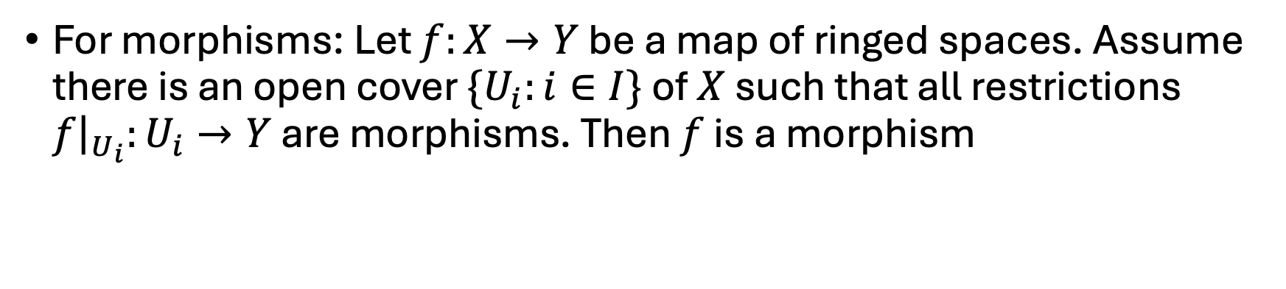
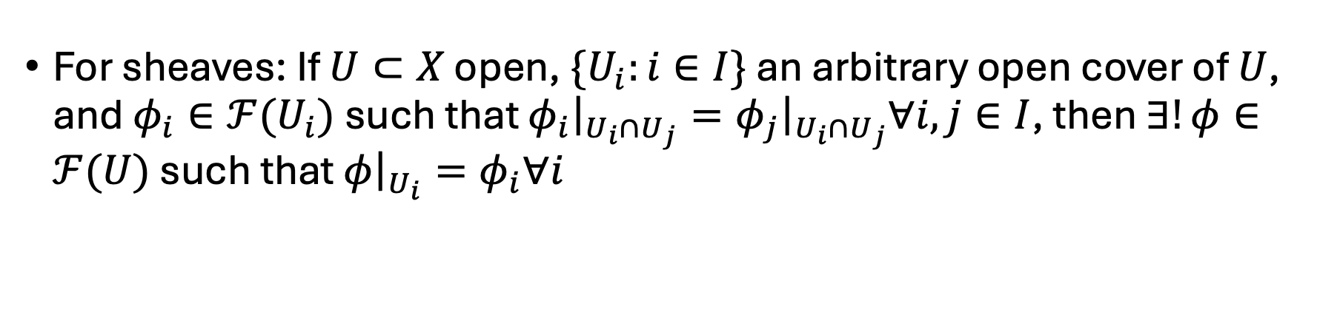
Gluing property
For sheaves: If $U⊂X$ open, $\{U_{i}:i∈I\}$ an arbitrary open cover of $U$, and $φ_{i}∈ℱ(U_{i})$ such that $φ_{i}{\left.​\right|}_{U_{i}∩U_{j}}=φ_{j}{\left.​\right|}_{U_{i}∩U_{j}}∀i,j∈I$, then $∃!φ∈ℱ(U)$ such that $φ{\left.​\right|}_{U_{i}}=φ_{i}∀i$
For morphisms: Let $f:X→Y$ be a map of ringed spaces. Assume there is an open cover $\{U_{i}:i∈I\}$ of $X$ such that all restrictions $f{\left.​\right|}_{U_{i}}:U_{i}→Y$ are morphisms. Then $f$ is a morphism

Slide 7
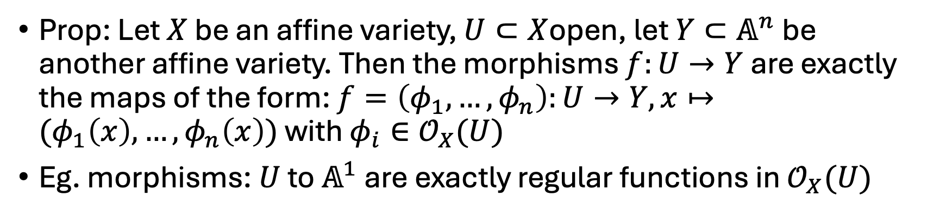
Morphisms between affine varieties
Prop: Let $X$ be an affine variety, $U⊂X$open, let $Y⊂𝔸^{n}$ be another affine variety. Then the morphisms $f:U→Y$ are exactly the maps of the form: $f=\left(φ_{1},…,φ_{n}\right):U→Y, x↦(φ_{1}\left(x\right),…,φ_{n}\left(x\right))$ with $φ_{i}∈𝒪_{X}(U)$
Eg. morphisms: $U$ to $𝔸^{1}$ are exactly regular functions in $𝒪_{X}(U)$
Notes:
Corollary, iso corresponds to iso

Slide 8

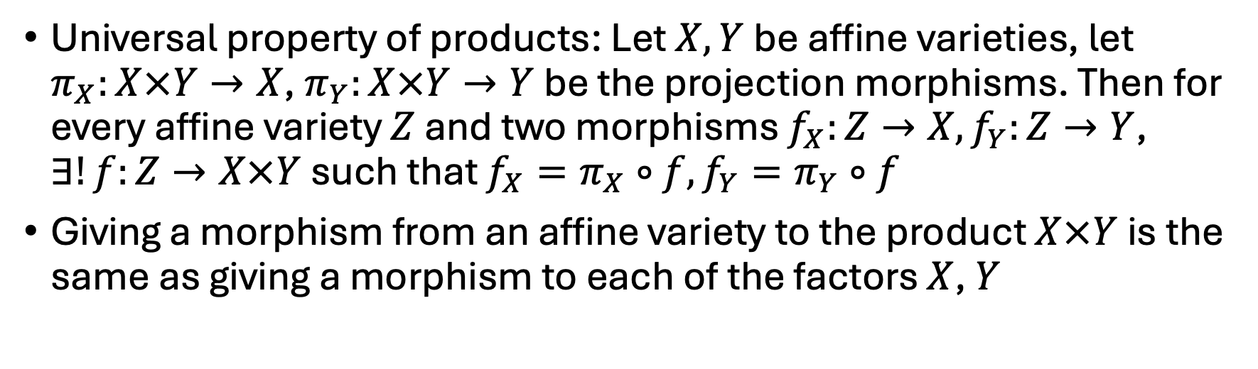
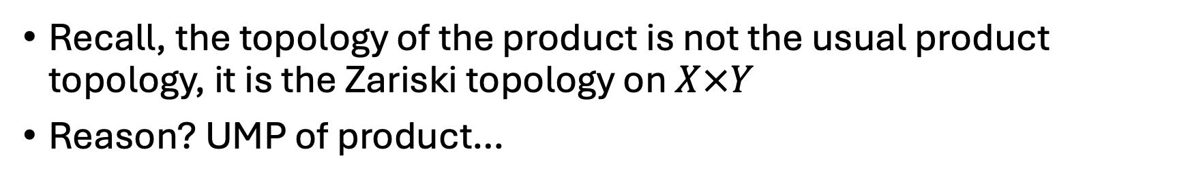
Product of affine varieties $X×Y$
Recall, the topology of the product is not the usual product topology, it is the Zariski topology on $X×Y$
Reason? UMP of product…
Universal property of products: Let $X, Y$be affine varieties, let $π_{X}:X×Y→X$, $π_{Y}:X×Y→Y$ be the projection morphisms. Then for every affine variety $Z$ and two morphisms $f_{X}:Z→X, f_{Y}:Z→Y$, $∃!f:Z→X×Y$ such that $f_{X}=π_{X}∘f, f_{Y}=π_{Y}∘f$
Giving a morphism from an affine variety to the product $X×Y$ is the same as giving a morphism to each of the factors $X$, $Y$

Slide 9
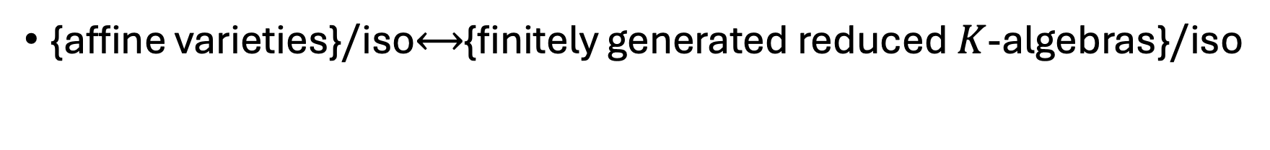
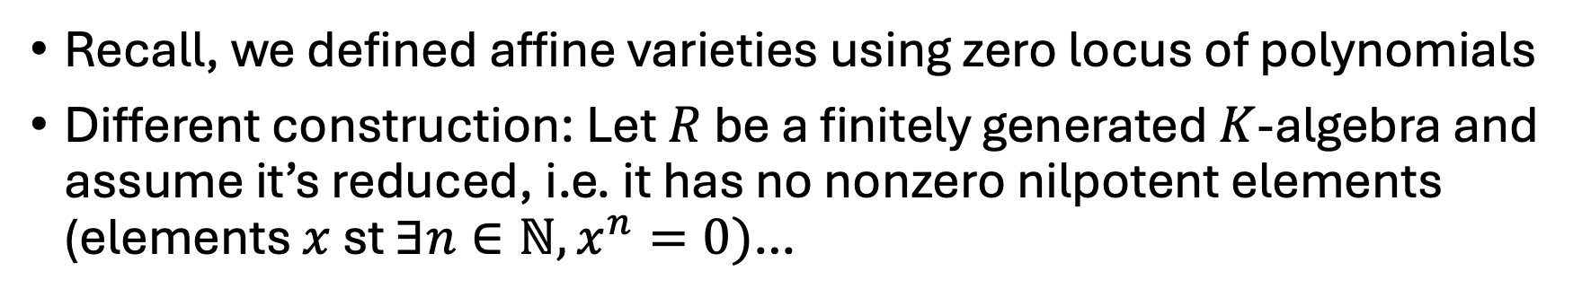
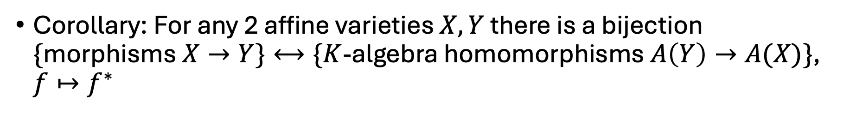
Affine varieties again
Corollary: For any 2 affine varieties $X, Y$ there is a bijection $\{$morphisms $X→Y\}⟷\{K$-algebra homomorphisms $A\left(Y\right)→A(X)\}$, $f↦f^{∗}$
Recall, we defined affine varieties using zero locus of polynomials
Different construction: Let $R$ be a finitely generated $K$-algebra and assume it’s reduced, i.e. it has no nonzero nilpotent elements (elements $x$ st $∃n∈ℕ, x^{n}=0)$…
Redefinition: An affine variety is a ringed space that is isomorphic to an affine variety which is the zero locus of polynomials
{affine varieties}$/$iso$⟷${finitely generated reduced $K$-algebras}$/$iso

Slide 10

