Slide 1
FactCheck AI
Google FactCheck API
Fact
RoBERTa ML Model
A Hybrid Real-Time Fact-Checking Browser Extension
Devansh Sharma
Dhairya Prabhakar
B.Tech CSE (IoT & IS) — 6th Sem | PBL-4 (IIS3270)
Wikipedia Context
Guide: Mr. G.L. Saini, Asst. Prof. | Dept. of IoT & IS, MUJ

Slide 2
The Problem
📰 Misinformation Surge
🔎 Manual Fact-Checking is Slow
Fake news spreads 6× faster than true news on social media. Users lack tools to verify claims in real time.
Existing tools require users to leave the page, visit external sites, and search manually.
🤖 ML Models Miss Known Facts
📸 Screenshot Misinformation
Pure ML models fail on well-documented claims already verified by journalists.
Images of false text evade text-based detection. OCR integration is rarely implemented.

Slide 3
System Architecture
INPUT
PIPELINE ORCHESTRATOR (background.js)
OUTPUT
Text / Headline
✅ True
1
Google FactCheck API
FOUND?
Queries 100+ verified fact-checkers
+ Relevance filter (40% keyword match)
❌ False
Screenshot (OCR)
NO ↓
2
RoBERTa ML Model
BACKEND UP?
⚠ Mixed
Right-Click Select
Fine-tuned on LIAR dataset
Returns True / False / Mixed / Uncertain
NO ↓
❓ Uncertain
3
Wikipedia API
📖 Context
Factual context as last resort
No verdict — context only

Slide 4
Technology Stack
Browser Extension
ML Backend
External APIs
▸ Manifest V3 (Chrome)
▸ FastAPI + Uvicorn
▸ Google FactCheck Tools API
▸ background.js service worker
▸ RoBERTa (roberta-base)
▸ 100+ IFCN fact-checkers
▸ Tesseract.js (OCR)
▸ Hugging Face Transformers
▸ Wikipedia opensearch API
▸ Content script + context menu
▸ PyTorch inference
▸ No paid tier required
44%
0.43
100+
3
Model Accuracy
F1 Score
Fact-Check Sources
Pipeline Stages

Slide 5
ML Model — RoBERTa on LIAR Dataset
Model Pipeline
Training Config
Input Claim (text)
Base Model: roberta-base
Dataset: LIAR (~3,000 samples)
Epochs: 2 | Batch Size: 16
Tokenizer (max_length=64)
Max Length: 64 tokens
Training Env: Kaggle GPU
RoBERTa Encoder (12 layers)
Label Simplification
Classification Head
pants-fire, false → FALSE
barely-true, half-true, mostly-true → MIXED
Softmax → [False, Mixed, True]
true → TRUE

Slide 6
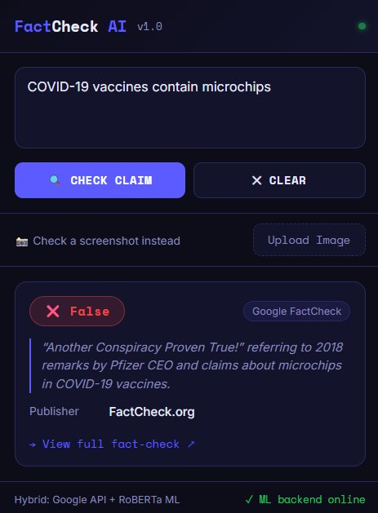
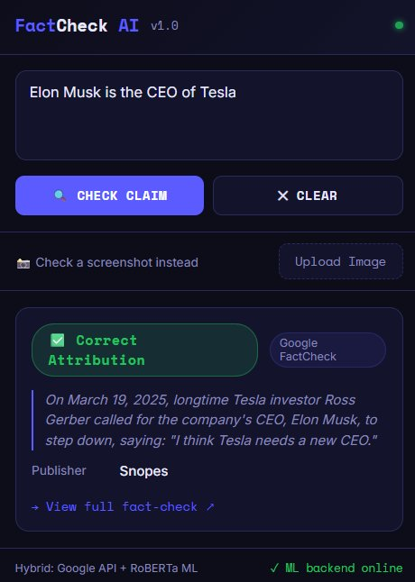
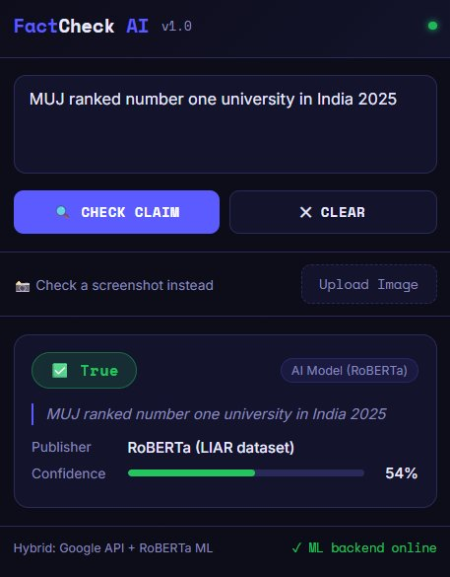
Live Results
❌ False — COVID vaccines & microchips
✅ Correct — Elon Musk / Tesla CEO
🤖 True (54%) — MUJ #1 University
Source: FactCheck.org via Google API
Source: Snopes via Google API
Source: RoBERTa ML Model

Slide 7
Key Design Decisions
Why hybrid instead of pure ML?
Why local server instead of cloud API?
ML accuracy is ~44% — insufficient as sole verifier. Google API handles known claims with near-perfect accuracy. ML only activates for unseen claims.
User privacy — no claim data leaves the machine. Also avoids latency and cost of cloud inference. PyInstaller can package it as a one-click .exe.
Why relevance filtering on Google results?
Why is Wikipedia last, not second?
Google API returns loosely-matched results. Without the 40% keyword filter, unrelated fact-checks (like CIA/SEAL Team stories for 'Osama is dead') were shown as verdicts.
Wikipedia gives context, not verdicts. Showing 'Context Found' before an ML prediction would confuse users who expect a True/False result.

Slide 8
Conclusion & Future Work
✅ What We Built
🚀 Future Work
✓ Real-time Chrome extension
→ Train on larger / combined dataset
✓ 3-stage hybrid pipeline
→ Add ClaimBuster pre-filter
✓ Google API + 100+ fact-checkers
→ Multi-language support (XLM-R)
✓ RoBERTa fallback classifier
→ Package backend as .exe
✓ OCR via Tesseract.js
→ ONNX model for in-browser inference
✓ Right-click + floating badge UI
→ User feedback & continuous learning
✓ Relevance filtering layer
Thank You

