Slide 1
Objective
Create a chatbot that hooks up to personal documents and provides Q&A ability

Slide 2
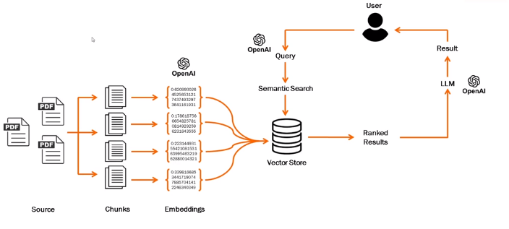
Architecture
5. When a question is made, calls Open API matching service
7. Use LLM do generate NPL answers and returns it to the user
6. Finds similarities between question embedding and text embedding in Vector Store
4. Store the embeddings in a Vector Store
1. Import personal documents
2. Extract text and break into smaller chuncks
3. Text to Numerical representations (embeddings), using OpenAI API

Slide 3
Para rodar no terminal:
cd caminho da pasta
streamlit run chatbot.py
Vai abrir direto e também dar o caminho (LOCAL URL)
* No terminal precisa ter instalado as bibliotecas
pip install pypdf2 langchain faiss-cpu openai tiktoken streamlit
* Precisa colocar a chave open ai nas linhas 44 e 60 para o programa funcionar

