Slide 1

Exploratory Data Analysis
G2M Insight for Cab Investment Firm
07/21/2022

Slide 2

Objectives and Approach
Main Objective: Provide insight into the market for cab services in order to determine which cab company would be more beneficial to invest in
Approach: To determine which cab company would be the most profitable to invest in, various aspects of each company’s performance will be analyzed, including:
Profit earned (total profit, profit per ride, profit per KM)
Customer base (number of customers, total number of rides given)
Customer reach/demographics (customer age, income level, gender, city)
Profit earned over time (is the company’s profit growing or shrinking?)

Slide 3
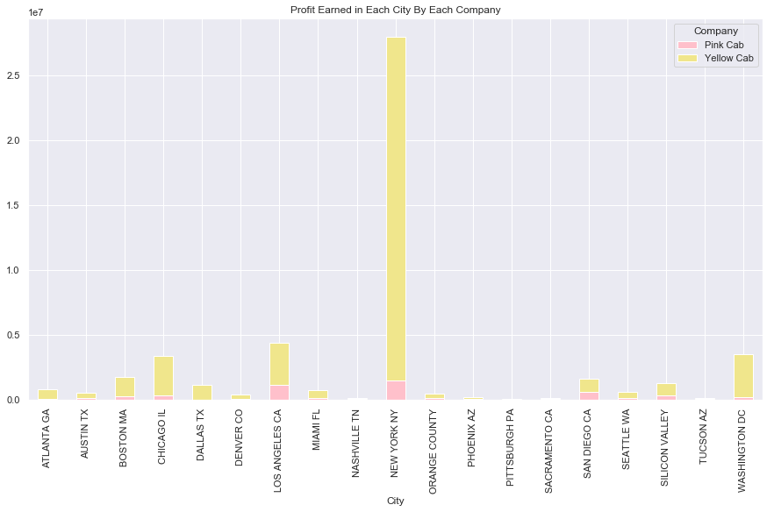
Profit Earned: Looking at Total Profit
In terms of total profit, the Yellow Cab Company strongly outperforms the Pink Cab Company
Across all cities, the Yellow Cab Company has earned a total profit of $44,020,370, while the Pink Cab Company has only earned a total profit of $5,307,328.
The Yellow Cab Company earns significantly higher profits than the Pink Cab Company in almost every city.

Slide 4
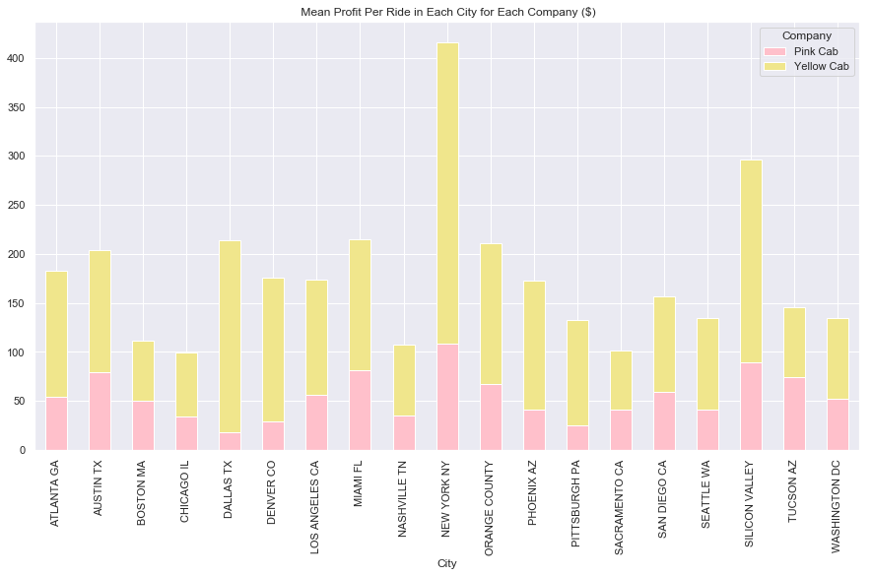
Profit Earned: Looking at Average Profit Per Ride
In terms of average profit per ride, the Yellow Cab Company outperforms the Pink Cab Company
The Yellow Cab Company earns approximately $160.26 in profit per ride on average, while the Pink Cab Company only earns $62.65 in profit per ride on average.
While the Pink Cab Company does earn a similar average profit per ride to that of the Yellow Cab Company in a few cities (Boston, Tucson, etc), it earns a significantly lower average profit per ride across almost all other cities.

Slide 5
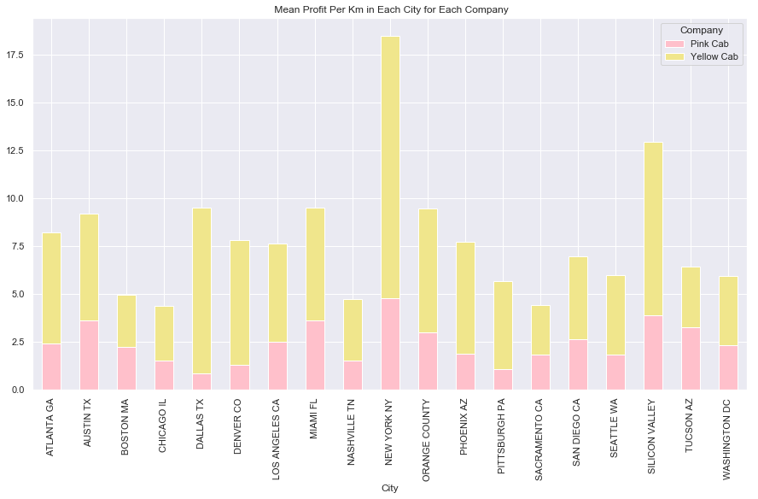
Profit Earned: Looking at Average Profit Per Km
In terms of average profit per KM, the Yellow Cab Company outperforms the Pink Cab Company
The Yellow Cab Company earns an average of $7.11 per KM in profit , while the Pink Cab Company only earns an average of $2.77 per KM in profit.

Slide 6
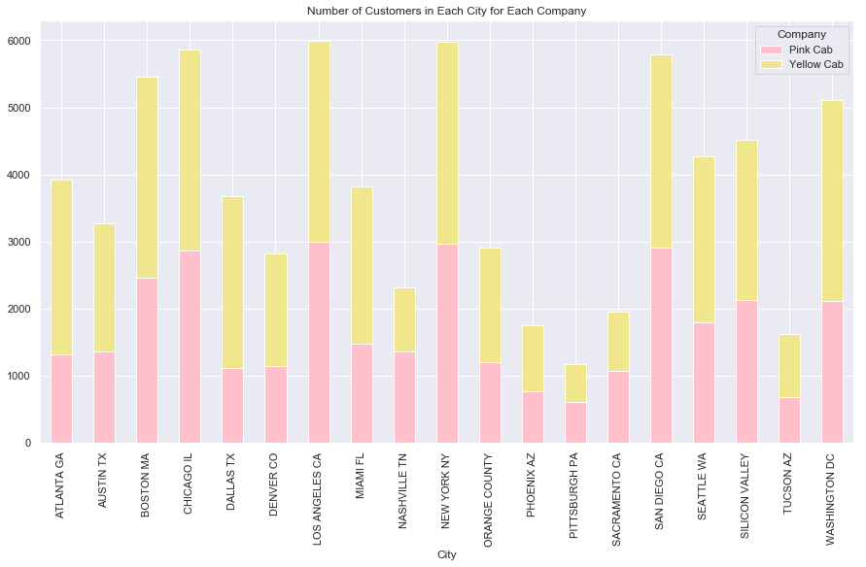
Customer Base: Total Number of Customers
In terms of total number of customers, the Yellow Cab Company outperforms the Pink Cab Company
Throughout the entire dataset, the Yellow Cab Company has had 39,896 unique customers , while the Pink Cab Company has only had 32,330 unique customers.

Slide 7
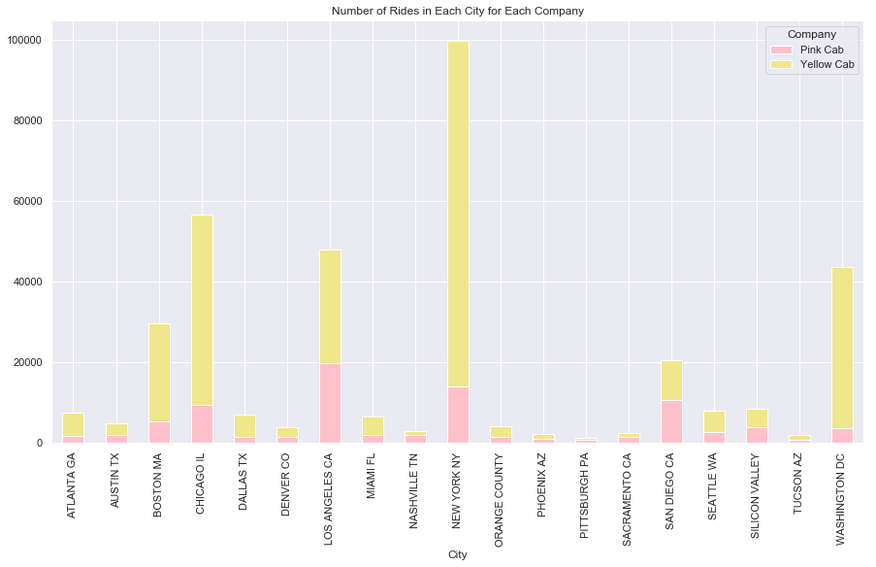
Customer Base: Total Number of Rides
In terms of total number of rides, the Yellow Cab Company outperforms the Pink Cab Company
Throughout the entire dataset, the Yellow Cab Company has given 274,681 total rides, while the Pink Cab Company has only given 84,711 total rides.

Slide 8

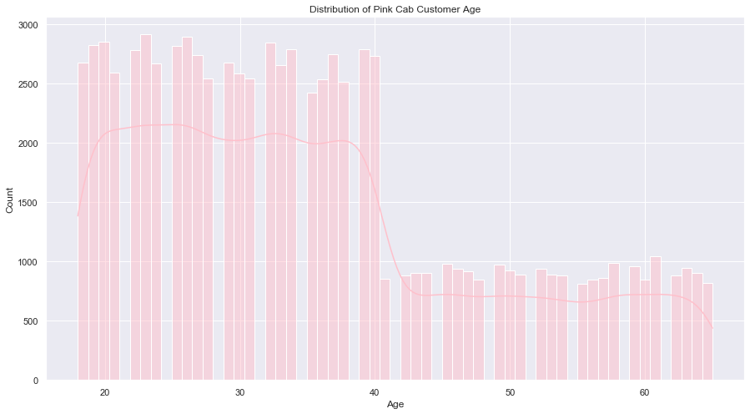
Customer Demographics: Age

Slide 9
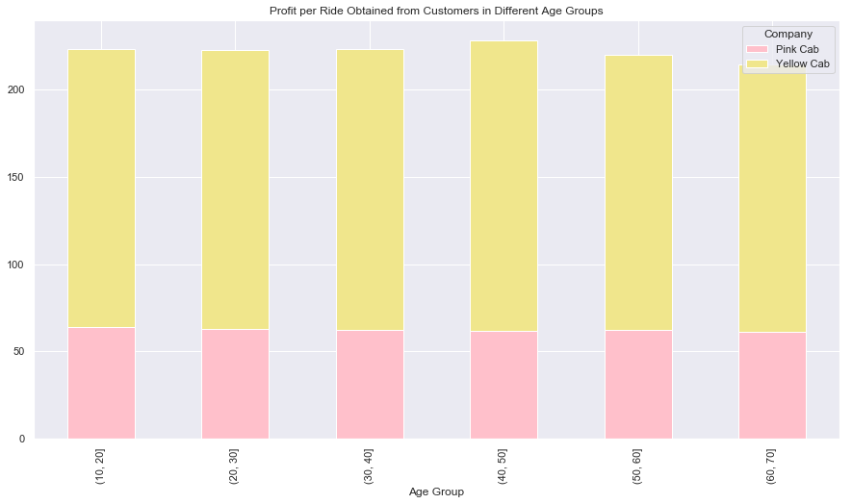
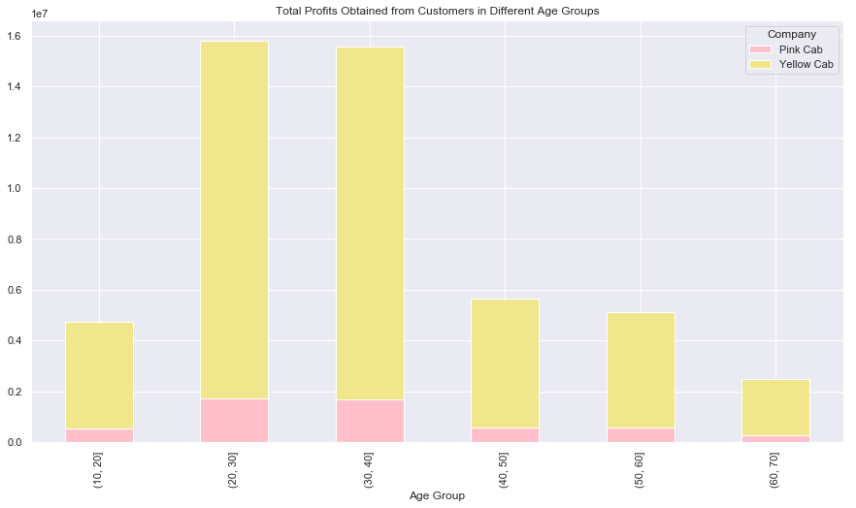
Customer Demographics: Age Cont.

Slide 10
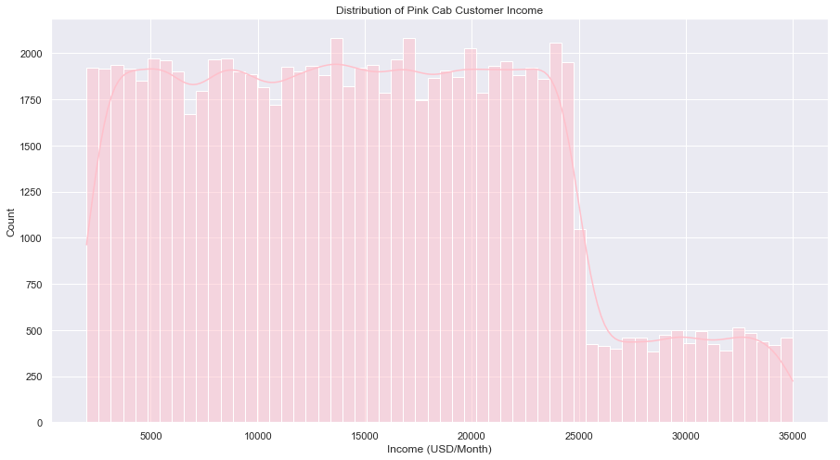
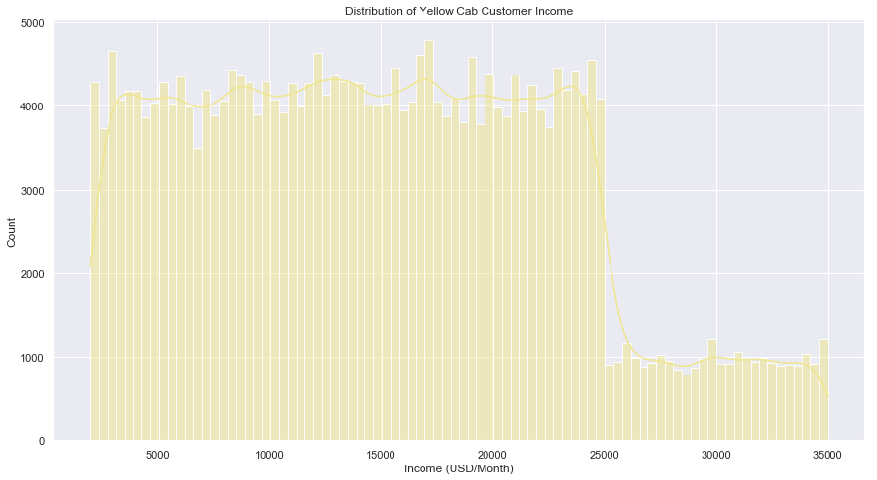
Customer Demographics: Income

Slide 11
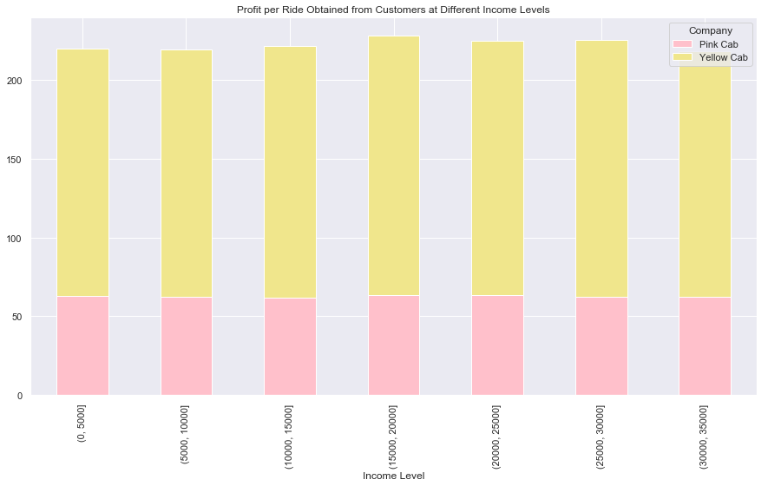
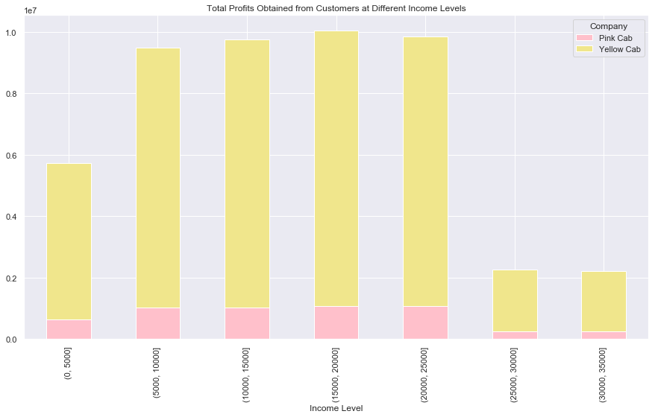
Customer Demographics: Income Cont.

Slide 12
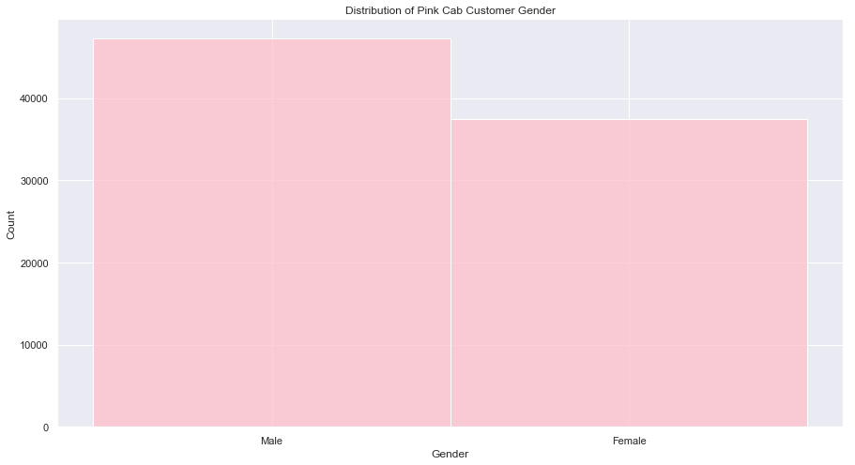
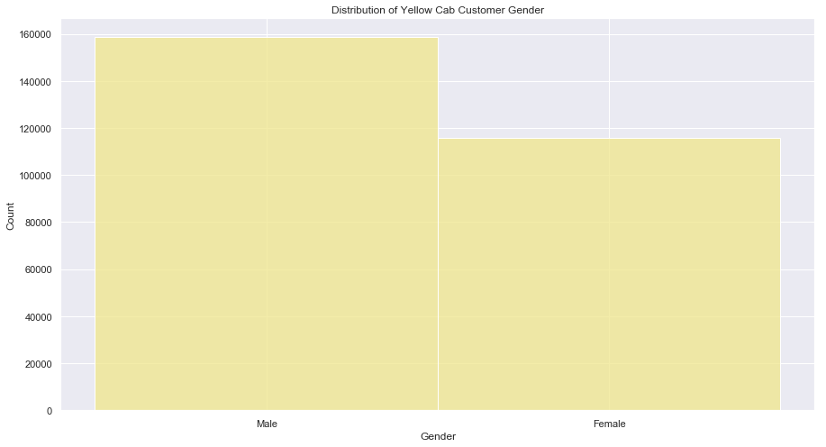
Customer Demographics: Gender

Slide 13
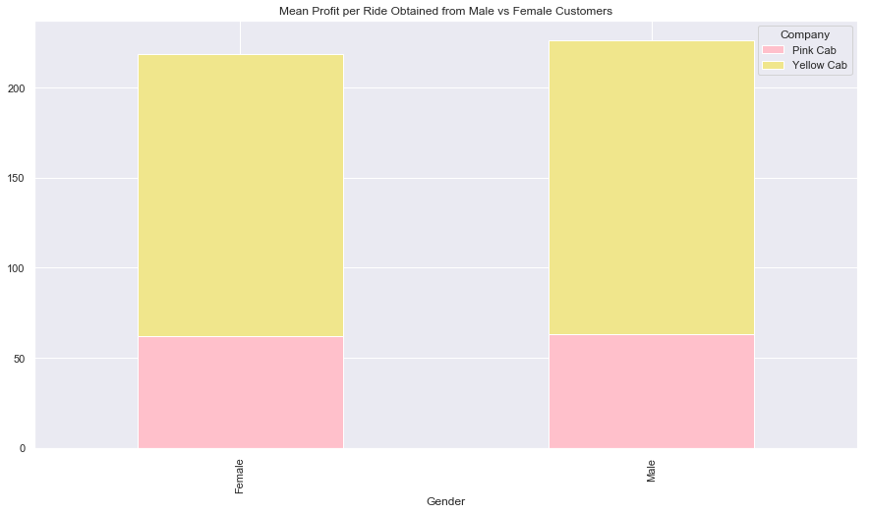
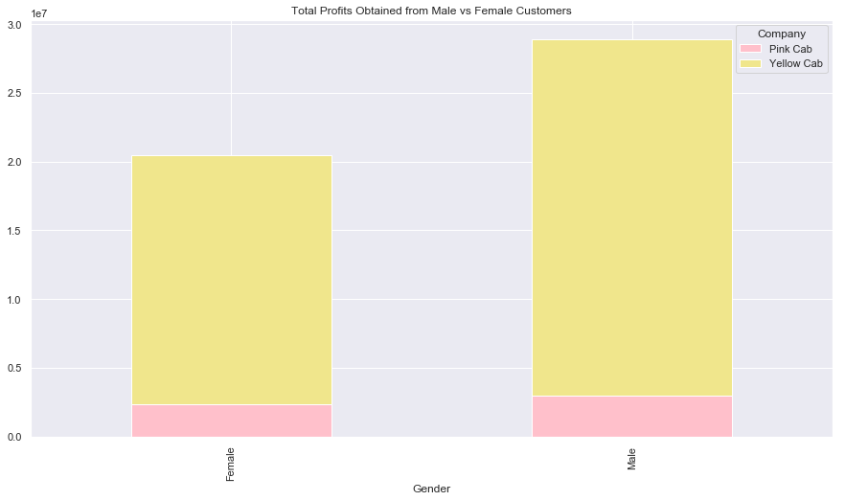
Customer Demographics: Gender Cont.

Slide 14
Customer Demographics: Summary
Age: Both cab companies seem to have a similar age range among their customers. Most customers are between the ages of 18 and 40 for both cab companies. However, the yellow cab company has significantly more customers than the pink cab company in every age group. The greatest profit is earned from customers in their 20s and 30s.
Income: Both companies also have a similar range of incomes among their customers. Most customers belong to the middle or upper class. However, the yellow cab company has significantly more customers than the pink cab company at every income level. The greatest profit is earned from middle-class and upper middle-class customers.
Gender: Both cab companies have slightly more male customers than female customers. More profit is earned from male customers.

Slide 15
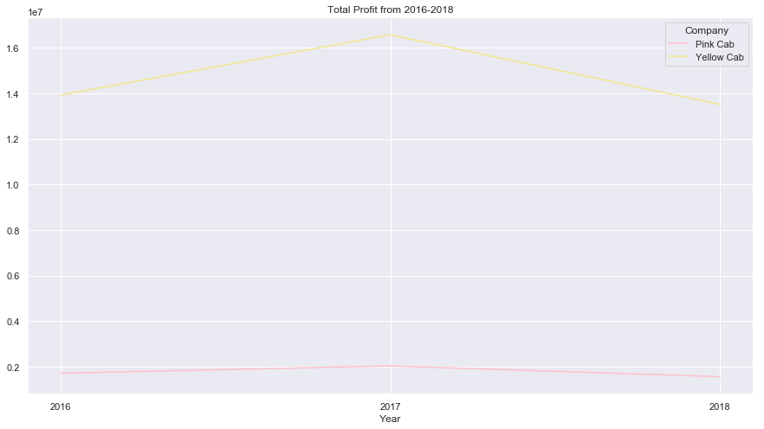
Profit Earned Over Time: Total Profit
Both cab companies follow a similar trend when it comes to total profit over time. Total profit increases from 2016 to 2017, and then decreases to its lowest point from 2017 to 2018. Over the time period from 2016-2018, both cab companies have not had much of a change in their total profit earned.

Slide 16
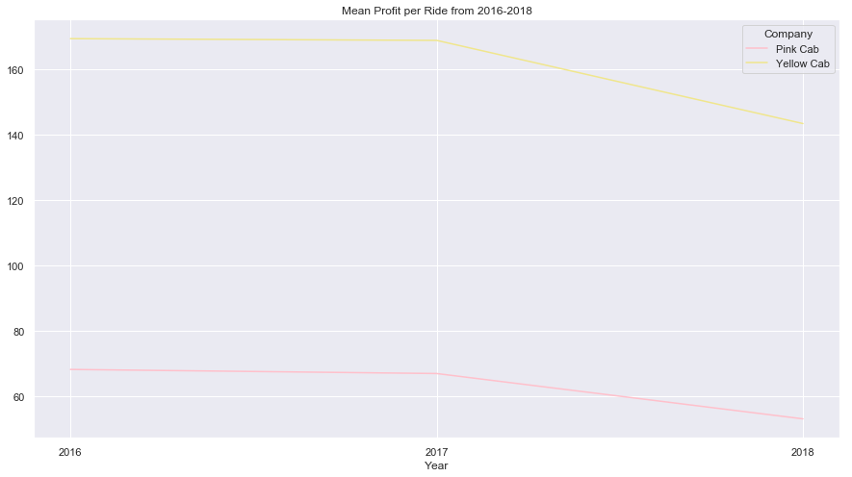
Profit Earned Over Time: Profit Per Ride
Like the previous slide, both cab companies follow a similar trend when it comes to average profit per ride over time. Profit per ride has stayed constant from 2016 to 2017, and then dropped from 2017 to 2018. Overall, it seems that the profit per ride is shrinking over time for both cab companies.

Slide 17
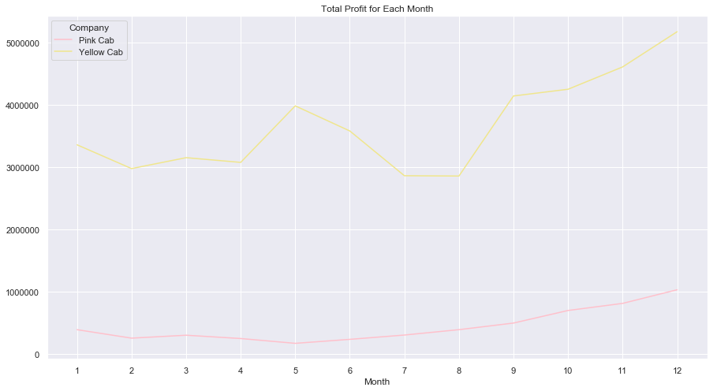
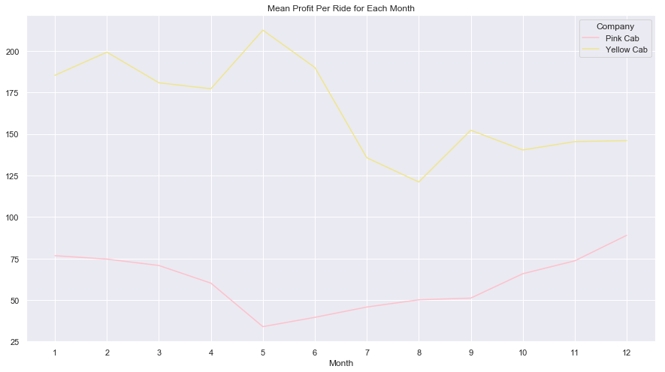
Profit Earned Over Time: In Which Months do Cabs Earn the Highest Profit?
Total Profit: For both cab companies, total profit was the highest in the Fall/Winter months.
Average Profit Per Ride: The Yellow Cab Company earns the highest average profit per ride during the Spring, while the Pink Cab Company earns the highest average profit per ride during the Fall/Winter.

Slide 18
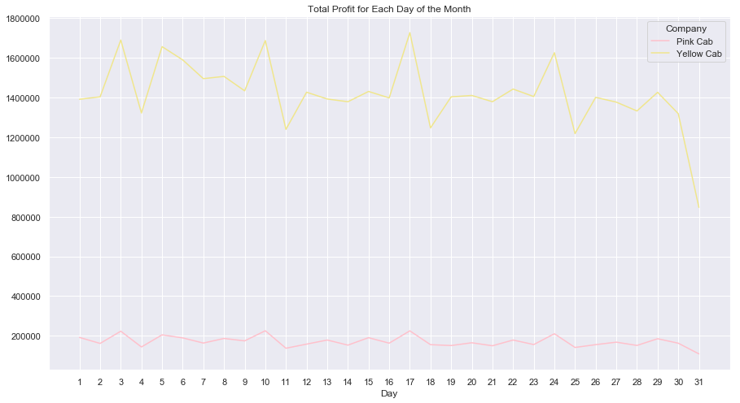
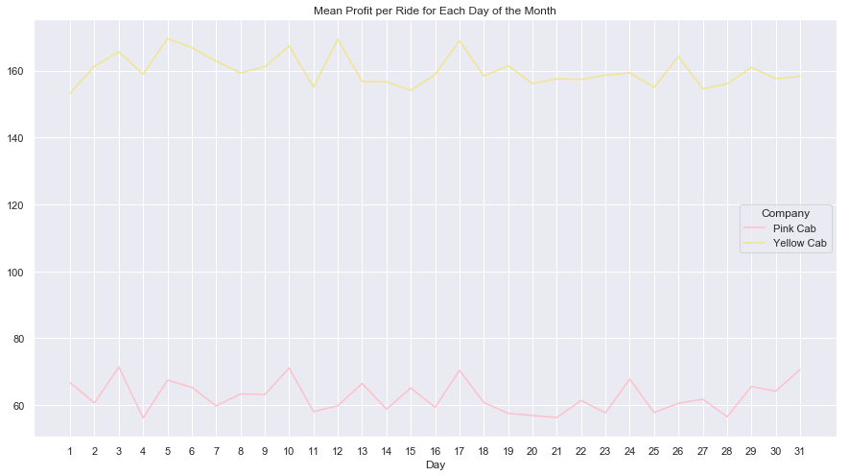
Profit Earned Over Time: On Which Days of the Month do Cabs Earn the Highest Profit?
Total Profit: For both cab companies, there seems to be a rise in total profit per day every 7 days or so, which lasts about 2 days. These are most likely weekend days.
Average Profit Per Ride: For both cab companies, there does not seem to be any trend in the average profit per ride per day.

Slide 19
Summary of Results and Recommendation
Summary of Results: Overall, the Yellow Cab Company strongly outperforms the Pink Cab Company.
The Yellow Cab Company has earned a significantly higher total profit, average profit per ride, and average profit per km, than the Pink Cab Company.
Both cab companies have seen similar trends in their total profit and average profit per ride over time. For both companies, profit seems to be slightly decreasing.
Both cab companies have a steady customer base with customers from many different demographics
Recommendation: It would be best to invest in the Yellow Cab Company.

Slide 20
Thank You

