Slide 1
Credit Card Fraud Detection
KI Bonus Projekt WS 19/20

Slide 2
Beschreibung der Daten / des Anwendungsfalls
Context: In order to enhance the security, credit card companies would like to reveal fraudulent transactions.
Inspiration: Implementation of an algorithm, which is able to identify fraudulent credit card transactions.
The Dataset: Transactions of credit cards, that occurred in two days in September 2013 by European cardholders
→ 492 frauds (=positive class) out of 284,807 transactions, which makes an unbalanced allocation of 0,172% frauds
Due to a PCA transformation, the datasets contains almost only numerical data
This also leads to anonymization of the data which is important due to confidentiality issues. The presentation of the original features and further details is not allowed.
The features ‘Time’ and ‘Amount’ will be scaled in order to have a similar distribution as the remaining features

Slide 3
Intro
Data is highly imbalanced:
99.83 % normal transactions
00.17 % fraudulent transactions
Possibilities:
Work on full imbalanced data set
Computationally expensive
Work on subset of imbalanced data set
Work on undersampled data set
Lot of information dismissed
Work on full over-sampled data set
Computationally very expensive
Work on subset of over-sampled data

Slide 4
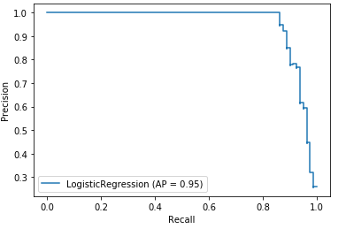
Metriken
We choose the method of the Area Under the Precision-Recall Curve (AUPRC).
When the classes are very imbalanced, precision-recall is beneficial compared to other metrics.
Precision tells how useful the search results are.
Recall tells how complete the results are.
Shows the result using the autoencoder ->

Slide 5
Idea
Standard method for binary classification:
Logistic Regression
Random Forest
SVM
XGBoost
Test them on the different datasets
Full and imbalanced set (1)
Full and imbalanced set + Autoencoder (2)
Under-sampled set (3)
Over-sampled set (4)

Slide 6
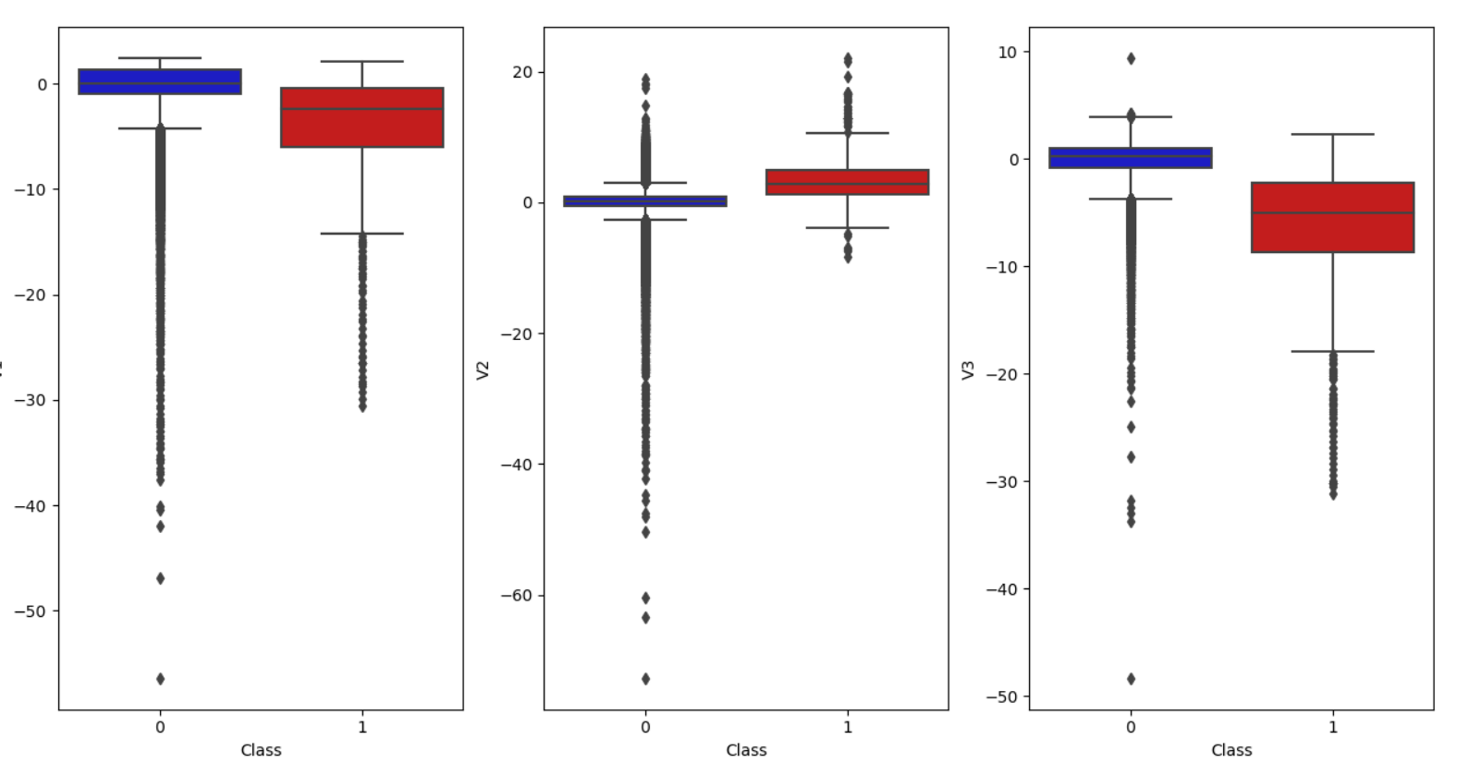
Outlier Analyse
Outliers to remove:
8
Modell | Outlier area
V4 | 15 bis 17
V5 | -38 bis -44 und -113
V6 | 73
Modell | Outlier area
V7 | 120
V8 | -37 - -42, -50 und -73
V9 | 15
-24/ -28
-39/ -42
-44/ -52
-31/ -35
-47
-59/ -65
-56,9
-73
-48
Modell | Outlier area
V10 | 24 und -15
V11 | 6 und 7
V12 | 8 und -11 bis -15
-5 - -57
-3 - -73
-4 - -48
Notes:
Outliers in the models (red area) are not removed because of insufficient data

Slide 7
Outlier Ergebnisse
TODO Jan

Slide 8
Data preparation
Completely untouched by sampling techniques to allow meaningful evaluation
Test Set
Full data set
Scaled data set
Scale
Split
Train Set
We scale ‚Amount‘ and ‚Time‘. Other features are a result of PCA and have already been standardized.

Slide 9
Option 1: Logistic Regression
Train Set
Trained Model
Test Set
K-Fold CV
Evaluate
Results

Slide 10
Option 2: Logistic Regression + Autoencoder
AE Set
Trained AE
Train
Train set
Split
Clf set
Predict
Latent repr
Results
Trained Model
Test Set
CV
Evaluate

Slide 11
Options 3 + 4: Over/Under-sampling
Train Set
Test
Set
K-Fold CV
Training
Validation
Fold 1
Fold 2
Fold…
Fold n
Best Model
Results
Note: by sampling during CV we avoid data leakage
Evaluate
Sample
Validate
Sampled Train Set
Train
Trained Model

Slide 12
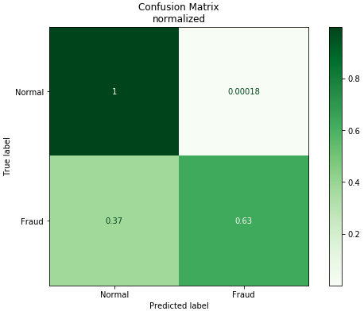
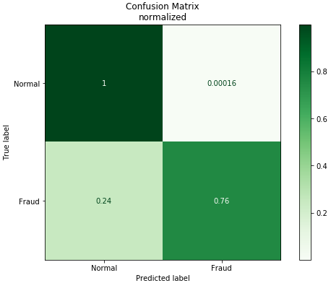
Evaluation
Logistic Regression:
Low rate of false positives
High rate of false negatives
Autoencoder + Logistic Regression:
Similarly low rate of false positives
Lower rate of false negatives, but still too high

Slide 13

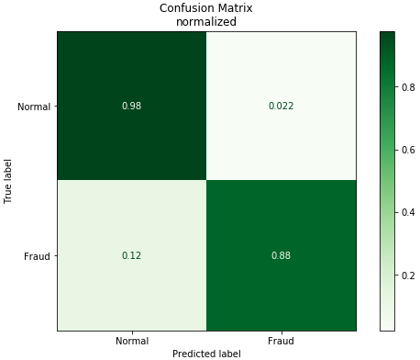
Evaluation
Undersampling + Logistic Regression:
Significantly higher rate of false positives
Even lower rate of false negatives
Oversampling + Logistic Regression:
Highest rate of false positives
Lowest rate of false negatives
Best fit for real world usage (out of selected methods)

Slide 14
Shapley Values
Use Game Theory (Monte Carlo Simulations) to gain Explainability on Machine Learning Models
For each feature value in each observation the marginal contribution is calculated
Regulators like the European Central Bank and Bank of England deem Shapley Values to lighten up the Black Box enough to make an approval for financial applications highly probable

Slide 15
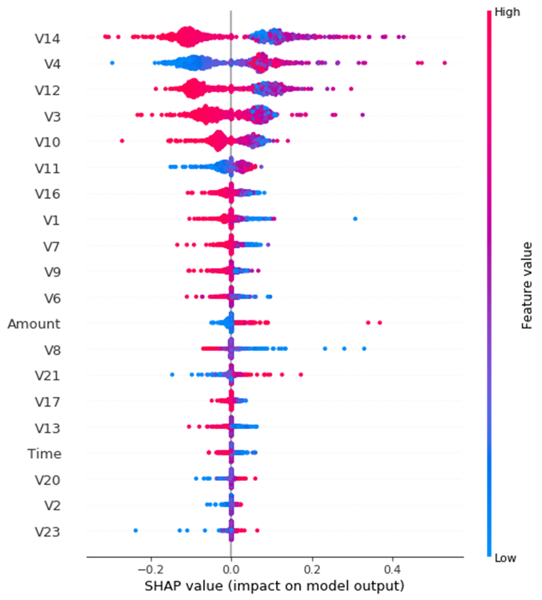
Shapley Values for a logistic regression applied to the under sampled dataset (equal number of fraudulent and non-fraudulent transactions
Feature 14 has the most impact on the prediction
Note that higher and lower feature values do not necessarily have an linear impact on the prediction but have to be judged depending on the whole observation

