Slide 1
Credit Card Fraud Detection
KI Bonus Projekt WS 19/20

Slide 2
Table of Content
The Data & Business Case
Approach
Evaluation Metrics
Outlier Analysis
Data Preparation
Models
Sampling Framework
Evaluation
Shapley Values

Slide 3
The Data & Business Case
Context: In order to enhance the security, credit card companies would like to reveal fraudulent transactions.
Inspiration: Implementation of an algorithm, which is able to identify fraudulent credit card transactions.
The Dataset: Transactions of credit cards, that occurred in two days in September 2013 by European cardholders [ref: https://www.kaggle.com/mlg-ulb/creditcardfraud/]
492 frauds (=positive class) out of 284,807 transactions, which makes an unbalanced allocation of 0,172% frauds
Features V1-V28 are the result of a PCA transformation. We assume they already have been scaled for the PCA.
This also leads to anonymization of the data which is important due to confidentiality issues. The presentation of the original features and further details is not allowed.
The features ‘Time’ and ‘Amount’ will be transformed by a Standard-Scaler.

Slide 4
Approach (1)
We considered a couple of options for dealing with the imbalance problem and settled for the following three:
Work on the full but imbalanced data set: It will be interesting to see how good models can perform on an imbalanced dataset.
Work on undersampled data set: Undersampling will yield balanced classes but with the cost of loss of information.
Work on the full over-sampled data set: Oversampling will also yield balanced classes but with a lot of data that makes training computationally expensive.

Slide 5
Approach (2)
In the banking context regulation plays a big role and therefore model explainability is very important.
We choose a Logistic Regression in order to keep the model simple. The Logistic Regression performed better in early testing then a Random Forest.
Instead of comparing many models we focused on the data preparation.
The Logistic Regression has been tested on the following data:
Fully imbalanced set (1)
Latent representation (from Autoencoder) of fully imbalanced set
Under-sampled set (3)
Over-sampled set (4)

Slide 6
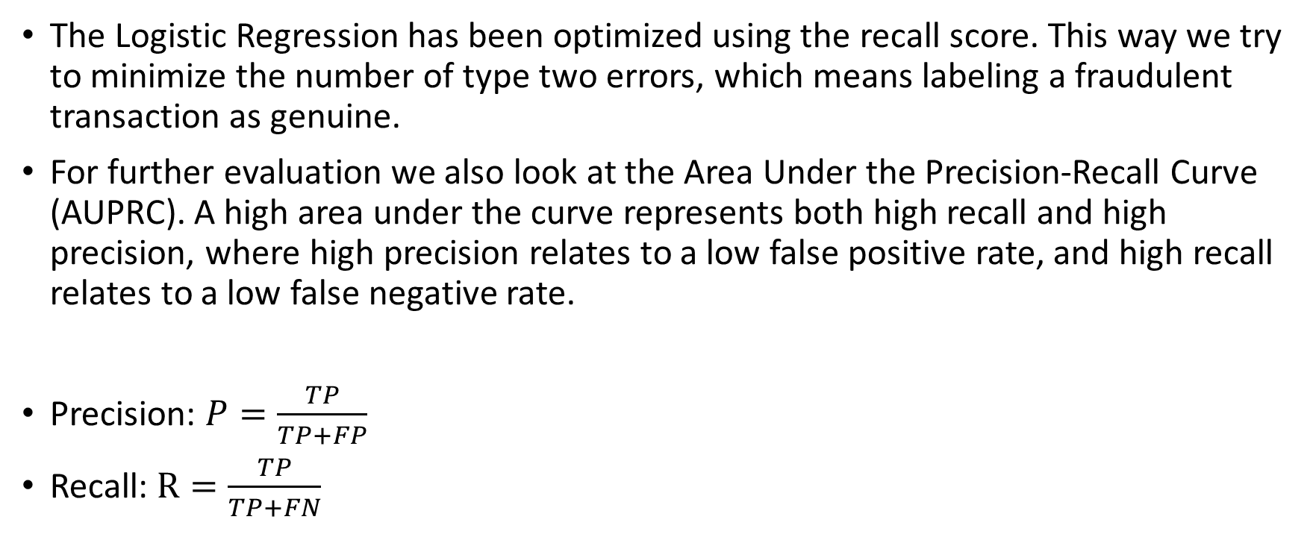
Evaluation Metrics
The Logistic Regression has been optimized using the recall score. This way we try to minimize the number of type two errors, which means labeling a fraudulent transaction as genuine.
For further evaluation we also look at the Area Under the Precision-Recall Curve (AUPRC). A high area under the curve represents both high recall and high precision, where high precision relates to a low false positive rate, and high recall relates to a low false negative rate.
Precision: $P=\frac{TP}{TP+FP}$
Recall: $R=\frac{TP}{TP+FN}$

Slide 7
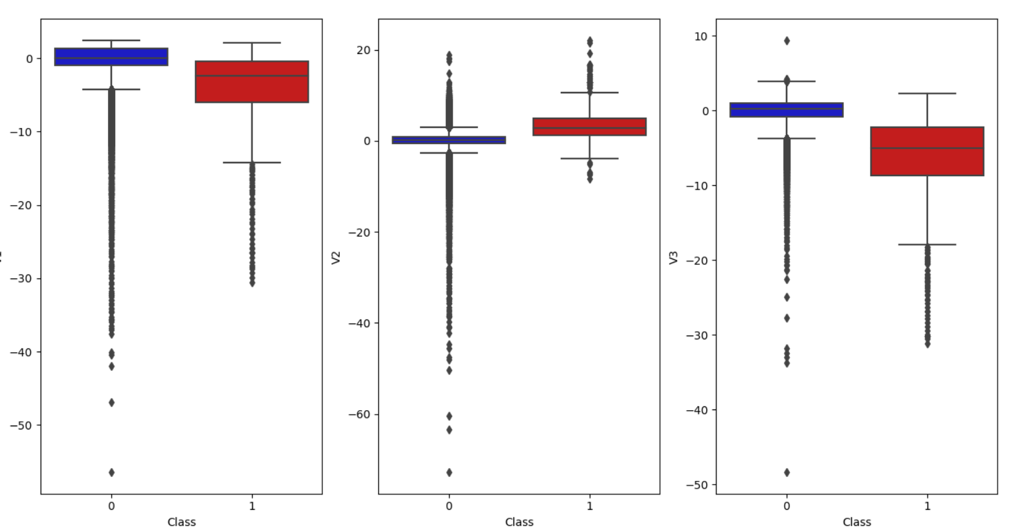
Outlier Analysis
Outliers to remove:
8
Feature | Outlier area
V4 | 15 bis 17
V5 | -38 bis -44 und -113
V6 | 73
Feature | Outlier area
V7 | 120
V8 | -37 - -42, -50 und -73
V9 | 15
-24/ -28
-39/ -42
-44/ -52
-31/ -35
-47
-59/ -65
-56,9
-73
-48
Feature | Outlier area
V10 | 24 und -15
V11 | 6 und 7
V12 | 8 und -11 bis -15
-5 - -57
-3 - -73
-4 - -48
Notes:
Only outliers of the majority class (blue boxes area) are removed in order to keep all examples of the minority class.

Slide 8
Data Preparation Pipeline
In order to ensure having compareable data when testing the models, we established a data preparation pipeline. The full data set will be split in a stratified manner such that we end up with a set for testing and a set for training. All models will be tested on the same test set.
Test Set
20 %
Completely untouched by sampling techniques to allow meaningful evaluation
Full data set
Scaled data set
Scale
Split
Train Set 80 %
We scale ‚Amount‘ and ‚Time‘. Other features are a result of PCA and have already been standardized.

Slide 9
Logistic Regression
For the logistic Regression we applied a Grid Search Cross-Validation with the following parameters:
C = [0.01, 0.1, 1, 10, 100]
K = 5 folds
Train Set
LogReg Model
Trained Model
GridSearchCV
Parameters

Slide 10
Autoencoder
We trained the Autoencoder on 25 % of the non-fraudulent transactions and used the encoder-layers to extract the latent representation of our data. With the latent data we trained another Logistic Regression Model in the same way as described in the previous slide.
Train Set
AE Model
AE Set
Trained AE
Train
Extract Encoder
Split
Clf Set
Trained Encoder
Predict
Latent Data

Slide 11
Sampling Framework
Train Set
Best Model
K-Fold CV
Sampling has to be done during Cross Validation. Otherwise information from the training data would end up in the validation set. Therefore we implemented the framework on the left for sampling our data.
Training
Validation
Fold 1
Fold 2
Fold…
Fold n
Note: by sampling during CV we avoid data leakage
Sample
Validate
Sampled Train Set
Train
Trained Model

Slide 12
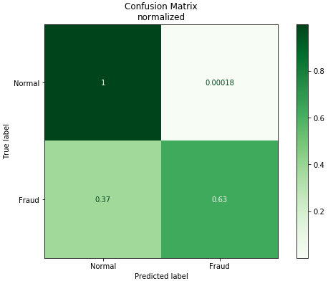
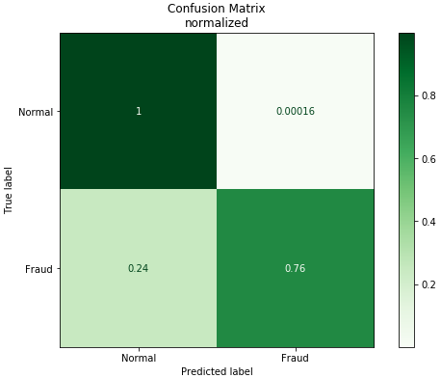
Evaluation (1)
Logistic Regression:
Low rate of false positives
High rate of false negatives
Autoencoder + Logistic Regression:
Similarly low rate of false positives
Lower rate of false negatives, but still too high

Slide 13

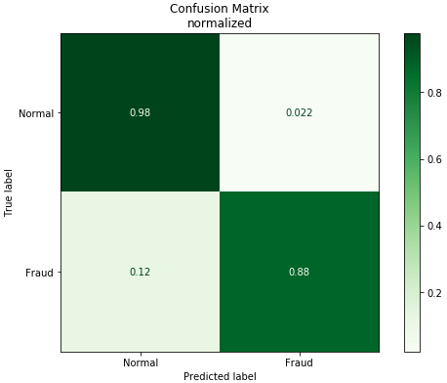
Evaluation (2)
Undersampling + Logistic Regression:
Significantly higher rate of false positives
Even lower rate of false negatives
Oversampling + Logistic Regression:
Highest rate of false positives
Lowest rate of false negatives
Best fit for real world usage (out of selected methods)

Slide 14
Shapley Values
Use Game Theory (Monte Carlo Simulations) to gain Explainability on Machine Learning Models
For each feature value in each observation the marginal contribution is calculated
Regulators like the European Central Bank and Bank of England deem Shapley Values to lighten up the Black Box enough to make an approval for financial applications highly probable

Slide 15
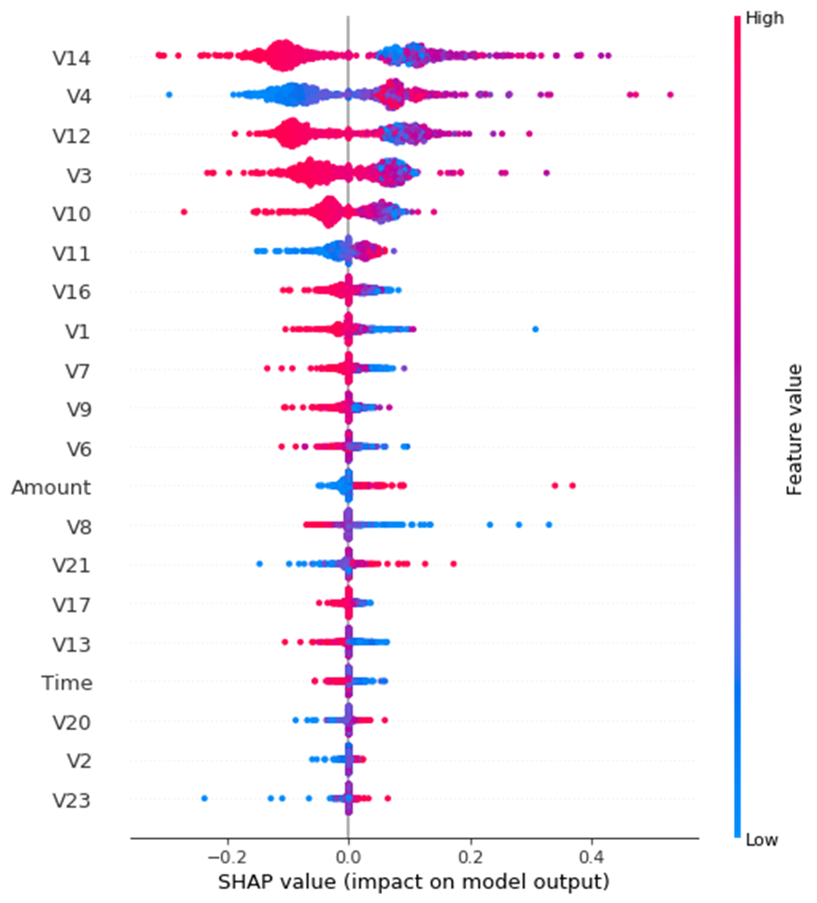
Shapley Values for a logistic regression applied to the under sampled dataset (equal number of fraudulent and non-fraudulent transactions
Feature 14 has the most impact on the prediction
Note that higher and lower feature values do not necessarily have an linear impact on the prediction but have to be judged depending on the whole observation

