Slide 1
Intro to W251
Deep Learning in the Cloud and at the Edge
Prabs Attaluri, IBM Distinguished Engineer
Ryan DeJana, IBM Senior Technical Staff Member

Slide 2
Contact Info
Email is the best way to contact us:
Ryan – rdejana@us.ibm.com
Prabs - pratt@ischool.berkeley.edu

Slide 3
Grading
Graded homework assignments (3, 5, 9, 11): 100-point scale, 40% of total grade (evenly weighted).
Homework submitted through the portal
If a GitHub repository is requested invite us:
rdejana
PrabsA
Extra credit possible on some homework!
Credit/No-Credit homework assignments (1, 2, 4, 6, 7, 8, 10, 12) 10% of total grade (evenly weighted).
Participation: 100-point scale, 10% of total grade
Final Project: 100-point scale, 40% of total grade. Students will organize into groups of four to five to perform an analysis on a large dataset and prepare a final presentation (slides) and a live demo or video (10 min).

Slide 4
AI / DL and Cloud News
Part of participation grade
Every student presents once
Present something current in the area of AI / Deep Learning and/or Cloud.
Can do a short write up or just talk to the the article
Example
AWS makes Arm processors available (https://www.zdnet.com/article/aws-makes-arm-processors-available-in-the-cloud-with-new-graviton-processor/).
Notes:
Something that you found interesting

Slide 5
Final Project
Large part of grade
Form teams of 3 to 5 people
Leverage Big Data, Cloud, DL, and the edge device
Should be more than you can do just on a workstation
Typically, modeled after an existing class of problems (e.g. NLP.. object detection…)
Check arxiv / conference workshops!
ideally, collect your own dataset - the format may borrow from existing
Ok to reuse existing model architecture but best to choose between them
Ideally, train your model on your dataset
Ideally, implement runtime on the jetson

Slide 6
Final Project Details
A 5- to 10-page white paper which is due on the day of the last live session, discussing the following:
What does the project do? What problem does it solve?
What tools are used to accomplish this?
How was it built? Please provide complete directions so that it can be replicated.
Provide sample data or pointers to
Discuss the challenges and the alternative ways that this problem could be solved
Final presentation of roughly 15 minutes and 5 minutes follow up questions from the audience. The final presentation is during the last live session.
Start thinking about teams now!
Notes:
Talk about your journey, especially things that we found didn’t work and what we would do differently if we had infinite time. Risk is low if you can talk about your journey

Slide 7
Sample idea
Leverage a dataset of a missing persons
Train a model in the cloud to recognize the missing persons
Deploy the model to your edge device
If a person is recognized, send the image and location back to the cloud for further actions
Service? Runtime application?
Notes:
This is just a simple example

Slide 8
At a glance..
Intro and setup of a Jetson Device (NX, Nano, etc)
Cloud: IaaS, SaaS
Containers, Docker and Kubernetes
DL 101
DL Frameworks
Running at the edge
DL 201
Datasets and Dataset processing
MNMG (distributed training)
GANs
DRL
ASR / NLP
AI in RL
Notes:
Examples: distracted driver solution (based

Slide 9
NGC: Nvidia GPU Cloud
Go to place to get assets (containers.. models..)
Please explore it
For the Jetson family, especially!
https://ngc.nvidia.com/catalog
Search for l4t
e.g. https://ngc.nvidia.com/catalog/containers/nvidia:l4t-ml
Note compatibility with your jetpack version
Also, for x86
Notes:
– Images are pulled from JetPack version
NGC contains docker library

Slide 10
Kaggle (by Google)
Competitions as a source of inspiration
Kernels / notebooks as a source of sample code
Datasets as a source of ground truth
Even models
Some GPU cycles, but GPUs are old
Cycles are limited
List of pre-installed packages sometime confusing
Docker file available

Slide 11
Colab (by Google Research)
Very easy to get started
GPUs are better than in KAggle but also limited
Limited packages installed
There’s a pro version that costs a little more
Less open; docker file not available

Slide 12
What Is Big Data?
Data is big if your standard tools start to fail.
You can no longer just (S)FTP your data.
Tools for big data are of a different lineage than conventional tools.
Notes:
Lots of definitons of there, this is just one…and it is a hard question
Tools such as Haddop and Spark come from a different linage from things like relational databases.
Tools of big data come from new source.
Of the course of the class, we’ll touch on tools to help manage big data.

Slide 13
The Four Vs
Volume
Velocity
Variety
Veracity
Data at rest
Terabytes to exabytes of existing data to process
Data in motion
Streaming data, milliseconds to seconds to respond
Data in many forms
Structured, unstructured, text, multimedia
Data in doubt
Uncertainty due to data inconsistency and incompleteness, ambiguities, latency, deception, model approximations

Slide 15
Cloud Computing
Cloud Computing has changed how IT resources are provisioned and consumed
At its core, Cloud Computing can be thought as an ATM for IT
Users provision via an API, CLI, or portal
No human interaction required
Typically available in minutes

Slide 16
Responsibilities in the Cloud
Traditional IT
IaaS
PaaS
SaaS
Applications
Applications
Intern Organization
Applications
Applications
Runtime
Runtime
Runtime
Runtime
Intern Organization
Middleware
Middleware
Middleware
Middleware
Intern Organization
Provider
OS
OS
Provider
OS
OS
Hypervisor
Hypervisor
Hypervisor
Hypervisor
Provider
Infrastructure
Infrastructure
Infrastructure
Infrastructure
Notes:
As a user moves to the right, the responsibilities decrease as dos time to market, however the flexibility decreases
IaaS is VM in the cloud. Need to patch and install software. Not have to deal with physical hardware
PaaS is like writing an application in cloud. This means cloud takes care of how to deploy. Just focus on writing code
SaaS is like I want to just use Google docs, no install or something to manage.
Lots of flexibility and faster time to delivery

Slide 17
Why?
According to Amazon,* average server utilization is less than 20%.
Users will provision based on peak needs.
Peaks occur based on time of day or by season.
Large-scale providers achieve around 65% utilization.
Typically leads to one-fourth the resources needed
Dynamic provisioning allows users to adjust to demand and “right-size” their consumption
*https://aws.amazon.com/blogs/aws/cloud-computing-server-utilization-the-environment/
Notes:
People tend to overspend their infrastructure.
Peak needs – Christmas, Black Friday. Can’t build infrastructure just based on peak needs alone.

Slide 18
Deep Learning: summary
Deep Learning (DL) is a brain-inspired branch of Machine Learning (ML) based on networks comprised of layers of “artificial neurons”
It gained popularity in 2012, when AlexNet won the ILSVC image classification challenge by a wide margin over traditional Computer Vision (CV) algorithms
Today, DL powers many (most) breakthrough AI systems and applications, outperforming humans on a growing range of tasks from image classification to automatic speech recognition
Leading DL models require hundreds of thousands / millions of artificial neurons and often take days and months to train on the latest hardware
Nvidia Graphics Processing Units (GPUs) are the leading DL HW accelerators, Google is developing their own TPU technology for Google Cloud, Intel and others are playing catchup
DL technologies are complex and exist at the unique intersection of Machine Learning, Big Data, Cloud, and High Performance Computing

Slide 19
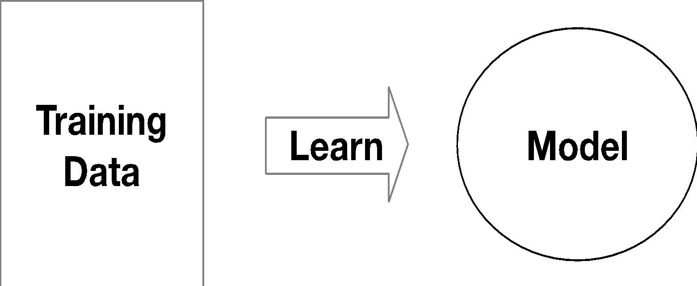
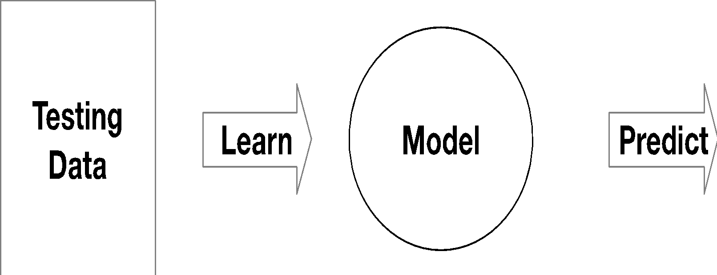
What is DL? What is ML? What is AI?
Deep Learning (DL) is a brain-inspired branch of Machine Learning (ML) based on networks comprised of layers of “artificial neurons”
“Machine learning is about predicting the future based on the past.”
-- Hal Daume III
past
future
Notes:
Machine learning is construction and study of systems that can learn from data
Do not explicitly program
Examples are used to train computers to perform tasks that would be difficult to program
Machine Learning relies on large quantities of data to train computers (OCR and detecting objects in images)
Computers can learn complex tasks that would require immense effort to program
Machine Learning is limited by the availability of examples and computational resources
With sufficient examples and computational power, computers can learn nearly any task
Models are the core component Machine Learning
A model is a method for using known examples to predict or produce inferences on new data.
Robots are exposed to noisy and dynamic environments, so programming a robot to handle all situations is infeasible
Therefore, engineers often use Machine Learning to teach robots to perform tasks, much like the way human children learn.
Deep Learning (DL) is a brain-inspired branch of Machine Learning (ML) based on networks comprised of layers of “artificial neurons”
It gained popularity in 2012, when AlexNet won the ILSVC image classification challenge by a wide margin over traditional Computer Vision (CV) algorithms
Today, DL powers many (most) breakthrough AI systems and applications, outperforming humans on a growing range of tasks from image classification to automatic speech recognition
Leading DL models require hundreds of thousands / millions of artificial neurons and often take days and months to train on the latest hardware
Nvidia Graphics Processing Units (GPUs) are the leading DL HW accelerators, Google is developing their own TPU technology for Google Cloud, Intel and others are playing catchup
DL technologies are complex and exist at the unique intersection of Machine Learning, Big Data, Cloud, and High Performance Computing

Slide 20
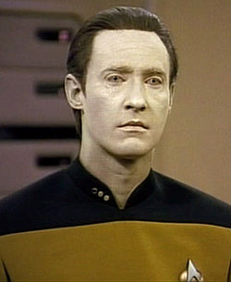
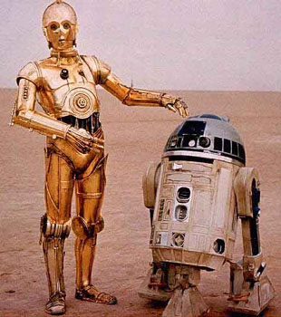
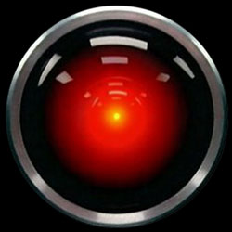
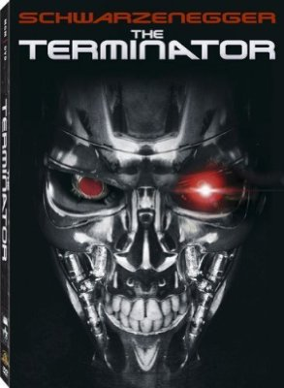
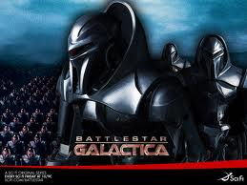
AI in Fiction
Notes:
Weak AI:
Machines can be made to act as if they were intelligent.
The philosophical position that machines can demonstrate intelligence, but do not necessarily have a mind
Strong AI:
Machines that act intelligently have real, conscious minds
An important topic for science fiction writers and futurists.

Slide 21
Types of DL
GAN – Generative adversarial network
CNN – Convolutional neural network
RNN – Recurrent neural network
DRL – Deep reinforcement Learning

Slide 22
GAN
Two neural networks contesting with each other
Can generate realistic images
Recent publicity for NVIDIA generating photographs of imaginary people

Slide 23
CNN
Great for image recognition

Slide 24
RNN
Great for speech/text recognition

Slide 25
DRL
Great for robotics

Slide 26
Current State of the Art in DL

Slide 27
DL in Your Daily Life
Autonomous Vehicles
Speech Recognition
Chatbots
Google Translate using Video
Subtitles on YouTube
Apple Face ID

Slide 28
IoT: what is it?
Internet of “Things”
“Things” were originally meant to be low-power, dumb
Aka “Sensors”
Embedded OSes
Arcane protocols
“Things” mostly read-only
“Things” send to “gateways”

Slide 29
IoT: why do we care?
The data that “Things” / “Devices” generate is not just big, it’s HUGE
Much of it dies today before it can be processed
The value is is enormous

Slide 30
NVIDIA Jetson Systems
Jetson Nana
Xavier NX
Xavier AGX

Slide 31
NVIDIA Jetson SDK
The Jetson Development Pack (JetPack) is an on-demand, all-in-one package that bundles and installs all software tools required to develop for the NVIDIA Jetson embedded platform.
JetPack includes tools for:
Deep Learning: TensorRT, cuDNN, NVIDIA DIGITS™ Workflow
Computer Vision: NVIDIA VisionWorks, OpenCV
GPU Compute: NVIDIA CUDA, CUDA Libraries
Multimedia: ISP Support, Camera imaging, Video CODEC
It also includes ROS compatibility, OpenGL, advanced developer tools, and much more.

Slide 32
NVIDIA Isaac
Create and deploy AI-powered robotics
A comprehensive set of frameworks, tools, APIs, and libraries to accelerate development of robotics algorithms and software.
Enables hardware-in-the-loop testing with NVIDIA Jetson AGX Xavier.

Slide 33
Next week…
Unit 2: Clouds, Infrastructure, and Machine Learning Cloud Services

