Slide 1
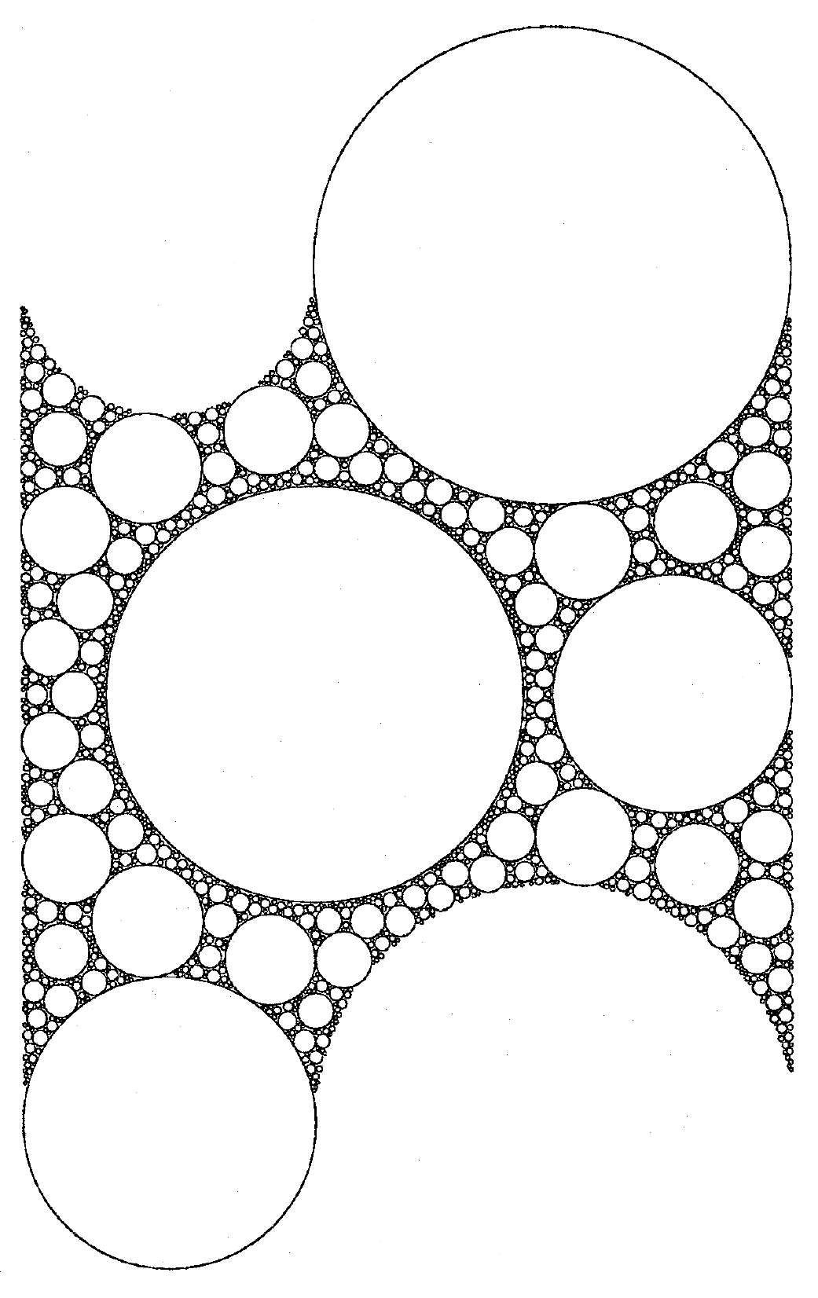
Midterm report:
Reaction-Diffusion Dynamics with Fractional Brownian motion
hans-herrmann.ethz.ch

Slide 2
Outline
Motivation
From Independent Variables to Brownian Motion
Fractional Brownian Motion
  Theory
  Algorithm
    Diffusion Reaction Dynamics
    Outlook

Slide 3
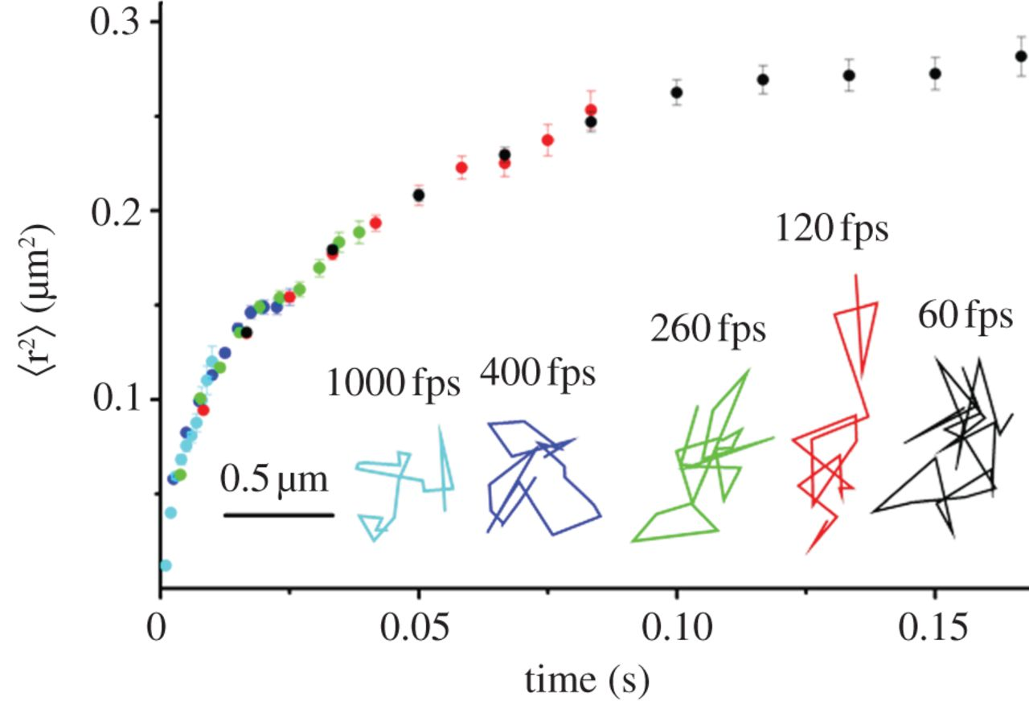
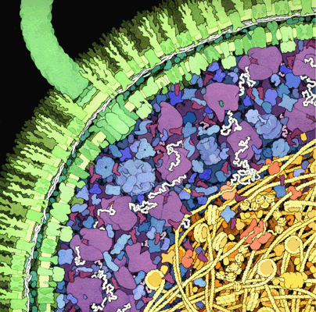
Motivation
Averaged mean square displacement of free GFP in the cytoplasm of E. coli.
cross-section of a small portion of an E. coli cell
Ken Ritchie et al. Phil. Trans. R. Soc. B 2013
Portion of an E. coli cell. Image courtesy of David Goodsell.

Slide 4
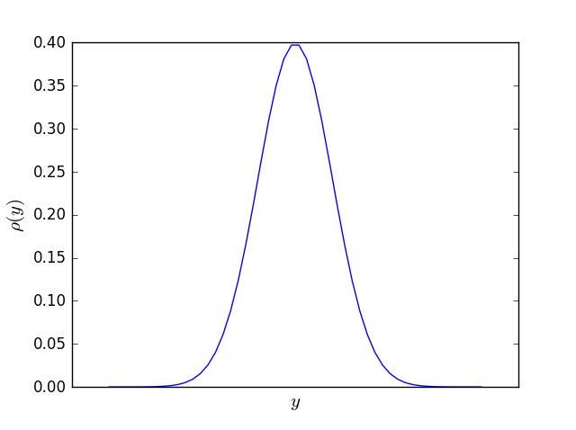
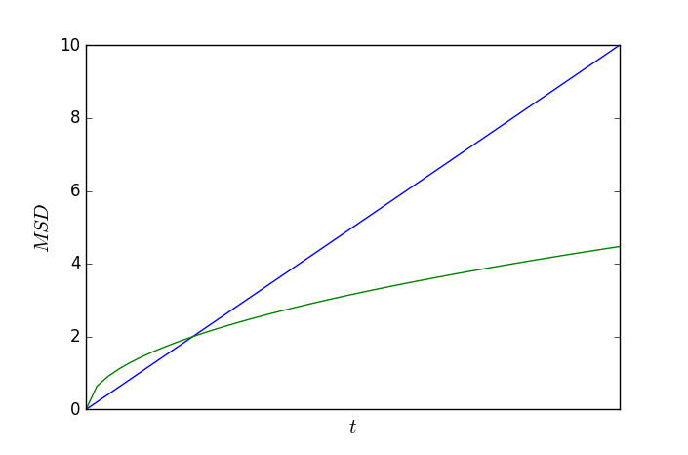
Normal Diffusion
Central Limit Theorem
For independent and identically distributed (i.i.d.) random variable with and
Normal Distribution
Normal Diffusion
Normal Diffusion
Drop Independence!
Assumption: i.i.d. random variables and Linear response:
Continuity Equation:
=> Brownian motion

Slide 5
Anomal Diffusion With Fractional Brownian Motion
Fractional Brownian Motion:
Gaussian Propagator:
Velocity Autocorrelation Fnction (VACF):
Frequency representation of VACF of fBM
Interesting Properties of fBM:
(interesting for analysis of algorithm)
Scale Free Propagator:
with
Non-Gaussian Parameter:
Non-Markovian !

Slide 6
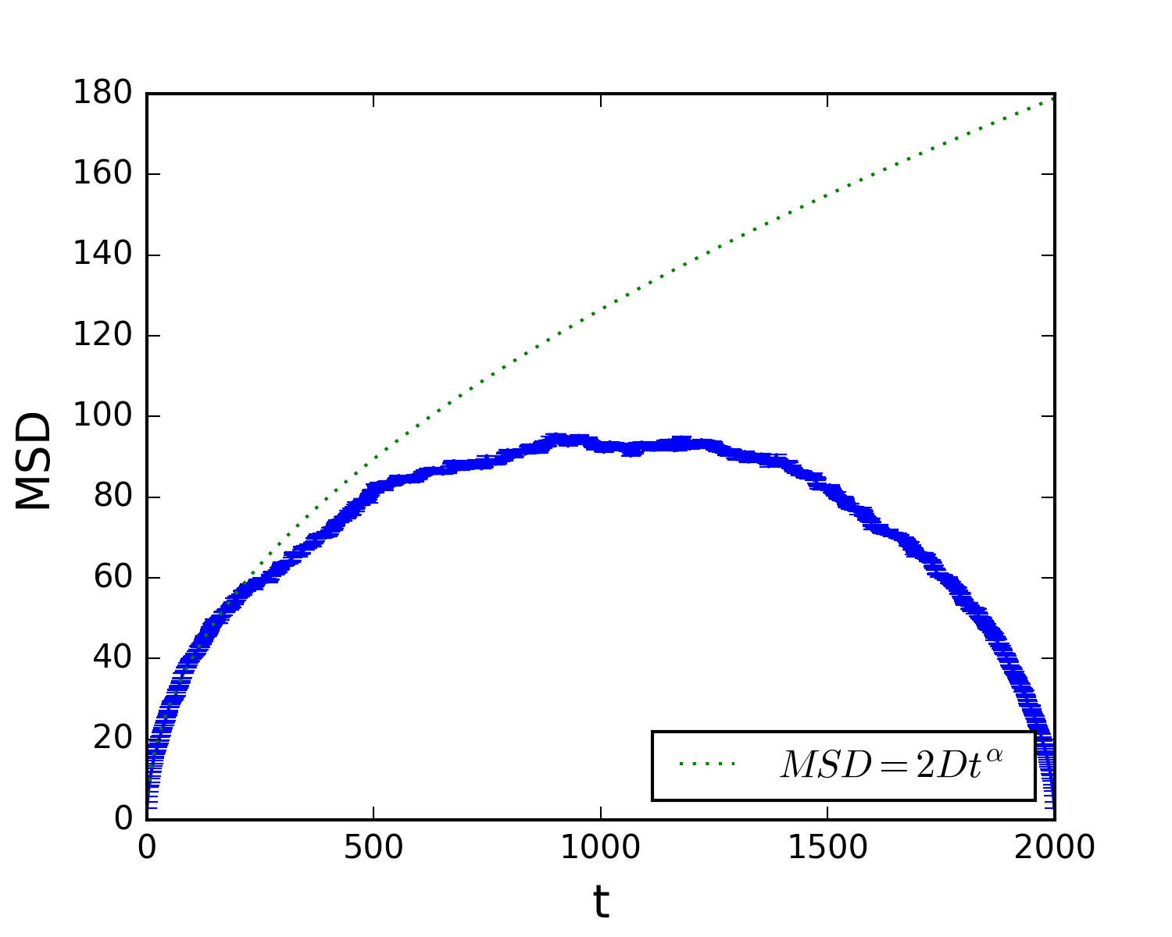
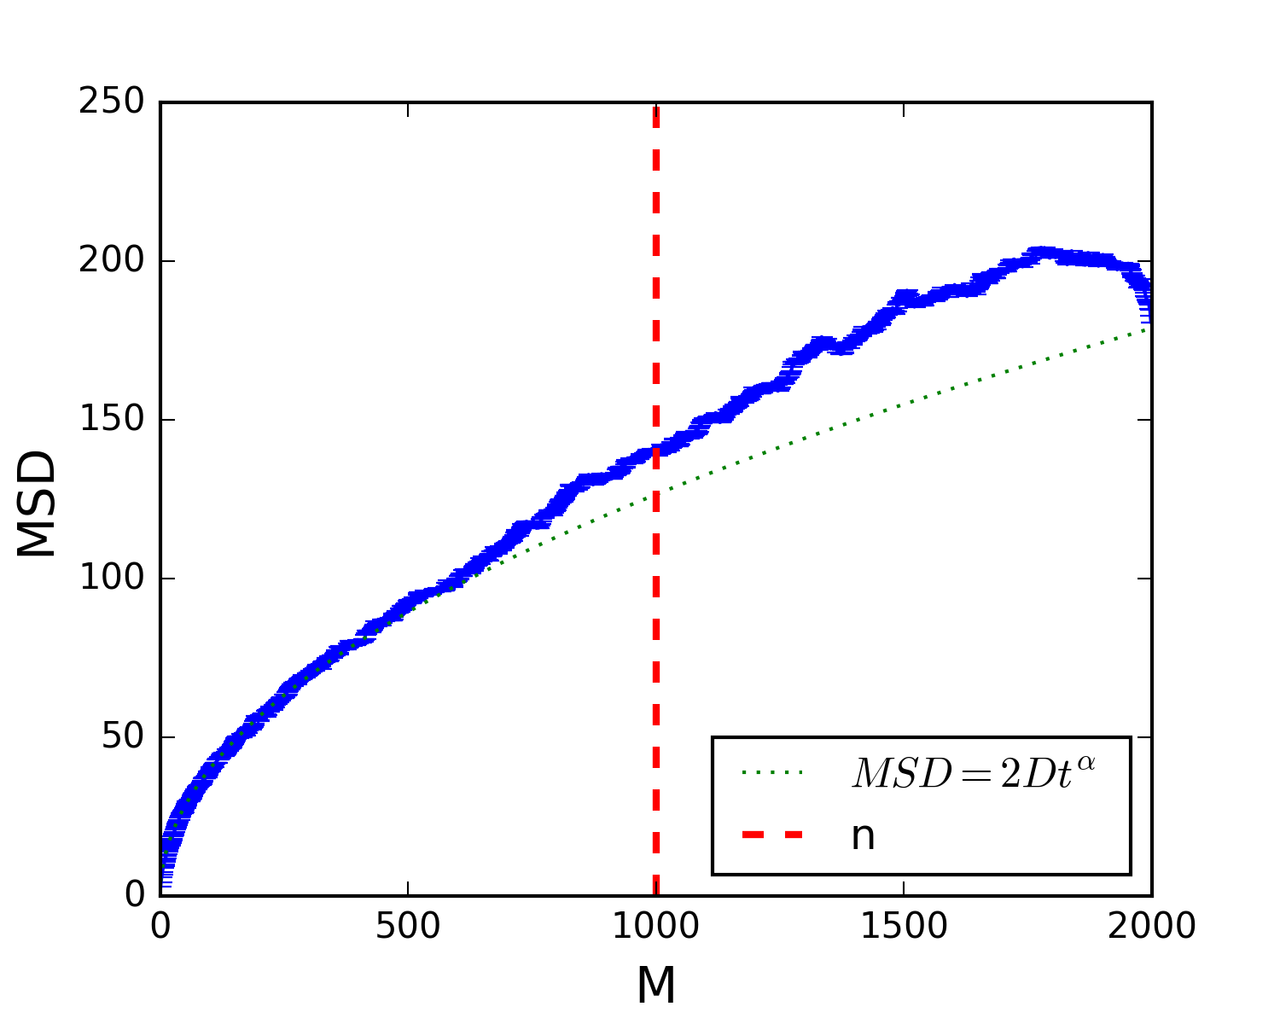
Algorithm
Velocity is the random Variable:
FBM: BM:
Decomposition in Fourier Modes:
Wiener-Khinchin:
Artificial Modification of the Power Spectrum:
Fourier Backtransform:
Discrete: and
1. with
2. finite time Problem
3. Problem:
4. Markovian: not true
5.
6. with
Finite Size Problem

Slide 7
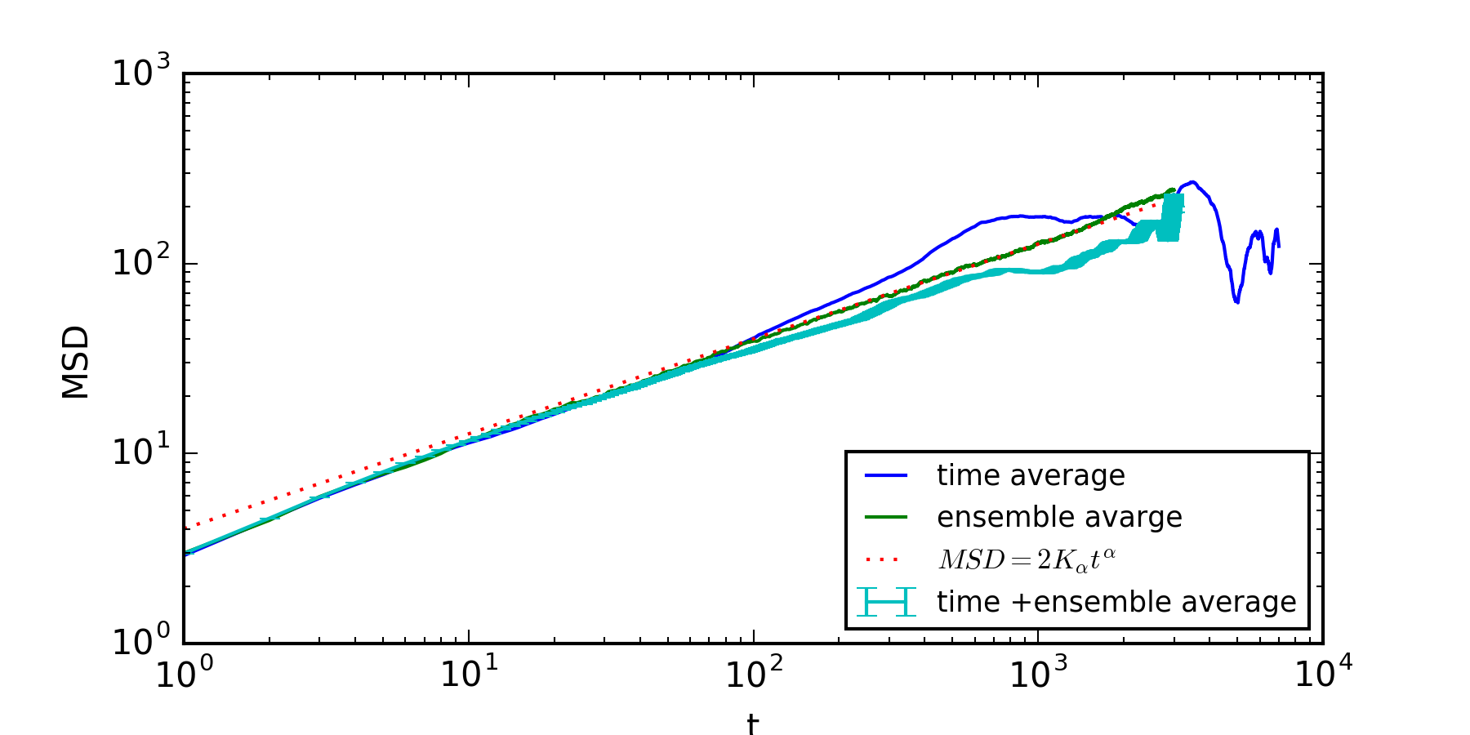
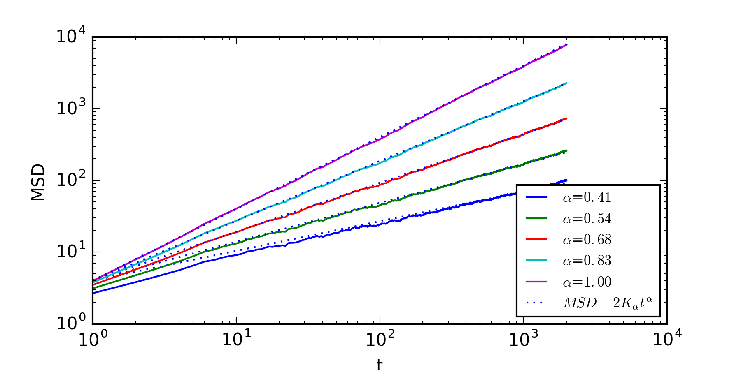
Testing of Algorithm
Mean Square Displacement
no obvious ergodicity breaking
Short lag time problem
Short lag time problem increases with higher
For normal diffusion
error disappears

Slide 8
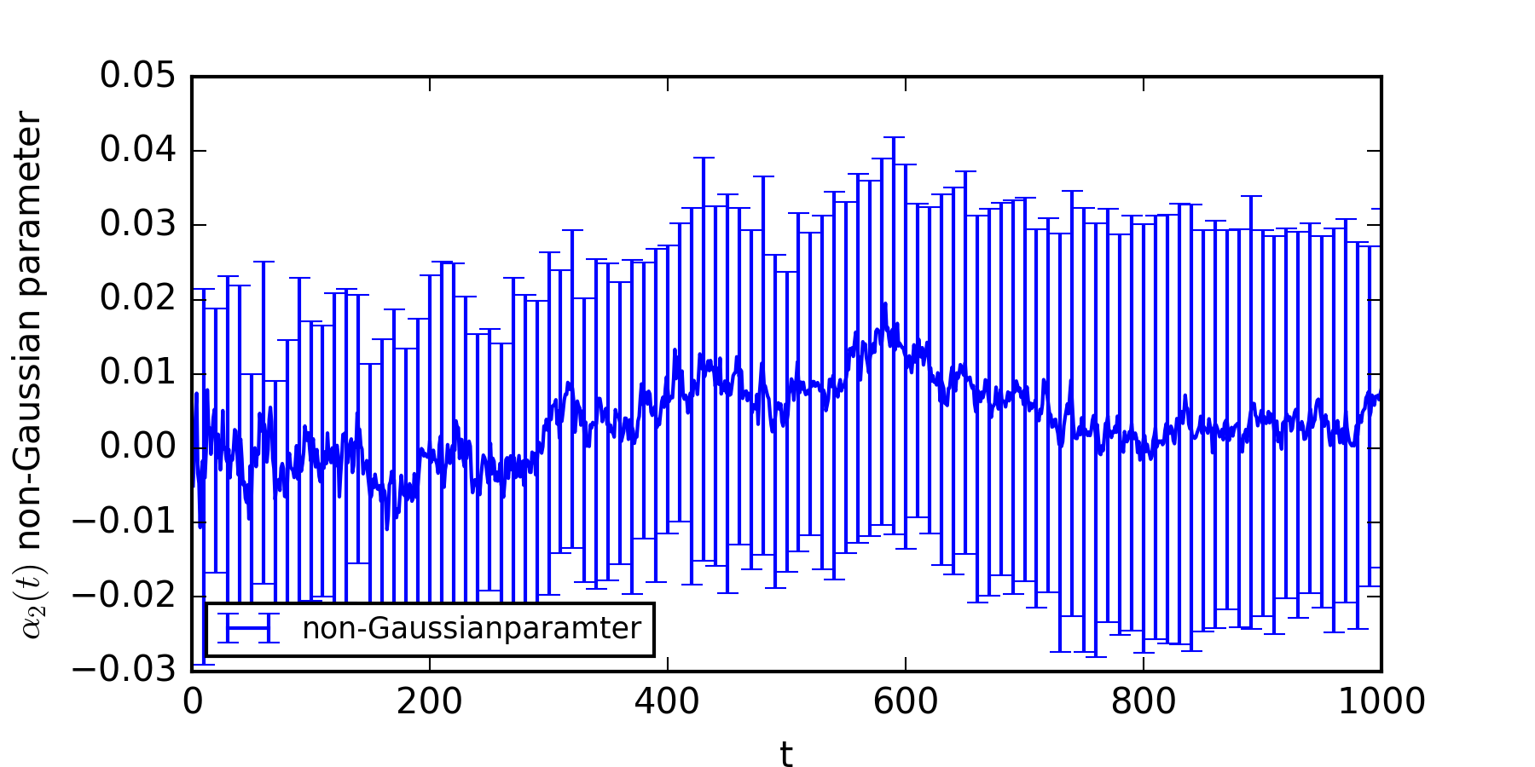
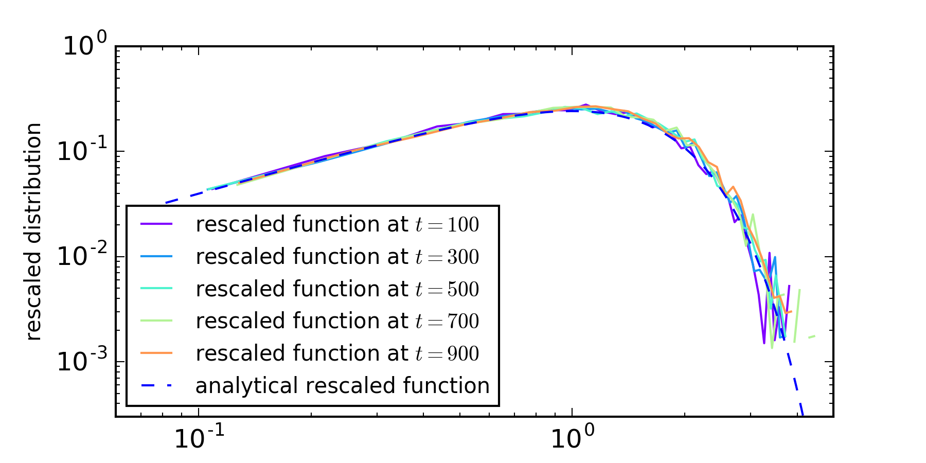
Testing of Algorithm
Non-Gaussian Parameter
Propagator seams Gaussian
Scale Free Form of Propagator

Slide 9
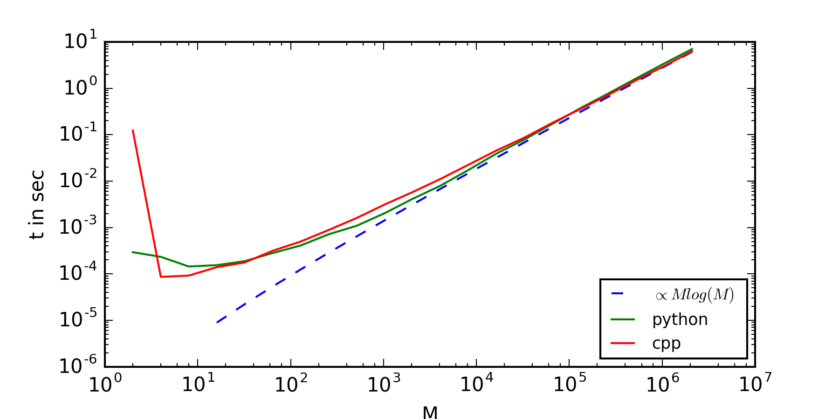
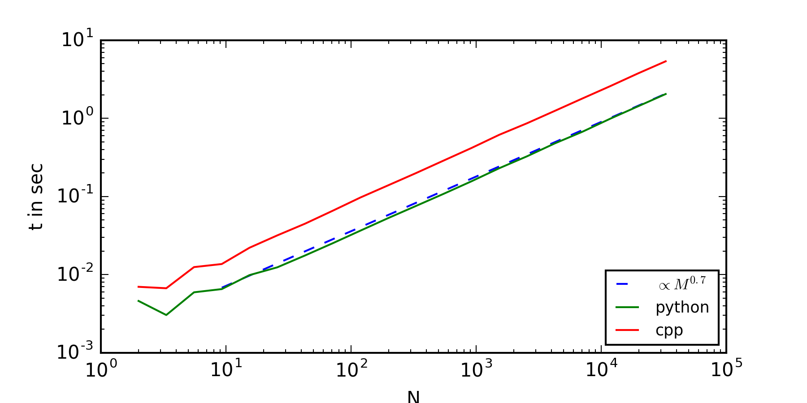
Algorithmic Scaling
Mean Square Displacement
no obvious ergodicity breaking
Short lag time problem
Short lag time problem increases with higher
For normal diffusion
error disappears

Slide 10
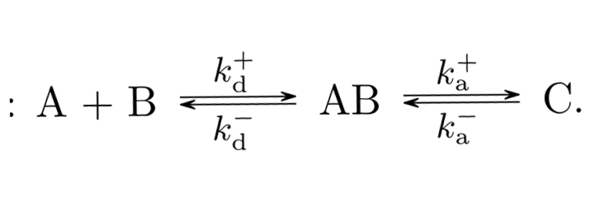
Chemical Reactions
Bi-Molecular Reactions
Smoluchowski Equation:
diffusion-based reaction rate constants
intrinsic Reaction rate constants

Slide 11
Chemical Reactions
diffusion-based reaction rate constants
Bi-molecular reactions in solution:
Chemists measure typically reaction rates which are combination of and
Diffusion-controlled bi-molecular reactions in solution :
Smoluchowski Equation:
intrinsic Reaction rate constants

Slide 12
RevReady

Slide 13
Results: Simulation of “Enzymatic” Reactions

Slide 14
Outlook

Slide 15
Vielen Dank für eure Aufmerksamkeit

