Slide 1
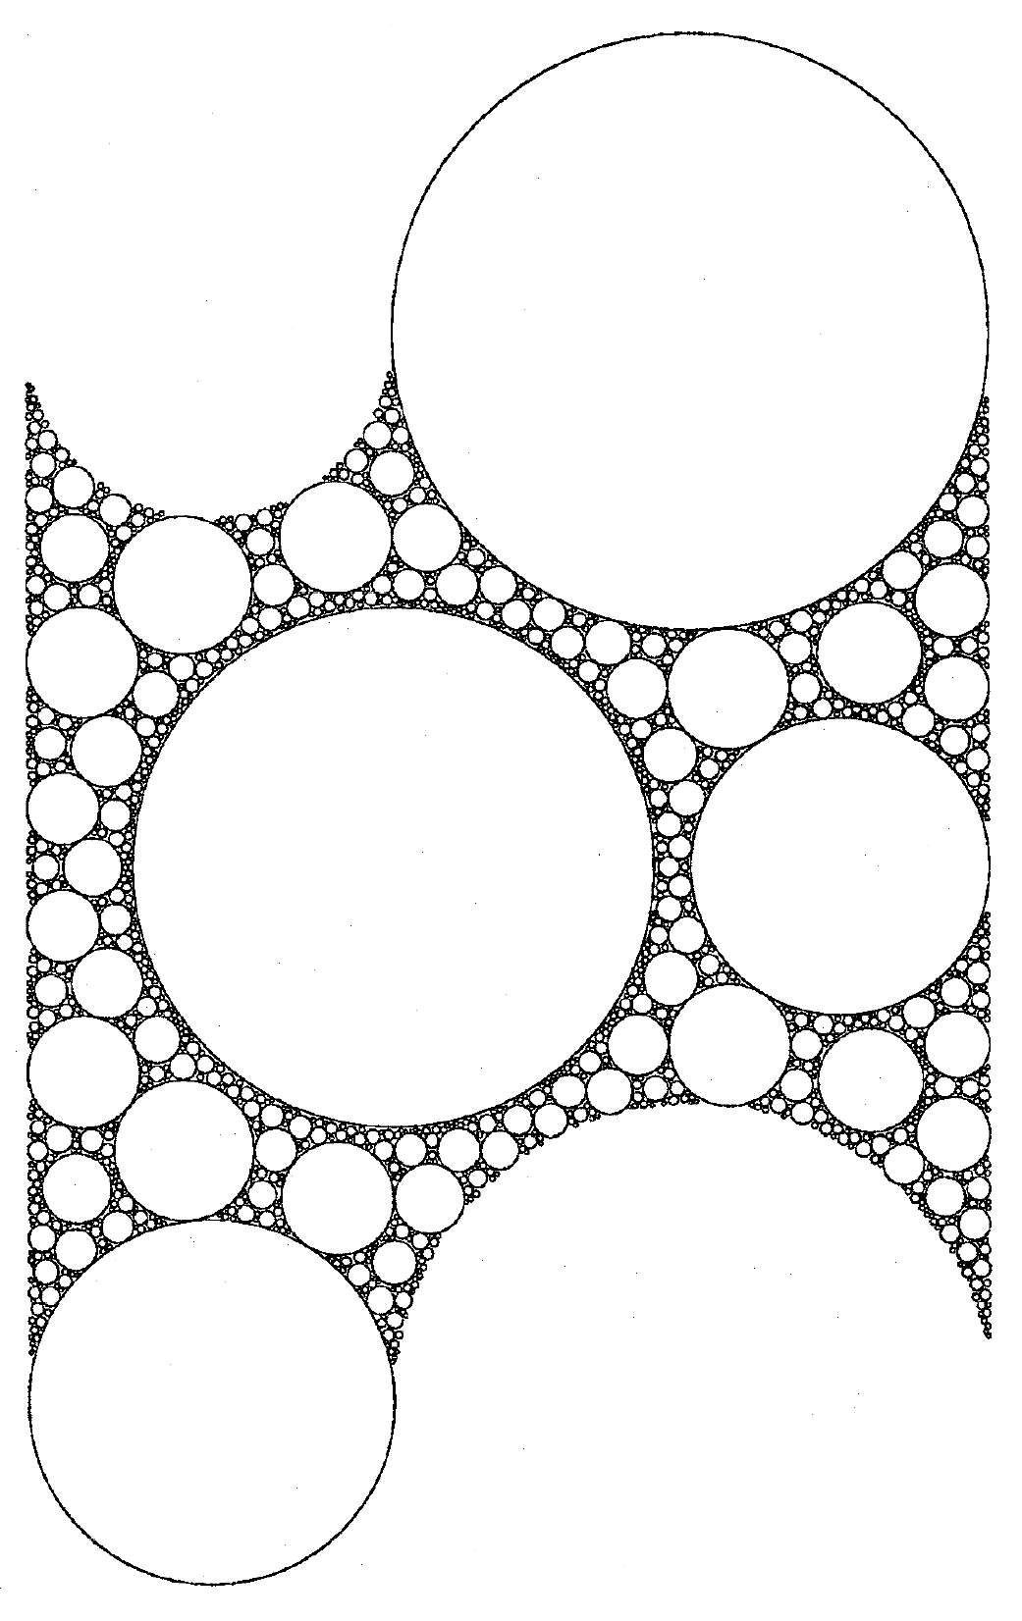
Reaction-Diffusion Dynamics with Fractional Brownian Motion
hans-herrmann.ethz.ch

Slide 2


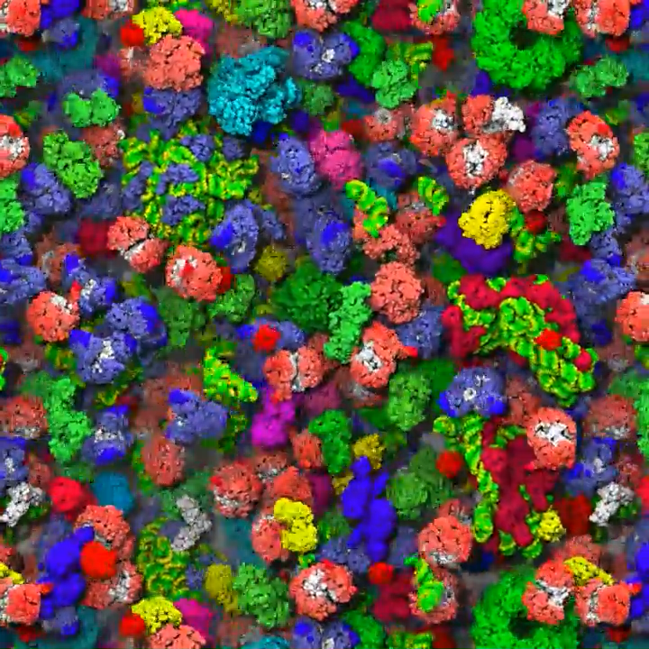
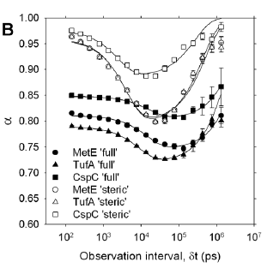
Motivation
Mean-square-displasment (MSD) for normal diffusion:
MSD for anomalous diffusion:
McGuffee SR, Elcock AH (2010) Diffusion, Crowding & Protein Stability in a Dynamic Molecular Model of the Bacterial Cytoplasm. PLoS Comput Biol 6(3): e1000694. doi:10.1371/journal.pcbi.1000694

Slide 3
Motivation
Mean-square-displasment (MSD) for normal diffusion:
MSD for anomalous diffusion:
McGuffee SR, Elcock AH (2010) Diffusion, Crowding & Protein Stability in a Dynamic Molecular Model of the Bacterial Cytoplasm. PLoS Comput Biol 6(3): e1000694. doi:10.1371/journal.pcbi.1000694

Slide 4
Outline
Enzymatic Kinetics with Normal Diffusion
Fractional Brownian Motion
Anomalous Reaction Kinetics

Slide 5






Erban-Chapman Bi-molecular Reaction
Bi-molecular mechanism:
Reaction-diffusion equation:
- the distribution of substrates with distance away from the enzyme.
- the Heaviside step function, - the flux ,
- the sum of diffusion constants of substrates and enzymes
- reaction distance
diffusion reaction

Slide 6




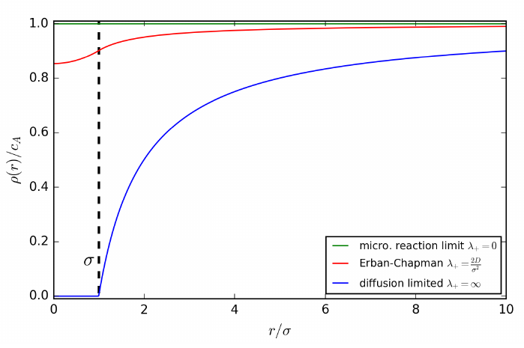
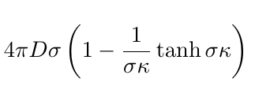




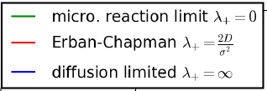


Erban-Chapman Bi-molecular Reaction
The stationary distribution for a single enzyme and constant concentration of substrates at infinity:
Solution for reaction kinetics:
reaction limited by diffusion:
reactions limited by
microscopic reaction rate:

Slide 7
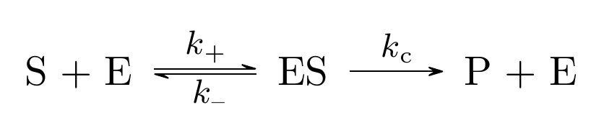
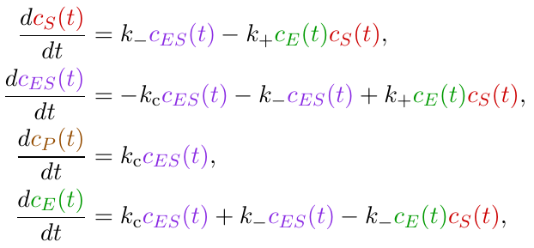


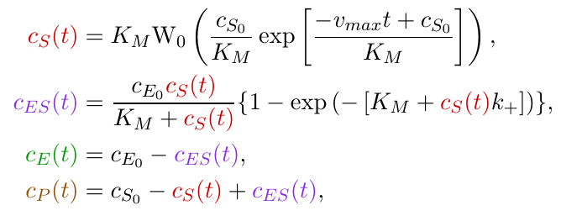


Enzymatic Reactions
Michaelis-Menten mechanism:
A closed solution with the quasi-steady state approximation ( ) for :
with , and the Lambert W function with

Slide 8












Simulation Model
parameters
Two Reactions:
Units of length : ; Units of time:
Length of simulation box with periodic boundary conditions:
Initial concentration of reactants: , , =0 , =0
Enzyme position: center of simulations box substrates positions : uniformly distributed
Diffusion constant for substrate:
Time step:
Length of trajectory:
Number of simulations per scenario: N > 2000
,
with microscopic rates:
,
,
constants

Slide 9







Observables
Number of substrates, enzymes, product, reactions forward:
Radial distribution function of substrates around enzymes:
Macroscopic reaction rate forward:
,
,
,

Slide 10
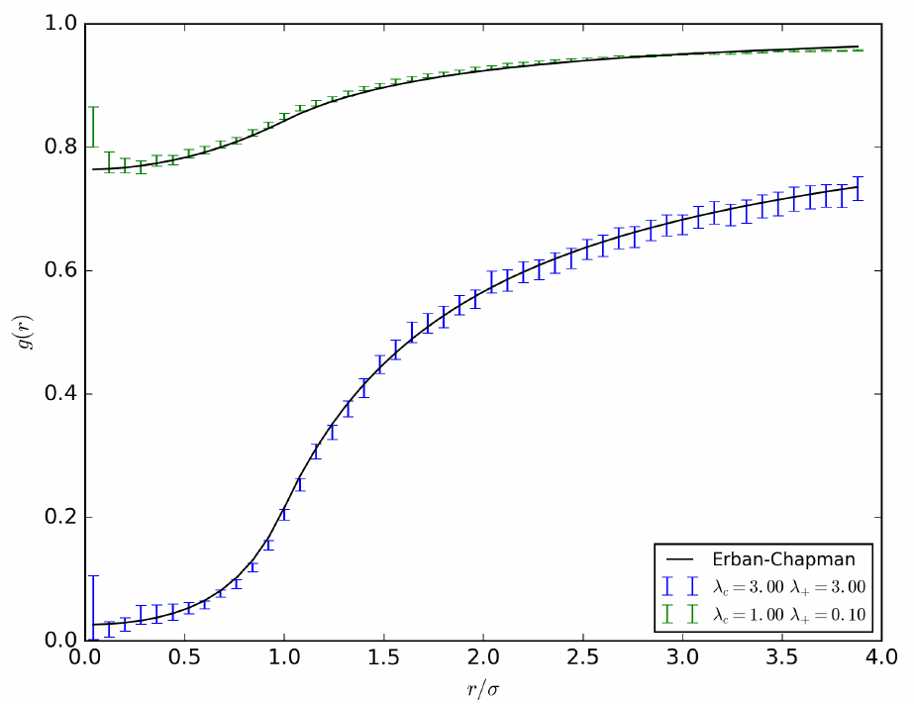

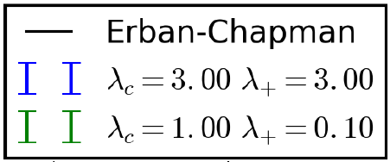


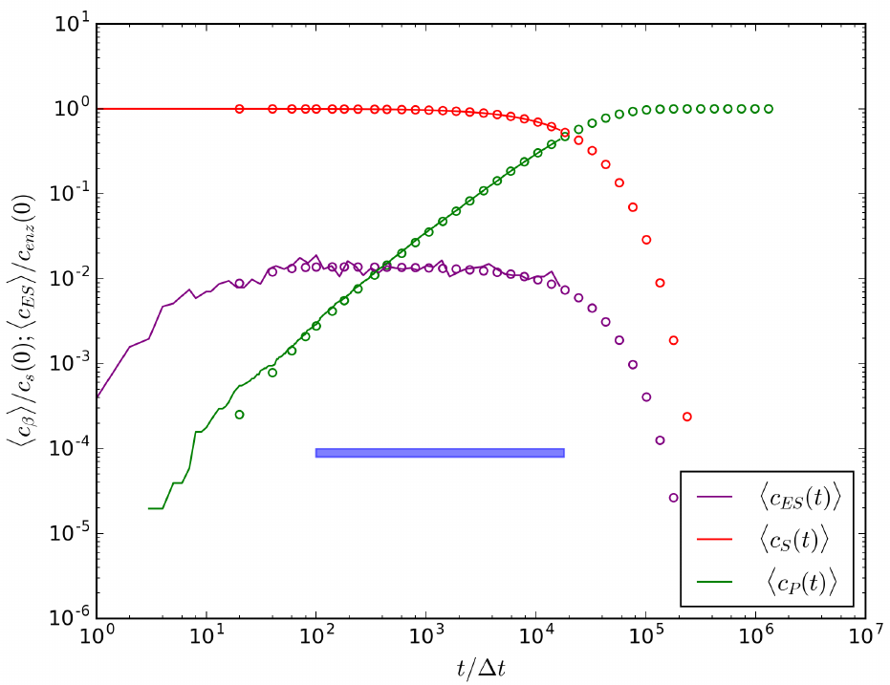
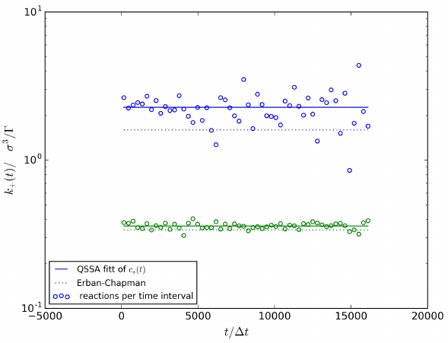


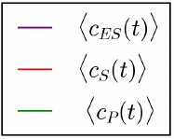


One-Way Reaction
Scenarios:
One-way “diffusion-limited” reaction:
One-way “Erban-Chapman” reaction:

Slide 11

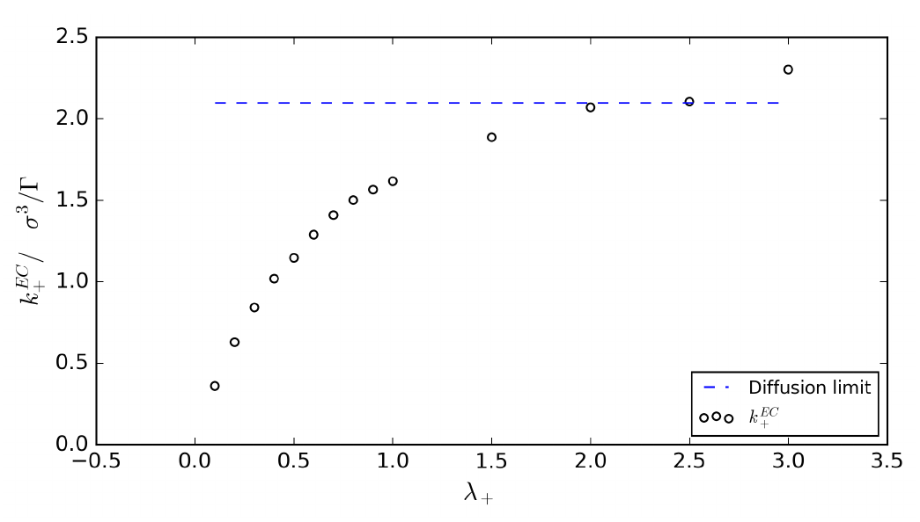
One-Way Reaction
Influence of diffusion on reaction rate:

Slide 12

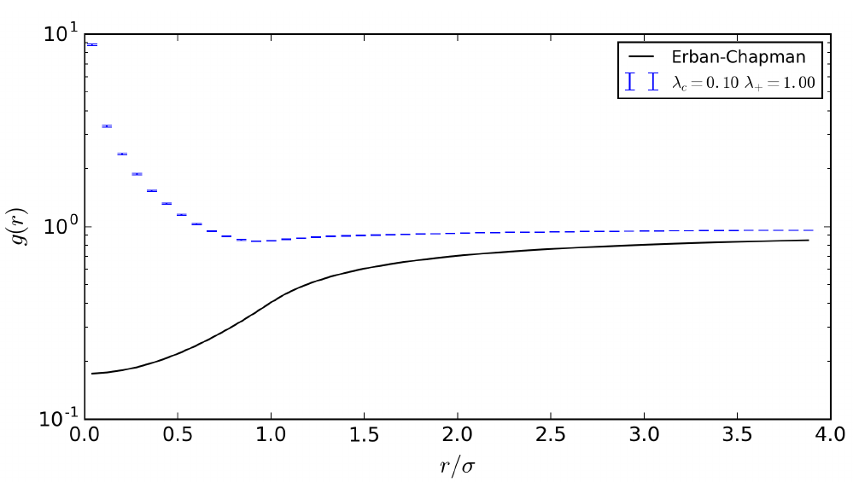



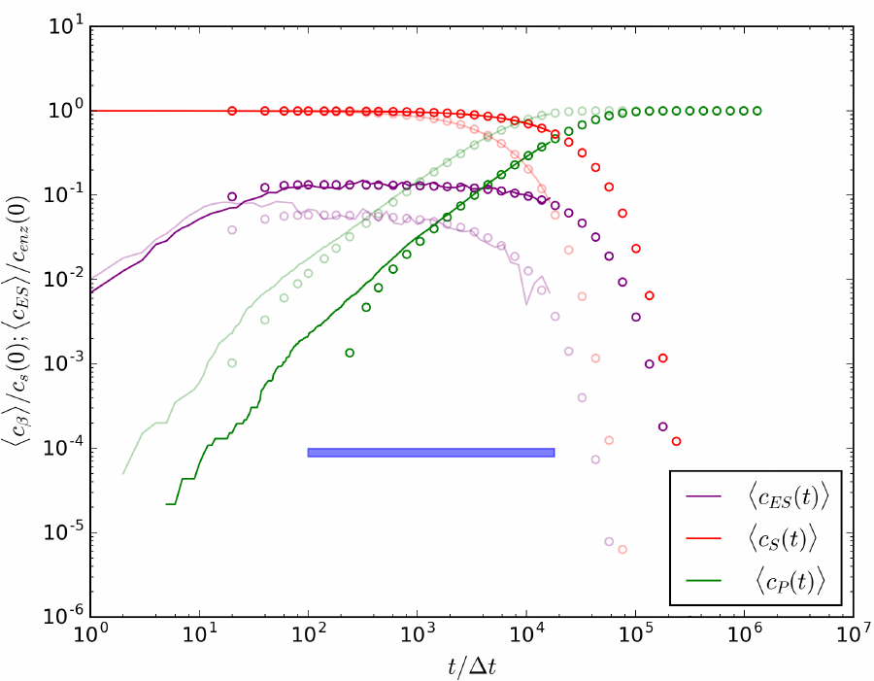

Michaelis-Menten Mechanism
Scenarios:
  One-way “enzyme blocking” reaction:
  The “enzyme blocking“ Michaelis-Menten:
transparent

Slide 13
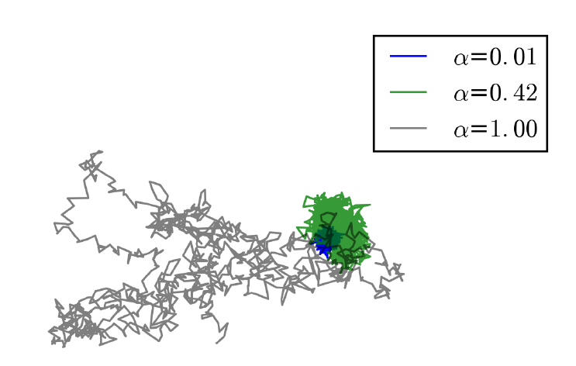
2. Fractional Brownian Motion

Slide 14
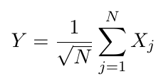




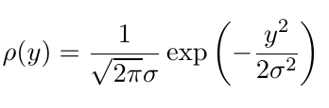
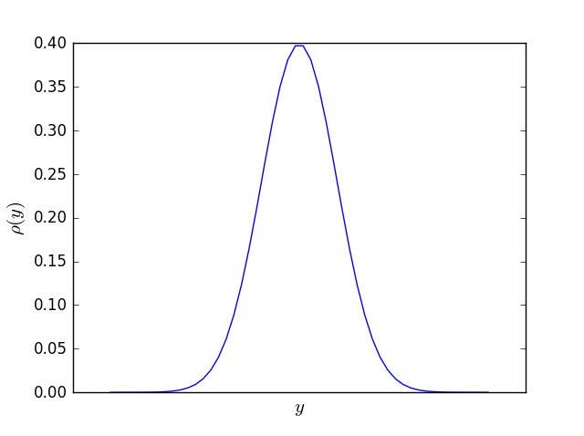
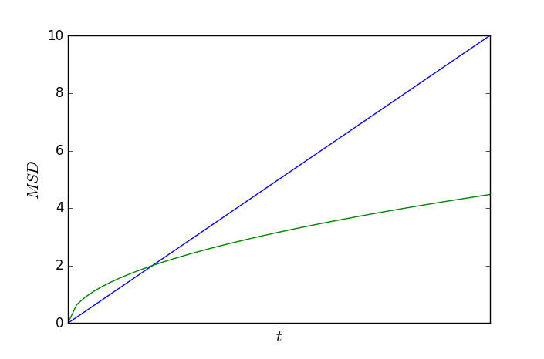
Normal Diffusion
Central Limit Theorem:
Here, independent and identically distributed (i.i.d.) random variable with and
Gaussian distribution:
Normal diffusion:
=> Wiener process
Drop Independence!
Assumption: i.i.d. random variables , and continuity equation

Slide 15



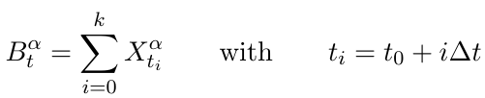





Fractional Brownian Motion and Fractional Gaussian Noise
Fractional Brownian motion is a stochastic process. It is fully specified by its mean :
and covariance function:
Power-law behavior of MSD:
Fractional Gaussian noise is a relate stationary stochastic process:
Its mean:
Its auto-covariace function:
Connection to the physical world:
Here, is the generalized diffusion coefficient of physical dimension .

Slide 16
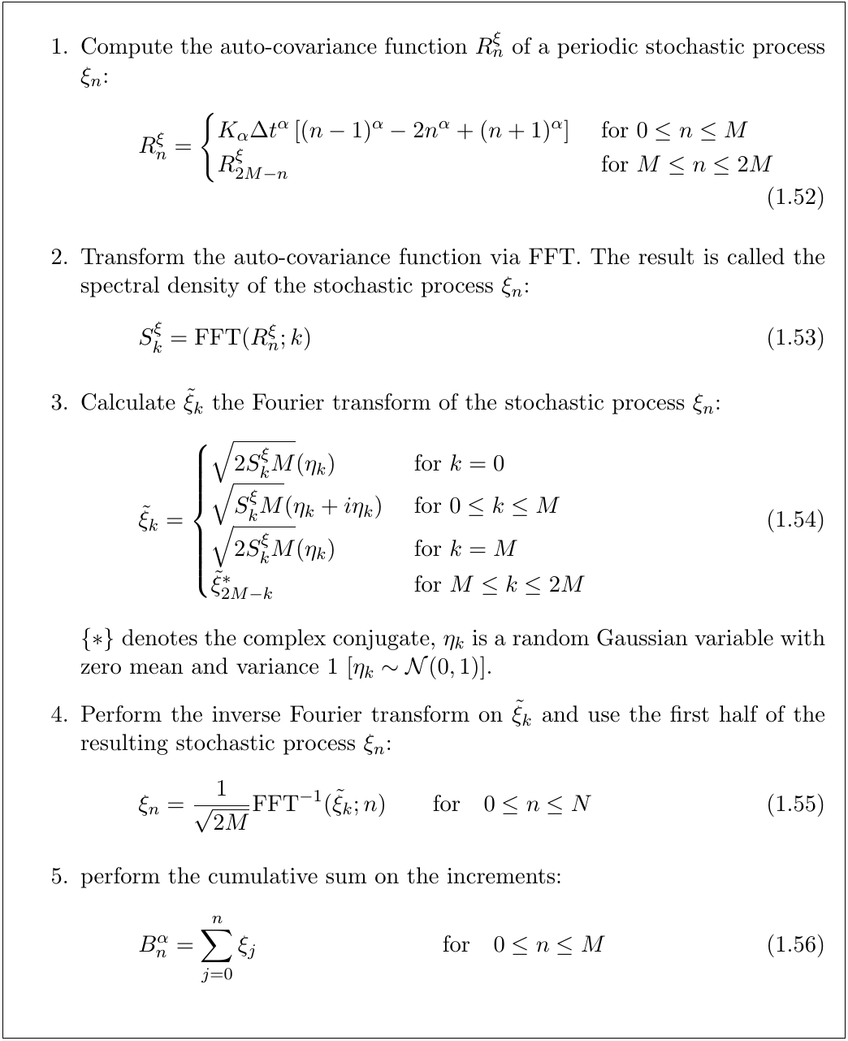
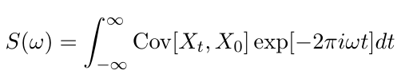
Davis-Harte Algorithm
Idea: Artificial modification of the power spectrum of a Wiener process to obtain the power spectrum of fractional Brownian noise.
Wiener-Khinchin theorem:
A wide-sense-stationary random process has a spectral decomposition given by the power spectrum of that process.
Power spectrum density:

Slide 17
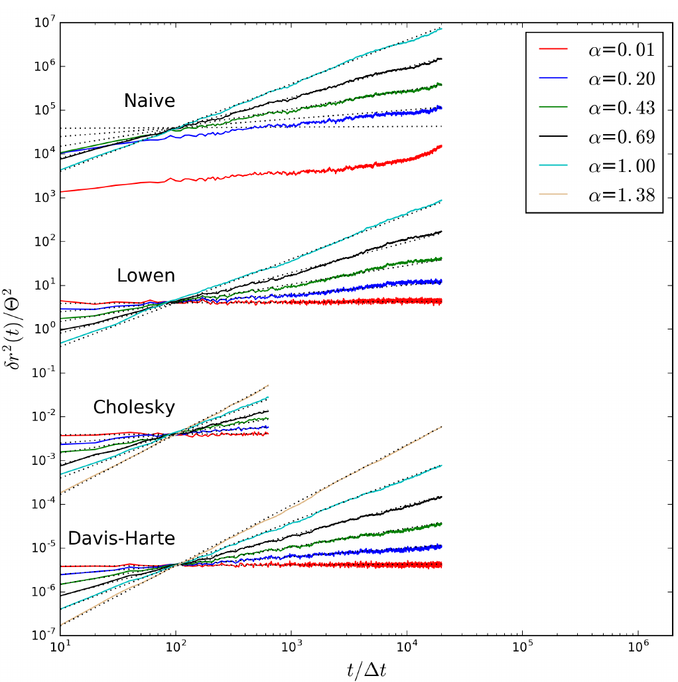

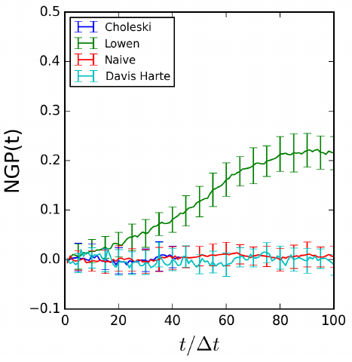



Algorithm Accuracy
Mean Square Displacement:
Non-Gaussian parameter:

Slide 18
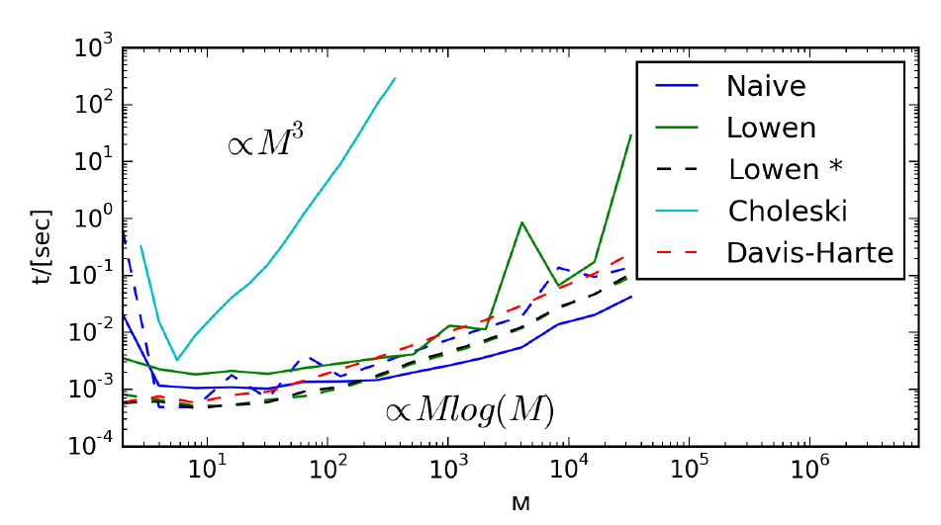
Algorithm Performance
Algorithmic scaling of computational time with the trajectory length:
Davis-Harte algorithm implemented in RevReaDDy
M

Slide 19
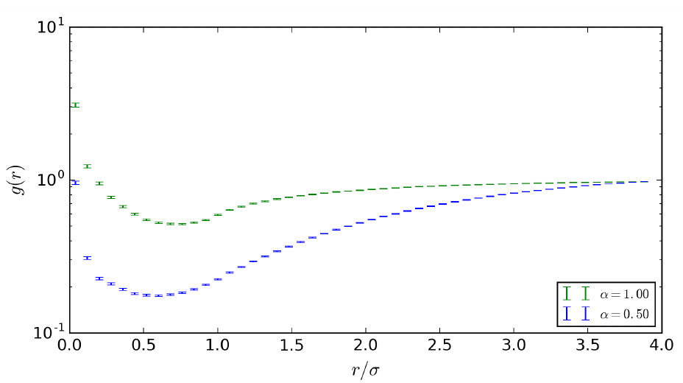



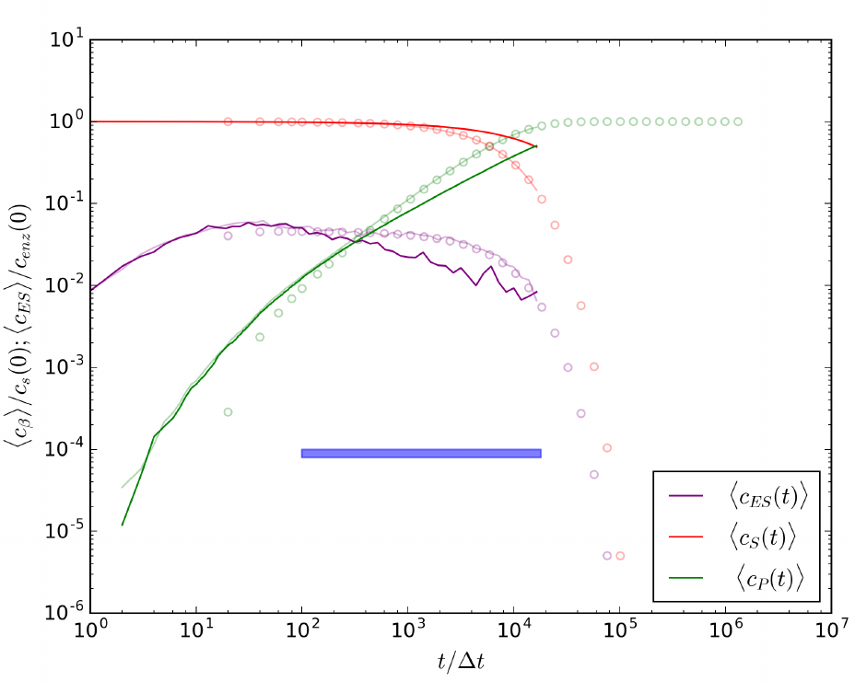



3. Anomalous Reaction Kinetics
Scenarios:
Michaelis-Menten with normal diffusion:
Michaelis-Menten with fBm:
transparent

Slide 20

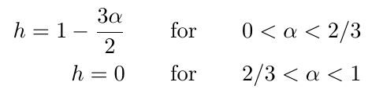
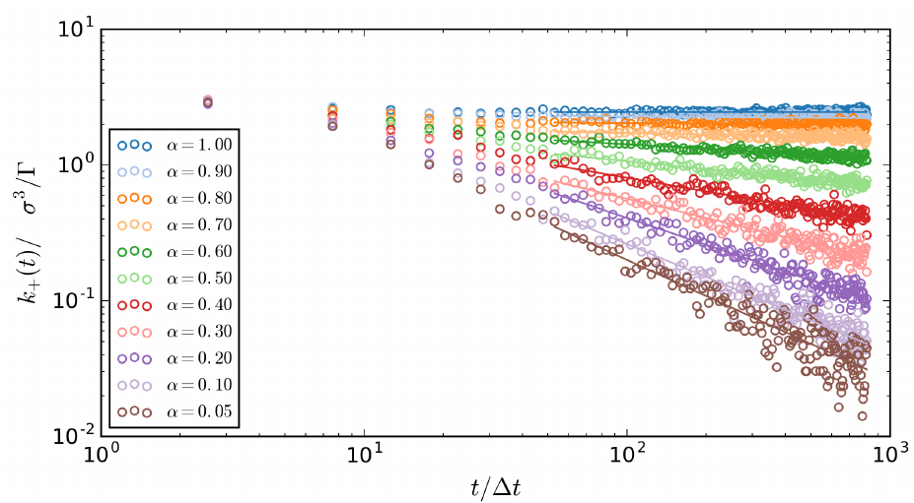
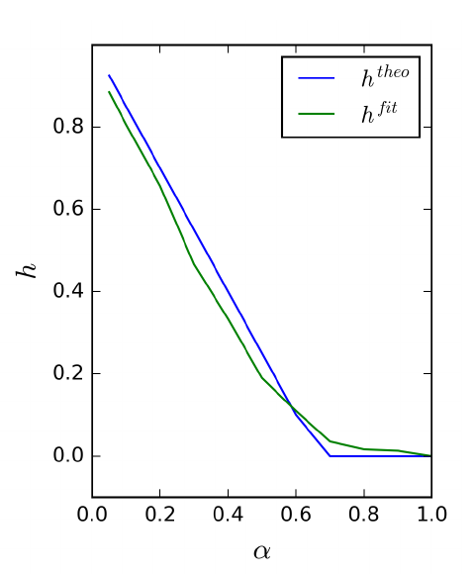
3. Fractional Reaction Kinetics
Time-dependent reaction rate:
Here, is fractional kinetics exponent.
Michaelis-Menten with fBm:
Theory for percolation cluster

Slide 21
Thank You
For Your Attention

