Slide 1
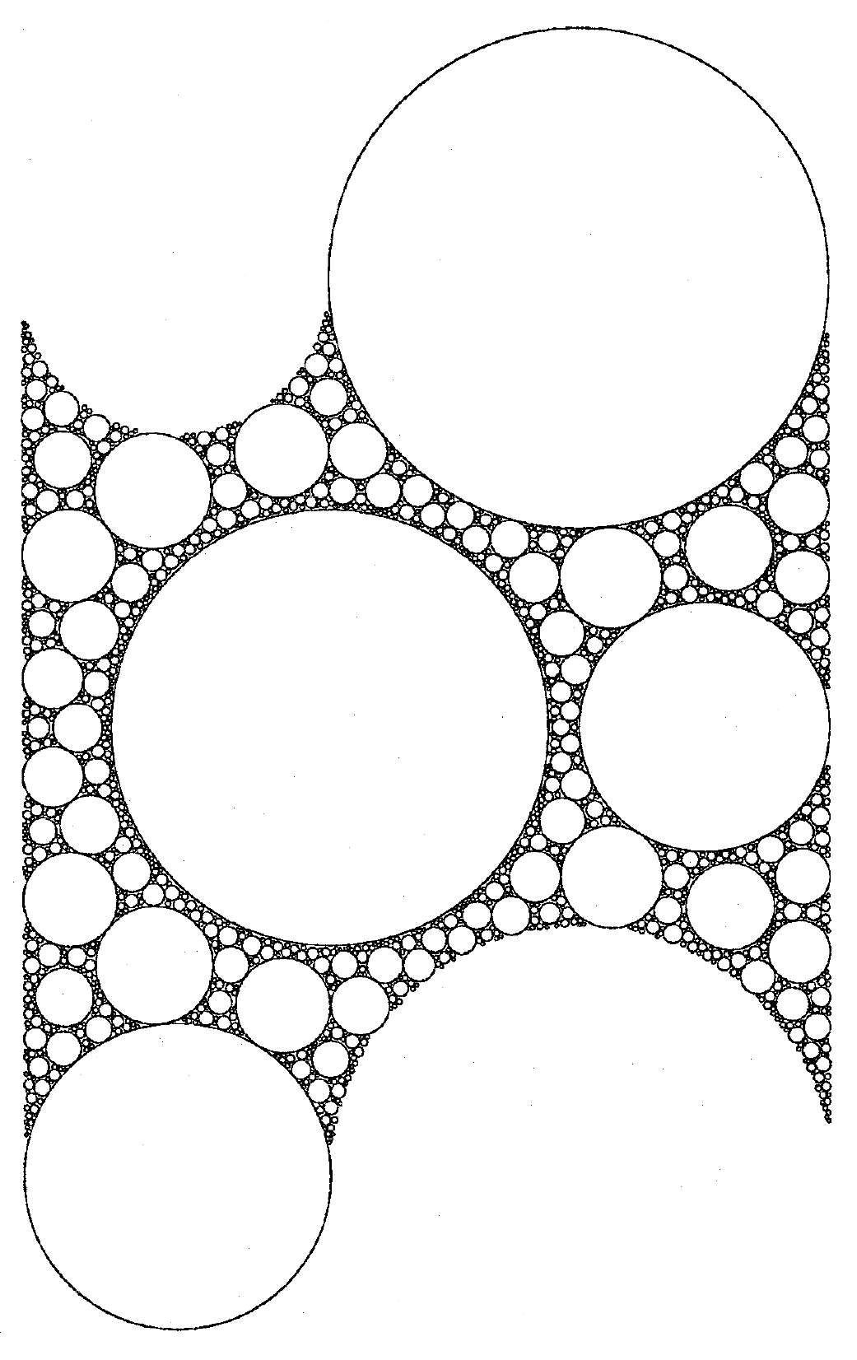
Midterm report:
Reaction-Diffusion Dynamics with Fractional Brownian motion
hans-herrmann.ethz.ch

Slide 2
Outline
Motivation
From Independent Variables to Brownian Motion
Fractional Brownian Motion
  Theory
  Algorithm
    Diffusion Reaction Dynamics
    Outlook

Slide 3
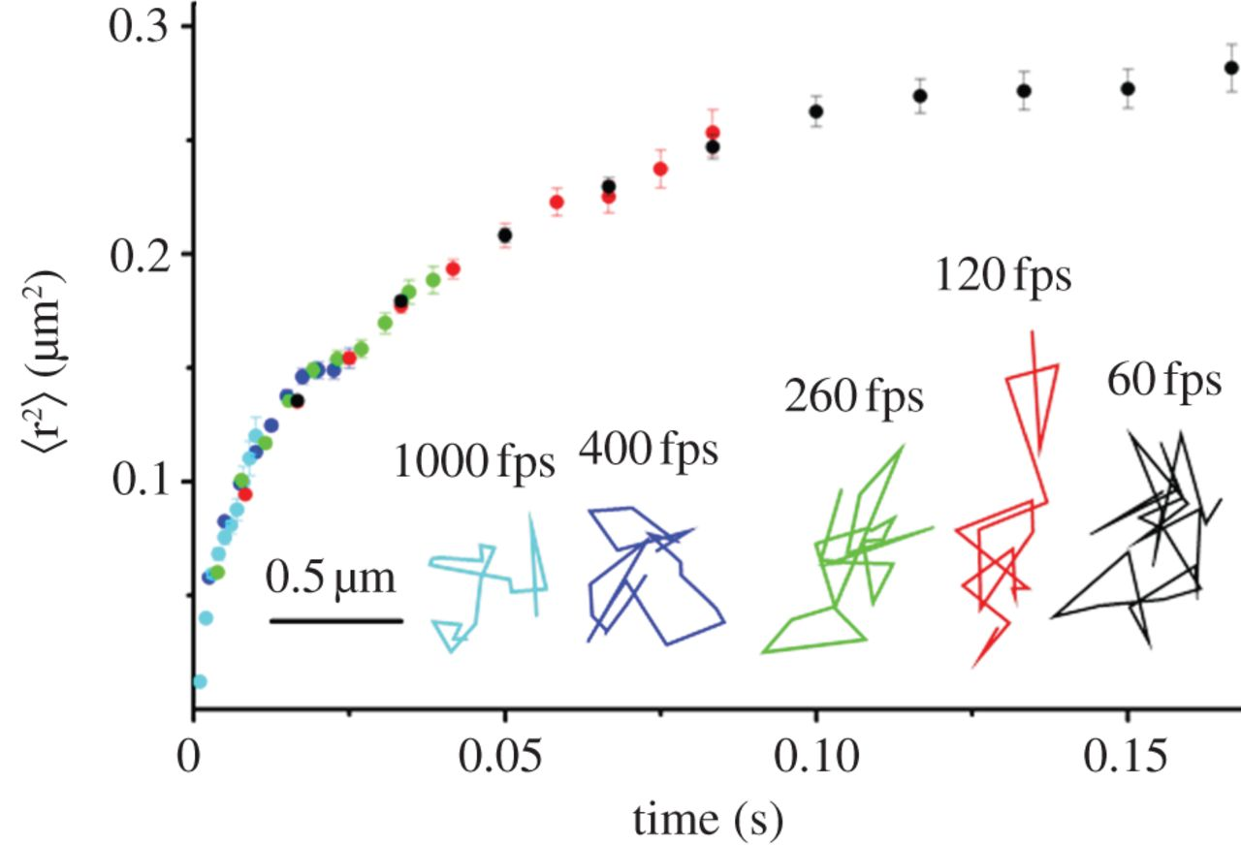
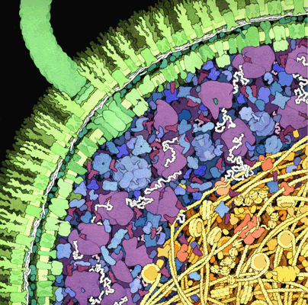
Motivation
Averaged mean square displacement of free GFP in the cytoplasm of E. coli.
cross-section of a small portion of an E. coli cell
Ken Ritchie et al. Phil. Trans. R. Soc. B 2013
Portion of an E. coli cell. Image courtesy of David Goodsell.

Slide 4
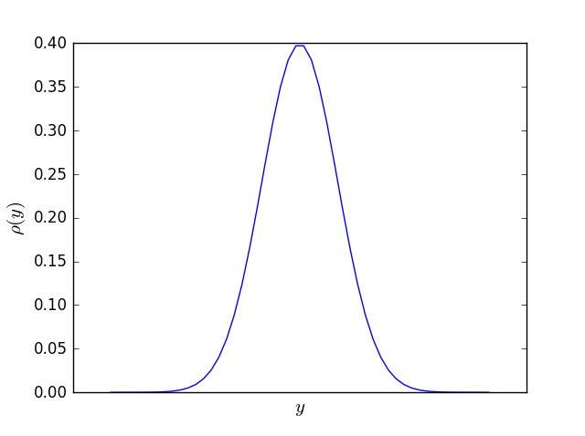
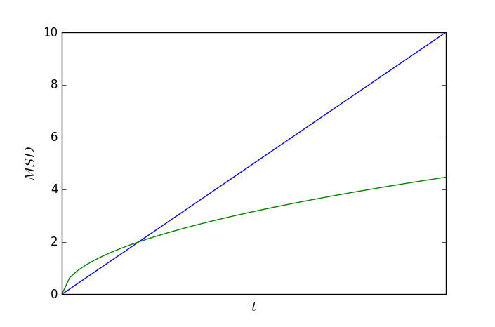
Normal Diffusion
Central Limit Theorem
For independent and identically distributed (i.i.d.) random variable with and
Normal Distribution
Normal Diffusion
Normal Diffusion
Drop Independence!
Assumption: i.i.d. random variables and Linear response:
Continuity Equation:
=> Brownian motion

Slide 5
Anomal Diffusion With Fractional Brownian Motion
Fractional Brownian Motion:
Gaussian Propagator:
Velocity Autocorrelation Fnction (VACF):
Frequency representation of VACF of fBM
Interesting Properties of fBM:
(interesting for analysis of algorithm)
Scale Free Propagator:
with
Non-Gaussian Parameter:
Non-Markovian !

Slide 6
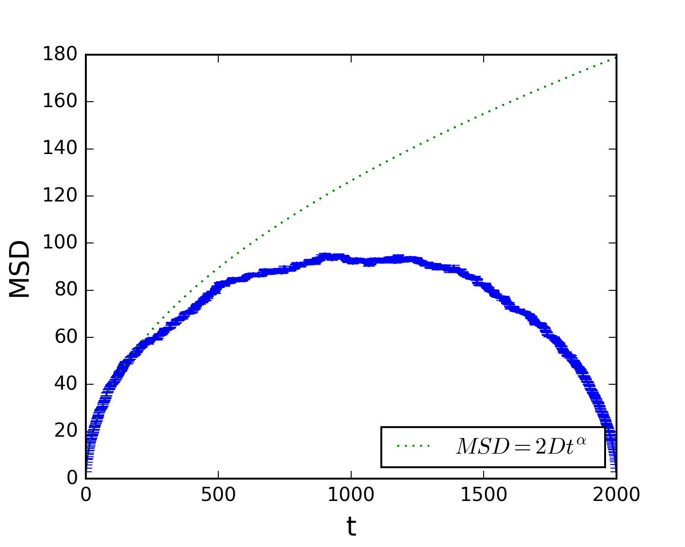
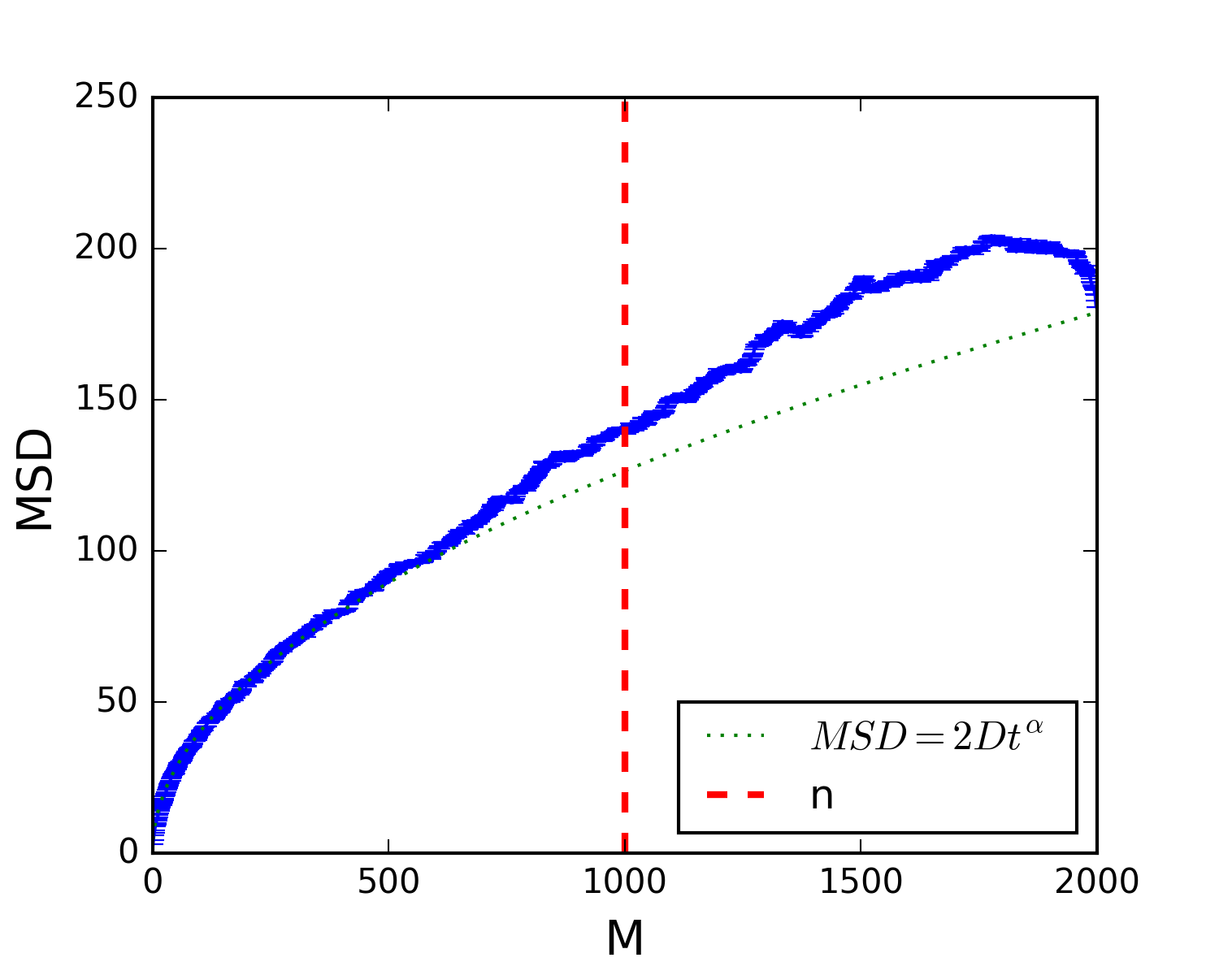
Algorithm
Velocity is the random Variable:
FBM: BM:
Decomposition in Fourier Modes:
Wiener-Khinchin:
Artificial Modification of the Power Spectrum:
Fourier Backtransform:
Discrete: and
1. with
2. finite time Problem
3. Problem:
4. Markovian: not true
5.
6. with
Finite Size Problem

Slide 7
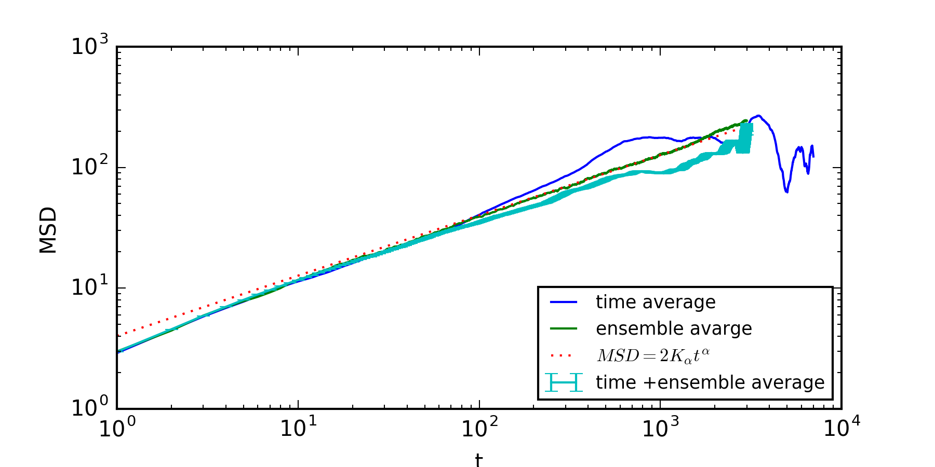
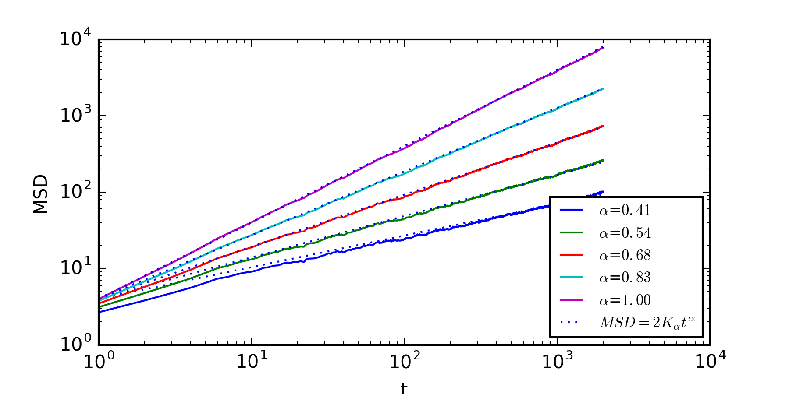
Testing of Algorithm
Mean Square Displacement
no obvious ergodicity breaking
Short lag time problem
Short lag time problem increases with higher
For normal diffusion
error disappears

Slide 8
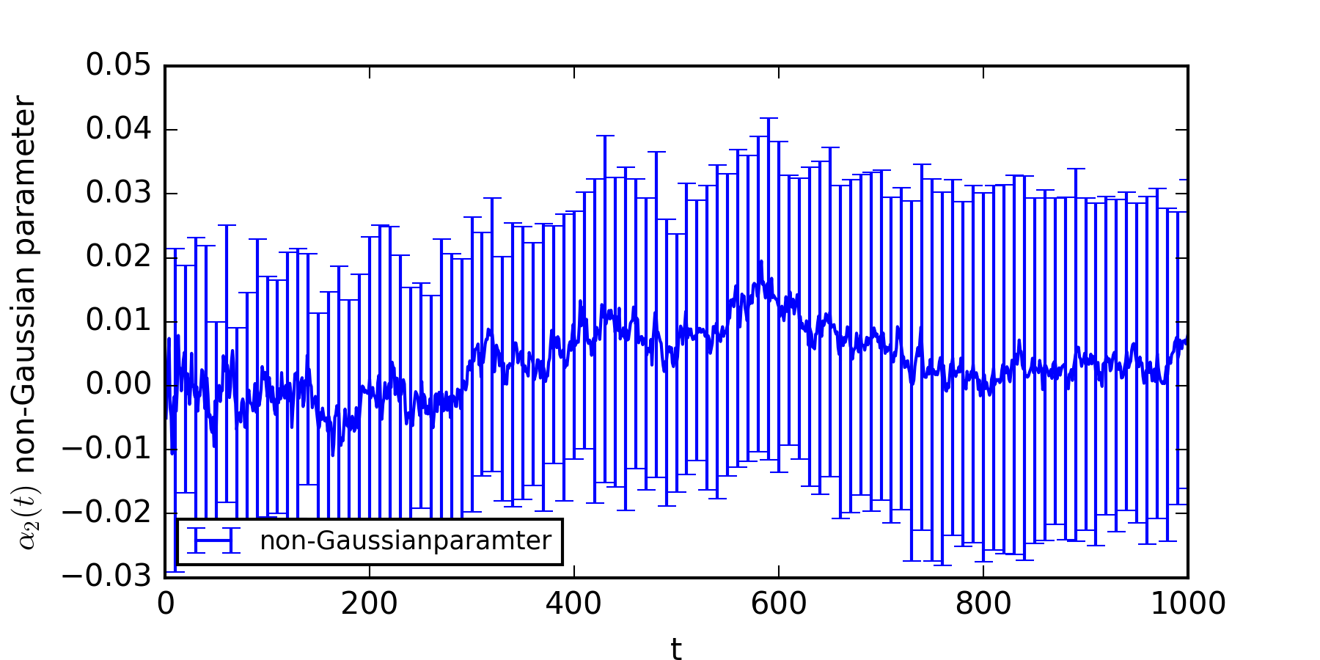
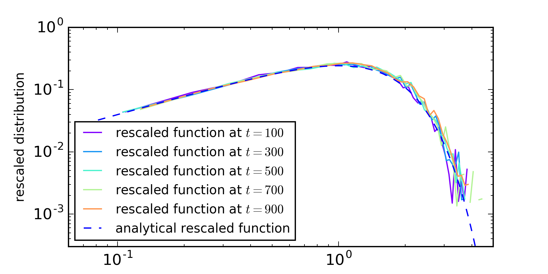
Testing of Algorithm
Non-Gaussian Parameter
Propagator seams Gaussian
Scale Free Form of Propagator

Slide 9
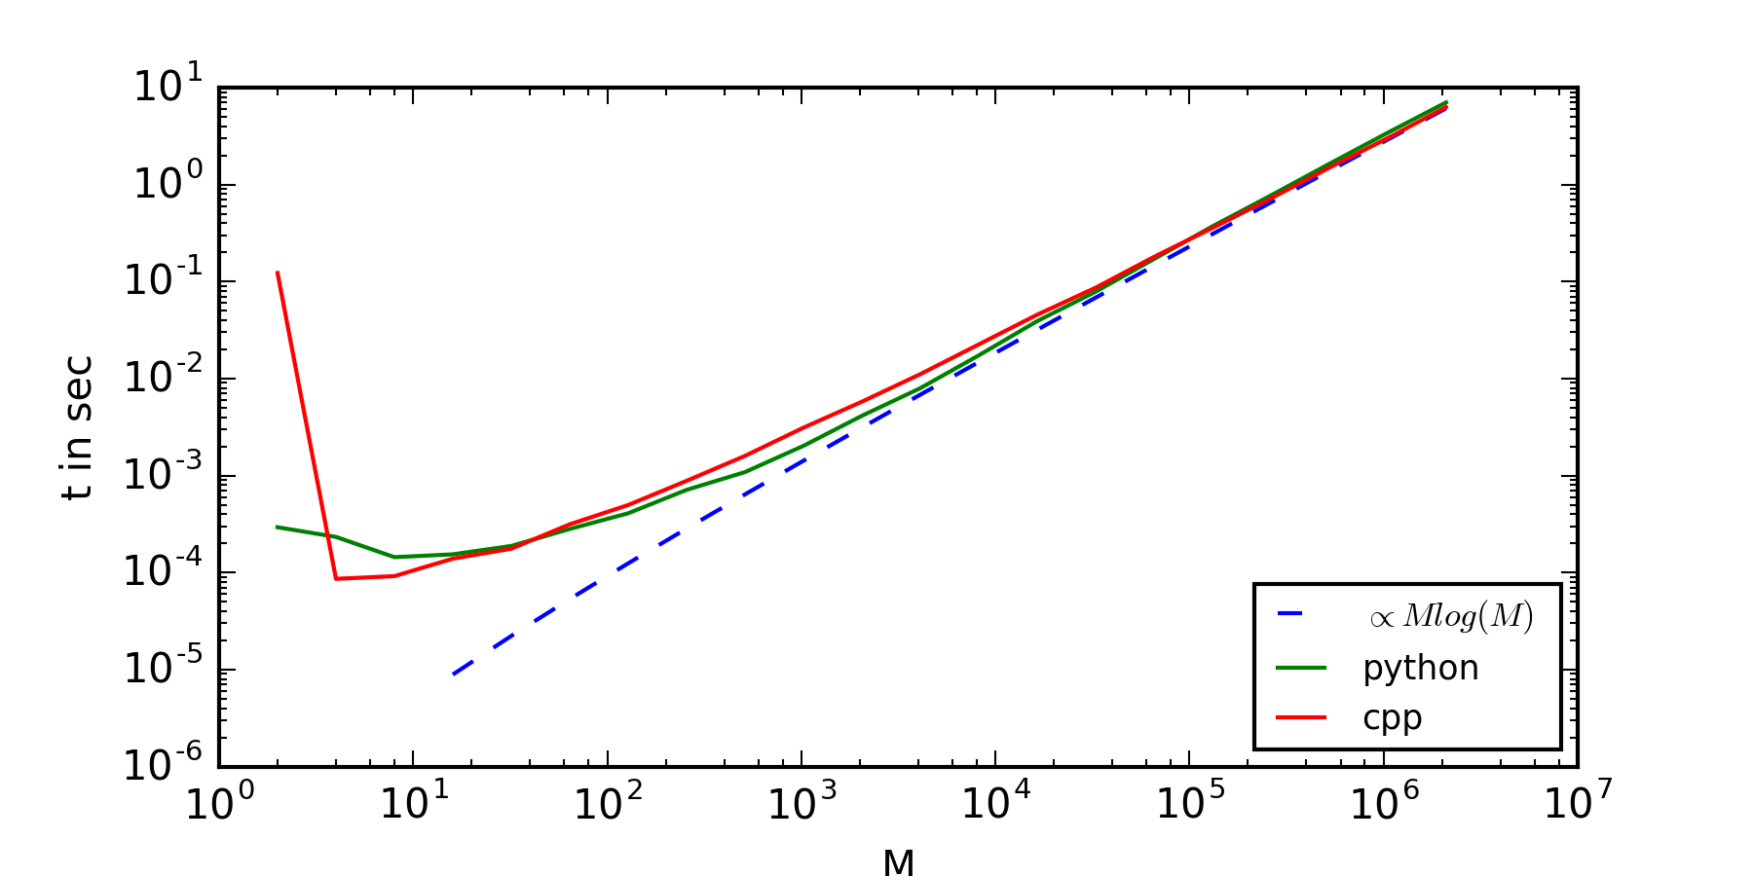
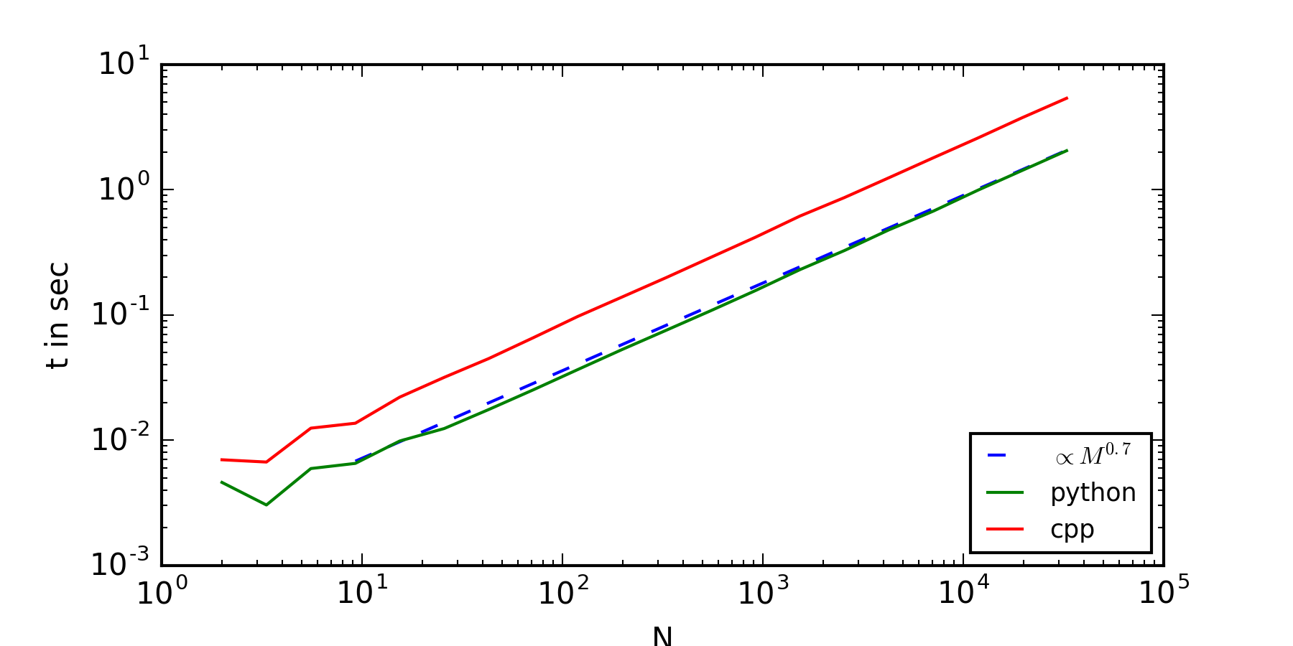
Algorithmic Scaling
Mean Square Displacement
no obvious ergodicity breaking
Short lag time problem
Short lag time problem increases with higher
For normal diffusion
error disappears

Slide 10
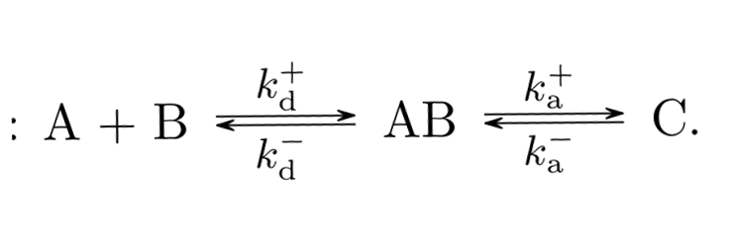
Chemical Reactions
Bi-Molecular Reactions
Smoluchowski Equation:
diffusion-based reaction rate constants
intrinsic Reaction rate constants

Slide 11
Chemical Reactions
diffusion-based reaction rate constants
Bi-molecular reactions in solution:
Chemists measure typically reaction rates which are combination of and
Diffusion-controlled bi-molecular reactions in solution :
Easy system solvable analytically:
Smoluchowski Equation:
intrinsic Reaction rate constants

Slide 12
Derivation: Bi Molecular Diffusion Limited Reaction Rate
Smoluchowski Equation:

Slide 13
RevReaDDy
Particle based reaction diffusion package:
Brownian motion or Lagevin Dynamics
Forces
Periodic boundary conditions
ReaDDyInput:
particle types: (Size, Diffusion-Parameter)
particle position:
reaction types: (reaction rates,reaction radius)
boxsize Temperature dt timesteps

Slide 14
Results: Simulation of “Enzymatic” Reactions
Michaels Menten what we want:
Thats what we have:
Theoretical change of rates:
Dependence on Diffusion. So what happens with fBM ?
Simulation chart

Slide 15
Outlook
fBm in ReaDDy
Analyse N_c(t) ← time depended observables like amount of reactants
Spatial distributions e.g. reactants P next to S as functions of time.
maybe: general tool for modelling: measurable Velocity Auto Correlation function
Integrattion of experimental environment in simulation without the simulating all particles and its interactive forceses of which the envirement is build of.

Slide 16
Thank You
For Your Attention

