Slide 1
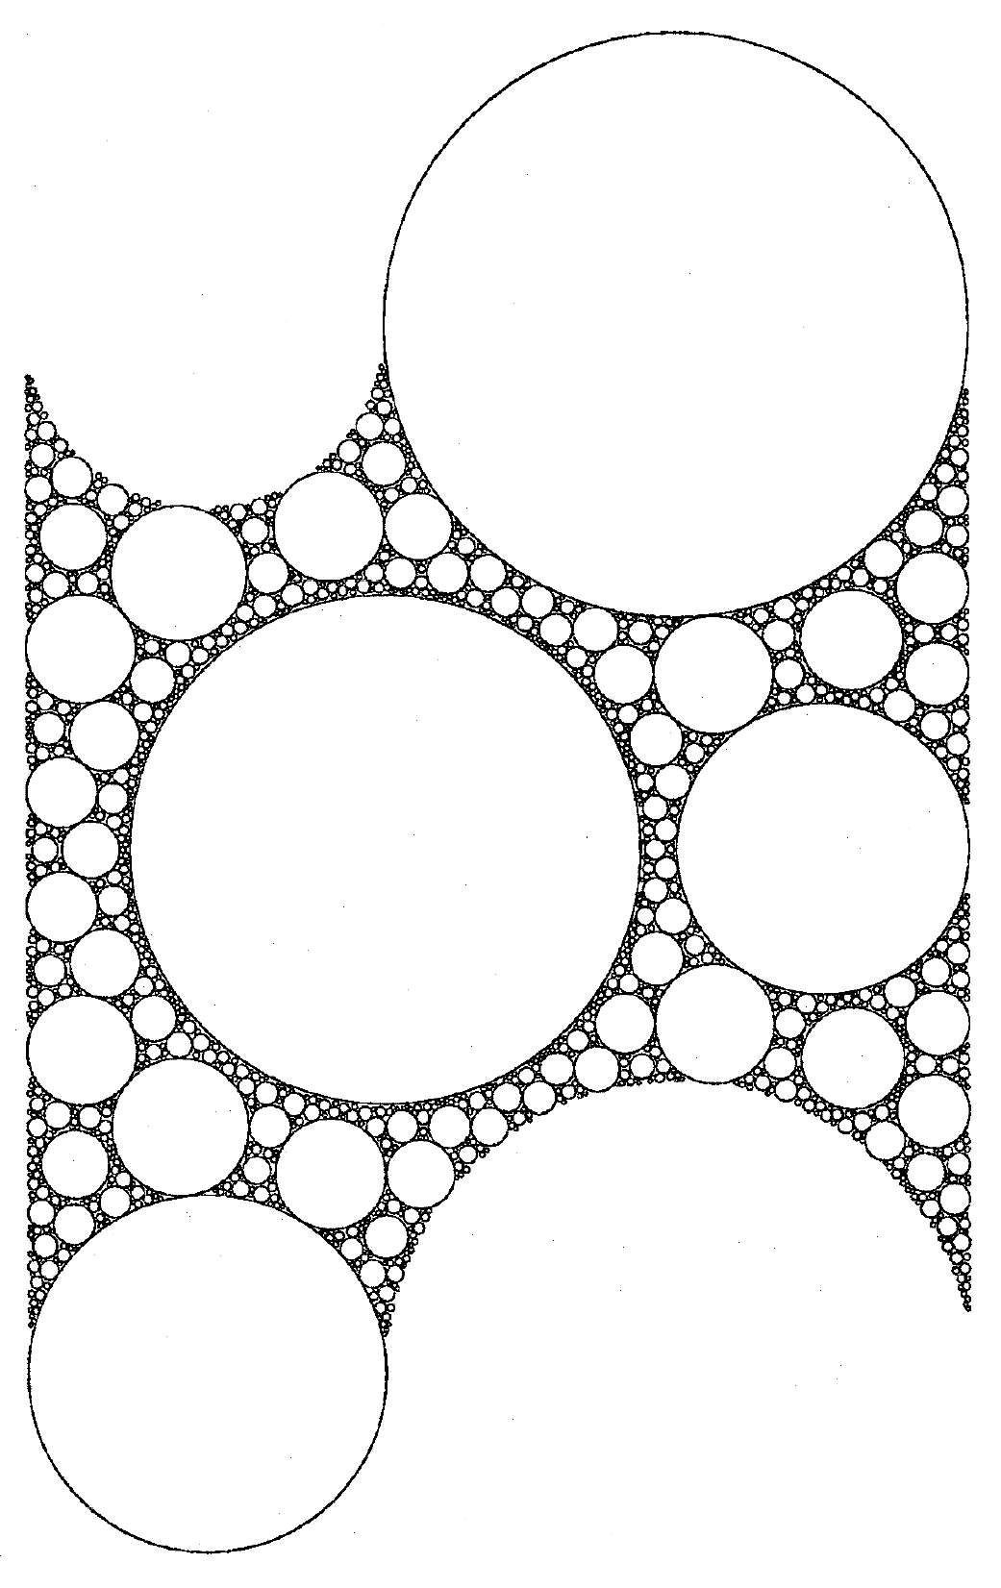
Midterm report:
Reaction-Diffusion Dynamics with Fractional Brownian motion
hans-herrmann.ethz.ch

Slide 2
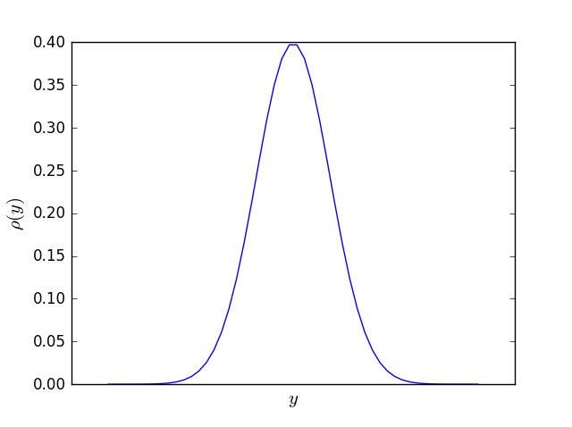
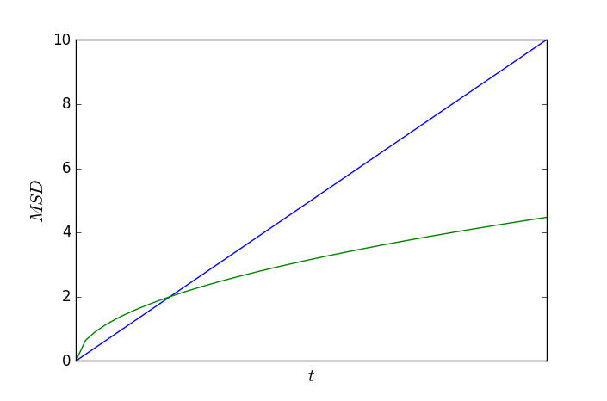
Normal Diffusion
Central Limit Theorem:
For independent and identically distributed (i.i.d.) random variable with and
Normal Distribution:
Normal Diffusion:
Drop Independence!
Assumption: i.i.d. random variables and linear response:
continuity equation:
=> Brownian motion

Slide 3
Anomal Diffusion With Fractional Brownian Motion
Fractional Brownian Motion:
Gaussian Propagator:
Velocity Autocorrelation Fnction (VACF):
Frequency representation of VACF of fBM
Interesting Properties of fBM:
(interesting for analysis of algorithm)
Scale Free Propagator:
with
Non-Gaussian Parameter:
Non-Markovian !

Slide 4
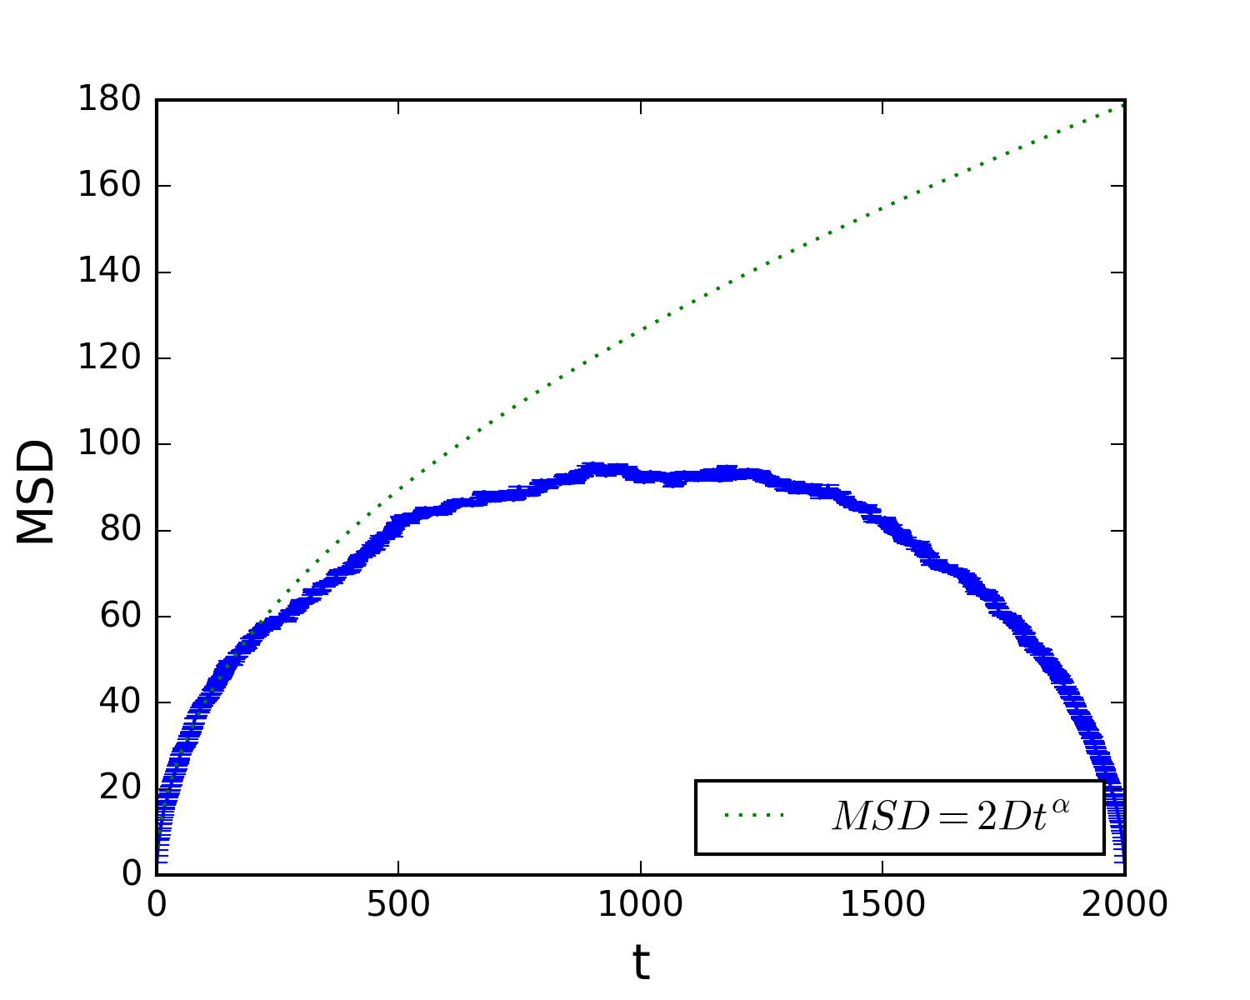
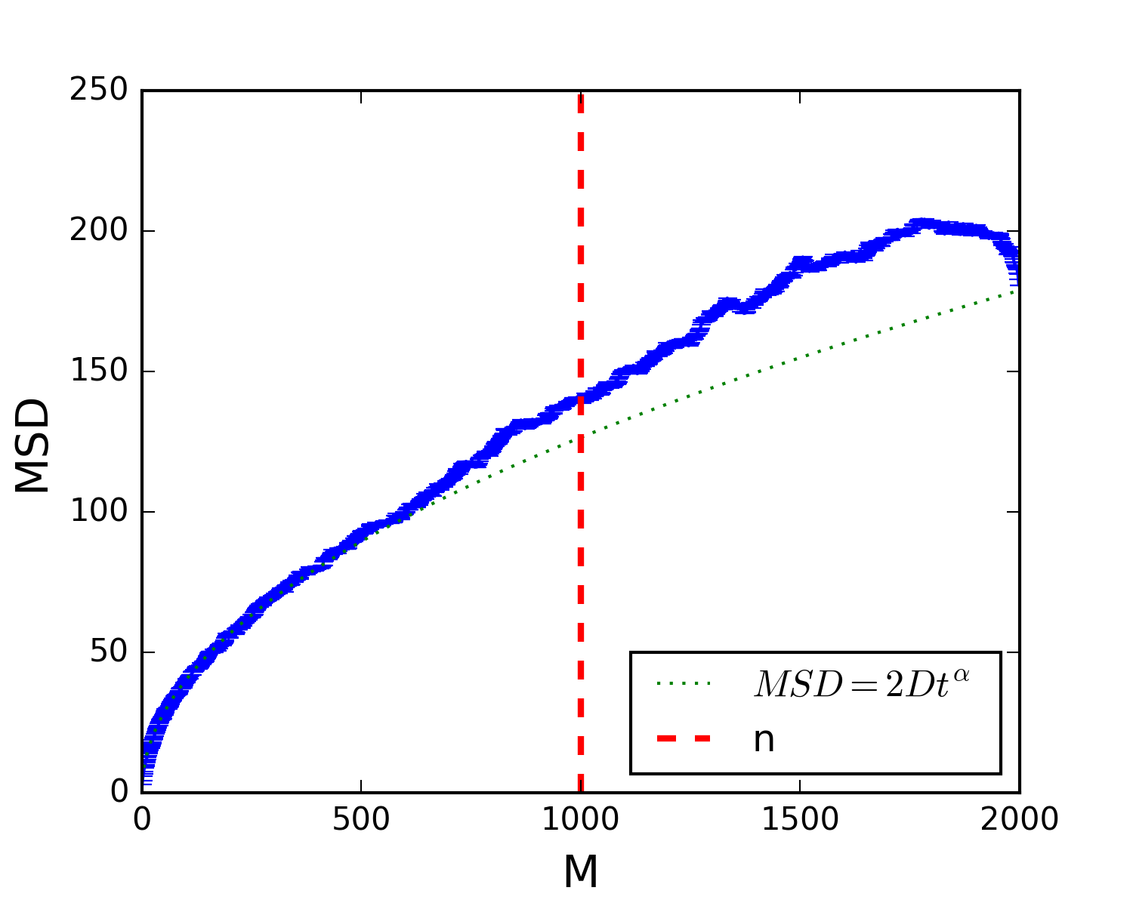
Algorithm
Velocity is the random Variable:
FBM: BM:
Decomposition in Fourier Modes:
Wiener-Khinchin:
Artificial Modification of the Power Spectrum:
Fourier Backtransform:
Discrete: and
1. with
2. finite time Problem
3. Problem:
4. Markovian: not true
5.
6. with
Finite Size Problem

Slide 5
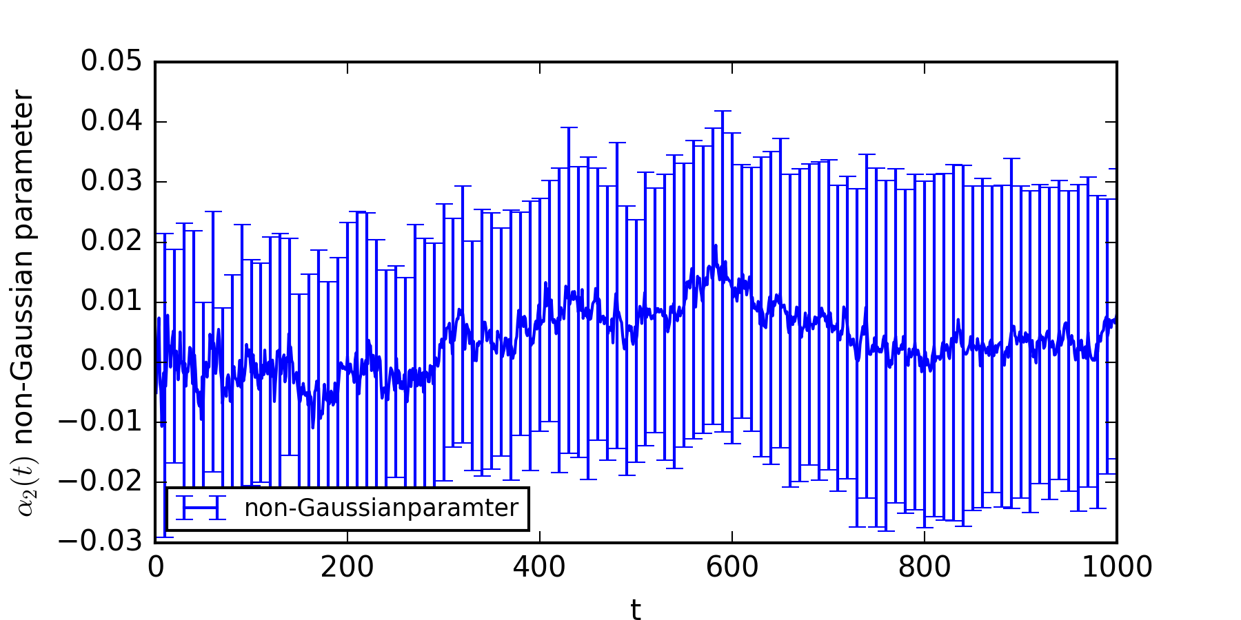
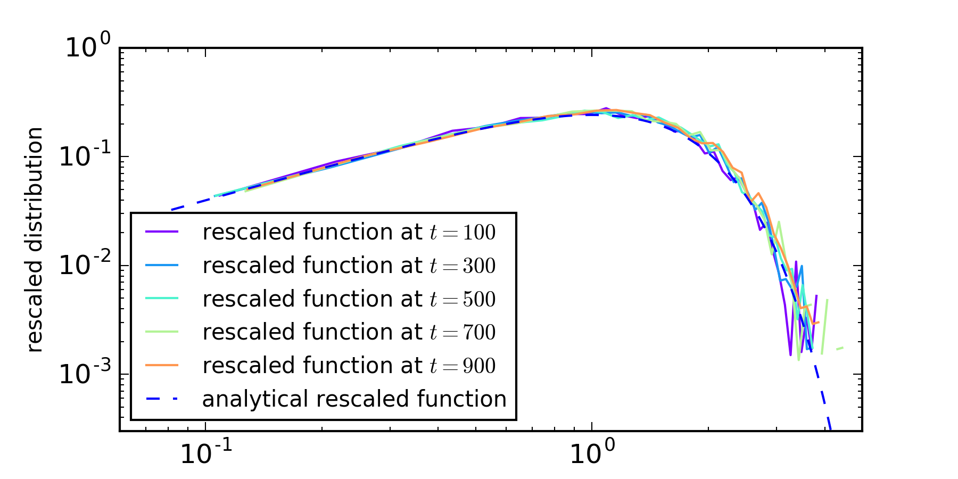
Testing of Algorithm
Non-Gaussian Parameter
Propagator seams Gaussian
Scale Free Form of Propagator

Slide 6
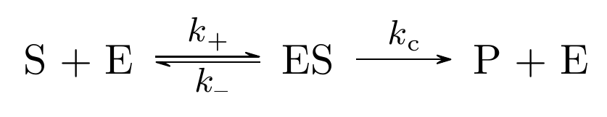
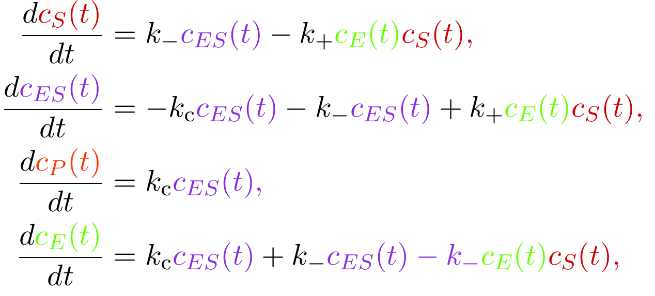
Michaelis-Menten (MM) kinetics

Slide 7
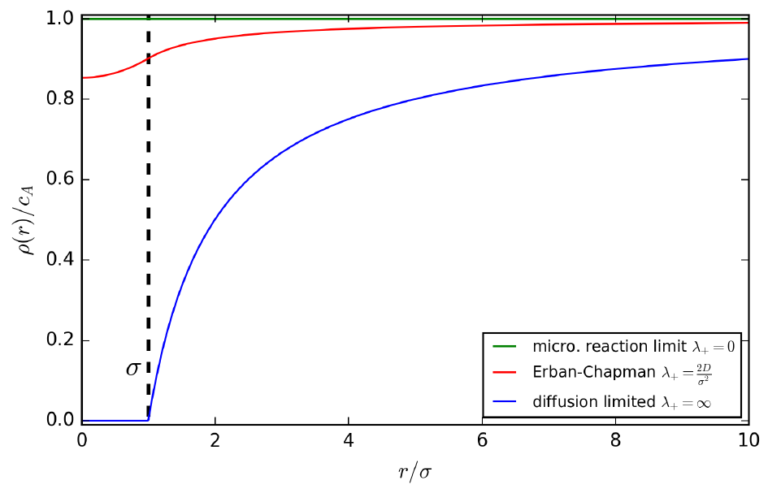
Erban-Chapman

Slide 8
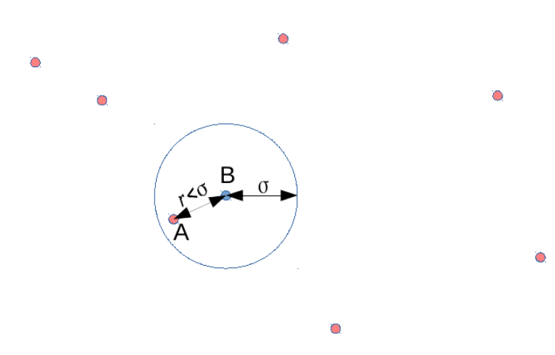
Simulation Model

Slide 9
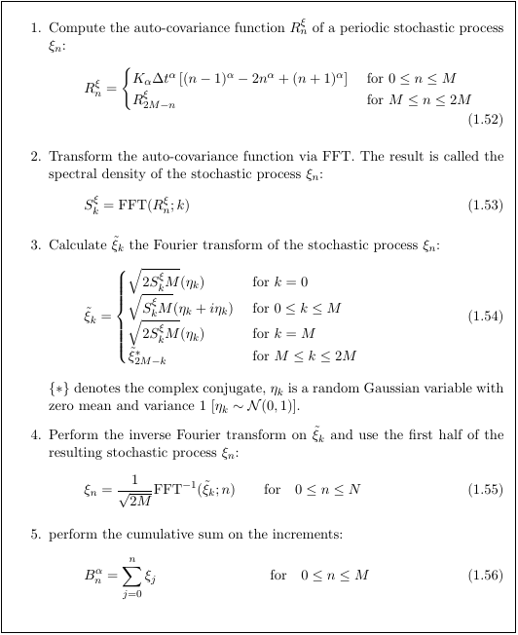
Davis-Harte Algorithm

Slide 10
Thank You
For Your Attention

