Slide 1
Mobile Community Hospital discussion
19 Dec 2024

Slide 2

Study objectives
What is the impact of implementing CHOF pilot care models on (i) overall healthcare utilisation, (ii) patient safety and quality of care, and (ii) patient/caregiver experience?
To understand barriers and facilitators in the implementation of the pilot care model
Workflow & coordinating care
Administrative burden
To evaluate the impact of the intervention on overall healthcare utilization of community hospital-related pathways
Patient safety
Quality of care; accessibility of care
Programme costs
To understand patient and caregiver experience among those who are enrolled in the pilot care model

Slide 3
Overview
Patient information (to date)
Data collection processes
In-depth interviews
Historical controls data

Slide 4
Overview
Patient information (to date)
Recruited: 28
Discharged from programme: 11

Slide 5
Overview
Patient master list
Data collection processes
CGH OrthoG/Hip Fracture team
SACH mobile community hospital team
SACH finance team
RMG TCF team
Site initiation visit (requirement from CTRU operational aspects of the project)
GKS
OHC
BK
JL
AL
Jia yan Who is still in flight and whether we can go down for a visit to ask for consent (rmg)jun ting Li Hnn Geraldine
Tele-rehab documentation on SCM (therapist notes); maybe get from Sharlene

Slide 6
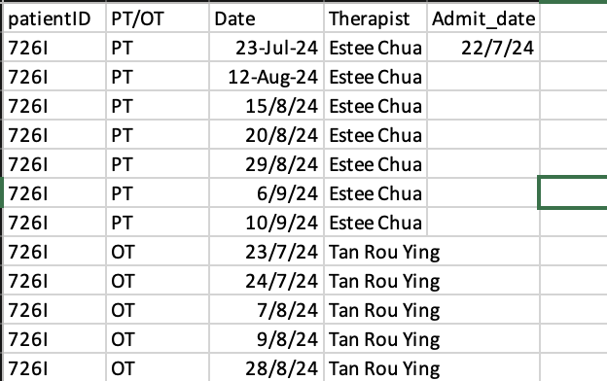
RMG TCF data
Number of therapy sessions/type

Slide 7
Overview
Patient master list
Data collection processes
In-depth interviews
Providers
Patients (rejected/discharged)
Best way to proceed?

Slide 8
To be collected: Patient/Caregiver in-depth interviews
How did you first become aware of the mobile CH team and its services?
What were some of your initial impressions/thoughts of the mobile CH team?
What specific services or support did you receive from the mobile CH team during the time you were managing your fracture at home/RMG?
How did they assist you in understanding your fracture and the necessary steps for self-care at home/RMG?
What were some resources provided?
What education or training did you receive? (i.e. self-care techniques, pain management, preventing further injury)
3. Did you feel adequately informed and supported throughout the process of managing your fracture at home/RMG? Why or why not?
What were the most valuable aspects of the support you received from the team during your recovery period?
4. Did you encounter any challenges or difficulties while managing your fracture at home/RMG?
If so, what were they?
How did the mobile CH team address any concerns or questions you had during the recovery process?
Can you share any specific examples of how the team helped you navigate challenges or obstacles related to your fracture management at home/RMG?
5. In what ways did the involvement of the mobile CH team impact your overall experience and outcome of managing your fracture at home/RMG?
6. What suggestions do you have for improving the support and services provided by mobile CH teams to patients/other caregivers?
7. Looking back, how beneficial do you think the mobile CH was in managing NWB fractures?
Who do you think will benefit most from this programme?
8. Is there anything else you would like to share about your experience of managing your fracture at home with the assistance of the mobile CH team?

Slide 9
To be collected: Provider in-depth interviews
Can you provide an overview of the new pilot model designed to manage non-weight-bearing fractures at home? What are its key features and objectives?
How is the new pilot model different from existing services?
How were patients assessed for eligibility? (i.e. clinical indicators? What were appropriate levels/types of support needed?)
2. What types of healthcare professionals or staff are involved in delivering services within this community health model?
3. What do you think are some key challenges patients face when managing NWB fractures at home?
How do you think the mobile CH team addressed these challenges?
4. What are the benefits of the new mobile CH model in the care of patients with NWB fractures at home?
5. What are some challenges/gaps in the new mobile CH care model for patients with NWB fractures?
If so, what are they? (i.e. education/training with caregivers & patients?; patient/caregiver comfort with care)
What suggestions do you have for enhancing the effectiveness and accessibility of community health services for patients with NWB fractures?
6. Can you describe any collaborations or partnerships that have been established to support the implementation of this community health model?
What are some collaborations between providers? Other community health services?
Any other coordination between partners?
7. How do you envision scaling up this community health model to reach a broader population or expand its geographical coverage?
What steps are being taken to assess the feasibility and readiness for scaling up, and what factors will influence the decision-making process?
Are there plans to adapt or modify the model to accommodate different contexts or populations as it is scaled up?
8. What resources are required to implement and sustain this community health model effectively?
How were the resources for this model initially acquired, and are there ongoing plans for resource allocation and management?
What do you think about the sustainability of this care model? – any potential challenges or barriers? How do you think these can be addressed?
9. Anything else you believe is important for understanding or implementing this community health model for NWB fractures?

Slide 10
Overview
Patient information (to date)
Data collection processes
In-depth interviews
Historical controls data
n = 52
Parameters currently being further updated for controls data

