Slide 2


Slide 3


Slide 4
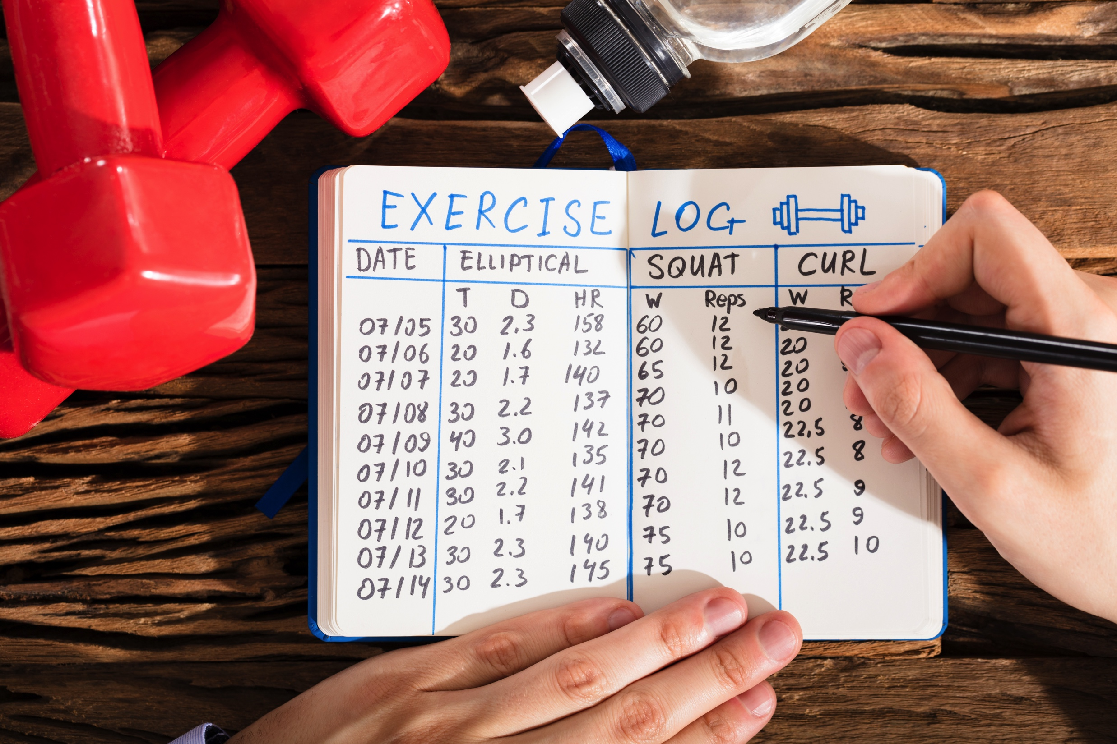

Slide 5
Exercise Log App
Developed by Mark Conanan and Thanh Dao

Slide 6

Purpose
To track the progress of the user during a workout in a easy to read table
To encourage people during their workout

Slide 7

Requirements
Repository link: ‘https://github.com/markconanan/CA_Assessment’
Ruby
Terminal Table Gem

Slide 8

Functionality
1. The application is able to take in inputs from the user for:
Exercise name
Number of sets for the exercise
Weight used in the exercise
Reps achieved for the exercise
2. The application can display the exercise log as the user is inputting each set of exercise.
3. The application can display the complete list after the workout is complete.

Slide 9
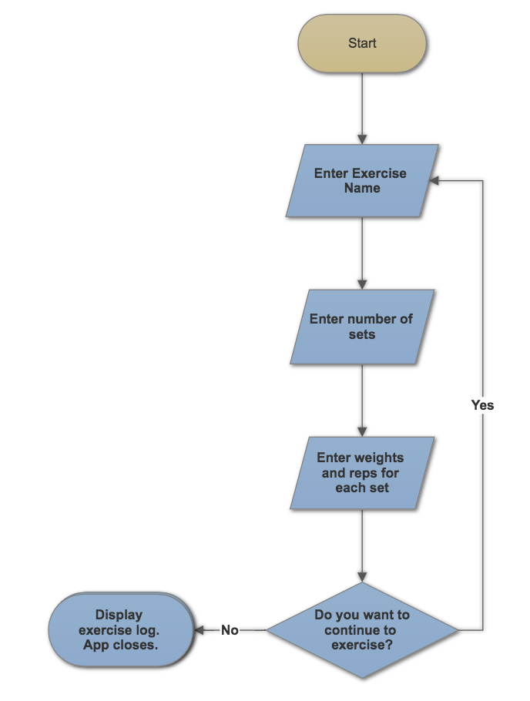
User Flow

Slide 10

Live Demo

Slide 11

Code Dive and Build Process

Slide 12
Future Improvements
Option to view history at the start of the application or proceed with the workout. The app has already been coded to save history logs.
Be able to record cardio exercises (running/swimming)
Option to put weights in pounds for American users
Have a list of exercises and definitions for reference in the app

Slide 13
Challenges
Refactoring – Methods and Classes
Isolation
Error handling
Automated testing
Control flow

Slide 14
Any Questions

