Slide 1
Modelling Border Gateway Protocol (BGP) for Anomaly Updates using Machine Learning
Janel Huang
Supervisors: Winston Seah and Marcus Frean
Mentor: Murugaraj Odiathevar

Slide 2








Introduction
BGP is the backbone of the Internet that determines how traffic is routed through networks or Autonomous Systems (AS) in the Internet

Slide 3
Problem
Current methods of historical BGP, time series, and reachability check cannot automatically learn from experience
Applying machine learning methods to find complex patterns in data that humans cannot discover
Node level features used to detect anomalies
Average Autonomous System (AS) path length
Number of withdrawals or announcements
No consideration on the entire network graph
Incapable of real-time detection and determining the source of the anomaly
Need to select network-level features to detect anomalies

Slide 4




Proposed Solution
BGP Updates
Graph
Machine Learning

Slide 5



Features Extracted
Eigenvector and betweenness centralities not feasible in memory and time
Closeness Centrality
Interconnectivity or clustering coefficients of the entire network lose individual network information
Degree Centrality

Slide 6
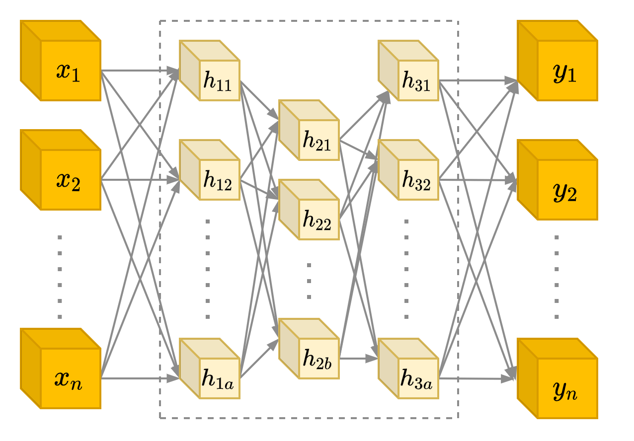
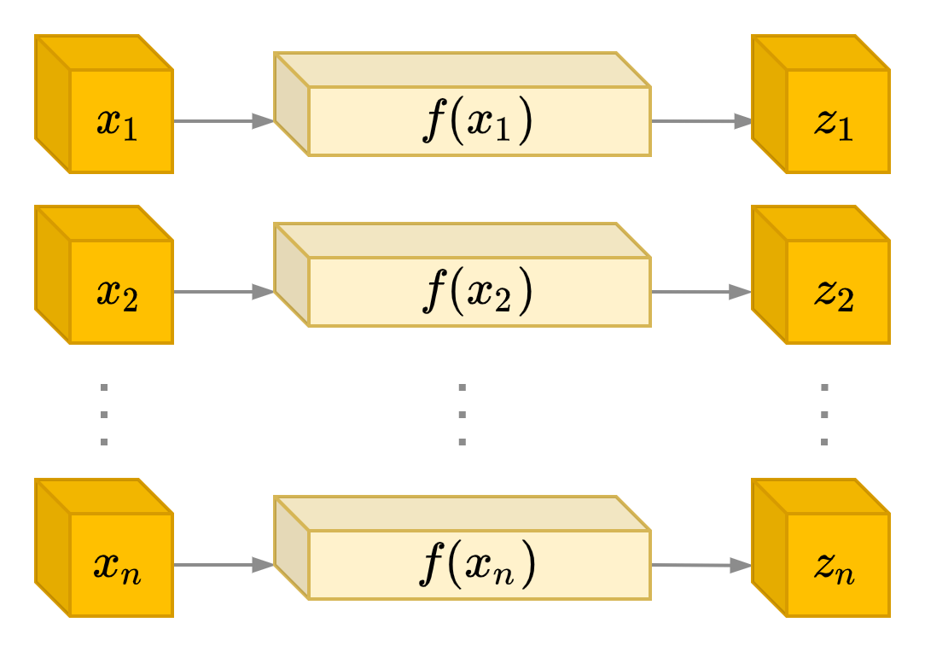
Machine Learning Algorithms
Entire anomaly detection using Autoencoders and UG and individual anomaly detection using UG
Autoencoders
UG is instable in detecting anomalies from routers that have a limited visibility
Univariate Gaussian(UG)

Slide 7
Experimental Results

Slide 8
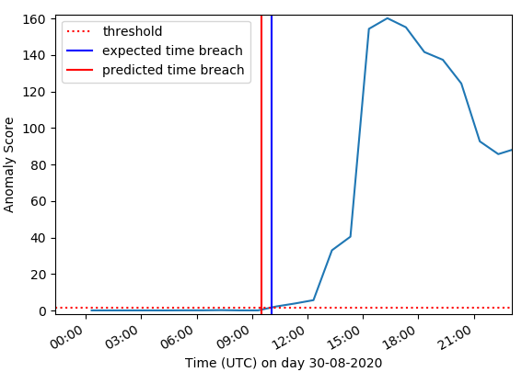
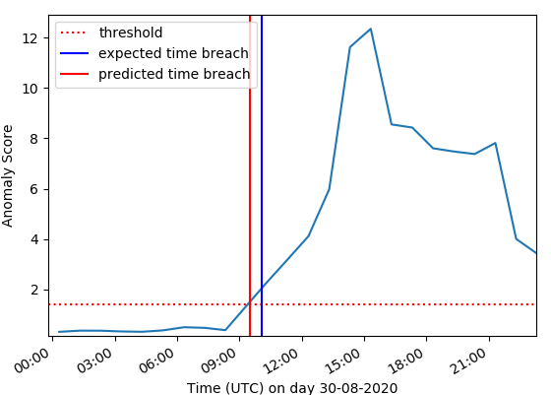
Entire Network
Closeness Centrality
Degree Centrality
Closeness and degree centrality was able to detect the anomaly in the entire network earlier

Slide 9

Entire Network: Visualisation
Time
Time
Normal
Anomaly
ASes
AS174
AS3561
Severity Level of BGP incidents can be determined through the number of networks affected

Slide 10
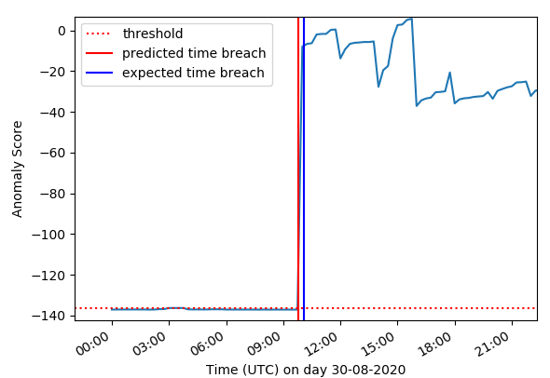
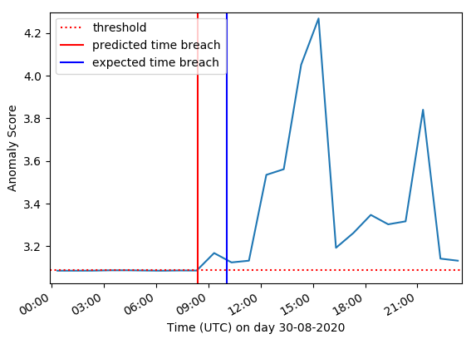
Individual Networks
AS38022 (REANNZ)
AS3561 (CenturyLink)
Source of the anomaly can be determined using the time at which the anomaly threshold is breached

Slide 11
Conclusion
Contributions
Use of graph-level features to determine anomalies
Reporting the severity of the incident using a black and white image of the number of ASes affected
Corroborating of multiple networks such as New Zealand, Japan and Serbia to determine anomalies
Anomaly Detection for the Entire Network
And Individual Networks
Source of BGP incident

Slide 12
Questions

