Slide 1
The Whole Process
PySolo Video to creates the mask file.
PySolo Acquire tracks the flies.
DAMConversion prepares the file for scanning.
DAMFileScan bins the data.
SCAMP generates the graphs.

Slide 2
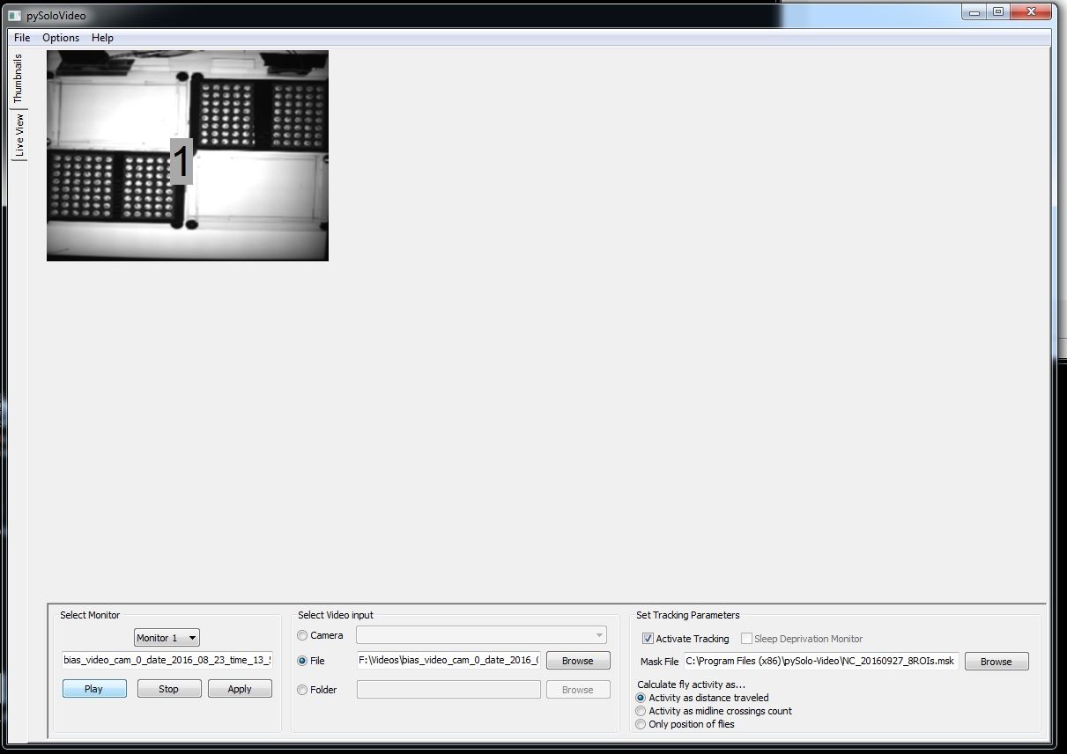
Pysolo Video, Thumbnails View

Slide 3
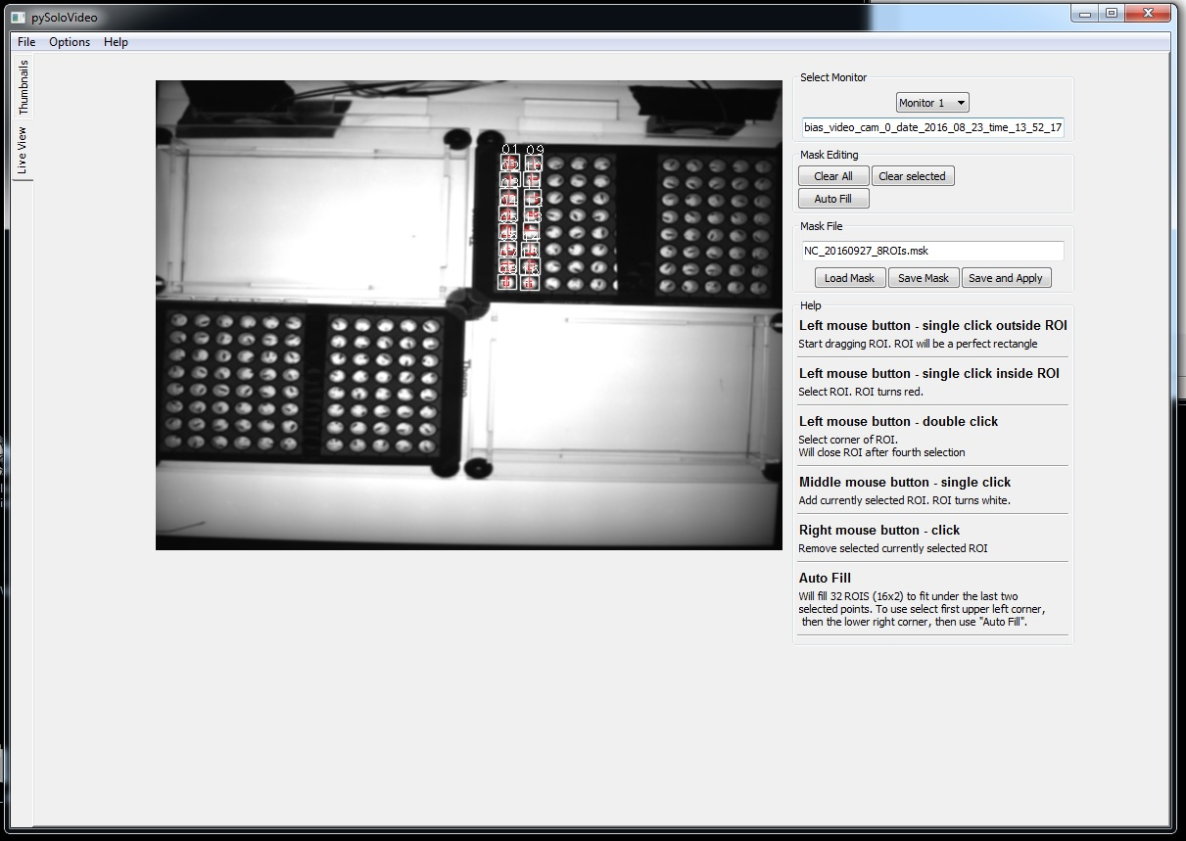
Pysolo Video, Live View

Slide 4
Pysolo Video
In thumbnail view,
Select a monitor
Browse to find the movie that will play on that monitor
Apply
Play
Don’t worry if it plays in the wrong window.
Once all movies have been applied to monitors, close PySolo-Video.
Restart PySolo-Video
Go immediately to the live view tab.
Any activity on the thumbnail view at this point will confuse the program as far as which file goes with which monitor.
Use the dropdown menu to select the monitor to be viewed.
The movie name will appear below the dropdown menu
The movie will play.
Other movies that were assigned when the program was shut down can be viewed as well, just don’t do anything in thumbnail view until you are done using live view.
The configuration file to be used in Acquire contains:
Output folder path (Options>Config>Default Output)
Monitor file name
Mask file name.

Slide 5
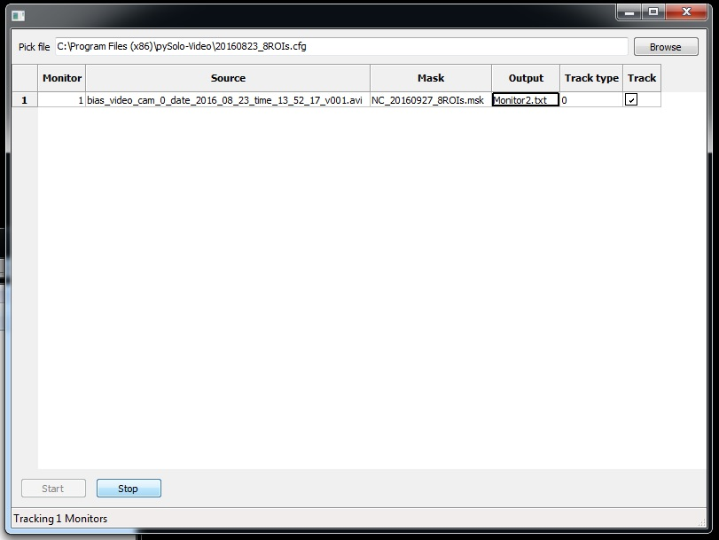
Pysolo Acquire

Slide 6
Pysolo Acquire
Browse to configuration file saved in Pysolo Video
Monitor name and Mask file were saved in the configuration file and cannot be changed here.
Click Start.
To see when Acquire is finished,
Browse to the folder containing the output file.
The folder name was specified in Pysolo Video and is saved in the configuration file.
When the time stamp on the output file no longer matches the current time, Acquire is done.
Click Stop when Acquire is done.

Slide 7
DAMConversion Adjust Date/Time and Change ‘?’s
1 | 31 Dec 69 | 19:01:00 | 1 | 1 | 0 | 0 | 0 | 0 | ? | 15 | 17 | 16 | 16 | 23 | 15 | 25 | 22 | 20 | 16 | 13 | 9 | 17 | 15 | 28 | 12 | 9 | 15 | 14 | 14 | 15 | 12 | 14 | 16 | 14 | 11 | 13 | 14 | 12 | 23 | 12 | 18
2 | 31 Dec 69 | 19:01:59 | 1 | 1 | 0 | 0 | 0 | 0 | ? | 2 | 0 | 2 | 4 | 2 | 4 | 0 | 5 | 3 | 2 | 4 | 2 | 8 | 0 | 7 | 4 | 8 | 4 | 0 | 7 | 3 | 3 | 5 | 0 | 5 | 5 | 5 | 0 | 0 | 0 | 4 | 0
3 | 31 Dec 69 | 19:02:58 | 1 | 1 | 0 | 0 | 0 | 0 | ? | 0 | 5 | 0 | 4 | 10 | 12 | 17 | 18 | 3 | 0 | 2 | 2 | 3 | 0 | 2 | 2 | 0 | 0 | 8 | 3 | 0 | 5 | 5 | 0 | 0 | 6 | 2 | 5 | 4 | 12 | 0 | 4
4 | 31 Dec 69 | 19:03:57 | 1 | 1 | 0 | 0 | 0 | 0 | ? | 39 | 29 | 23 | 40 | 29 | 25 | 56 | 58 | 44 | 34 | 8 | 6 | 16 | 11 | 33 | 38 | 22 | 27 | 22 | 3 | 13 | 16 | 15 | 43 | 29 | 37 | 28 | 22 | 31 | 31 | 16 | 17
5 | 31 Dec 69 | 19:04:56 | 1 | 1 | 0 | 0 | 0 | 0 | ? | 0 | 0 | 0 | 3 | 0 | 0 | 0 | 9 | 2 | 3 | 5 | 2 | 6 | 0 | 2 | 0 | 5 | 3 | 0 | 7 | 8 | 0 | 2 | 0 | 0 | 5 | 3 | 0 | 3 | 0 | 0 | 3
1 | 23 Aug 16 | 9:01:00 | 1 | 1 | 0 | 0 | 0 | 0 | 0 | 15 | 17 | 16 | 16 | 23 | 15 | 25 | 22 | 20 | 16 | 13 | 9 | 17 | 15 | 28 | 12 | 9 | 15 | 14 | 14 | 15 | 12 | 14 | 16 | 14 | 11 | 13 | 14 | 12 | 23 | 12 | 18
2 | 24 Aug 16 | 9:01:59 | 1 | 1 | 0 | 0 | 0 | 0 | 0 | 2 | 0 | 2 | 4 | 2 | 4 | 0 | 5 | 3 | 2 | 4 | 2 | 8 | 0 | 7 | 4 | 8 | 4 | 0 | 7 | 3 | 3 | 5 | 0 | 5 | 5 | 5 | 0 | 0 | 0 | 4 | 0
3 | 25 Aug 16 | 9:02:58 | 1 | 1 | 0 | 0 | 0 | 0 | 0 | 0 | 5 | 0 | 4 | 10 | 12 | 17 | 18 | 3 | 0 | 2 | 2 | 3 | 0 | 2 | 2 | 0 | 0 | 8 | 3 | 0 | 5 | 5 | 0 | 0 | 6 | 2 | 5 | 4 | 12 | 0 | 4
4 | 26 Aug 16 | 9:03:57 | 1 | 1 | 0 | 0 | 0 | 0 | 0 | 39 | 29 | 23 | 40 | 29 | 25 | 56 | 58 | 44 | 34 | 8 | 6 | 16 | 11 | 33 | 38 | 22 | 27 | 22 | 3 | 13 | 16 | 15 | 43 | 29 | 37 | 28 | 22 | 31 | 31 | 16 | 17
5 | 27 Aug 16 | 9:04:56 | 1 | 1 | 0 | 0 | 0 | 0 | 0 | 0 | 0 | 0 | 3 | 0 | 0 | 0 | 9 | 2 | 3 | 5 | 2 | 6 | 0 | 2 | 0 | 5 | 3 | 0 | 7 | 8 | 0 | 2 | 0 | 0 | 5 | 3 | 0 | 3 | 0 | 0 | 3

Slide 8
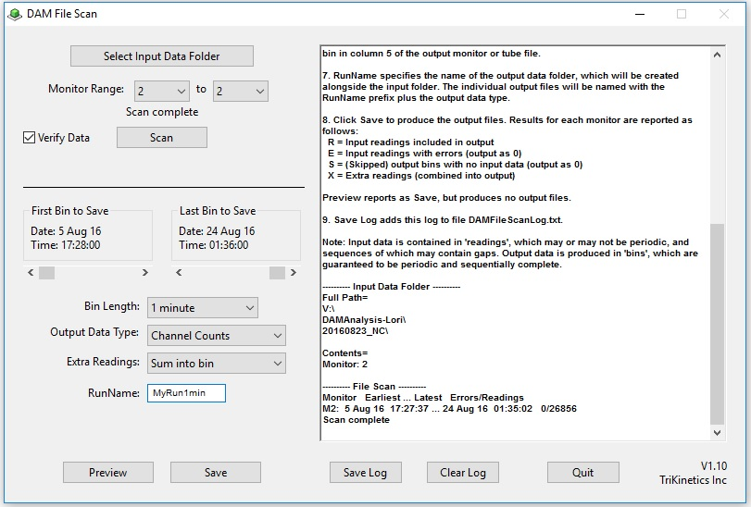
DAM File Scan

Slide 9
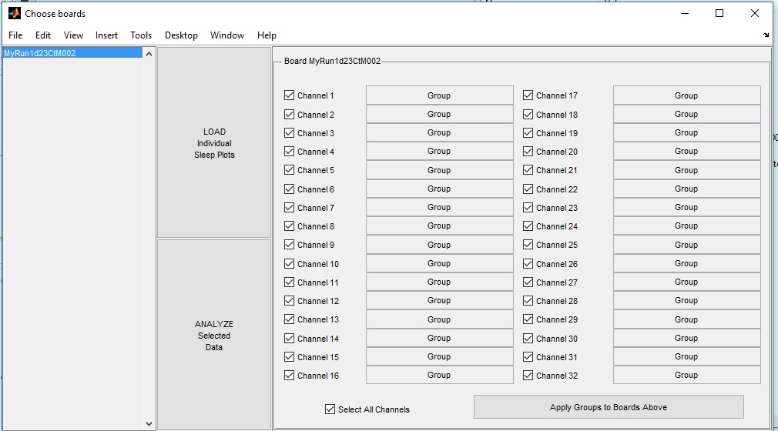
SCAMP

Slide 10
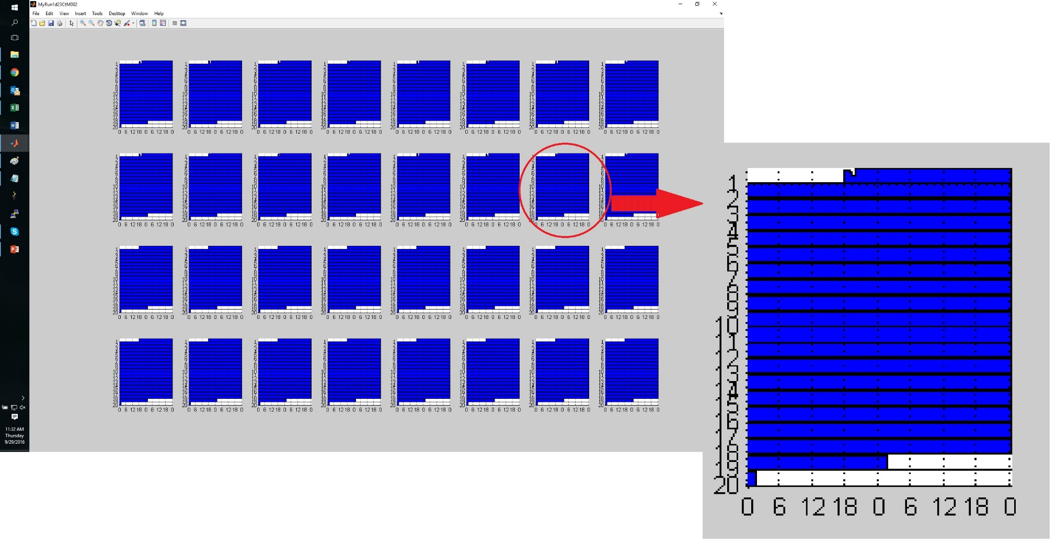
SCAMP – load sleep plots

Slide 11
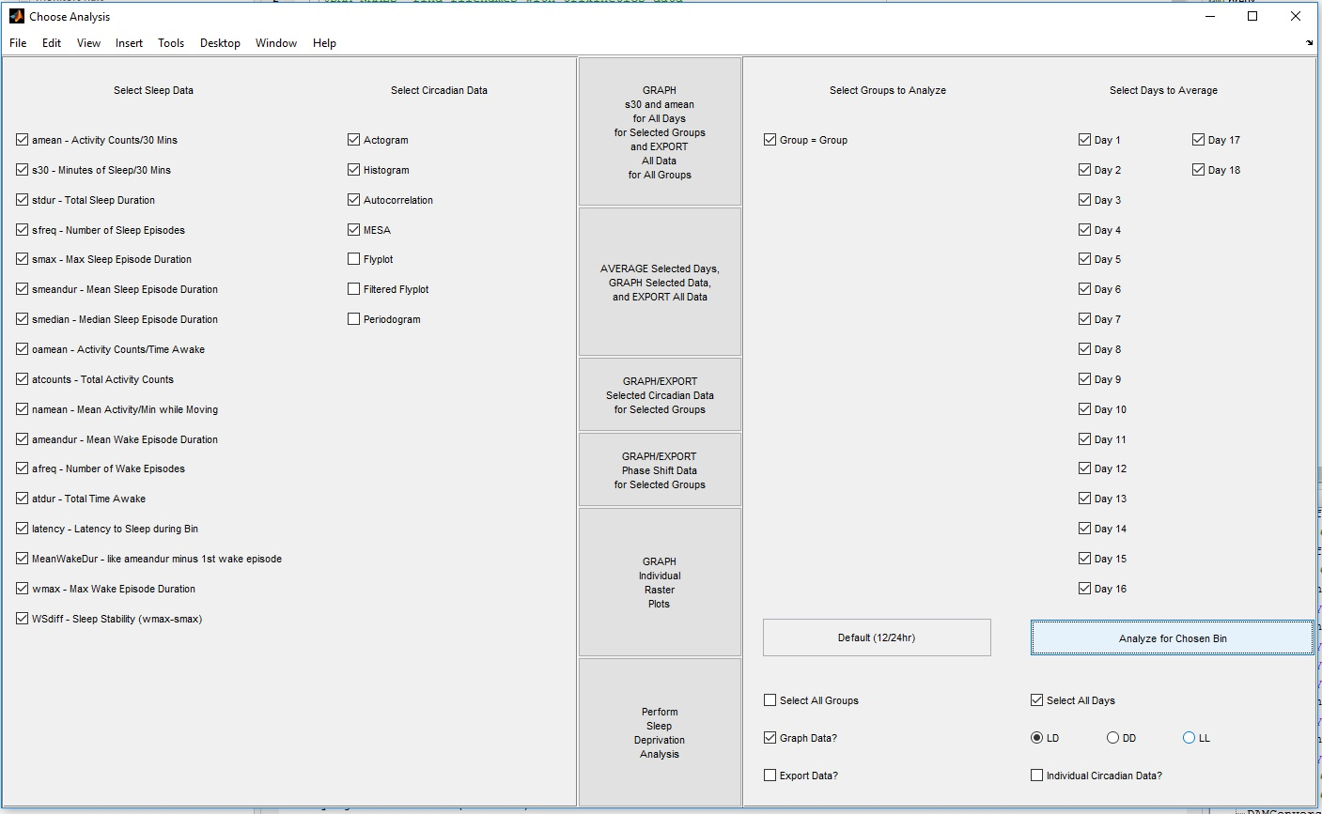
SCAMP Analyze

Slide 12
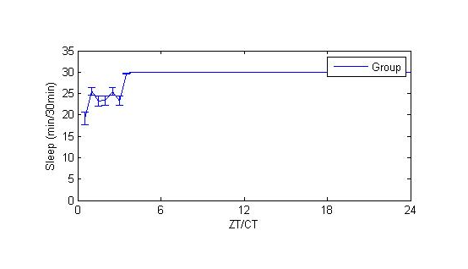
SCAMP Sleep Graphs

Slide 13
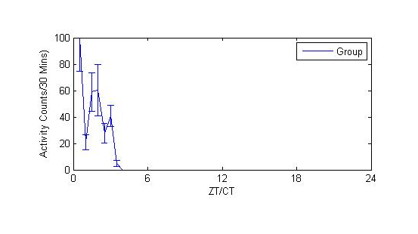
SCAMP Activity Graphs

Slide 14
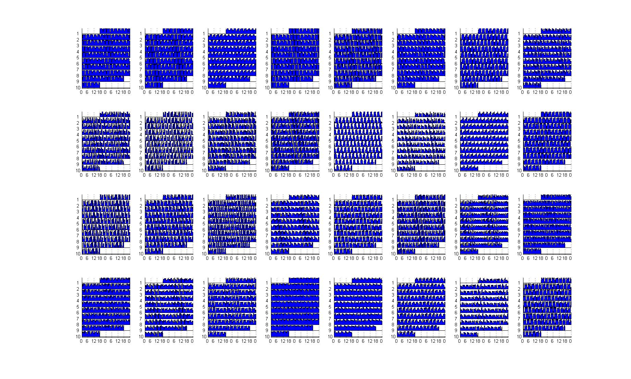
Expanded Data – load sleep plots

Slide 15
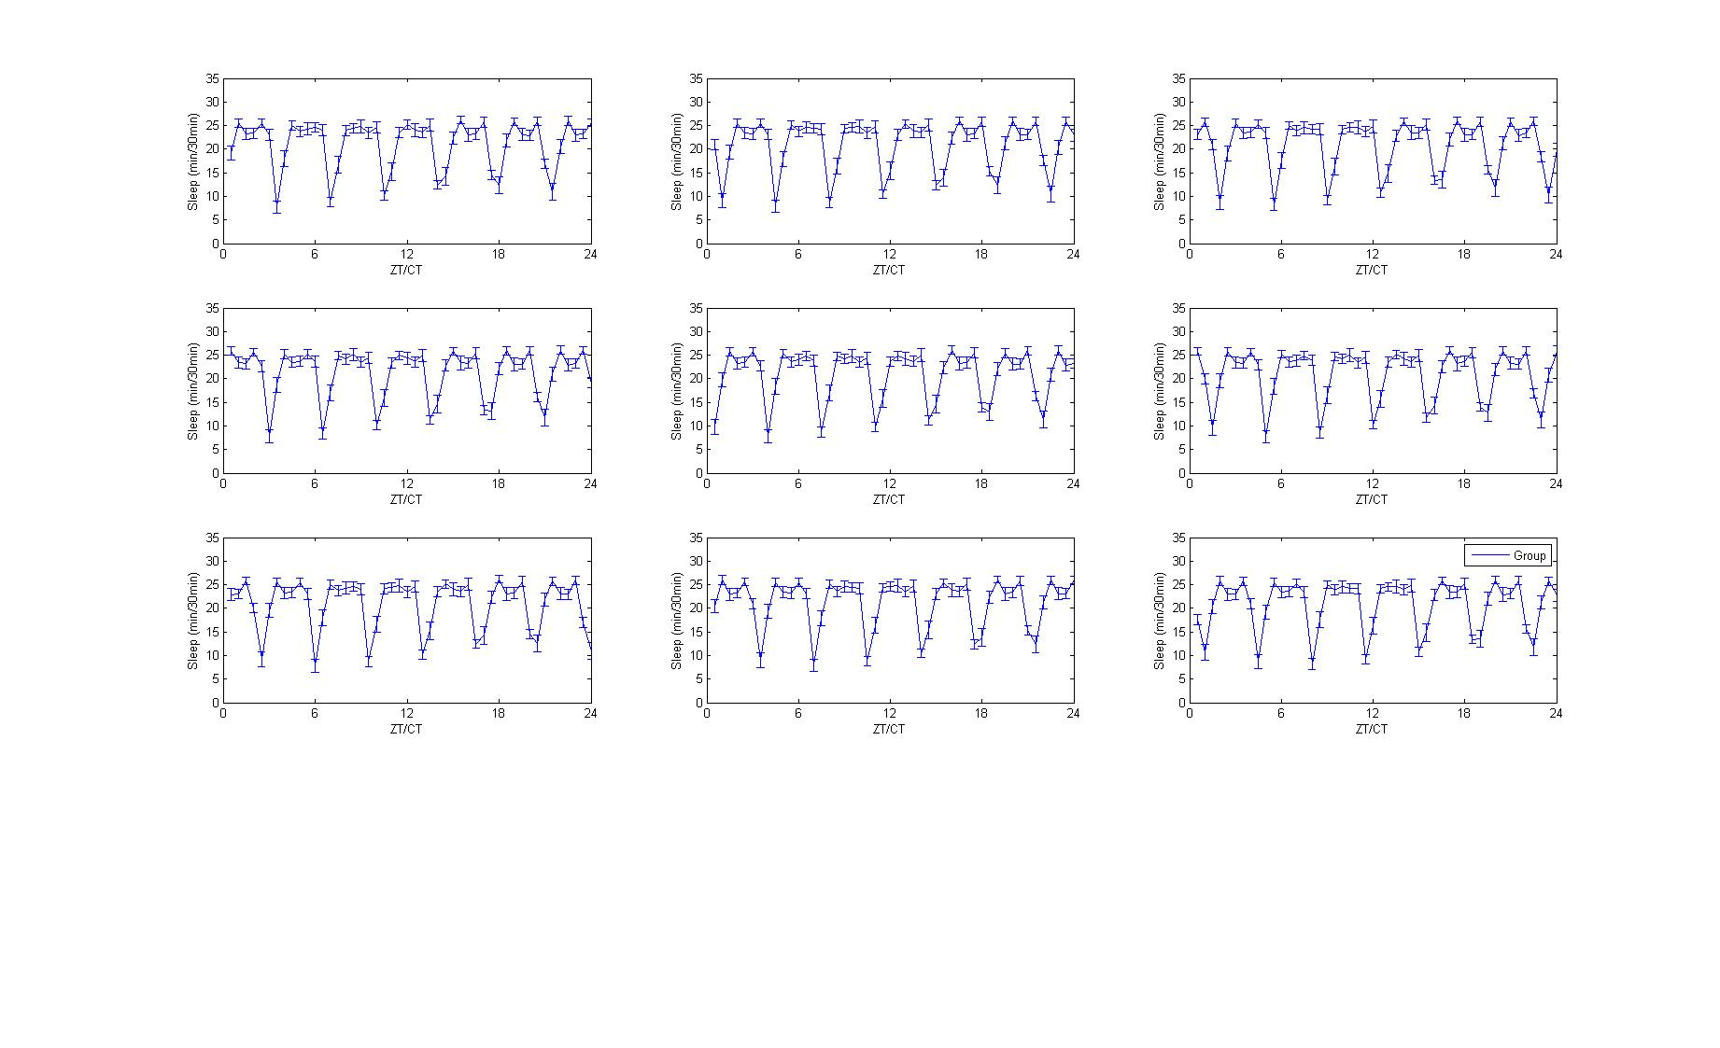
Expanded Data – Sleep Graphs

Slide 16
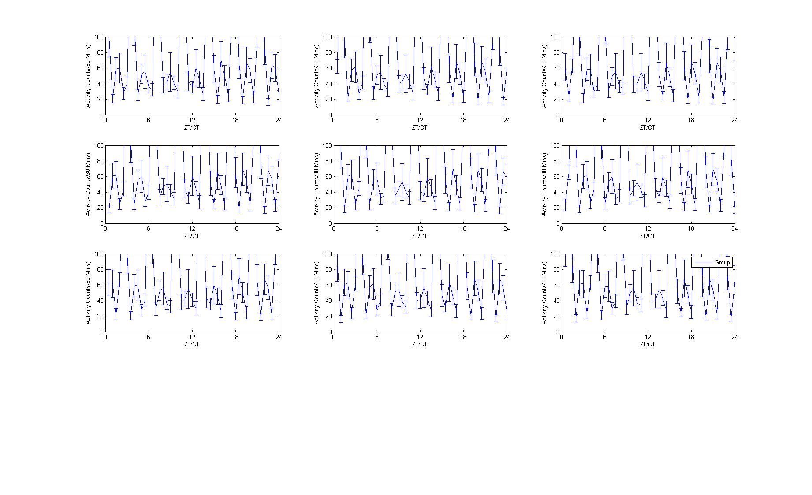
Expanded Data – Activity Graphs

