Slide 1




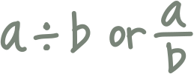
A S Y N C H R O N O U S A C T I V I T Y N O . 3
Name It, Draw It
ORGANIC CHEMISTRY
ORGANIC CHEMISTRY
PRESENTED BY:
JANELLE A. ARAÑA
BS CHE 2A

Slide 2
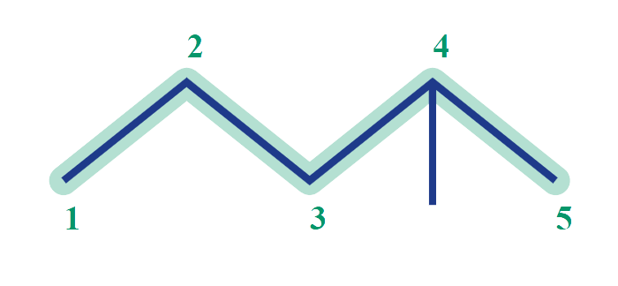
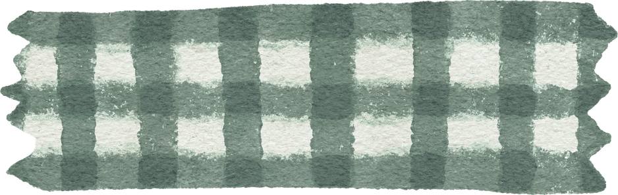
CARD A01 — STRUCTURE → NAME FOUNDATION Molecular Formula (counted): C6H14
1. NUMBERED PARENT
2. NAMING TRAIL
Parent: Longest chain = 5 C → pentane.
Numbering:
Left → Right gives methyl at C2.
Right → Left gives methyl at C4.
First point of difference: 2 < 4, so number from left.
Substituents: Methyl at C2 → 2-methyl.
3. MY NAME (WRITTEN FIRST)
4. THE ALKANE CHECK
Returned Name: 2-methylpentane
✓ Match
Verdict: Software output agrees directly with systematic IUPAC reasoning.
2-methylpentane
Typed before opening software tool.
✓ longest chain confirmed ✓ lowest locants ✓ alphabetical order ✓punctuation ✓formula counted

Slide 3
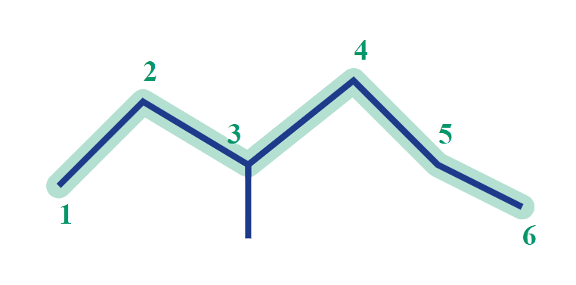
CARD A02 — STRUCTURE → NAME FOUNDATION Molecular Formula (counted): C7H16
1. NUMBERED PARENT
2. NAMING TRAIL
Parent: Longest chain = 6 C → hexane (chain is bent, not straight horizontal).
Numbering: Left-bottom to right gives methyl at C3. Opposite direction gives methyl at C4. 3 < 4, so number from left end.
Substituents: Methyl on C3 → 3-methyl.
3. MY NAME (WRITTEN FIRST)
4. THE ALKANE CHECK
Returned Name: 3-methylhexane
✓ Match
Verdict: Successfully recognized non-linear longest chain.
3-methylhexane
Typed before opening software tool.
✓ longest chain confirmed ✓ lowest locants ✓ alphabetical order ✓punctuation ✓formula counted

Slide 4
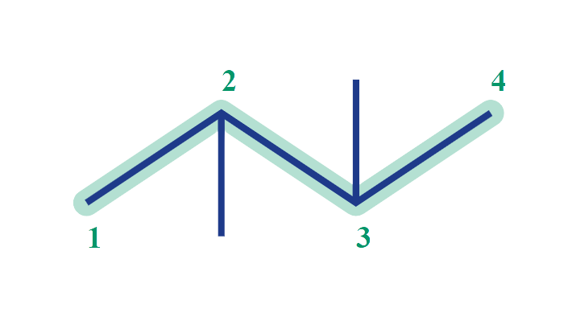
CARD A03 — STRUCTURE → NAME DEVELOPING Molecular Formula (counted): C6H146
1. NUMBERED PARENT
2. NAMING TRAIL
Parent: Longest chain = 4 C → butane.
Numbering: Left → Right gives locants 2,3. Right → Left gives locants 2,3. Symmetrical numbering set.
Substituents: Methyl groups on C2 and C3 → 2,3-dimethyl (requires di- prefix).
3. MY NAME (WRITTEN FIRST)
4. THE ALKANE CHECK
Returned Name: 2,3-dimethylbutane
✓ Match
Verdict: Correct prefix usage and comma punctuation verified.
2,3-dimethylbutane
Typed before opening software tool.
✓ longest chain confirmed ✓ lowest locants ✓ alphabetical order ✓punctuation ✓formula counted

Slide 5
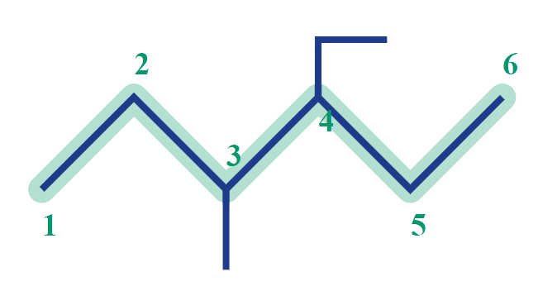
CARD A04 — STRUCTURE → NAME DEVELOPING Molecular Formula (counted): C9H20
1. NUMBERED PARENT
2. NAMING TRAIL
Parent: Longest chain = 6 C → hexane.
Numbering: Left → Right gives 3-methyl, 4-ethyl (locant set {3,4}). Right → Left gives 3-ethyl, 4-methyl (locant set {3,4}). Tie broken alphabetically: ethyl gets lower locants (3-ethyl vs 4-ethyl). Number from right.
Substituents: 4-ethyl, 3-methyl.
3. MY NAME (WRITTEN FIRST)
4. THE ALKANE CHECK
Returned Name: 4-ethyl-3-methylhexane
✓ Match
Verdict: Correctly alphabetized ethyl before methyl and assigned locants.
4-ethyl-3-methylhexane
Typed before opening software tool.
✓ longest chain confirmed ✓ lowest locants ✓ alphabetical order ✓punctuation ✓formula counted

Slide 6
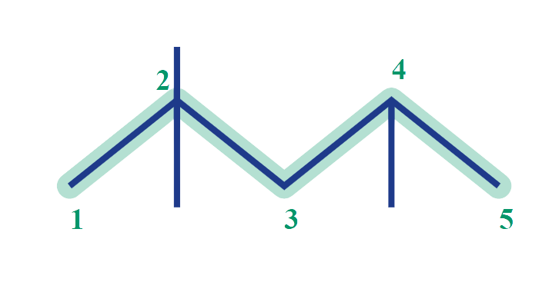
CARD A05 — STRUCTURE → NAME DEVELOPING Molecular Formula (counted): C8H18
1. NUMBERED PARENT
2. NAMING TRAIL
Parent: Longest chain = 5 C → pentane.
Numbering: Left → Right set = {2,2,4}. Right → Left set = {2,4,4}. First point of difference: 2 < 4 at second locant, so set {2,2,4} wins. Number from left.
Substituents: Three methyl groups → 2,2,4-trimethyl.
3. MY NAME (WRITTEN FIRST)
4. THE ALKANE CHECK
Returned Name: 2,2,4-trimethylpentane
✓ Match
Verdict: Isooctane reference structure confirmed by first point of difference rule.
2,2,4-trimethylpentane
Typed before opening software tool.
✓ longest chain confirmed ✓ lowest locants ✓ alphabetical order ✓punctuation ✓formula counted

Slide 7
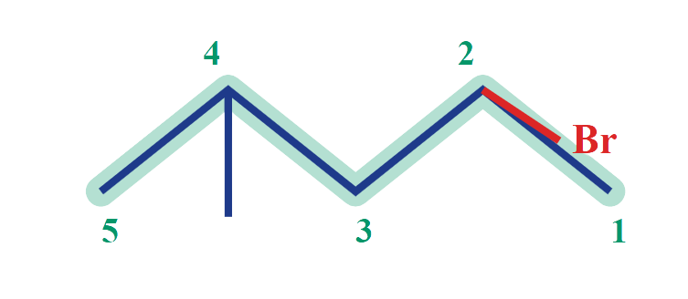
CARD A06 — STRUCTURE → NAME DEVELOPING Molecular Formula (counted): C6H13Br
1. NUMBERED PARENT
2. NAMING TRAIL
Parent: Longest chain = 5 C → pentane.
Numbering: Right → Left gives 2-bromo, 4-methyl (locants {2,4}). Left → Right gives 2-methyl, 4-bromo (locants {2,4}). Set {2,4} ties; bromo precedes methyl alphabetically, so bromo receives lower locant (C2). Number from right.
Substituents: 2-bromo, 4-methyl.
3. MY NAME (WRITTEN FIRST)
4. THE ALKANE CHECK
Returned Name: 2-bromo-4-methylpentane
✓ Match
Verdict: Alphabetical tie-break rule applied correctly.
2-bromo-4-methylpentane
Typed before opening software tool.
✓ longest chain confirmed ✓ lowest locants ✓ alphabetical order ✓punctuation ✓formula counted

Slide 8
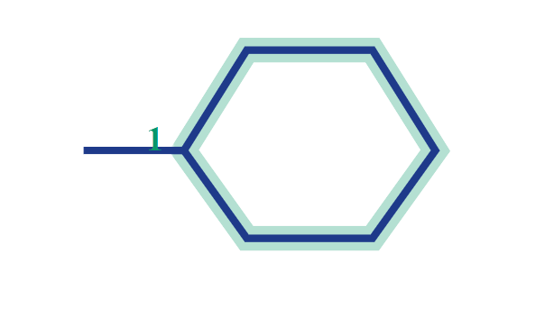
CARD A07 — STRUCTURE → NAME CHALLENGE Molecular Formula (counted): C7H14
1. NUMBERED PARENT
2. NAMING TRAIL
Parent: 6-membered ring = cyclohexane.
Numbering: Ring carbon with the single methyl branch automatically becomes C1. No other substituents exist.
Locant Rule: For a monosubstituted cycloalkane, locant "1" is omitted as redundant.
Substituent: methyl.
3. MY NAME (WRITTEN FIRST)
4. THE ALKANE CHECK
Returned Name: methylcyclohexane
✓ Match
Verdict: Redundant locant omitted in accordance with IUPAC rules.
methylcyclohexane
Typed before opening software tool.
✓ longest chain confirmed ✓ lowest locants ✓ alphabetical order ✓punctuation ✓formula counted

Slide 9
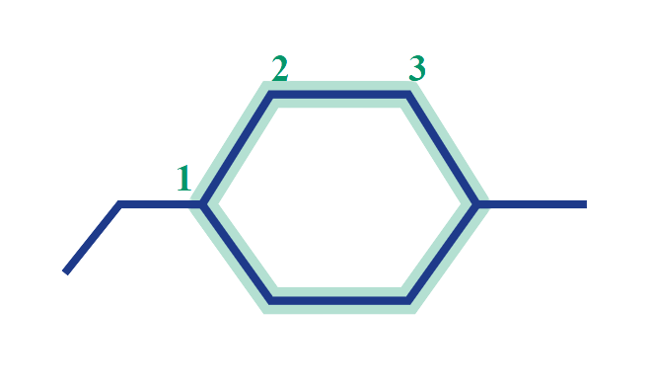
CARD A08 — STRUCTURE → NAME CHALLENGE Molecular Formula (counted): C9H18
1. NUMBERED PARENT
2. NAMING TRAIL
Parent: 6-carbon ring = cyclohexane.
Numbering: Locant sets around ring give {1,3} in either direction. Tie broken alphabetically: ethyl precedes methyl, so ethyl carbon gets C1, methyl carbon gets C3.
Substituents: 1-ethyl, 3-methyl.
3. MY NAME (WRITTEN FIRST)
4. THE ALKANE CHECK
Returned Name: 1-ethyl-3-methylcyclohexane
✓ Match
Verdict: Alphabetical tie-break rule on ring verified.
1-ethyl-3-methylcyclohexane
Typed before opening software tool.
✓ longest chain confirmed ✓ lowest locants ✓ alphabetical order ✓punctuation ✓formula counted

Slide 10
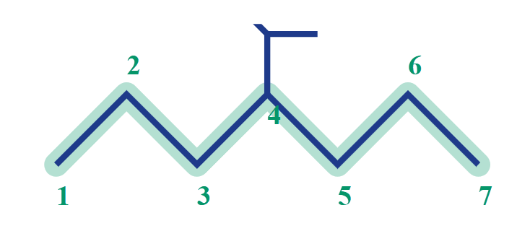
CARD A09 — STRUCTURE → NAME CHALLENGE Molecular Formula (counted): C10H22
1. NUMBERED PARENT
2. NAMING TRAIL
Parent: Longest continuous chain = 7 C → heptane.
Numbering: Symmetrical 7-carbon parent chain gives branch at C4 from either end.
Substituent: Branched group at C4 = isopropyl or (1-methylethyl).
Name Assembly: 4-(1-methylethyl)heptane or 4-isopropylheptane.
3. MY NAME (WRITTEN FIRST)
4. THE ALKANE CHECK
Returned Name: 4-(1-methylethyl)heptane
✓ Match
Verdict: Equivalent traditional name: 4-isopropylheptane.
4-(1-methylethyl)heptane
Typed before opening software tool.
✓ longest chain confirmed ✓ lowest locants ✓ alphabetical order ✓punctuation ✓formula counted

Slide 11
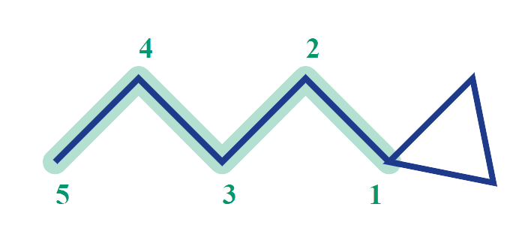
CARD A010 — STRUCTURE → NAME CHALLENGE Molecular Formula (counted): C8H16
1. NUMBERED PARENT
2. NAMING TRAIL
Parent Priority: Chain has 5 C (pentane); ring has 3 C (cyclopropane).
Current IUPAC (2013): Ring is always parent → pentylcyclopropane.
Traditional/Older IUPAC Rule: Longer unit is parent → pentane (5C > 3C) → 1-cyclopropylpentane.
Numbering: C1 at ring attachment point.
3. MY NAME (WRITTEN FIRST)
4. THE ALKANE CHECK
Returned Name: pentylcyclopropane
X Rule Difference
Explanation: The Alkane applies 2013 IUPAC rules (ring = parent). Both names are valid under their respective IUPAC editions.
1-cyclopropylpentane
Typed before opening software tool.
✓ longest chain confirmed ✓ lowest locants ✓ alphabetical order ✓punctuation ✓formula counted

Slide 12

CARD B01 — NAME → STRUCTURE FOUNDATION Given Name: 2-methylpropane
1. NAME DECODED
2. BOND-LINE STRUCTURE (THE ALKANE)
Parent: propane → 3-carbon open chain.
Substituents: methyl group on carbon-2.
Expected Formula: CnH2n+2 = C4H10.
3. FORMULA CHECK
4. BACK-CHECK
Counted from drawing: C4H10
Open-chain rule: CnH2n+2 for n = 4 → C4H10.
✓ Formula Verified
Returned Name: 2-methylpropane
✓ Same as given name
Common Name: Isobutane (R-600a refrigerant).
✓ parent length matches ✓ substituent positions match ✓ formula agrees ✓ back-check recorded

Slide 13
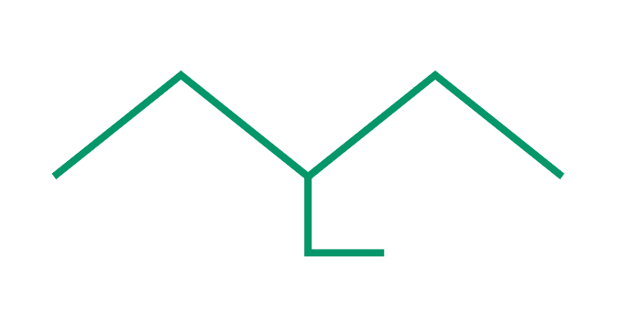
CARD B02 — NAME → STRUCTURE FOUNDATION Given Name: 3-ethylpentane
1. NAME DECODED
2. BOND-LINE STRUCTURE (THE ALKANE)
Parent: pentane → 5-carbon open chain.
Substituents: ethyl group on carbon-3.
Expected Formula: C5+2H2(7)+2 = C7H16.
3. FORMULA CHECK
4. BACK-CHECK
Counted from drawing: C7H16
Open-chain rule: CnH2n+2 for n = 7 → C7H16.
✓ Formula Verified
Returned Name: 3-ethylpentane
✓ Same as given name
Context: Gasoline-range alkane isomer.
✓ parent length matches ✓ substituent positions match ✓ formula agrees ✓ back-check recorded

Slide 14

CARD B03 — NAME → STRUCTURE FOUNDATION Given Name: 2,2-dimethylbutan
1. NAME DECODED
2. BOND-LINE STRUCTURE (THE ALKANE)
Parent: butane → 4-carbon chain.
Substituents: two methyl groups both on C2.
Expected Formula: C4+2H2(6)+2 = C6H14.
3. FORMULA CHECK
4. BACK-CHECK
Counted from drawing: C6H14
Open-chain rule: CnH2n+2 for n = 6 → C6H14.
✓ Formula Verified
Returned Name: 2,2-dimethylbutane
✓ Same as given name
Common Name: Neohexane.
✓ parent length matches ✓ substituent positions match ✓ formula agrees ✓ back-check recorded

Slide 15
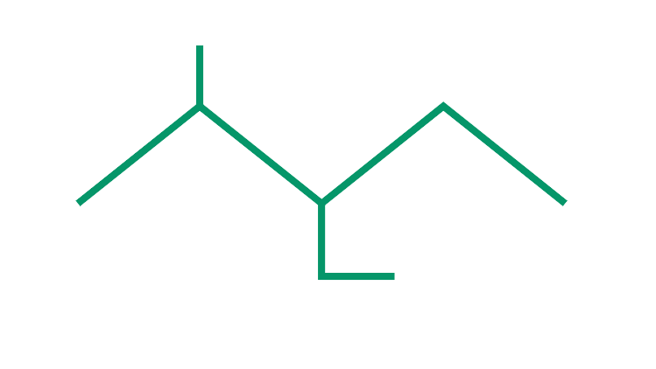
CARD B04 — NAME → STRUCTURE DEVELOPING Given Name: 3-ethyl-2-methylpentane
1. NAME DECODED
2. BOND-LINE STRUCTURE (THE ALKANE)
Parent: pentane → 5-carbon chain.
Substituents: methyl at C2, ethyl at C3.
Expected Formula: C5+1+2H2(8)+2 = C8H18.
3. FORMULA CHECK
4. BACK-CHECK
Counted from drawing: C8H18
Open-chain rule: CnH2n+2 for n = 8 → C8H18.
✓ Formula Verified
Returned Name: 3-ethyl-2-methylpentane
✓ Same as given name
Context: Highly branched C8 octane isomer.
✓ parent length matches ✓ substituent positions match ✓ formula agrees ✓ back-check recorded

Slide 16
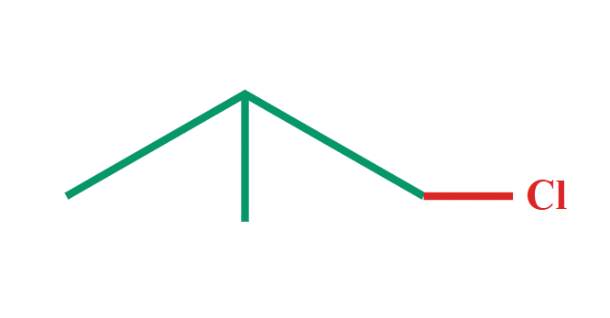
CARD B05 — NAME → STRUCTURE DEVELOPING Given Name: 1-chloro-2-methylpropane
1. NAME DECODED
2. BOND-LINE STRUCTURE (THE ALKANE)
Parent: propane → 3-carbon chain.
Substituents: chloro at C1, methyl at C2.
Expected Formula: C4H9Cl (1 Cl replaces 1 H).
3. FORMULA CHECK
4. BACK-CHECK
Counted from drawing: C4H9Cl
Formula Rule: C4H10 minus 1 H plus 1 Cl = C4H9Cl.
✓ Formula Verified
Returned Name: 1-chloro-2-methylpropane
✓ Same as given name
Common Name: Isobutyl chloride.
✓ parent length matches ✓ substituent positions match ✓ formula agrees ✓ back-check recorded

Slide 17
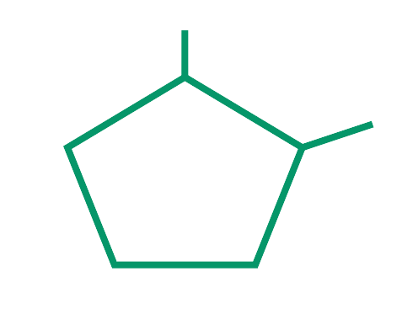
CARD B06 — NAME → STRUCTURE DEVELOPING Given Name: 1,2-dimethylcyclopentane
1. NAME DECODED
2. BOND-LINE STRUCTURE (THE ALKANE)
Parent: cyclopentane → 5-membered ring.
Substituents: methyl groups on adjacent carbons C1 and C2.
Expected Formula: CnH2n = C7H14 (1 ring).
3. FORMULA CHECK
4. BACK-CHECK
Counted from drawing: C7H14
Cycloalkane rule: CnH2n for 7 carbons = C7H14.
✓ Formula Verified
Returned Name: 1,2-dimethylcyclopentane
✓ Same as given name
Context: Petroleum naphtha naphthene component.
✓ parent length matches ✓ substituent positions match ✓ formula agrees ✓ back-check recorded

Slide 18
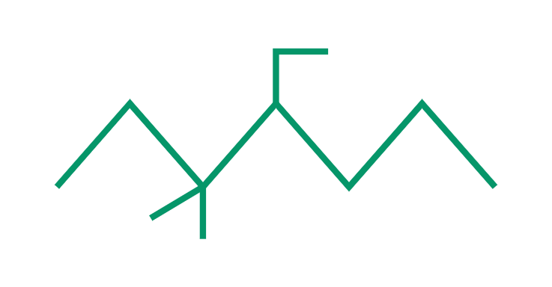
CARD B07 — NAME → STRUCTURE DEVELOPING Given Name: 4-ethyl-3,3-dimethylheptane
1. NAME DECODED
2. BOND-LINE STRUCTURE (THE ALKANE)
Parent: heptane → 7-carbon chain.
Substituents: methyls at C3, C3; ethyl at C4.
Expected Formula: C7+2+2H2(11)+2 = C11H24.
3. FORMULA CHECK
4. BACK-CHECK
Counted from drawing: C11H24
Open-chain rule: CnH2n+2 for n = 11 → C11H24.
✓ Formula Verified
Returned Name: 4-ethyl-3,3-dimethylheptane
✓ Same as given name
Context: Kerosene-range paraffin compound.
✓ parent length matches ✓ substituent positions match ✓ formula agrees ✓ back-check recorded

Slide 19
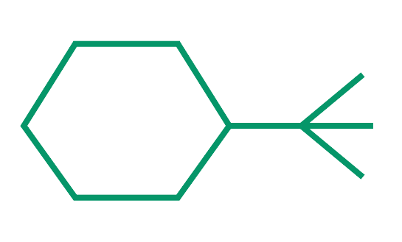
CARD B08 — NAME → STRUCTURE CHALLENGE Given Name: tert-butylcyclohexane
1. NAME DECODED
2. BOND-LINE STRUCTURE (THE ALKANE)
Parent: cyclohexane → 6-membered ring.
Substituent: tert-butyl group = -C(CH3)3.
Expected Formula: C6+4H2(10) = C10H20.
3. FORMULA CHECK
4. BACK-CHECK
Counted from drawing: C10H20
Cycloalkane rule: CnH2n for n = 10 → C10H20.
✓ Formula Verified
Returned Name: (1,1-dimethylethyl)cyclohexane
✓ Equivalent IUPAC Form
Explanation: The Alkane uses bracketed systematic substituent nomenclature for tert-butyl.
✓ parent length matches ✓ substituent positions match ✓ formula agrees ✓ back-check recorded

Slide 20
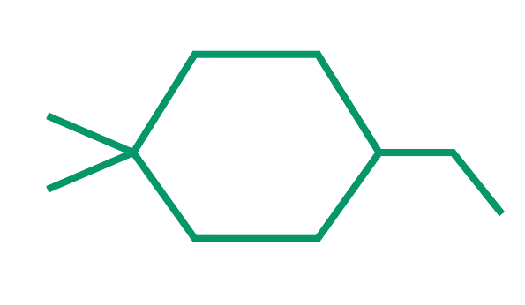
CARD B09 — NAME → STRUCTURE CHALLENGE Given Name: 3-ethyl-1,1-dimethylcyclohexane
1. NAME DECODED
2. BOND-LINE STRUCTURE (THE ALKANE)
Parent: cyclohexane → 6-membered ring.
Substituents: methyls at C1, C1; ethyl at C3.
Expected Formula: C6+2+2H2(10) = C10H20.
3. FORMULA CHECK
4. BACK-CHECK
Counted from drawing: C10H20
Cycloalkane rule: CnH2n for n = 10 → C10H20.
✓ Formula Verified
Returned Name: 3-ethyl-1,1-dimethylcyclohexane
✓ Same as given name
Rule Note: Doubly substituted carbon (C1) gets priority {1,1,3} over {1,3,3}.
✓ parent length matches ✓ substituent positions match ✓ formula agrees ✓ back-check recorded

Slide 21
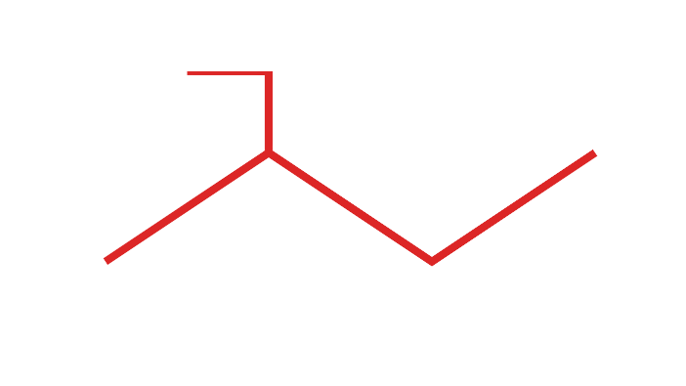
CARD B010 — NAME → STRUCTURE (RULE-TESTING CASE) CHALLENGE Given Name: 2-ethylbutane (INCORRECT)
1. NAME DECODED
2. BOND-LINE STRUCTURE (THE ALKANE)
Literal Drawing Instructions: Draw butane (4 C), attach ethyl (-CH2CH3) to C2.
Expected Formula: C4+2H2(6)+2 = C6H14.
3. FORMULA CHECK
4. BACK-CHECK
Returned Name: 3-methylpentane
X Mismatch (Given Name Broken Rule)
Rule Broken: Longest chain rule! Attaching ethyl to C2 extends the main chain to 5 carbons (pentane). An "ethyl" cannot exist at C2.
Counted from drawing: C6H14
Open-chain rule: C6H14.
✓ Formula Verified
✓ drawn literally ✓ longest chain error identified ✓ correct name derived ✓ back-check recorded

