Slide 1


Audio Emotion Classifier
Presented by Janelle Tam,
Yun Jia Zhuang, and Sina Salmannia

Slide 2
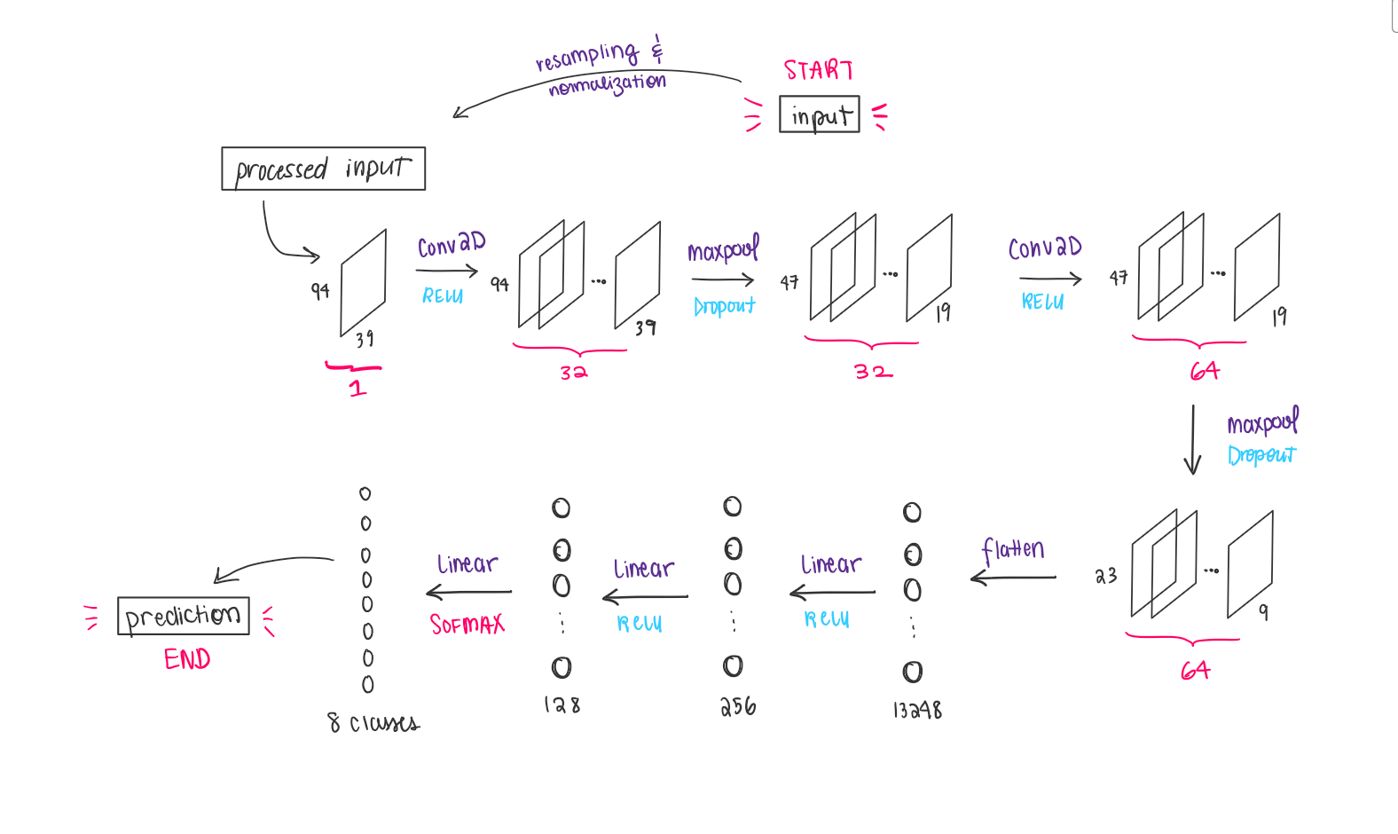
Our model and dataprocessing

Slide 3
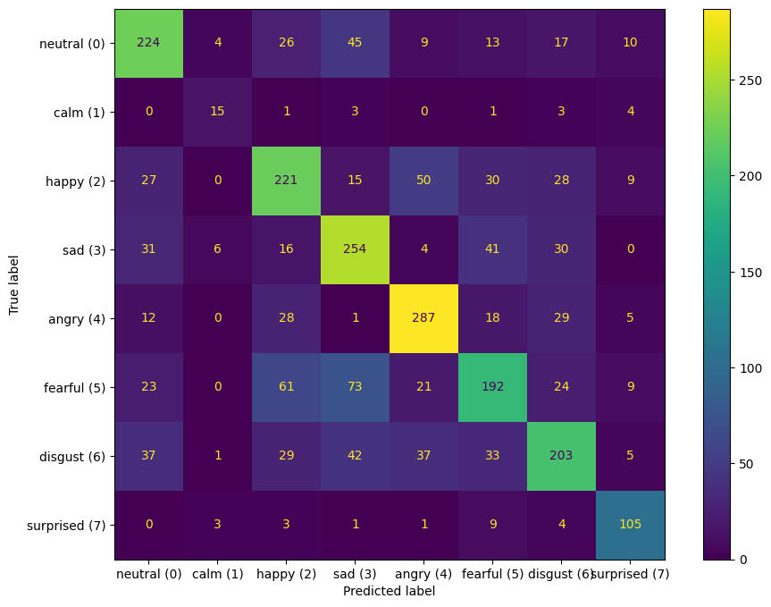
Results

Slide 4
Improvements to our model
Improving our model
Adding a dataset: EmoDB (German dataset)
Deleting files labelled ‘calm’ from dataset (not enough sample)
Removing silence from audio
Increasing audio length
Something happened…
New model never predicts the ‘surprise’ label…

Slide 5
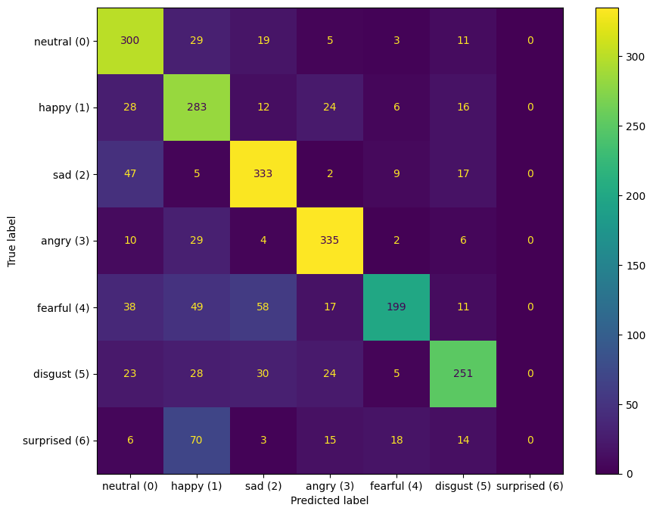
Challenges
Confusion matrix over
test dataset

Slide 6
Challenges
Confusion matrix over
entire dataset (train+test)

