Slide 1
IMDB Movie Data
SQL Exploratory Analysis · 2010–2019
Part 2 — SQL Summative Lab
145,081
8
2010–2019
3
Movies in Dataset
Tables in Database
Time Range
Key Deliverables

Slide 2
01
Initial Data Exploration Findings
📊 Dataset Scale
🎬 Genre Landscape
145,081 movies in scope (2010–2019). Production peaked in 2017 (~17,504 films/year). 2019 data is incomplete (~8,379 entries) — excluded per assignment instructions.
Drama dominates in volume (11,612 films). Documentary has the highest average rating (7.29) but draws only 173 average votes per film. Comedy (5,613 films) attracts the most audience votes at 1,217 per movie.
⚠️ Key Pattern — Ratings ≠ Engagement
📈 Horror's Growth Trend
High critical ratings and high audience engagement do NOT move together. Documentary is highest-rated but least-watched; Comedy rates lower yet drives 7× more votes. This divergence drives the business question.
Horror nearly doubled in production from 283 films (2010) to 602 films (2018) — a +113% increase — showing accelerating commercial interest despite lower average ratings (4.84) and 589 avg votes per film.

Slide 3
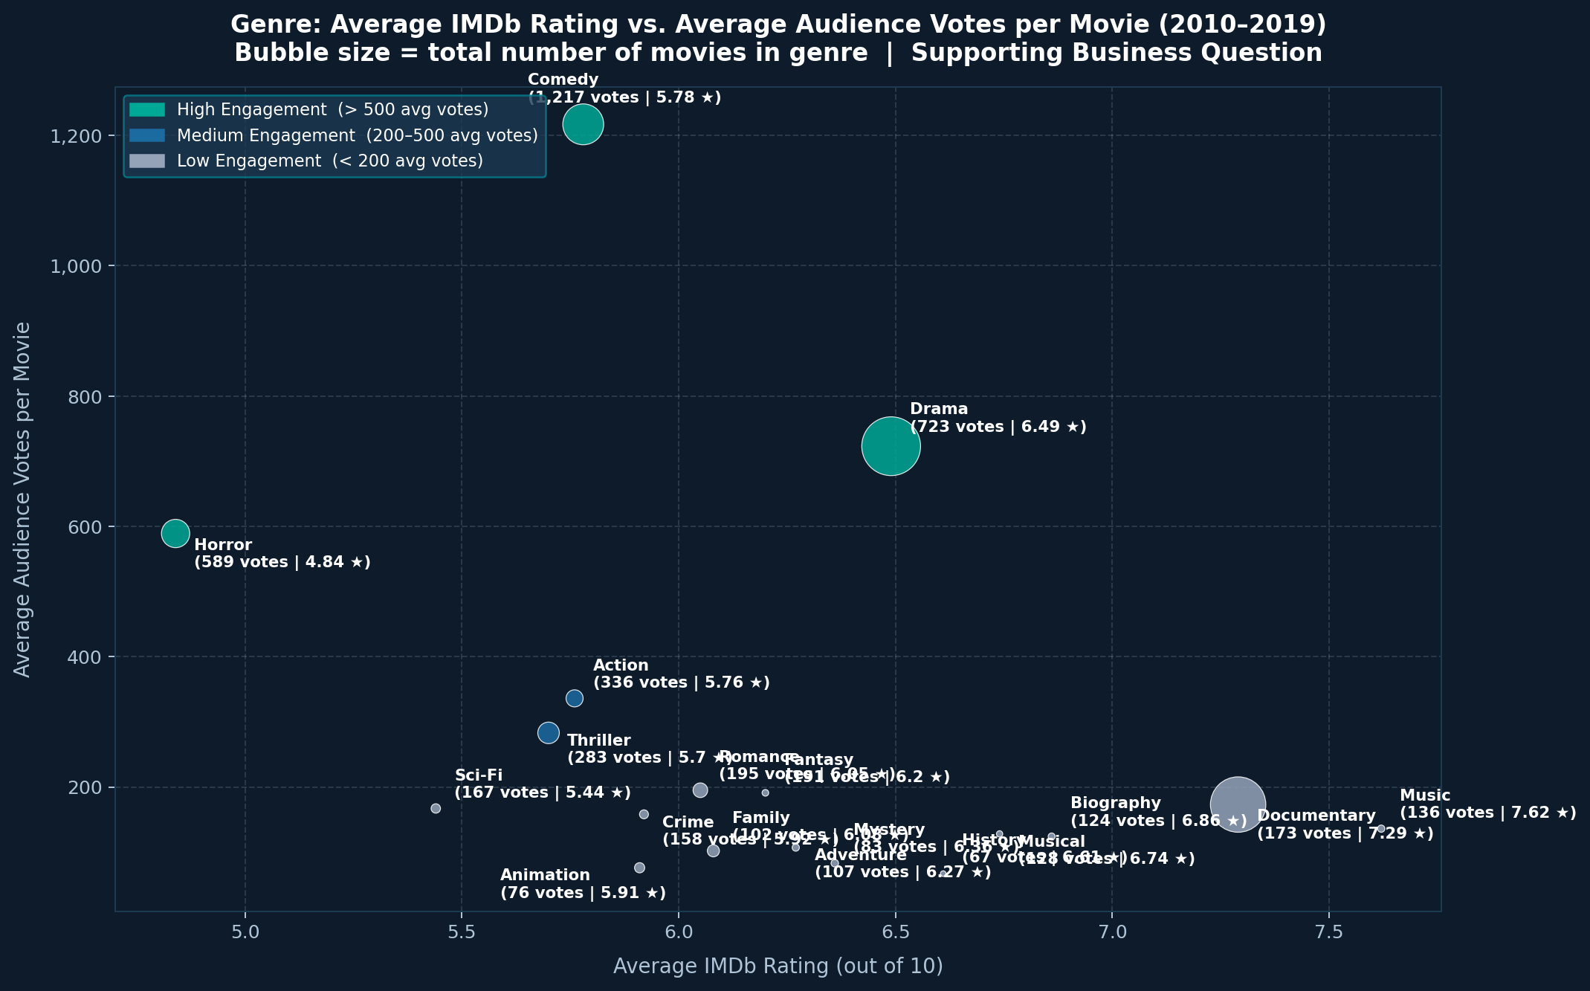
02
Business Question
The Question
For a new production studio entering the market, which single genre offers the best balance of audience engagement (average votes per film) and critical reception (average rating) — and does Horror's accelerating post-2015 production growth signal it is an emerging commercially undervalued opportunity?
Stems from:
Comedy: 1,217 avg votes — highest engagement
Documentary: 7.29 avg rating — highest rated, only 173 votes
Horror: 589 avg votes + near-doubling of output (2010→2018)
Drama: best balance — 6.49 rating + 723 avg votes

Slide 4
03
Data Cleaning Tasks Identified
01
Null runtime_minutes
02
Null genres
03
Null birth_year / death_year
NULL
HANDLING
30,765 records (21.2%) missing. Exclude via IS NOT NULL. If filling needed, use genre-median — document the strategy.
5,359 records (3.7%) missing genre labels. Must be excluded from all genre-level queries to prevent distortion of aggregates.
persons table: widespread nulls plus '\N' string placeholders from raw IMDB TSV files. Cast to integer before any age analysis.
04
Parse Multi-Genre Strings
05
Filter Low-Vote Outliers
06
Exclude Post-2019 Records
DATA
NORM.
genres stores comma-separated values (e.g., 'Action,Crime,Drama'). Must be split and exploded into one row per genre.
Titles with < 50 votes skew genre average ratings. Set and document a consistent minimum vote threshold before comparisons.
start_year > 2019 data is incomplete. Apply WHERE start_year BETWEEN 2010 AND 2019 consistently across every query.
07
Null movie_akas.region
08
Normalize Region Codes
09
Deduplicate movie_akas Entries
STAND-
ARDIZ.
Region field contains nulls. Exclude via WHERE region IS NOT NULL before any international distribution analysis.
Mixes ISO codes (US, GB), non-standard entries, and nulls. Standardize all region codes before international reach analysis.
Multiple rows per movie-region exist for different release types. Use COUNT(DISTINCT movie_id) to avoid double-counting.

Slide 5
04
Null Value Handling
WHAT THE ASSIGNMENT REQUIRES — AND HOW IT WAS ADDRESSED:
1
Be aware that the dataset contains null values in certain fields
Null presence was quantified before any analysis. movie_basics: runtime_minutes missing in 30,765 records (21.2%); genres missing in 5,359 records (3.7%). persons: birth_year null in 86.4% of records plus '\N' string placeholders. movie_akas.region also contains nulls.
2
Exclude these null values from your exploration
Every exploration query applies IS NOT NULL filters on genres, runtime_minutes, averagerating, and numvotes in the WHERE clause — ensuring AVG(), COUNT(), and SUM() only operate on complete rows. Example pattern:
WHERE mb.genres IS NOT NULL AND mr.averagerating IS NOT NULL AND mr.numvotes IS NOT NULL
3
Do not attempt to input or fill in missing information
No imputation, estimation, or filling of any kind was performed. Rows with null values are simply excluded from query results. The dataset is used strictly as-is. The trade-off (excluding 21.2% of runtime records) is acknowledged.
Source: IMDB | 145,081 movies | SQL Summative Lab — Part 2

