Slide 1
WORdLE
A Deep Reinforcement Learning Approach

Slide 2
Introduction - Wordle
A popular online word puzzle game.
Players need to guess a secret 5-letter word within a limited number of attempts.
After each guess, the system provides feedback by coloring the letters that are either present in the correct position within the original word or that appear in the word but are located differently.
Each guess needs to be a valid 5-lettered word.

Slide 3
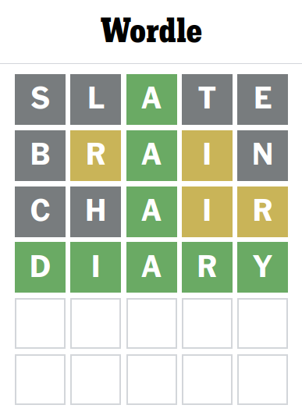
Introduction - Wordle

Slide 4
Motivation to use RL
Complexity: While wordle may seem simple, it involves a degree of complexity in terms of the strategies needed to efficiently guess the correct word within a limited number of attempts.
Feedback mechanism: The feedback provided after each guess, where letters are colour coded to indicate correctness, resembles the reward signal in RL.
Adaptability: Minimal changes would be required in the event of rule adjustments in the game, such as increasing the length of the target word or altering the number of attempts allowed, changes in the initial guess.

Slide 5
Environment
Game state representation:
Feedback mechanism
Reward function
Terminal condition

Slide 6
Environment - MDP (Game State Representation)
State representation: A 78-dimensional vector encodes each letter's correctness and position relative to the target word.
Action representation: Selecting a word from a dictionary, with masking to prevent repeated guesses.

Slide 7
Environment - Feedback Mechanism
After each guess made by the agent, the environment provides feedback on the correctness of the guess.
This feedback includes information on which letters are correct and in correct position, which letters are correct but in wrong position, and which letters are not present in the target word at all.

Slide 8
Environment - Reward Function
Correct Word:
+10 reward for guessing the target word correctly.
Attempts Exhausted: -10 penalty for exhausting attempts without guessing correctly.
Midway Progress: +1 reward for each correctly positioned letter in the guessed word.

Slide 9
Environment - Terminal Condition
Correct Guess: The agent correctly guesses the target word within the specified number of attempts. This is the desired outcome, and achieving it results in a successful completion of the game.
Attempts Exhausted: The agent exhausts all available attempts without correctly guessing the target word. This indicates that the agent was unable to identify the word within the given constraints and results in an unsuccessful completion of the game.

Slide 10
Analysis of Algorithms
Environment formulation reveals that state space and action space are large. Not feasible to apply tabular methods. Hence, the following two algorithms are implemented:
Double DQN
Advantage Actor Critic

Slide 11
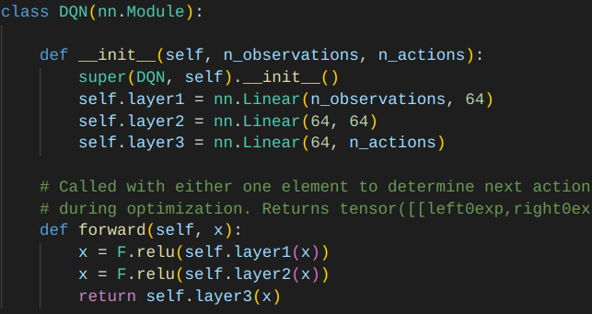
Analysis of Algorithms - DDQN

Slide 12
Analysis of Algorithms - DDQN
In this, we parameterize the Q-function to find an estimate of the Q-value for a given state and action pair.
Replay buffer has been used to make the data points independent.
We have used Double DQN, which has separate Q-network functions, one for finding the optimal action and another for finding the Q-value.
Epsilon greedy action selection is used to achieve a balance between exploration and exploitation.

Slide 13
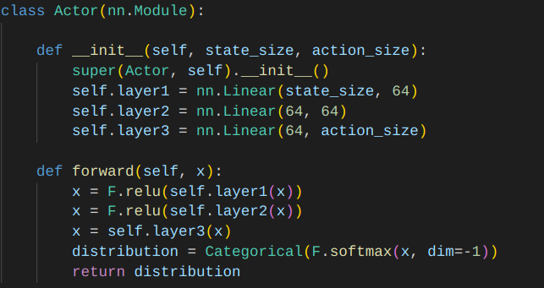
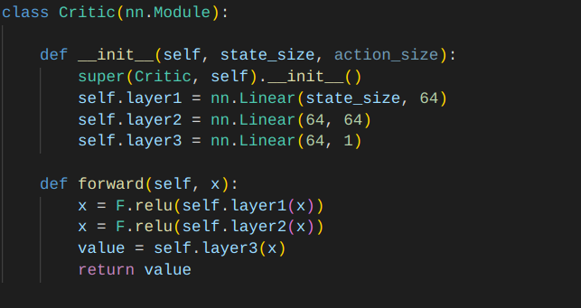
Analysis of Algorithms - A2C

Slide 14
Analysis of Algorithms - A2C
Actor: Selects actions based on the policy to maximize rewards, continually refining it to adapt to the environment.
Critic: Evaluates actor's actions, providing feedback to guide towards higher returns and improve learning.
The advantage function, A(s,a), measures the advantage of taking action a in state s​ over the expected value of the state under the current policy. A(s,a) = Q(s,a) - V(s)

Slide 15
Results - DDQN
When training our model for 300,000 epochs, it took approximately 3 hours.
Trials with SALET start: 1000, Success rate: 0.71, Average number of attempts: 4.95
Trials with exploration: 1000 , Success rate: 0.60, Average number of attempts: 5.16

Slide 16
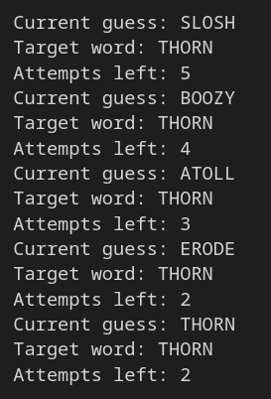
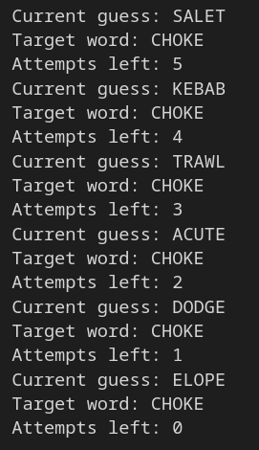
Results - DDQN

Slide 17
Results - A2C
When training our model for 300,000 epochs, it took approximately 1 hours.
Trials with SALET start: 1000, Success rate: 0.76, Average number of attempts: 4.80
Trials with exploration: 1000 , Success rate: 0.7, Average number of attempts: 4.98

Slide 18
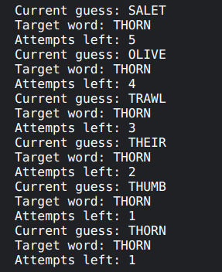
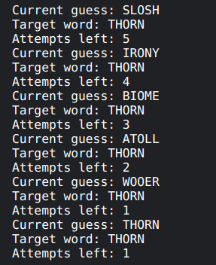
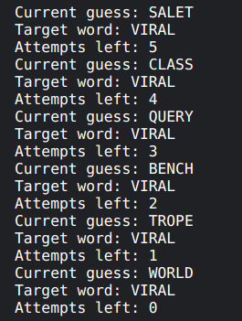
Results - A2C

Slide 19
Comparison: DDQN vs A2C
Advantage of A2C over DDQN:
Faster Convergence: The method’s ability to update both the policy and value function concurrently contributes to faster convergence during training, enabling quicker adaptation to the learning task.
Improved Sample Efficiency: The hybrid nature of Actor-Critic algorithms often leads to improved sample efficiency, requiring fewer interactions with the environment to achieve optimal performance.

Slide 20
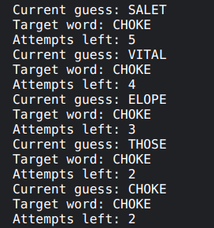
Comparison: DDQN vs A2C
DDQN
A2C

Slide 21
Novelty
In our environment, we're not giving away the exact positions of the correct letters you've guessed. Instead, our agent is trained to make its next move by preserving the positions of the letters you've already nailed down in previous attempts.
Rather than relying on a standard model, we’ve integrated an advantage technique into our actor-critic framework in the hope of better results.

Slide 22
References
Wordle
Double Deep Q-Network
Advantage Actor Critic

Slide 23
Thank You
Harsh Shah (IMT2020006)
Ujjwal Agarwal (IMT2020128)
Anwit Damale (IMT2020532)

