Slide 1
[ Model ]
combine.0
(one product)
excited-inception3-180-02c
four 180x180 ^{#1}
SE-inceptionV3 (short epoch)
dim=4x2048
sftp://root@192.168.1.115/root/share/project/kaggle/cdiscount/results/gated-combined4-00c
LB=0.69809
FcNet3 (MLP with feature-scaling) *less dropout (p=0.15,0.15,0.20)
valid (split v0) = 0.6841
excited-resnet50-180-00a
(one product)
probability 5270
four 180x180 ^{#1}
SE-Resnet-50 (short epoch)
dim=4x2048
dim=4x8192
concate
LB=0.68939
valid (split v0) = 0.6749
excited-resnext101-180-03b
SE-ResNext101 (short epoch)
dim=4x2x2048
LB = 0.76630 valid (split v0) = 0.7699
four 180x180 ^{#1}
+ flip
LB=0.71064
valid (split v0) = 0.7006
#1 : if the product has less than 4 images, it is stuffed with zero images

Slide 2
combine.1
(one product)
excited-inception3-180-02c
four 180x180 ^{#1}
SE-inceptionV3 (short epoch)
dim=4x2048
sftp://root@192.168.1.115/root/share/project/kaggle/cdiscount/results/gated-combined4-drop0.3-01a
LB=0.69809
FcNet3 (MLP with feature-scaling) *more dropout (p=0.50,0.30,0.30)
valid (split v0) = 0.6841
excited-resnet50-180-00a
(one product)
probability 5270
four 180x180 ^{#1}
SE-Resnet-50 (short epoch)
dim=4x2048
dim=4x8192
concate
LB=0.68939
valid (split v0) = 0.6749
excited-resnext101-180-03b
SE-ResNext101 (short epoch)
dim=4x2x2048
LB = 0.76803
valid (split v0) = 0.7712
four 180x180 ^{#1}
+ flip
LB=0.71064
valid (split v0) = 0.7006
#1 : if the product has less than 4 images, it is stuffed with zero images

Slide 3
combine.2
sftp://root@192.168.1.115/root/share/project/kaggle/cdiscount/results/gated-combined4-05a
(one product)
resnet101-160-08b
FcNet3 (MLP with feature-scaling) *more dropout (p=0.50,0.30,0.30)
four 180x180 ^{#1}
ResNet101 (long epoch)
dim=4x2x2048
+ flip
(one product)
LB=???
dim=4x8192
valid (split v1) = 0.7256
concate
probability 5270
xcpetion-20b
four 180x180 ^{#1}
Xception (long epoch)
dim=4x2x2048
+ flip
LB=???
LB = 0.77185 valid (split v1) = 0.7753
valid (split v1) = 0.7192
#1 : if the product has less than 4 images, it is stuffed with zero images

Slide 4
combine.5
(one product)
se-resnext101-51c
fcnet3-dpn-seresnext-00b
SE-ResNext101 (long epoch)
dim=4x2x2048
FcNet3 (MLP with feature-scaling) *more dropout (p=0.50,0.30,0.30)
four 180x180 ^{#1}
+ flip
(one product)
LB= >0.71827 #1
dim=4x8192
valid (split v0) = 0.7487 #2 #1 this is LB score for early iterations (not the final model) #2 some overlap of train/validation dataset
concate
probability 5270
dpn92-180-05a
four 180x180 ^{#1}
Dpn92 (long epoch)
dim=4x2x2048
+ flip
LB = 0.7817 valid (split v0) = 0.77027
LB=???
valid (split v0) = 0.7218
#1 : if the product has less than 4 images, it is stuffed with zero images

Slide 5
combine.5max
(one product)
se-resnext101-51c
fcnet1-dpn-seresnext-00f
SE-ResNext101 (long epoch)
dim=4x2x2048
FcNet1 (MLP with view max pooling) *more dropout (p=0.50,0.20,0.20)
four 180x180 ^{#1}
+ flip
(one product)
LB= >0.71827 #1
dim=4x8192
valid (split v0) = 0.7487 #2 #1 this is LB score for early iterations (not the final model) #2 some overlap of train/validation dataset
concate
probability 5270
dpn92-180-05a
four 180x180 ^{#1}
Dpn92 (long epoch)
dim=4x2x2048
+ flip
LB = 0.7791 valid (split v0) = 0.76812
LB=???
valid (split v0) = 0.7218
#1 : if the product has less than 4 images, it is stuffed with zero images

Slide 6
combine.5mix
(one product)
se-resnext101-51c
ffcnet0-dpn-seresnext-soft-02a
SE-ResNext101 (long epoch)
dim=4x2x2048
FcNet1 (MLP with view max pooling) *more dropout (p=0.50,0.20,0.20)
four 180x180 ^{#1}
+ flip
(one product)
LB= >0.71827 #1
dim=4x8192
valid (split v0) = 0.7487 #2 #1 this is LB score for early iterations (not the final model) #2 some overlap of train/validation dataset
concate
probability 5270
dpn92-180-05a
four 180x180 ^{#1}
Dpn92 (long epoch)
dim=4x2x2048
+ flip
LB = 0.7743 valid (split v0) = 0.76478
LB=???
valid (split v0) = 0.7218
mixup augmentation at training #2
#1 : if the product has less than 4 images, it is stuffed with zero images
#2 : "mixup: Beyond Empirical Risk Minimization" - Hongyi Zhang, ... arvix 2017 (https://arxiv.org/abs/1710.09412)

Slide 7
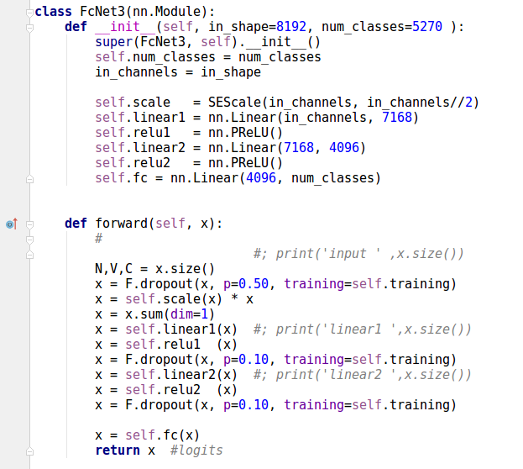
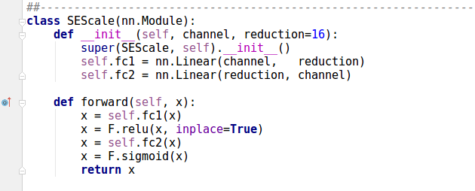
[ Fuse net ]
FcNet3: view feature scaling (gating)
gate
N = batch size = 4096
V = num of images per product = 4
C = concat feature dim = 8192

Slide 8
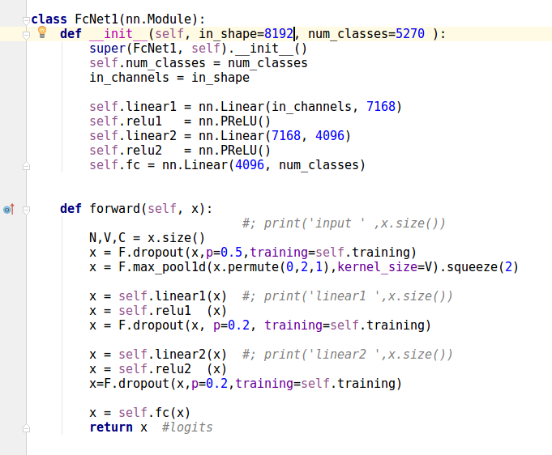
FcNet1: view feature max pooling
max pool
N = batch size = 4096
V = num of images per product = 4
C = concat feature dim = 8192

Slide 9

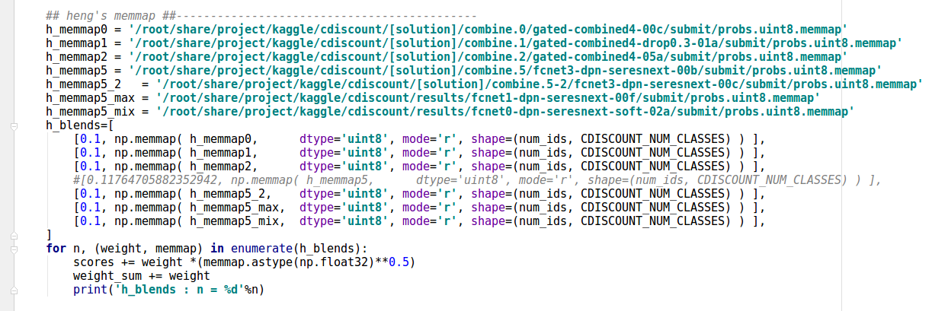
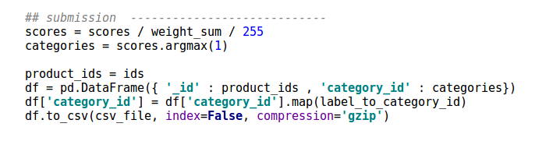
Ensembling of all fuse nets:
reshape probability

Slide 10
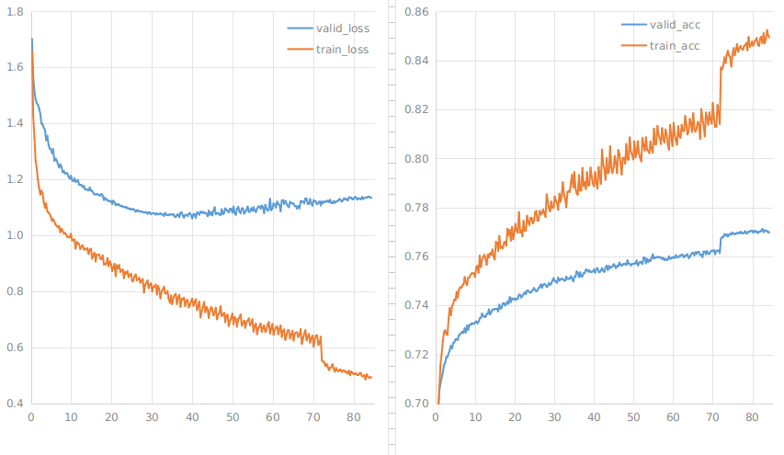
Difference loss (Training/Validation) for model combine.1
train = 0.8471 validation = 0.7712 public LB = 0.76803
rate = 0.001
rate = 0.01
epoches
# rate = 0.0001 didn't improve results (not shown here)
epoches
epoches
Compare generalisation: - validation accuracy is about 0.07 lower than train accuracy - LB accuracy is close to validation accuracy, less than 0.01 difference

Slide 11
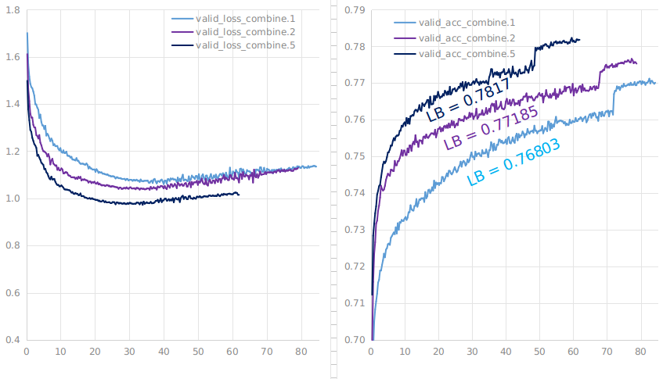
Training loss for difference models combine.1,2,5
epoches
epoches
Compare base net: - if base net is better, fuse net is also better

Slide 12
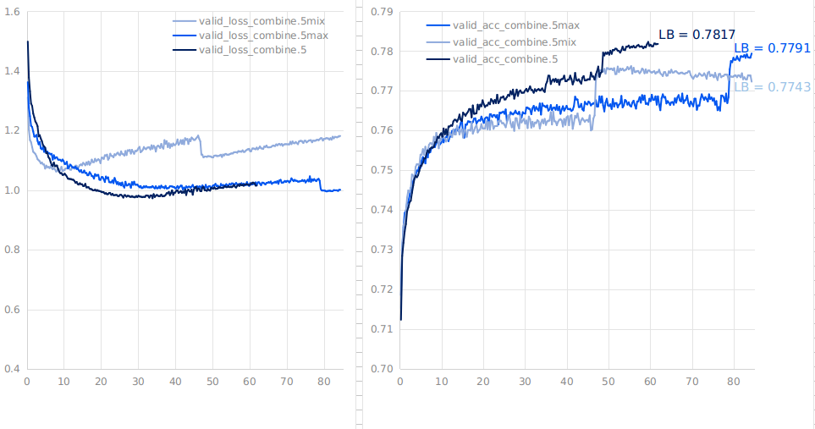
Training loss for difference fuse net
Compare fuse net: - fcNet3 (view scaling) is better than fcNet1 (view max pooling) - fcNet1 (view max pooling) is better than FcNet0 (view max pooling + mixup augmentation)

