Slide 1
0. System setup
Hardware requirement
- GPU Machine: 4x 1080Ti
- SSD 256 GB
Software requirement
- pytorch 0.30
- python 3.6 (for IDE, pycharm is used)

Slide 2
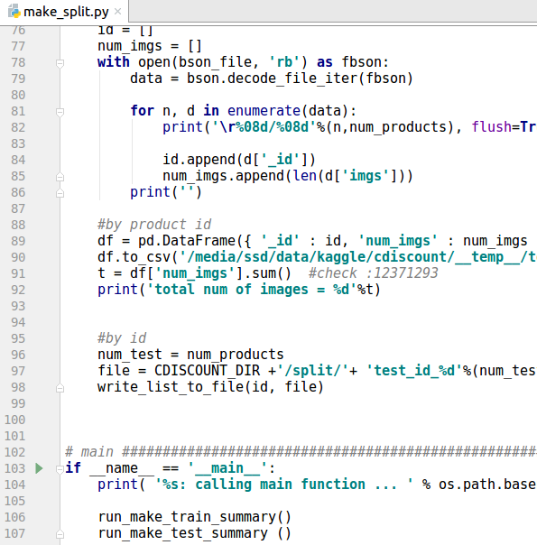
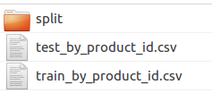
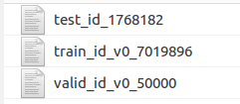
1. Split dataset
script: solution-submit-1/dataset/make_split.py
This create "test_by_product_id.csv", "train_by_product_id.csv" to faciliate loading of dataset
"train_id_v0_7019896", "valid_id_v0_50000", "test_id_1768182" are created for training, validation and testing respectively.

Slide 3
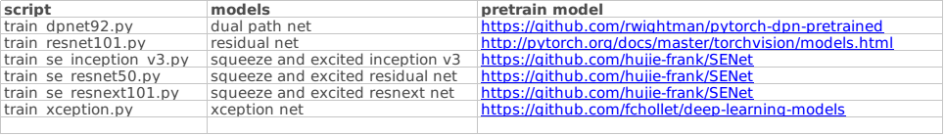
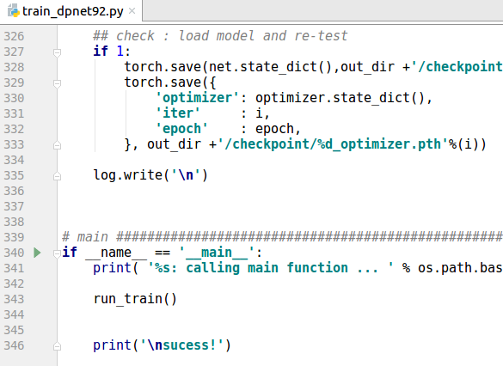

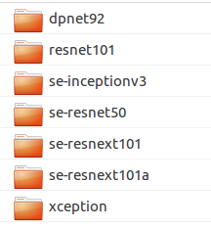

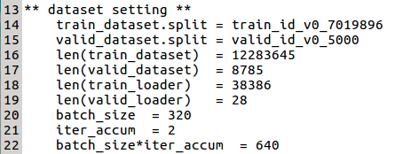
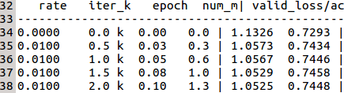
2. Train 7 base nets
script: solution-submit-1/train_<network>.py
Each of the train_<network>.py train the base nets, where <network> are dpn, resnet, etc
We use image pretrained model, see below:
We use image pretrained model and SGD optimizer with hand tunned learning rate of 0.01, 0.001 and 0.0001.
For actual use of parameters, please refer to the training log files provided.
As an example, we show dpnet92.py
final iterations = 32000
batch size
code/training_log/base_nets
learning rate

Slide 4
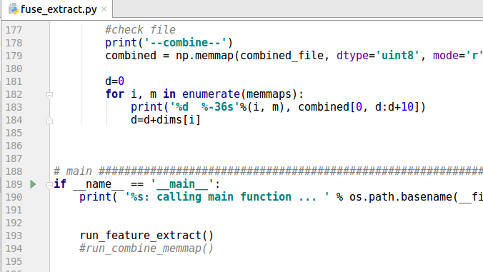
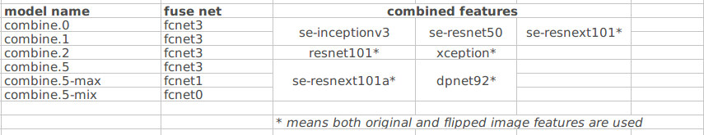
3. Extract the features of base nets
script: solution-submit-1/fuse_extract.py
run_feature_extract(): for a base net, extracts features of all images and saves as a numpy memmap file run_feature_extract(): combines 2 to 3 numpy memmap files into one. The combined files are use to train fused net later.
how to combine features (memmap files)

Slide 5
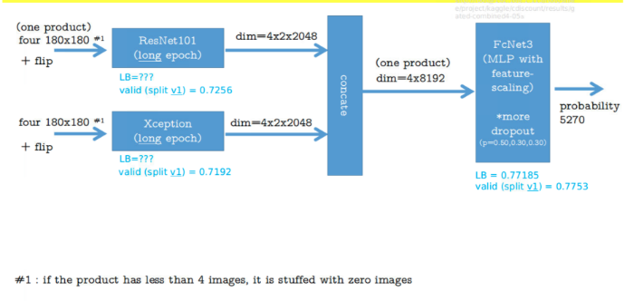
4. Train 6 fuse nets
script: solution-submit-1/fuse_train_fcnet<3,1,0>.py
A fuse net is one that load input features of base net (from numpy combined memmap file). An example is shown in the digram below. There are three type of fuse nets fcNet3, fcNet0, fcNet1 used, each differs in their structure.
fuse net

Slide 6
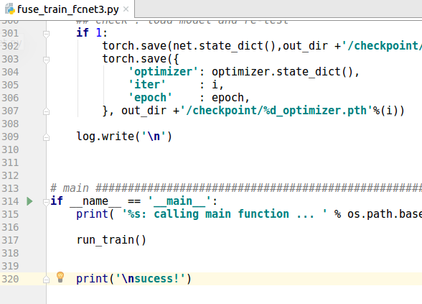
The fuse net are trained from scratch, with random initialisation.
Similiar to the base nets, we use SGD optimizer with hand tunned learning rate of 0.01, 0.001 and 0.0001. We also provide the training log files to show are train parameters are used.

Slide 7
5. Make submit cvs for single fuse net
script: solution-submit-1/fuse_train_submit_cvs.py
Make submit cvs file for each of the model in step.4. Note that the extracted features of the test images should be prepared in the same way (as the training) to make the memmap file.
A memmap file of the test results is also produced for blending in the next step.
6. Make submit cvs for ensembled fuse net
script: solution-submit-1/blend.py
Blend the results of the 6 fuse nets from step 5 to make an ensembled submit cvs file..

