Slide 1



Personal Voice Assistant
Presented by :
Janet Flavia Francis
Sharon Yadav
Prashant Karhale
(Center Coordinator)
Akshay Tilekar
(External Guide)

Slide 2
Introduction :
Personal digital assistants are capturing a lot of attention lately.
Chatbots are common in most commercial websites.
With growing advancements in artificial intelligence, training the machines to tackle day-to-day tasks is the norm.
Voice based personal assistants have gained a lot of popularity in this era of smart homes and smart devices.
My Desktop Voice Assistant takes the user input in form of user’s voice and processes it and return the output in various ways like an action to be performed or the search result is speaked out to the end user
My very own “Digital” Personal voice Assistant,though is not as capable and high as Amazon’s Alexa or Google Assistant, Home or Apple’s Siri or JARVIS from Iron Man, but I’ve tried doing images classification by just a voice command

Slide 3
Aim of this project…..
Currently, the project aims to provide the Windows Users with a Virtual voice Assistant that would not only aid in their daily routine tasks like searching the web, extracting document data, vocabulary help and many others but also help in automation of various activities.
In the long run, we aim to develop a complete server assistant, by automating the entire server management process - deployment, backups, auto-scaling, logging, monitoring and make it smart enough to act as a replacement for a general server administrator.

Slide 4
How we have implemented new features….
We’ll be using the pyttsx3 package which is a text-to-speech library for Python. The basic reason why we use this is because it works offline.
Another basic requirement of this project will be Python’s Speech Recognition library.
There are other requirements for the project which are listed below(libraries used).
Numpy
Matplotlib
Os
pyttsx3
speech_recognition
datetime
webbrowser
walk
Wikipedia
datetime
The overall system design consists of following phases: (a) Data collection in the form of user’s voice (b) Voice analysis and conversion to text (c) Data storage and processing (d) Generating the task to be done from the processed text output

Slide 5
Flow chart
Image classes
Load images category-wise
Size Normalization(Resizing & flattening)
Training data with SVM
Setting of model parameters
Splitting data
Models
SVM Classisfication on prediction dataset
Classified in N - classes

Slide 6
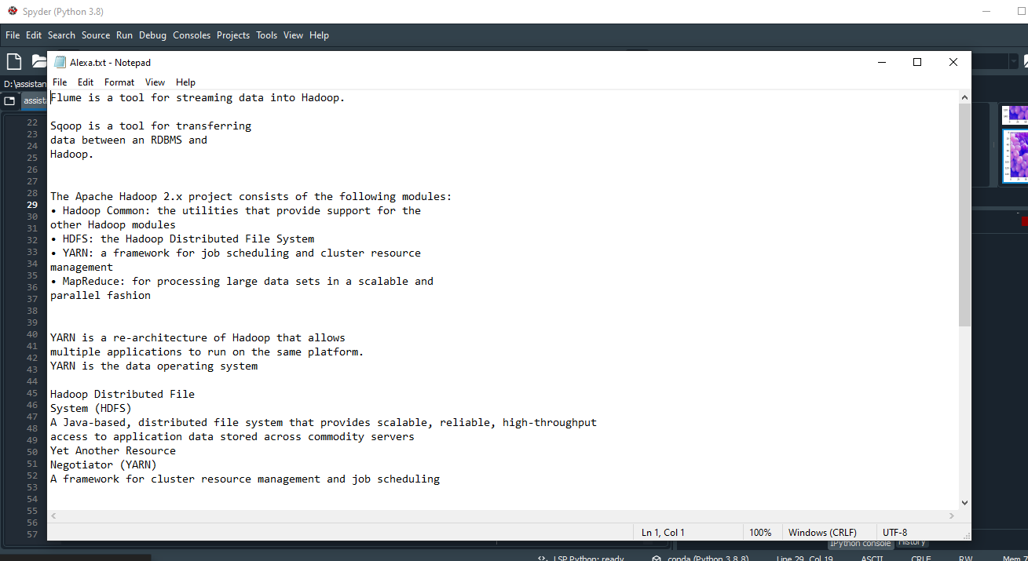
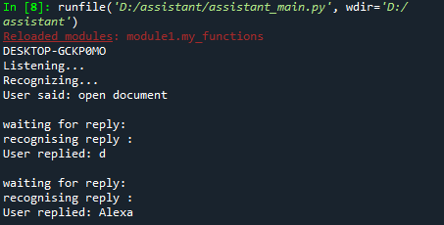
Feature in Voice Assistant:
1. Opening document
Our personal assistant is designed for searching any document or any type of file example jpg from local machine by taking the voice command from the user.It doesn’t matter what extension it has.

Slide 7
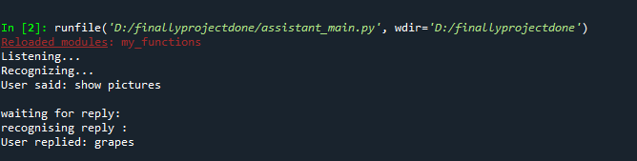
2. Image classification
Have you ever stumbled upon a dataset or an image and wondered if you could create a system capable of differentiating or identifying the image? The concept of image classification will help us with that. Image Classification is one of the hottest applications of computer vision and a must-know concept for anyone wanting to land a role in this field.
Our personal assistant is designed to do that also we will see a very simple but highly used application that is Image Classification. Not only will we see how to make a simple and efficient model classify the data but also learn how to implement a pre-trained model and compare the performance of the two.
1

Slide 8
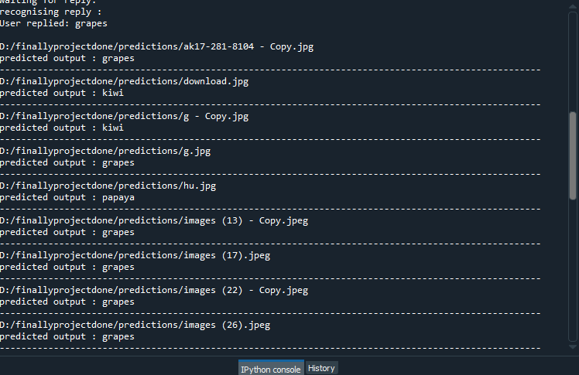
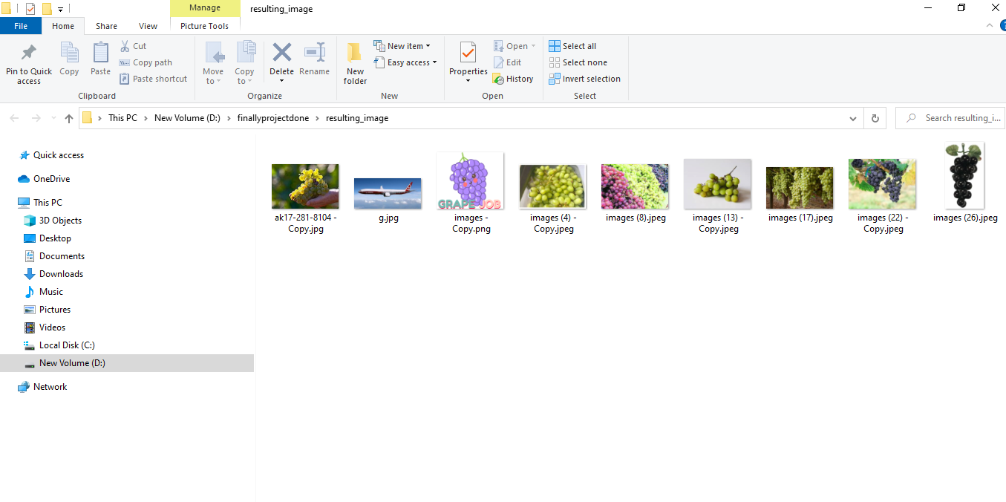
2
3

Slide 9
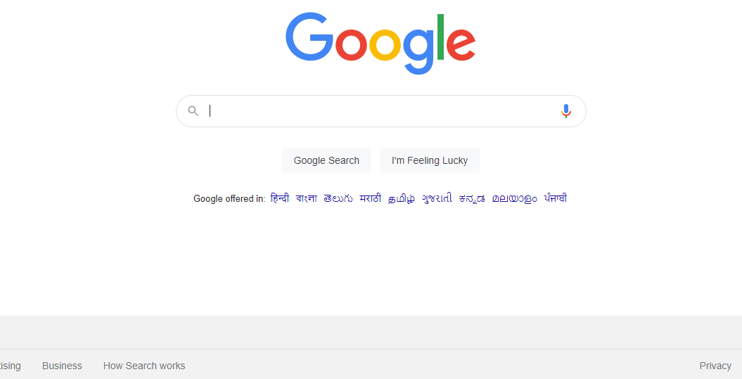
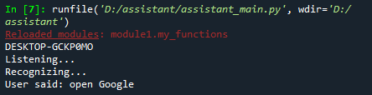
3. Queries from the web:
Making queries is an essential part of one’s life, and nothing changes even for a developer working on windows. We have addressed the essential part of a netizen’s life by enabling our voice assistant to search the web. Personal assistant supports Google, Google displays the result according to voice queries.

Slide 10
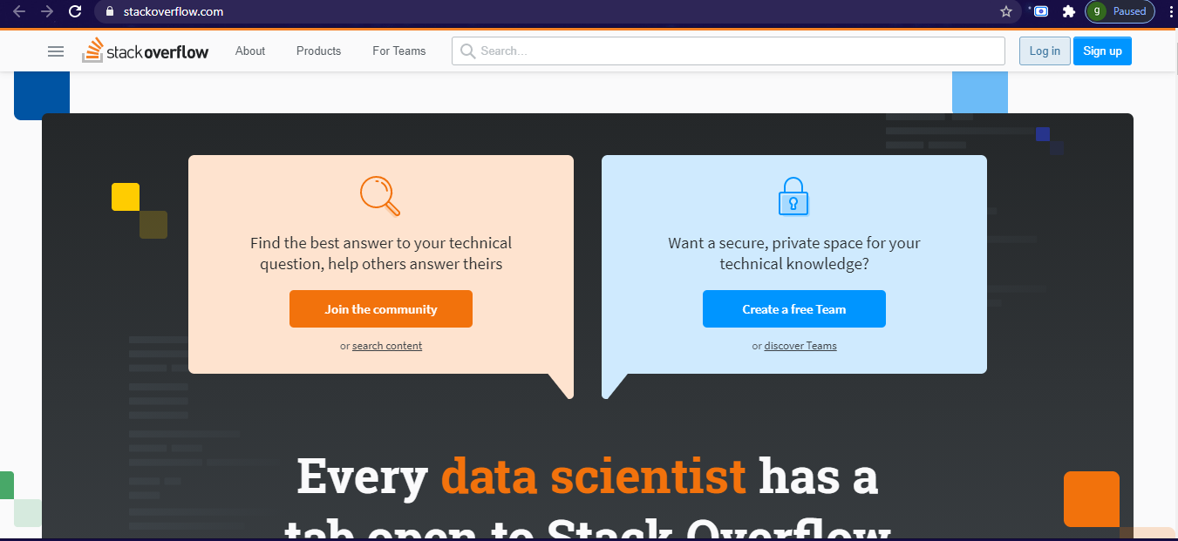

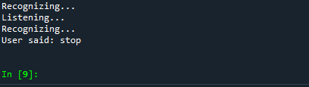
4. OPEN STACKOVERFLOW
5. IT STOP’S WHEN USER SAYS STOP

Slide 11
Future Prospective….
Undoubtedly, Desktop Assistants are a great help for e-commerce stores. The goal is to provide people a quick and easy way to have their questions answered.
It would be wrong to say that Desktop Assistant is evolving. Desktop Assistant are more intelligent. Even there are reports that 80- 85% of businesses will be giving out more enhanced Desktop Assistants by 2020. Natural Language Programming (NLP) helps in giving a raised human involvement, hence making the Desktop Assistants more communicative.
We’ll be incorporating document classification and using NLP for more precise voice recoginition.

