Slide 1
Module 6
Testing and Troubleshooting
Microsoft® Windows Communication Foundation Services
Notes:
Presentation: 60 minutes
Diagnose service errors and symptoms.
Expose fault information from Microsoft® Windows Communication Foundation (WCF) services and consume faults from client applications.
Use debugging and diagnostics tools for service monitoring and troubleshooting.
Appreciate the importance of runtime governance.
Read all of the materials for this module.
Practice performing the demonstrations and the lab exercises.
Work through the Module Review and Takeaways section, and determine how you will use this section to reinforce student learning and promote knowledge transfer to on-the-job performance.
Preparation Tasks
To prepare for this module:
Required materials
To teach this module, you need the Microsoft® Office PowerPoint® file 10263A_06.ppt
Important: It is recommended that you use PowerPoint 2002 or a later version to display the slides for this course. If you use PowerPoint Viewer or an earlier version of PowerPoint, all the features of the slides might not be displayed correctly.
Lab: 60 minutes
After completing this module, students will be able to:
Course 10263A
Module 6: Testing and Troubleshooting Microsoft® Windows Communication Foundation Services

Slide 2
Module Overview
Errors and Symptoms
WCF Faults
Debugging and Diagnostics Tools
Runtime Governance
Notes:
Course 10263A
Module 6: Testing and Troubleshooting Microsoft® Windows Communication Foundation Services

Slide 3
Lesson 1: Errors and Symptoms
Understanding Errors in Distributed Systems
Understanding Common Error Symptoms
Notes:
Course 10263A
Module 6: Testing and Troubleshooting Microsoft® Windows Communication Foundation Services

Slide 4
Understanding Errors in Distributed Systems
Distributed systems are complex and involve many types of errors:
✓
Corrupt messages
Timeouts
Large messages
Network problems
Functional errors
Concurrency problems
Transactions problems
Configuration errors
Channel mismatch
Wrong channel state
Notes:
Distributed systems involve many complex mechanisms in their implementation. With this complexity comes various types of errors that can occur. Listed here are some of the most common errors, as well as suggestions for fixing the problem—where available.
Corrupt messages
Something is wrong with the message received: Usually there is a wrong “action” or a malformed header. The reason might be as simple as an XML namespace inconsistency between the client and the service. Sometimes the message itself is corrupt due to communication errors, but this is quite rare.
Timeouts
The time to send a message or the time to receive an answer exceeds a predefined timeout. Usually this is a symptom for another problem, such as an overloaded server.
Large messages
Serialization is a CPU-intensive operation. Large messages are expensive with regard to communication resources, CPU, and memory. WCF is configured to have a limit for serialization depth as well as message size. If the service needs to support large messages, a simple configuration change can solve the problem.
Network problems
Sending a message requires a healthy transport channel. A broken socket prevents WCF communication. You can check the network health using network monitoring and diagnostics tools.
Functional errors
The service code or the code it consumes can fail due to a bug or invalid input. Make sure the service code is well tested. Make sure the input sent to the service is valid.
Concurrency problems
Each service invocation is serviced by a different thread. The wrong concurrency mode or code that is not thread-safe can cause the service to block indefinitely, to corrupt data, to enter a deadlock, or to throw an exception and fail.
Course 10263A
Module 6: Testing and Troubleshooting Microsoft® Windows Communication Foundation Services

Slide 5
Notes Page Over-flow Slide. Do Not Print Slide. See Notes pane.
Notes:
Transaction problems
A service might execute inside a transaction. Failure to set the transaction isolation mode correctly might cause deadlocks or data corruption.
Configuration errors
WCF services are usually configured using an XML configuration file. When there are errors in the configuration (for example, referencing a behavior that does not exist), the host will throw an exception during the execution of the ServiceHostBase.Open method. WCF will include detailed information about the problem in the exception message.
Channel mismatch
Using different bindings on the client and the service is akin to two people trying to communicate in different languages. If the client and the service use different bindings (or different binding configurations), messaging will fail. Ensure the channel configuration is consistent on both sides.
Wrong channel state
A channel can only be used when it is in the Opened state. Trying to communicate over a channel in the Faulted state will cause an exception. The channel’s state must be checked before it is used.
Question: What can go wrong if a service is not configured to allow multiple clients?
Answer: A service that does not support multiple clients will be able to support only one concurrent client at a time. If the service is called by numerous clients, each client will need to wait for the previous client to complete its process, and eventually this can cause clients to time out and fail.
Module 6: Testing and Troubleshooting Microsoft® Windows Communication Foundation Services
Course 10263A

Slide 6
Understanding Common Error Symptoms
The client throws an exception
✓
The client or service blocks indefinitely
✓
An invalid response is received
✓
The host throws an exception
✓
Messages disappear or go out of order
✓
Notes:
There are many symptoms that can make us suspect that something went wrong.
Exceptions. The most trivial sign for a failure is an exception. The server catches every unhandled exception, and forwards it back to the client.
WCF default behavior is to throw an exception on the client-side. The exception does not include any information about the problem, and does not expose intimate information about the service application.
Sometimes exception are handled at the service without being transmitted to the client.
Only reviewing the service logs might reveal their existence and cause. (Logging and monitoring will be discussed later in this module)
Invalid response. If the result is invalid, something went wrong.
Service blocks. The client calls the service, but the response will never arrive. The service might block due to a transaction lock, or a concurrency issue. The client might have locked and failed to send or receive the message.
Message disappears. Usually this an illusion, and the real issue is concurrency. Message loss is a known issue in the communication arena.
Course 10263A
Module 6: Testing and Troubleshooting Microsoft® Windows Communication Foundation Services

Slide 7
Lesson 2: WCF Faults
Introducing Fault Messages
Designing Fault Contracts
Using Faults and Exceptions
Declaring Typed Faults with Data Contracts
Using Typed Faults with Data Contracts
Handling FaultException<T> on the Client
Understanding WCF Exception Information
Using Error Handlers
Notes:
Course 10263A
Module 6: Testing and Troubleshooting Microsoft® Windows Communication Foundation Services

Slide 8
Introducing Fault Messages
Services are based on message (data) exchange
✓
.NET error handling is based on the Exception class
✓
The data representation of an error is a fault message
✓
The SOAP standard defines a special section in the SOAP message for fault information
✓
Notes:
Services are about data. Service-Oriented Architecture (SOA) is based upon data exchange, in contrast to object-oriented programming (OOP ) languages and frameworks that are based on objects.
Microsoft.NET is an OOP framework, and its error handling is based on the Exception class.
Fault messages are the SOA equivalent to exceptions.
.NET code throws exceptions; SOA services response with fault messages.
Fault messages are standardized. Faults are an integral part of the SOAP standard. The following is an example of a SOAP fault:
<s:Body>
<s:Fault>
<s:Code>
<s:Value>s:Sender</s:Value>
</s:Code>
<s:Reason>
<s:Text xml:lang="en-US">Demo</s:Text>
</s:Reason>
<s:Detail>
<ErrorInfo xmlns="http://schemas.datacontract.org/2004/07/CalcService" xmlns:i="http://www.w3.org/2001/XMLSchema-instance">
<Info>This is an error</Info>
</ErrorInfo>
</s:Detail>
</s:Fault>
</s:Body>
Question: Why is it important that the fault message will be returned using a standard format?
Answer: A service should be interoperable, meaning you can use various technologies to call the service. Therefore, WCF services use the SOAP standard for messages, whether it is for requests, responses, or faults.
Course 10263A
Module 6: Testing and Troubleshooting Microsoft® Windows Communication Foundation Services

Slide 9
Designing Fault Contracts
Services operate under a variety of assumptions; if these assumptions are not met, an error should be returned to the client
✓
A fault contract is the shape of the error information
✓
The client can use the fault contract to learn about the service’s assumptions
✓
The client and the service must prepare for expected and unexpected faults
✓
Notes:
Like any other software, services are based on assumptions.
When assumptions break in normal .NET code, it throws they throw an exception. Services, on the other hand, respond with a fault message.
In both scenarios, the developer knows the assumptions, and can declare the types of the errors that might be thrown. This can help the client and the service implement better error handling.
The service uses service contracts and data contracts to define the shape of messages. The same idea is used to define fault messages.
To implement proper error handling, the client must know about the fault messages that might be returned.
Fault contracts are used to exchange fault message schema between the service and its clients.
The faults can teach the client about the service’s assumptions.
There are numerous types of errors. This means that the client must be prepared for fault messages that are declared by the service, and as well as for general faults originating from other types of errors.
Course 10263A
Module 6: Testing and Troubleshooting Microsoft® Windows Communication Foundation Services

Slide 10
Using Faults and Exceptions
WCF catches all unhandled exceptions that occur within the service code, and creates an untyped fault message
✓
When the client receives a fault message, WCF throws
an empty FaultException
✓
You can configure WCF to send unhandled exception details to the client inside the fault message
✓
The client will receive a
FaultException<ExceptionDetail> exception
✓
<behavior name=“. . .">
<serviceDebug includeExceptionDetailInFaults="true"/>
</behavior>
Notes:
WCF catches all unhandled exceptions that occur within the service code. This prevents the host process from crashing in case of an unhandled exception.
If the exception is not declared in a fault contract, WCF will create a new empty fault message and send it back to the client.
When the empty fault message arrives at the client, WCF generates and throws a new empty FaultException.
Empty fault messages cause a FaultException to be thrown.
Fault messages with declared content (declared in a fault contract) cause a FaultException<T> to be thrown, where T represents the data contract of the error message (for example, the shape of the information sent in the error message).
It is possible to configure WCF to send non-empty fault messages in case of unhandled exceptions using the ServiceDebug behavior, as shown on the slide, or by using the IncludeExceptionDetailInFaults property of the ServiceBehavior attribute.
In that case, WCF will throw a FaultException<ExceptionDetail> exception on the client side. This exception will contain the exception details sent from the service.
It is not recommended to configure includeExceptionDetailInFaults="true" in production environments, due to security constraints, and due to exposing sensitive information about the service’s implementation, such as call stacks.
Course 10263A
Module 6: Testing and Troubleshooting Microsoft® Windows Communication Foundation Services

Slide 11
Declaring Typed Faults with Data Contracts
The service can send the client explicit error information using a fault message
✓
First, declare a data contract for the fault, and decorate operations with the FaultContract attribute
✓
[DataContract]
public class ErrorInfo
{
[DataMember]
public string Info { get; set; }
}
interface Icalculator
{
[OperationContract]
[FaultContract(typeof(ErrorInfo))]
int Add(int a, int b);
}
Notes:
In this code snippet we can see how to declare a fault contract.
Create a data type for the error information, and decorate it with DataContract attributes.
Declare a FaultContract on top of the appropriate operation, using the data type declared in step 1.
(This process is continued on the next slide.)
Course 10263A
Module 6: Testing and Troubleshooting Microsoft® Windows Communication Foundation Services

Slide 12
Using Typed Faults with Data Contracts
In case of an error, create a new FaultException<T> with your fault data contract and throw it
✓
WCF creates the fault message and returns it to the client
✓
FaultReason reason = new FaultReason("Demo");
ErrorInfo error = new ErrorInfo
{
Info = "This is an error“
};
throw new FaultException<ErrorInfo>(error, reason);
Notes:
In this code snippet, we can see how to throw a fault contract.
(The following numbered steps are continued from the previous slide.)
In case of an error, create a new FaultException.
Set the reason and the error information. (This is the data type declared in step 1.)
Throw the fault exception.
Course 10263A
Module 6: Testing and Troubleshooting Microsoft® Windows Communication Foundation Services

Slide 13
Handling FaultException<T> on the Client
When the service returns a typed fault, the client receives a typed FaultException<T>
✓
The typed fault exception can be caught only if a fault contract is declared
✓
catch (FaultException<ErrorInfo> fault)
{
MessageBox.Show(fault.Detail.Info +
fault.Reason.ToString());
}
catch (FaultException ex)
{
MessageBox.Show(ex.Message);
}
Notes:
Fault messages with declared content (declared in a fault contract) cause a FaultException<T> to be thrown on the client. T represents the data contract of the error message (for example, the shape of the information sent in the error message).
When the fault contract is distributed to the client, WCF can generate the FaultException<T>, which can be caught by the client code. This enables granular error handling.
If the shape of the error was not declared in a data contract, an untyped FaultException will be thrown on the client-side.
Question: What do you need to do with the error information data types?
Answer: You need to declare your error information data types as data contracts, so their structure will be included in the WSDL document.
Course 10263A
Module 6: Testing and Troubleshooting Microsoft® Windows Communication Foundation Services

Slide 14
Understanding WCF Exception Information
WCF exception messages are very informative
✓
The exception messages follow the pattern:
What happened, why, and what can be done
✓
Log any exception that occurs in your service
✓
When something wrong happens, read the message
✓
Usually the exception message itself will guide you to the source of problem, and often to its resolution
✓
Notes:
One of the best tools for troubleshooting WCF problems is to simply read the WCF exception messages.
System.ServiceModel exceptions are very informative. Careful consideration was put into designing the exception messages to make them helpful in solving common problems.
The exceptions messages follow the pattern: what happened, why it happened, and how to fix it.
It is a well known best practice to log exceptions that occur in your code., In WCF, it is even more important—in many cases, the exception contains the clearly written solution to the problem.
Course 10263A
Module 6: Testing and Troubleshooting Microsoft® Windows Communication Foundation Services

Slide 15
Using Error Handlers
WCF error handlers can automatically convert exceptions to typed fault messages
✓
An error handler is an implementation of the IErrorHandler interface, attached to WCF using a custom service behavior
✓
public bool HandleError(Exception error) { return true; }
public void ProvideFault(
Exception error, MessageVersion version, ref Message fault)
{
FaultException<MyErrorInfo> faultException =
new FaultException<MyErrorInfo>(
new MyErrorInfo { Message = error.Message });
MessageFault messageFault =
faultException.CreateMessageFault();
fault = Message.CreateMessage(
version, messageFault, faultException.Action);
}
Notes:
As mentioned earlier, WCF catches all unhandled exceptions and converts them to an empty fault message.
Error handlers allow you to customize how the fault message is built. It provides an extensibility point that allows custom functionality to be attached to the WCF error handling mechanism.
Error handlers are implementations of the IErrorHandler interface.
You can use your implementation of the IErrorHandler interface to fully customize the fault message that is returned to the client, and to perform additional error processing—such as logging. IErrorHandler has two methods:
ProvideFault. Controls the fault message that is returned to the client.
HandleError. Attaches custom error-related functionality—for example, logging, fail-fast, and shutting down the application.
The following code demonstrate how to attach an error handler to your WCF service using a service behavior.
public sealed class ErrorBehaviorAttribute : Attribute, IServiceBehavior
{
private Type _errorHandler;
public ErrorBehaviorAttribute(Type errorHandler)
{
_errorHandler = errorHandler;
}
void IServiceBehavior.Validate(ServiceDescription description,
ServiceHostBase serviceHostBase) { }
void IServiceBehavior.AddBindingParameters
(ServiceDescription description,
ServiceHostBase serviceHostBase,
Collection<ServiceEndpoint> endpoints,
BindingParameterCollection parameters) { }
void IServiceBehavior.ApplyDispatchBehavior(
ServiceDescription description, ServiceHostBase serviceHostBase)
{
IErrorHandler errorHandler;
try
Course 10263A
Module 6: Testing and Troubleshooting Microsoft® Windows Communication Foundation Services

Slide 16
Notes Page Over-flow Slide. Do Not Print Slide. See Notes pane.
Notes:
{
errorHandler = (IErrorHandler)Activator.CreateInstance(_errorHandlerType);
}
catch (MissingMethodException ex)
{
throw new ArgumentException(
"No parameterless ctor defined on error handler class");
}
catch (InvalidCastException ex)
{
throw new ArgumentException("Error handler must implement IErrorHandler");
}
foreach (ChannelDispatcherBase channelDispatcherBase
in serviceHostBase.ChannelDispatchers)
{
ChannelDispatcher channelDispatcher =
channelDispatcherBase as ChannelDispatcher;
channelDispatcher.ErrorHandlers.Add(errorHandler);
}
}
}
If you attach multiple error handlers to the same service using the ErrorHandlers property of the ChannelDispatcher, they will be called in the order in which they were added.
Module 6: Testing and Troubleshooting Microsoft® Windows Communication Foundation Services
Course 10263A

Slide 17
Lesson 3: Debugging and Diagnostics Tools
Performing a Sanity Test
Using the WCF Test Client
Configuring WCF Message Logging and Tracing
Using WCF Message Logging and Tracing
Diagnosing Errors with the WCF Service Trace Viewer
Demonstration: Using WCF Tracing
Notes:
Course 10263A
Module 6: Testing and Troubleshooting Microsoft® Windows Communication Foundation Services

Slide 18
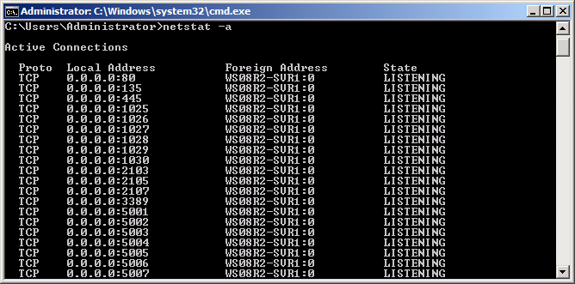
Performing a Sanity Test
A sanity test makes sure that the service is running
✓
List the listening ports using the netstat -a command, or any other network monitoring tool
✓
My Services
Notes:
One of the first things to verify is whether the service is running.
As will be described later, Windows Server® AppFabric™ presents the state of the hosted service.
When using a simpler host, you need to verify the state of the service manually.
The simplest method to check the service state is to list the listening ports on the machine.
There are various network monitoring tools for that. The Windows® netstat -a command will list the listening ports on the machine. In the resulting output, look for listening addresses that appear to be originating from endpoints on your service.
Course 10263A
Module 6: Testing and Troubleshooting Microsoft® Windows Communication Foundation Services

Slide 19
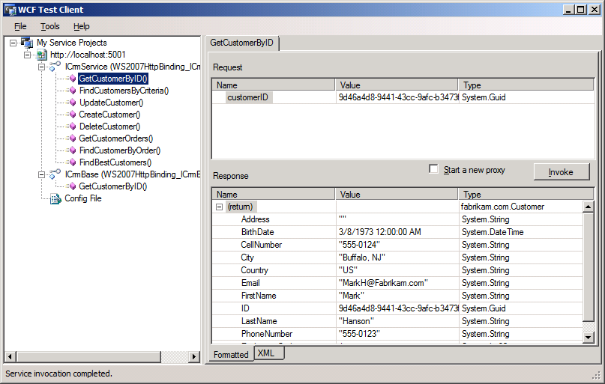
Using the WCF Test Client
The WCF Test Client is a simple debugging and testing tool for WCF services
✓
The WCF Test Client automatically starts when debugging WCF projects in Visual Studio 2010
✓
Notes:
The WCF Test Client (WCFTestClient.exe) is a Graphical User Interface (GUI) application that you can use to send test parameters to a service and view the response information, without writing explicit code to invoke the service.
You can use the WCF Test Client to see the exact SOAP message that was sent to the service, as well as the message that was received from the service.
You can use the WCF Test Client to preview the client configuration that you would obtain by using the Add Service Reference tool in Microsoft Visual Studio® 2010.
By default, when debugging a service that was implemented in a WCF project, Visual Studio 2010 will host the service in the WCF Service Host. The WCF Test Client will automatically start to perform simple testing.
To disable this setting, change the project properties under the Debug tab.
If you want to run the WCF Test Client outside of Visual Studio 2010, run the tool by accessing it directly at Common7\IDE subfolder in the Visual Studio 2010 installation directory.
Course 10263A
Module 6: Testing and Troubleshooting Microsoft® Windows Communication Foundation Services

Slide 20
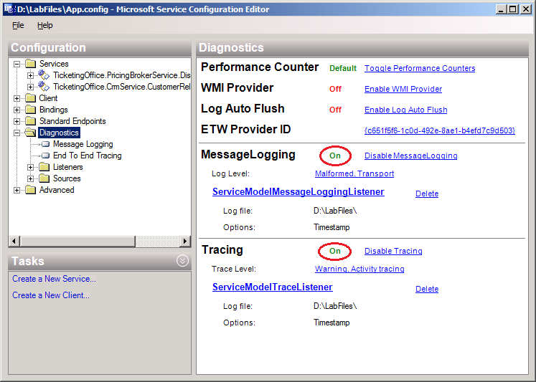
Configuring WCF Message Logging and Tracing
WCF message logging and tracing can be turned on using configuration only
✓
Notes:
WCF provides messages logging and tracing out as part of the WCF infrastructure.
To activate logging and tracing, you add a configuration element to the service’s configuration.
You can easily apply configuration using the WCF Configuration Editor (SvcConfigEditor.exe), which can be launched from Visual Studio 2010. This is a GUI tool for modifying configuration settings without having to edit XML configuration files manually.
The WCF Configuration Editor is part of the Windows Software Development Kit (SDK), and . is located at: Program Files\Microsoft SDKs\Windows\v6.0\Bin\SvcConfigEditor.exe
The WCF Configuration Editor can be activated by right-clicking on the configuration file in WCF projects in Visual Studio® 2010. You can also access the WCF Configuration Editor under the Tools menu in Visual Studio 2010.
The diagnostic settings you can configure include the following:
Tracing
Message logging
Windows Management Instrumentation (WMI): enable / disable WMI provider
Performance counters profile
Question: What can happen if you use verbose tracing in a production environment?
Answer: The overhead of logging each action can harm your service's performance, and can lead to your server running out of disk space.
Course 10263A
Module 6: Testing and Troubleshooting Microsoft® Windows Communication Foundation Services

Slide 21
Using WCF Message Logging and Tracing
At runtime, WCF creates two files:
App_messages.svclog, and App_tracelog.svclog
✓
Open the .svclog files using the WCF Service Trace Viewer (SvcTraceView.exe)
✓
The WCF Service Trace Viewer displays:
All the messages received and returned by the service
Exception information, including internal error details
WCF activity traces
✓
Notes:
After configuring message logging and tracing, and running your service, WCF will create two files:
App_messages.svclog. Message logging is recorded in this file.
App_tracelog.svclog. WCF tracing is recorded in this file.
You can open both files using the WCF Service Trace Viewer tool (SvcTraceView.exe).
The WCF Service Trace Viewer helps to analyze message logs and traces that are generated by the WCF Service. You can view and filter trace messages in the log to diagnose WCF service problems.
The WCF Service Trace Viewer is part of the Windows SDK, and . is located at: Program Files\Microsoft SDKs\Windows\v6.0\Bin
Double-clicking the message or trace file will also open WCF Service Trace Viewer.
Course 10263A
Module 6: Testing and Troubleshooting Microsoft® Windows Communication Foundation Services

Slide 22
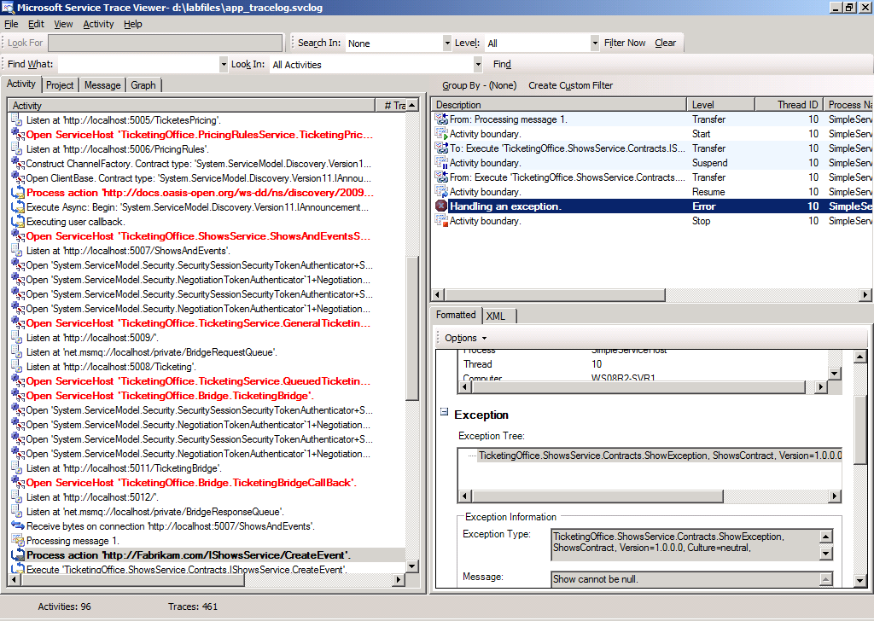
Diagnosing Errors with the WCF Service Trace Viewer
Notes:
You can easily find an exception that is thrown when tracing is on, by using the WCF Service Trace Viewer, and opening the log. The message or activity will be colored in red. You can observe the faults sent by the service.
All the exception information can be obtained from the log, including the stack trace, the exception message, and the module in which the exception occurred.
Course 10263A
Module 6: Testing and Troubleshooting Microsoft® Windows Communication Foundation Services

Slide 23
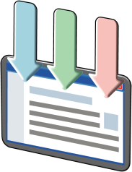

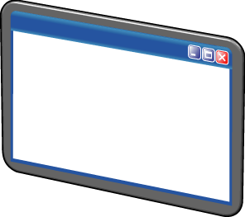
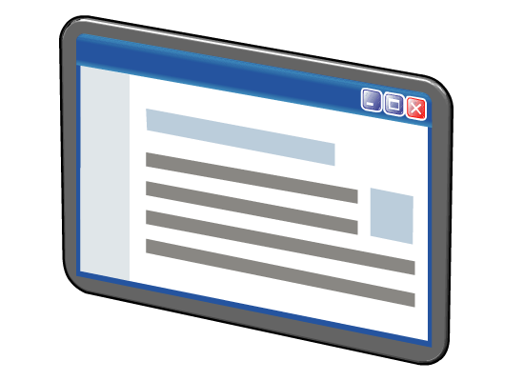

Demonstration: Using WCF Tracing
Run a service with tracing enabled
Call the service with input that will crash the service
Call the service. Exception is thrown and traced
Present the trace and show the exception
Notes:
Demonstration Steps
In this demonstration, you will configure your service for tracing and use the WCF Service Trace Viewer utility.
1. Log on to the virtual machine named 10263A-SVR1 as Administrator with the password Pa$$w0rd.
2. Open Microsoft® Visual Studio 2010.
Click Start, click All Programs, click Microsoft Visual Studio 2010, and then click Microsoft Visual Studio 2010.
3. Open the solution Calculator.sln from either the D:\Demofiles\M06\Calculator\CS folder for Microsoft Visual C#® or from the D:\Demofiles\M06\Calculator\VB folder for Microsoft Visual Basic®.
In the File menu, select OpenProject/Solution.
In the Open Project dialog box, browse to either the D:\Demofiles\M06\Calculator\CS or the D:\Demofiles\M06\Calculator\VB folder, click the Calculator.sln file, and then click Open.
4. Open either the CalculatorService.cs or CalculatorService.vb file, and examine the code. Notice that the Divide method does not check before attempting division by zero, so trying to do that will result in a DivideByZeroException.
5. Open the Calculator project's App.config file in the WCF Service Configuration Editor.
In the Solution Explorer window, right-click the App.config file, and then select Edit WCF Configuration.
6. Make sure MessageLogging and Tracing is turned on.
In the Configuration tree, click the Diagnostics node.
Make sure the MessageLogging is on. If it is not, click enable MessageLogging.
Make sure the Tracing is on. If it is not, click enable Tracing.
7. Save the configuration file.
Open the File menu, and then click Save.
8. Close the WCF Service Configuration Editor.
Course 10263A
Module 6: Testing and Troubleshooting Microsoft® Windows Communication Foundation Services

Slide 24
Notes Page Over-flow Slide. Do Not Print Slide. See Notes pane.
Notes:
9. Build and run the project without debugging.
Return to Visual Studio 2010. If a reload confirmation message appears when returning to Visual Studio 2010, click Yes.
From the Build menu, select Build Solution.
From the Debug menu, select Start Without Debugging.
Verify that the WCF Test Client application is running, and that you can see the service's operations.
Test the Divide operation with the values of a=10, b=5.
Double-click the Divide operation, and set the values of the request to a=10, b=5
Click Invoke, and if a security warning appears, click OK.
12. Test the Divide operation with the values of a=10, b=0.
Double-click the Divide operation, and set the values of the request to a=10, b=0
Click Invoke, and if a security warning appears, click OK.
13. Examine the error message, and then close the error window by clicking Close.
14. Close the WCF Test Client
15. Open the Calculator project's tracing file with the Microsoft Service Trace Viewer.
Return to Visual Studio 2010, right-click the Calculator project, and then select Open Folder in Windows Explorer.
Double-click the app_tracelog.svclog file to open it with the Microsoft Service Trace Viewer.
If an error report dialog box displays, click OK.
Note: If your service is still running when you open the trace file, you might get an error message–this is because the file is currently opened by the service, and is still in the writing process.
16. Select the faulty activity, and examine the content of the exception.
In the Activity list, select the activity in red text.
In the Description list, select the Handling an exception row.
Click the XML tab to see the content of the exception.
17. Close the Microsoft Service Trace Viewer.
Module 6: Testing and Troubleshooting Microsoft® Windows Communication Foundation Services
Course 10263A

Slide 25
Lesson 4: Runtime Governance
Introduction to Runtime Governance
Inspecting WCF Performance Counters
Introduction to the AppFabric Dashboard
Using the AppFabric Dashboard
Introduction to Service Level Agreements
Ensuring an Acceptable Latency
Ensuring an Acceptable Throughput
Ensuring an Acceptable Message Size
Ensuring Reasonable Resource Consumption
Notes:
Course 10263A
Module 6: Testing and Troubleshooting Microsoft® Windows Communication Foundation Services

Slide 26
Introduction to Runtime Governance
It is very important to collect information about the service during its execution
✓
Runtime governance is the process of collecting information about running services and using it to comply with business requirements
✓
Information must be presented clearly to ensure it will be useful for finding and correcting problems
✓
Before AppFabric, there was no built-in runtime governance support in WCF hosts
✓
Notes:
Services consume resources. It is important to verify that there is no leak, and that the system is stable and healthy. To measure the system’s health, a wide range of information must be logged, including memory usage, CPU utilization, request latencies, and the number of messages transferred.
Logging has a high performance overhead. To overcome that, logging policies are applied.
A logging policy defines which messages are to be logged (verbose, warnings, critical) and from which sources—for example, different types of performance counters.
Logging is only part of the solution. The information must be presented clearly to be effective. There are various tools and profilers to conduct runtime performance measurements.
Runtime governance is crucial for any SOA system. Without it, quality and reliability are almost impossible.
There are various runtime governance tools and infrastructures.
Until the advent of AppFabric, Microsoft did not provide a free host with runtime governance capabilities that includes runtime performance measurements tools. The developer was responsible to implement runtime measurements using custom code or external tools and profilers.
Course 10263A
Module 6: Testing and Troubleshooting Microsoft® Windows Communication Foundation Services

Slide 27
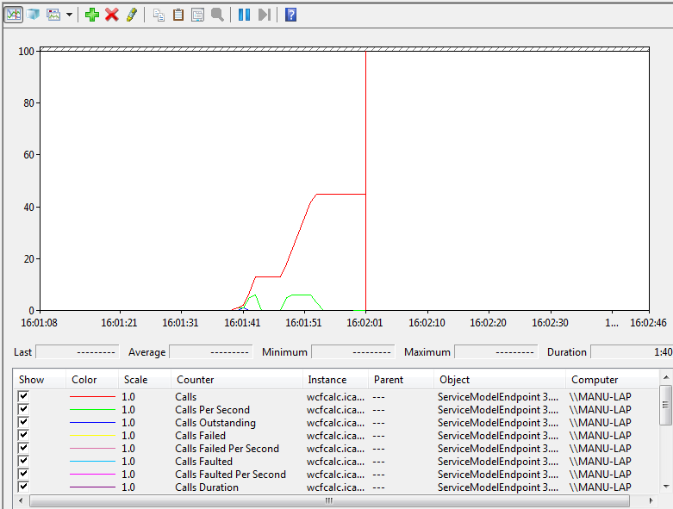
Inspecting WCF Performance Counters
WCF defines a wide collection of performance counters that can be inspected at runtime with a minimal cost
✓
Notes:
The basic source for runtime information are performance counters.
WCF defines a wide range of performance counters in several granularities—Service, Endpoint, Operation
.
You can activate WCF performance counters in your service’s XML configuration file.
Some examples of WCF performance counters are:
Number and rate of calls
Calls duration
Number and rate of failed calls
Number of instances
Number of transactions
The Windows Performance Monitor (perfmon) is used to view performance counter values, and can be used to record performance counter logs, and even raise alerts when a threshold is exceeded.
Course 10263A
Module 6: Testing and Troubleshooting Microsoft® Windows Communication Foundation Services

Slide 28
Introduction to the AppFabric Dashboard
AppFabric is a hosting infrastructure
✓
AppFabric collects logging and monitoring information
✓
The AppFabric Dashboard is a centralized gateway to view the health of WCF services
✓
The dashboard provides a hierarchical view of the system
✓
Notes:
AppFabric is a host for WCF and Workflow Services based on Internet Information Services (IIS) and Windows Process Activation Service (WAS).
AppFabric was designed not only to host services, but to manage them as well.
AppFabric collects a vast amount of runtime information to effectively perform runtime governance of the hosted services.
As was mentioned earlier collecting, the data is only half of the story. Effective management requires a simple, yet powerful user interface (UI). AppFabric Dashboard is exactly that—a simple and powerful management UI.
Course 10263A
Module 6: Testing and Troubleshooting Microsoft® Windows Communication Foundation Services

Slide 29
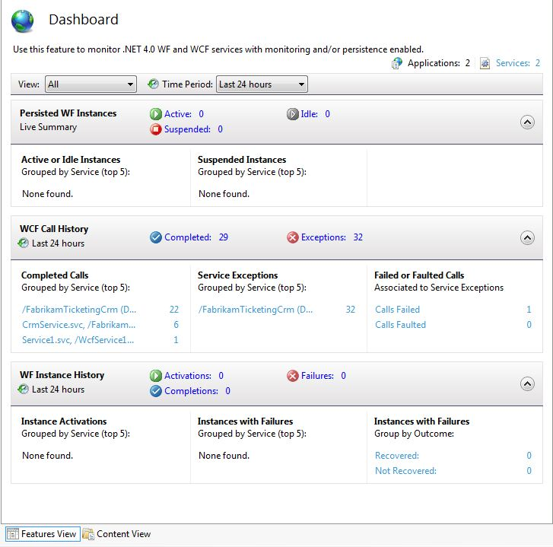
Using the AppFabric Dashboard
Notes:
The AppFabric Dashboard is the center of the AppFabric monitoring tools.
The AppFabric Dashboard provides a centralized gateway to view the health of WCF and Workflow services that are deployed on the local computer or in a web farm. Real-time information is presented alongside with the ability to view a history of service operations.
The AppFabric Dashboard is designed to be simple.
It provides a holistic hierarchical view of the system, and allows drilling down to the details, if necessary.
AppFabric is built on top of IIS and WAS, and the Dashboard is consistent with other IIS Manager features.
You can use the WCF Call History section to see a count of successfully completed calls and exceptions that occurred in your WCF services. Inside this section you can see:
The top 5 services with the highest number of calls.
The top 5 services with the highest number of exceptions.
Root causes of exceptions: failed calls, and faulted calls.
Course 10263A
Module 6: Testing and Troubleshooting Microsoft® Windows Communication Foundation Services

Slide 30
Introduction to Service Level Agreements
An SLA is an agreement between the provider of a service and a user of that service that may include:
✓
Availability guarantees: uptime and downtime
✓
Latency and throughput guarantees
✓
Maximum acceptable error rates
✓
Notes:
When providing a service to a customer, a Service Level Agreement( SLA) is defined.
An SLA is a contract between the service and its client about the quality of service.
A service can provide different SLAs to different kind of customers.
Quality is often defined using the following terms:
What is the probability that the service will be down?
Maximum tolerable delays (response time).
Number of concurrent calls supported.
Other acceptable error rates.
Course 10263A
Module 6: Testing and Troubleshooting Microsoft® Windows Communication Foundation Services

Slide 31
Ensuring an Acceptable Latency
Measure round-trip timing in different scenarios, configurations, and deployments
✓
Durable messages and persistence increase message processing time
✓
Test service chains (one service waits for another)
✓
Test latency considering DB type and location, transactions, security, and other infrastructure protocols
✓
Notes:
Service performance measurement includes many aspects. Two of the most basic aspects are latency, and throughput.
Latency measures the time elapsed from the moment a request is sent to the moment the response arrives.
There are many factors that affect latency.
When messages are persisted, it takes longer to process them.
If services are chained sequentially, processing might take a long time as services wait for each other. Service chains might introduce bottlenecks that cause very long delays.
Database performance is usually a major factor in the service’s latency.
Transactions and other complex protocols can create a substantial overhead on the messaging layer.
Check the average latency. Look for extreme scenarios in which latency exceeds acceptable thresholds.
Course 10263A
Module 6: Testing and Troubleshooting Microsoft® Windows Communication Foundation Services

Slide 32
Ensuring an Acceptable Throughput
To diagnose throughput bottlenecks, consider the following questions:
✓
What part of the service’s work is performed concurrently?
✓
How many concurrent sessions can be processed?
✓
How many concurrent messages can be accepted?
✓
System
Throughput
[load / time]
Latency [in time units]
Notes:
Throughput is the amount of requests that are passing through a system from input to output in a certain unit of time. Consider the following questions for diagnosing throughput bottlenecks:
How much data or requests can be pushed through the service concurrently?
Queuing incoming messages (sometime persisting) creates latencies, but improves throughput (The Microsoft BizTalk® Server is an example of a server that does this).
Stress testing should be performed to measure the throughput in various scenarios.
Change the topology of the system (for example, add servers, duplicate services), and check the effect on throughput.
Question: What can you gain by increasing the number of concurrent calls the service can handle?
Answer: Increasing the number of concurrent calls allows the service to handle more requests at a given time, which is suitable for situations when a service has a heavy load of requests reaching it. However, you should test your service after changing this setting to make sure your service's memory consumption has not increased too much, and that your CPU usage has not overloaded and reached 100 percent.
Course 10263A
Module 6: Testing and Troubleshooting Microsoft® Windows Communication Foundation Services

Slide 33
Ensuring an Acceptable Message Size
Serialization is a CPU-intensive operation
✓
Message size is expensive with respect to CPU, memory usage, and bandwidth utilization
✓
The message size and the serialization graph are both limited by the service’s configuration settings
✓
<behavior name="...">
<dataContractSerializer maxItemsInObjectGraph="1000"/>
</behavior>
<binding name="..." maxReceivedMessageSize="1000" >
<readerQuotas maxDepth="100" maxArrayLength="10000"/>
</binding>
Notes:
Often services work well until large messages are sent to or from the service. Unfortunately, this is often discovered only in the production environment.
WCF limits the serialization depth and the messages size.
Make sure the service is configured correctly so it can cope with all message types and lengths that are required by the business. Also ensure that large malicious messages are detected and rejected, to prevent a denial of service attack (DoS) situation.
Consider streaming when dealing with large messages.
Course 10263A
Module 6: Testing and Troubleshooting Microsoft® Windows Communication Foundation Services

Slide 34
Ensuring Reasonable Resource Consumption
Use profilers and performance counters to monitor the memory and CPU consumption of your services; ask the following questions:
✓
What are the limits of the physical server?
✓
Is it possible to add another server?
✓
Can load be balanced better across servers?
✓
Notes:
WCF services and clients consume resources, such as memory, CPU, and network sockets.
It is important to monitor to ensure that resources are being consumed and released correctly.
For example, if proxies are created faster then they are released, you will experience a memory leak.
It is important to find the limits—the resources that must be available for the service to run correctly. For example:
What is the maximum load the service can accept?
What is the maximum size of data it can process?
After the limits are found, you should check if adding hardware improves the service performance.
If the service was designed to scale to multiple servers, you should prove that it does, before the need to scale arises in the production environment.
Course 10263A
Module 6: Testing and Troubleshooting Microsoft® Windows Communication Foundation Services

Slide 35
Lab: Testing and Troubleshooting WCF Services
Exercise 1: Viewing Unplanned SOAP Faults
Exercise 2: Using Fault Contracts
Exercise 3: Using Error Handlers and Handling Faults
Exercise 4: Using WCF Message Logging and Tracing
Exercise 5: Supporting Large Messages
Logon information
Virtual machine | 10263A-SVR1
User name | Administrator
Password | Pa$$w0rd
Estimated time: 60 minutes
Notes:
Lab Objectives
After completing this lab you will be able to:
Use fault exceptions to return specific error information from a service.
Handle fault exceptions and unplanned exceptions on the client side.
Use WCF diagnostics.
Use the WCF Service Trace Viewer to analyze exceptions.
Test service behavior when large messages are transmitted.
Exercise 1: Viewing Unplanned SOAP Faults
Open the starter solution
Call the Reservation service with invalid input.
Configure the service to expose exception details inside fault messages.
Retest the service.
Exercise 2: Using Fault Contracts
Create a fault contract.
Throw a fault exception.
Exercise 3: Using Error Handlers and Handling Faults
Create and attach an error handler.
Throw a standard .NET exception instead of a fault exception.
Invoke the service and catch any fault exceptions.
Exercise 4: Using WCF Message Logging and Tracing
Use the WCF Configuration utility to add tracing and message logging.
Cause the service to throw an exception.
Use the SvcTraceViewer.exe utility to inspect the exception.
Course 10263A
Module 6: Testing and Troubleshooting Microsoft® Windows Communication Foundation Services

Slide 36
Notes Page Over-flow Slide. Do Not Print Slide. See Notes pane.
Notes:
Exercise 5: Supporting Large Messages
Clear the database from all the shows with Category = Comedy.
Create 10 comedies.
Start the Shows service.
Call the FindShowsByCriteria operation of the Shows service.
Create 100 more comedies.
Call the service again.
Repeat step 3. The service fails. Read the exception.
Configure the service to support large messages.
Change the configuration used by the WCF Test Client.
Note: The lab exercise answer keys are provided on the Course Companion CD. To access the answer key, click the link located at the bottom of the relevant lab exercise page.
Module 6: Testing and Troubleshooting Microsoft® Windows Communication Foundation Services
Course 10263A

Slide 37




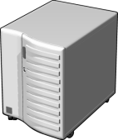
Lab Scenario
Notes:
Problems in your service operation often cause it to crash or not function properly. Operations staff is not equipped with the tools or information required to decipher runtime exceptions that occur within the service, and management has figures to report that support costs are increasing. You have been asked to come up with error handling techniques that will ensure reliable communication between the client and the service, while still retaining the ability to report errors and to monitor request execution when problems arise.
Additionally, you have been asked to make sure that the service does not encounter sudden scalability problems in the field. To ensure this, you are asked to implement a test plan for large messages, high concurrent load and other factors.
Course 10263A
Module 6: Testing and Troubleshooting Microsoft® Windows Communication Foundation Services

Slide 38
Lab Review
Review Questions
What happens when an exception is thrown from a service that is not configured with a fault contract?
Explain the steps required to throw a fault exception
What is an error handler?
Explain the steps required to turn on tracing and message logging in a WCF service
How do you configure a service to support large messages?
Notes:
Use the questions on the slide to guide the debriefing after students have completed the lab exercises. Point the students to the appropriate section in the lab if they are not able to answer the questions presented in this section.
1. What happens when an exception is thrown from a service that is not configured with a fault contract?
WCF catches all unhandled exceptions. If the exception is not a declared in a fault contract, WCF will create a new empty fault message and send it back to the client. When a fault message arrives at the client, WCF generates and throws a new empty FaultException.
What are the steps required to throw a fault exception?
The steps to throw a fault exception are:
Define a data contract for error information.
Define a fault contract using the error information data contract.
Throw a FaultException<T>, where T is the error message data contract type.
Catch the FaultException<T> at the client.
3. What is an error handler?
Error handlers are an extensibility point in WCF fault handling. Error handlers convert exceptions to faults, and can provide additional functionality—such as logging—in the error-handling process.
What is required to turn on tracing and message logging in a WCF service?
You must enable message logging and tracing in the service’s configuration file. (You can use the WCF Service Configuration Editor.)
5. How do you configure a service to support large messages?
You can set the maxReceivedMessageSize attribute in the binding configuration.
Course 10263A
Module 6: Testing and Troubleshooting Microsoft® Windows Communication Foundation Services

Slide 39
Module Review and Takeaways
Review Questions
Real-World Issues and Scenarios
Best Practices
Notes:
Review Questions
1. What is a fault message?
A fault message is a data representation of an error. Faults are standardized in the SOAP standard. When a service needs to return error information, it is put inside a fault message.
2. What tools can be used to debug a WCF service?
Visual Studio 2010
WCF Test Client
WCF Service Trace Viewer
3. What runtime governance aspects should be tested?
SLA (Service Level Agreement)
Throughput
Latency
Message size
Resource consumption
4. What tools does WCF provide to test runtime behavior?
ServiceModel performance counters
Windows Management Instrumentation (WMI)
AppFabric DashBoard
Real-World Issues and Scenarios
1. You have a deployed service that sometimes return fault messages, or does not return messages to clients. You need to check what is wrong with the service. How do you do it?
Add Message logging and Tracing to the service's configuration, wait for an error to occur ,and then use the SvcTraceViewer.exe to check the logs for any exception thrown by the service.
2. Your service is experiencing a high load of requests, and some of the requests are thrown back to the client because of a time out. What can you do?
Increase the throttling settings of the service to allow more requests to be handled at the same time, and then use the Windows Performance Monitor to test the service to see if requests are no longer timing out, and that the memory consumption and CPU usage are in acceptable ranges.
Course 10263A
Module 6: Testing and Troubleshooting Microsoft® Windows Communication Foundation Services

Slide 40
Notes Page Over-flow Slide. Do Not Print Slide. See Notes pane.
Notes:
Best Practices
Mention some best practices in the context of your own business situations.
Design faults into your service contracts.
Use the WCF debugging and monitoring tools.
Apply runtime governance to your services.
Increasing the limits set by WCF will not always make your service work faster, so be sure to test your service after making changes to its configuration.
Module 6: Testing and Troubleshooting Microsoft® Windows Communication Foundation Services
Course 10263A

