Slide 1
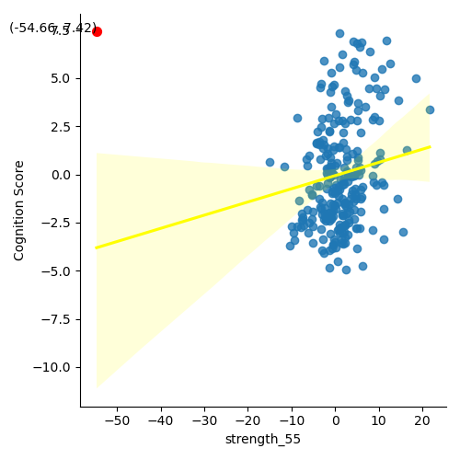
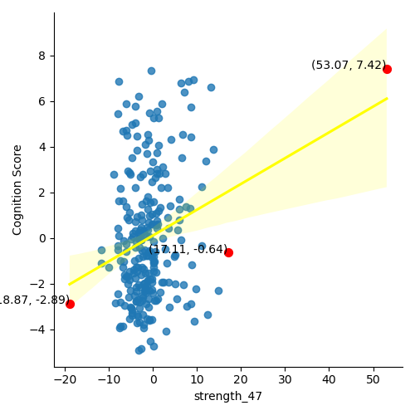
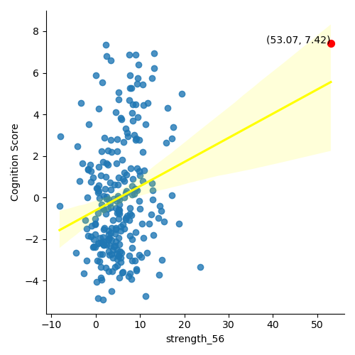
Strength(Local Measure)
Outlier : Q1-3*IQR 미만, Q3+3*IQR 초과
R : 0.169631568
P_value_fdr : 0.044613
R : 0.231262986
P_value_fdr : 0.009708
R : 0.187958671
P_value_fdr : 0.030117

Slide 2
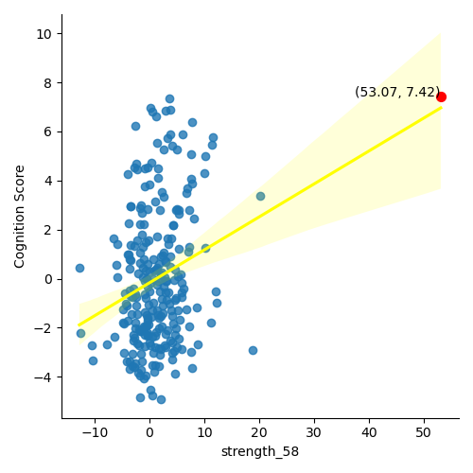
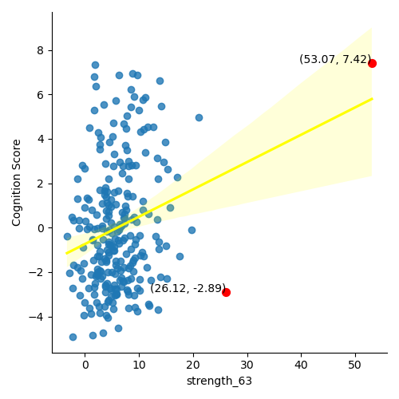
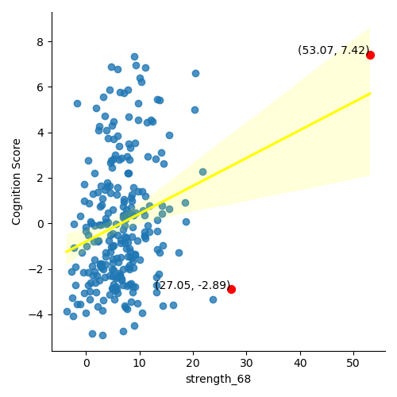
Strength(Local Measure)
R : 0.185410989
P_value_fdr : 0.030723
R : 0.172128241
P_value_fdr : 0.042417
R : 0.206032124
P_value_fdr : 0.017252

Slide 3
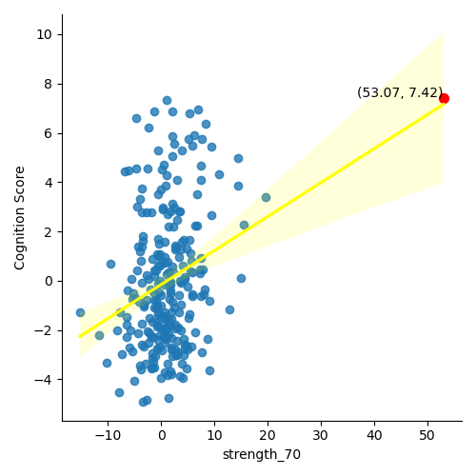
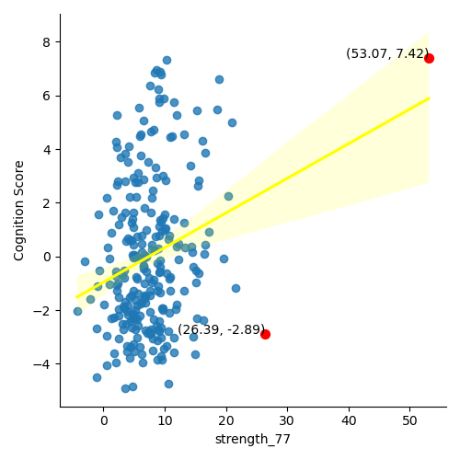
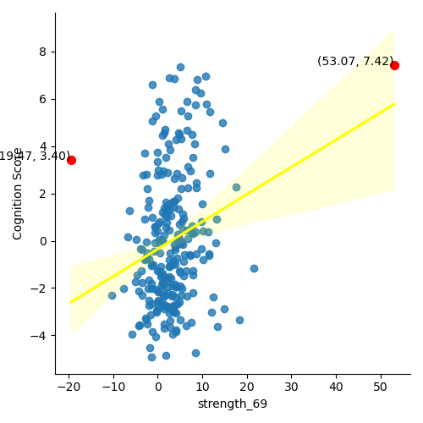
Strength(Local Measure)
R : 0.212546673 P_value_fdr : 0.017252
R : 0.196779131
P_value_fdr : 0.024595
R : 0.179885885 P_value_fdr : 0.031848

Slide 4
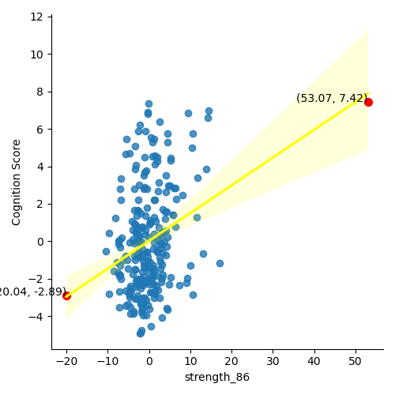
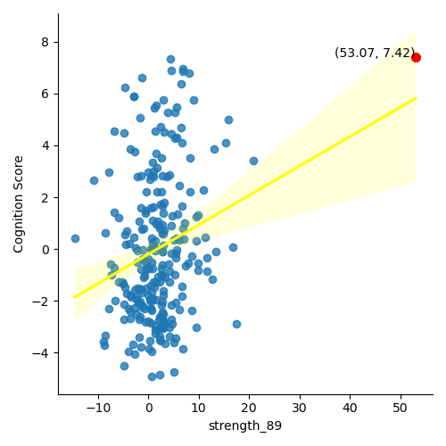
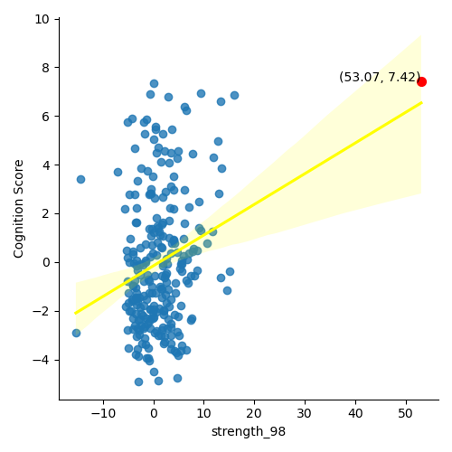
Strength(Local Measure)
R : 0.229848694 P_value_fdr : 0.009708
R : 0.191096807 P_value_fdr : 0.02898
R : 0.179294035 P_value_fdr : 0.031848

