Slide 1
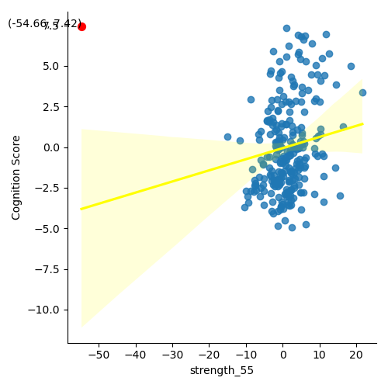
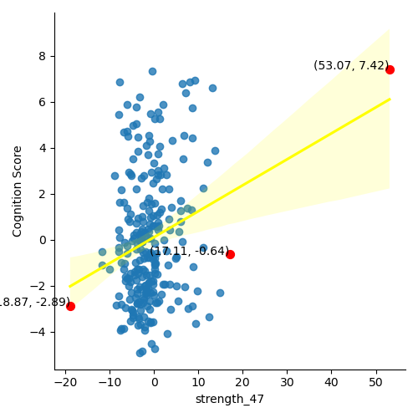
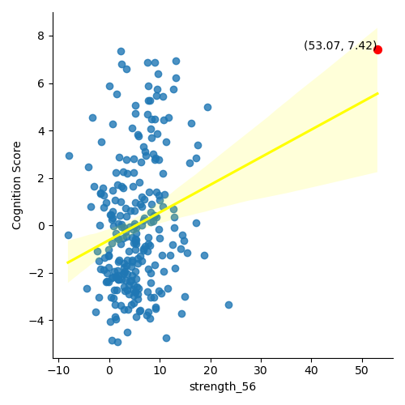
Strength(Local Measure)
Outlier : Q1-3*IQR 미만, Q3+3*IQR 초과
R : 0.169631568
P_value_fdr : 0.044613
R : 0.231262986
P_value_fdr : 0.009708
R : 0.187958671
P_value_fdr : 0.030117

Slide 2
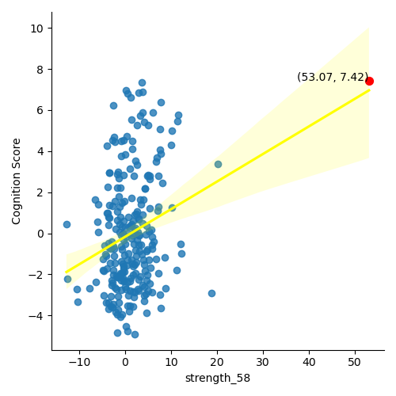
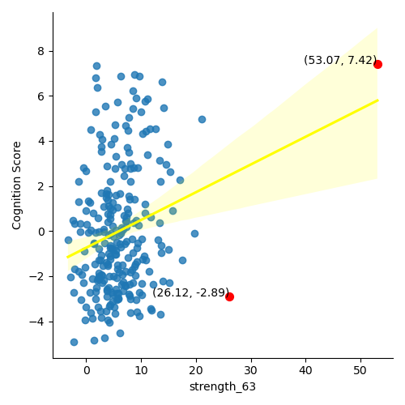
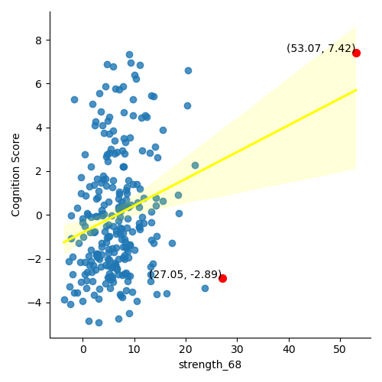
Strength(Local Measure)
R : 0.185410989
P_value_fdr : 0.030723
R : 0.172128241
P_value_fdr : 0.042417
R : 0.206032124
P_value_fdr : 0.017252

Slide 3
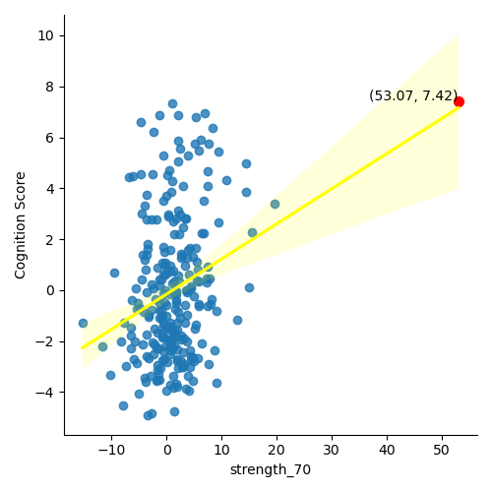
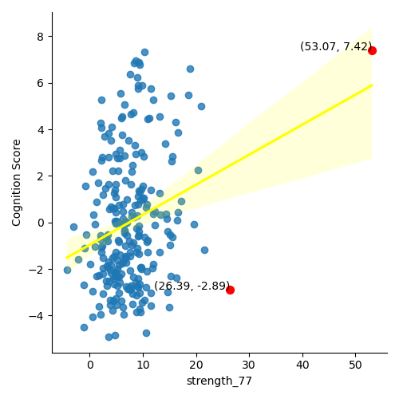
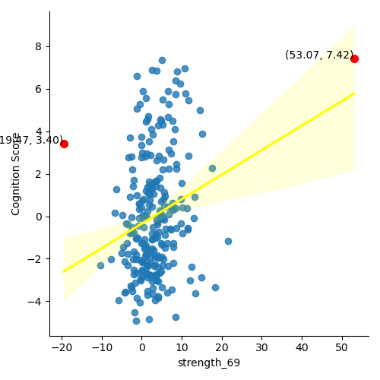
Strength(Local Measure)
R : 0.212546673 P_value_fdr : 0.017252
R : 0.196779131
P_value_fdr : 0.024595
R : 0.179885885 P_value_fdr : 0.031848

Slide 4
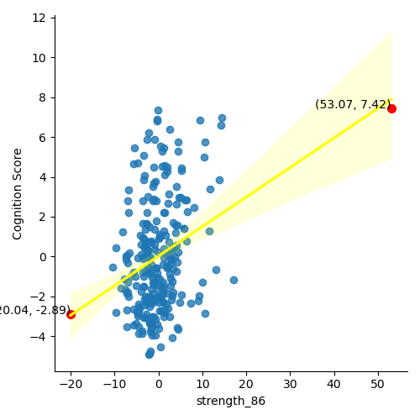
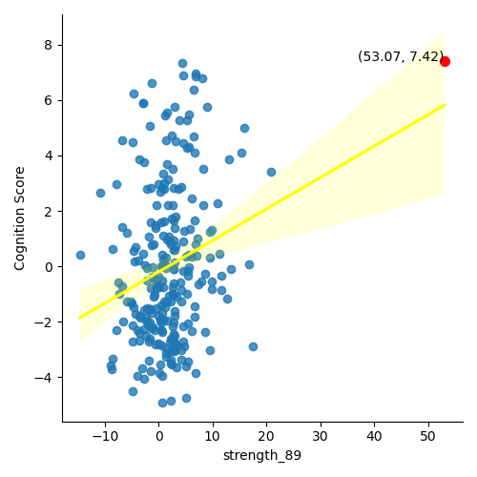
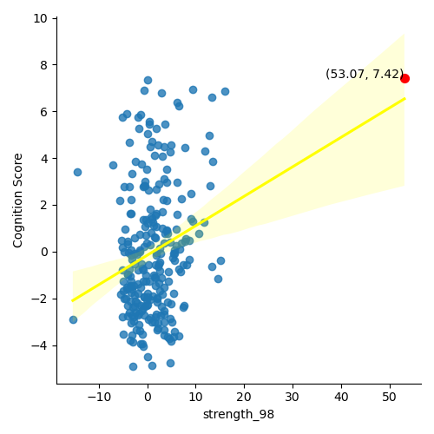
Strength(Local Measure)
R : 0.229848694 P_value_fdr : 0.009708
R : 0.191096807 P_value_fdr : 0.02898
R : 0.179294035 P_value_fdr : 0.031848

Slide 5
{'sub-10271': 55,
'sub-10438': 8,
'sub-50029': 100,
'sub-10998': 25,
'sub-10171': 11,
'sub-50005': 1,
'sub-10316': 3,
'sub-50020': 5,
'sub-60017': 5,
'sub-50052': 3,
'sub-70021': 3,
'sub-50006': 1,
'sub-60078': 2}

Slide 6
{'sub-10271': 56,
'sub-10438': 7,
'sub-10998': 28,
'sub-50029': 84,
'sub-60078': 17,
'sub-70020': 27,
'sub-50015': 1,
'sub-50006': 58,
'sub-10429': 5,
'sub-50061': 8,
'sub-50052': 14,
'sub-50008': 10,
'sub-50020': 8,
'sub-60017': 10,
'sub-50077': 9,
'sub-60051': 1,
'sub-10316': 1, 'sub-10304': 1, 'sub-10171': 8, 'sub-10361': 5, 'sub-70021': 1, 'sub-60070': 2, 'sub-50022': 1}

Slide 7
{'sub-60046': 1,
'sub-70020': 37,
'sub-50006': 51,
'sub-50029': 16,
'sub-50077': 4,
'sub-50008': 12,
'sub-10271': 23,
'sub-50015': 1,
'sub-10361': 6,
'sub-50052': 5,
'sub-10171’: 2
, 'sub-10998': 12,
'sub-60078': 9,
'sub-10429': 1, 'sub-60051': 3, 'sub-60017': 2, 'sub-11062': 3, 'sub-10316': 1, 'sub-50022': 1, 'sub-10206': 1}

Slide 8
