Slide 1
The Python Ecosystem

Slide 2
Free Software

Slide 3
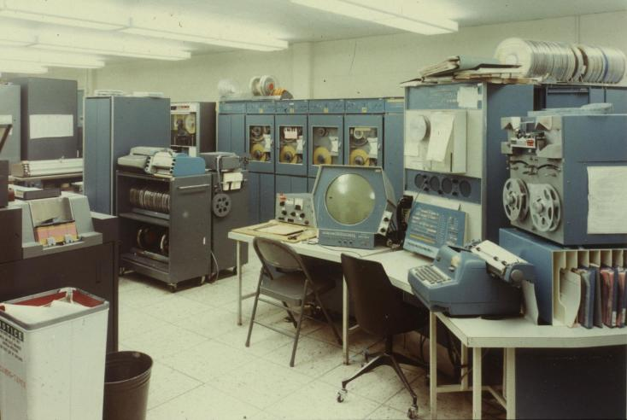
The MIT Hackers

Slide 4
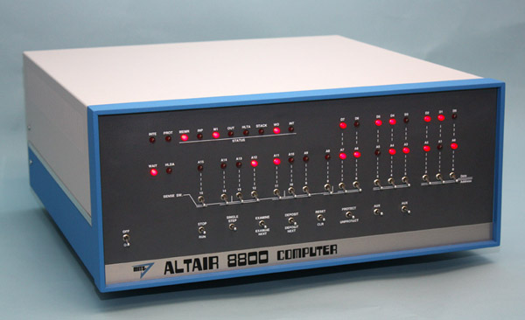
The first PC

Slide 5
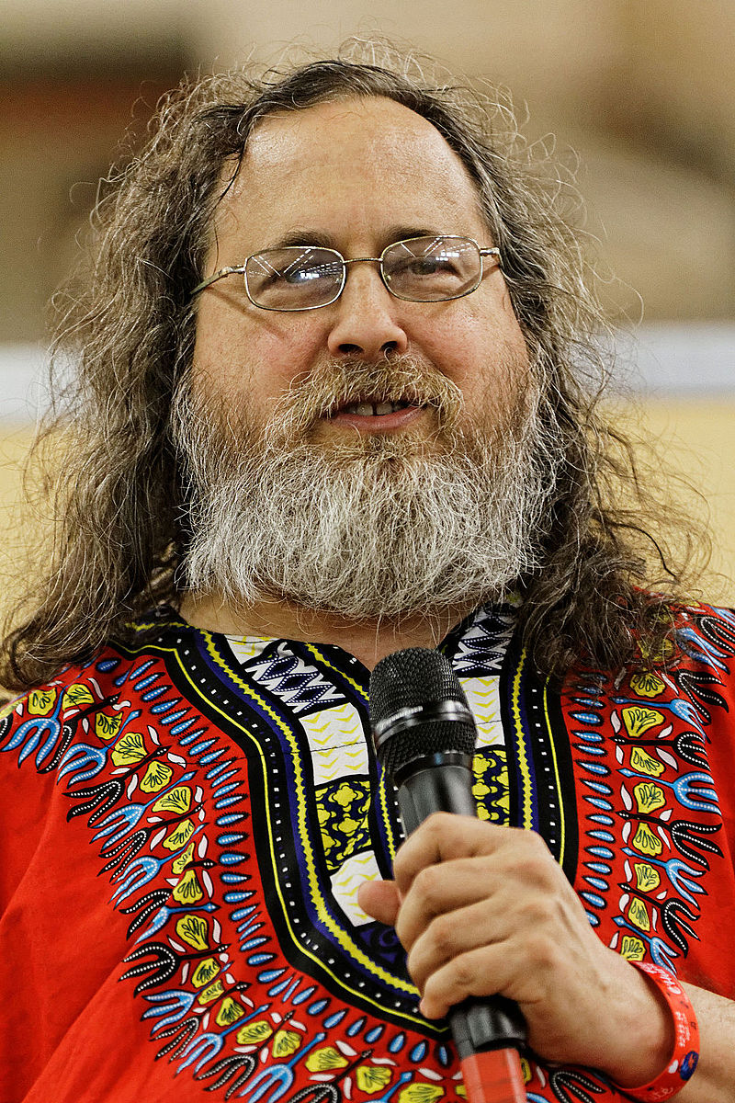
RMS
It's GNU/Linux!!

Slide 6
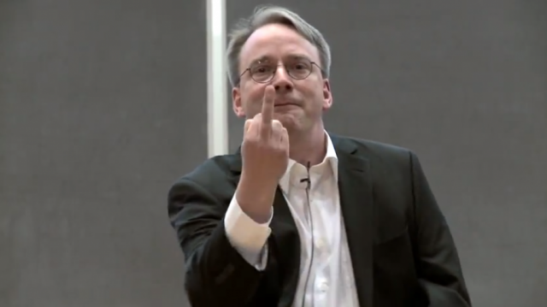
Linus

Slide 7
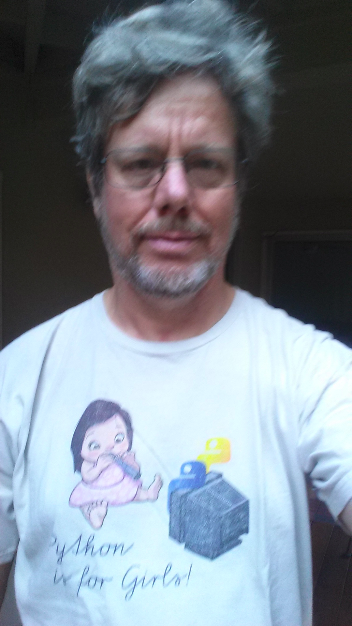
BD
FL

Slide 8
Python as a Programming Language
Moshe Goldstein

Slide 9
The Python story

Slide 10
Import this
Notes:
The zen of python. Read this in your own time. Complements moshe's talk

Slide 11
2.8
Notes:
This is a controversial t-shirt, an in-joke. Let me explain
-python story, python 2, standard library
- google, nasa
- resolver one
- python 3
- slow adoption
- starting to be honestly recommend
- adoption in education

Slide 12
pip install...

Slide 13
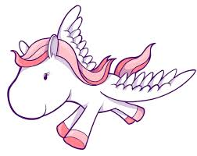
Ponies, Bottles, Flasks.
Notes:
Just talk about the different communities within python
- lots of web developers. Reddit, disqus, instagram, all built with python. Django, flask, bottle (whisky/ wsgi joke, sigh)
- scientists! Mad scientists. Numpy, scipy, pandas, matplotlib, astropy, ppl switching from old fortran libraries
- guis, embedded, raspberry pi(pi=python), lots more
- see notes

Slide 14
When pip fails
- download installers
- Anaconda

Slide 15
What is a git?

Slide 16
Community

