Slide 1
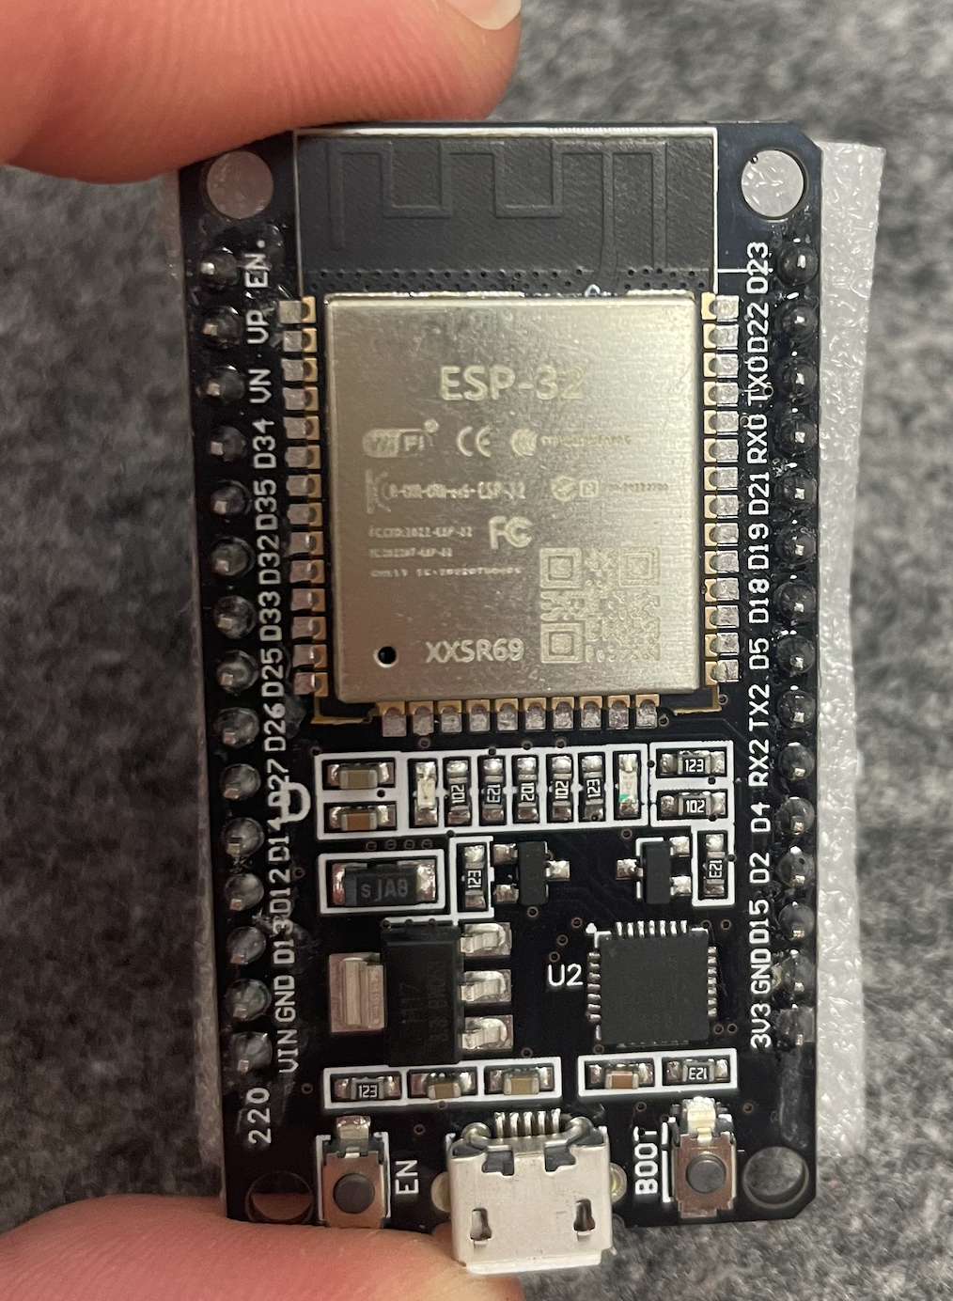

Getting Started
with ESP32
ESP-IDF • FreeRTOS • interrupts • sleep modes
LABORATORY 1 / 2 HOURS
Notes:
Show the exact board students received. Confirm that a data-capable USB cable is required.
Source image: course file lib/ESP32_board.png.

Slide 2
The ESP32 board
A microcontroller module plus development-board support circuitry
COMPUTE
Two 32-bit Xtensa LX6 CPU cores, up to 240 MHz
CONNECTIVITY
2.4 GHz Wi-Fi and Bluetooth are integrated in the chip
PERIPHERALS
GPIO, ADC, DAC, PWM, UART, SPI, timers and interrupts
BOARD SUPPORT
USB-to-UART bridge, 3.3 V regulator, EN reset and BOOT button
The visible LED is a power indicator, not a user LED.
LAB 1 / 02
Notes:
Contrast a microcontroller with a general-purpose Raspberry Pi. This lab does not use the Raspberry Pi.
Sources: Lecture_4_arduino.pptx slide 39; ESP32 datasheet: https://www.espressif.com/sites/default/files/documentation/esp32_datasheet_en.pdf

Slide 3
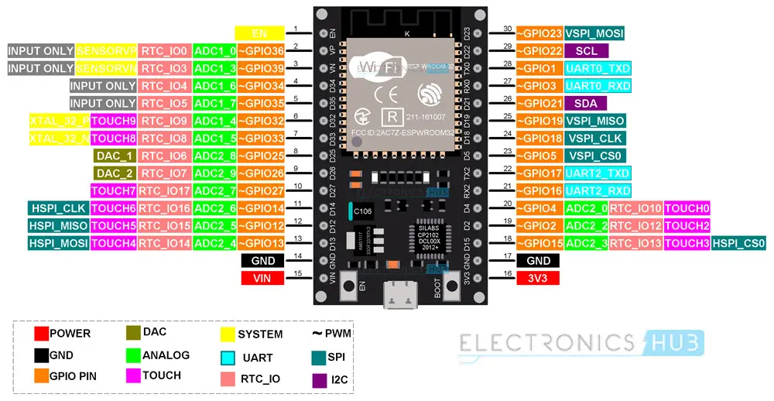
30-pin board pinout
Read GPIO numbers, not only the D-label printed on the board
3.3 V GPIO • GPIO34–39 input only • GPIO1/3 UART0 • GPIO0/2/5/12/15 affect boot
LAB 1 / 03
Notes:
Hold the physical board in the same orientation as the pinout. Point out EN, BOOT/GPIO0, GND, 3V3 and VIN.
Source image: embedded media from Lecture_4_arduino.pptx slide 40. Electrical limits: ESP32 datasheet.

Slide 4
VS Code + ESP-IDF workflow
Use the ESP-IDF extension to build, flash and monitor
1 OPEN
2 EDIT
3 BUILD
4 FLASH
5 MONITOR
VS Code +
ESP-IDF
main/main.c
CMake + Ninja
+ link
Select port
+ Flash
ESP-IDF
Monitor
TERMINAL EQUIVALENT
idf.py set-target esp32
idf.py build
idf.py -p PORT flash monitor
LAB 1 / 04
Notes:
Explain that the ROM bootloader receives images produced by the ESP-IDF build. Stop the monitor with Ctrl+].
Source: https://docs.espressif.com/projects/esp-idf/en/stable/esp32/get-started/index.html

Slide 5
Exercise 1: System information
Project: code/01_system_info
RUN
1
FIND
IDF version, chip revision, core count, flash size and free heap
idf.py set-target esp32
idf.py build
idf.py -p PORT flash monitor
2
OBSERVE
A heartbeat every two seconds
3
EXPLAIN
Flash stores the program; RAM holds runtime state
CHECKPOINT 1 Show a successful flash and recognizable chip information.
LAB 1 / 05
Notes:
Verify that the core count is two and the selected target is esp32. Ask one student to distinguish flash from heap.
Source code: lab01-esp32/code/01_system_info/main/main.c

Slide 6
Exercise 2: Tasks on both cores
Project: code/02_dual_core_tasks
1
PREDICT
xTaskCreatePinnedToCore(
periodic_task, "task_a", 3072,
&task_a_config, 5, NULL, 0);
xTaskCreatePinnedToCore(
periodic_task, "task_b", 3072,
&task_b_config, 5, NULL, 1);
Write down the first six task messages
2
OBSERVE
Task A reports core 0; Task B reports core 1
3
REASON
vTaskDelay() yields instead of wasting CPU time
CHECKPOINT 2 Show interleaved output from core 0 and core 1.
LAB 1 / 06
Notes:
The exact ordering is intentionally not guaranteed. Ask what would change if both tasks wrote the same variable.
Sources: Lecture_4_arduino.pptx slides 42–43; lab01-esp32/code/02_dual_core_tasks/main/main.c

Slide 7
Exercise 3: BOOT-button interrupt
Project: code/03_button_interrupt
GPIO0
ISR
TASK
falling edge
notify only
debounce + log
An ISR must not delay, block, allocate memory, or perform ordinary logging.
CHECKPOINT 3 Produce five deliberate events.
Do not hold BOOT while resetting: GPIO0 low selects download mode.
LAB 1 / 07
Notes:
Mechanical contacts bounce. The task rejects notifications arriving within 200 ms. Logging stays outside interrupt context.
Sources: https://docs.espressif.com/projects/esp-idf/en/stable/esp32/api-reference/peripherals/gpio.html; lab01-esp32/code/03_button_interrupt/main/main.c

Slide 8
Exercise 4: Light-sleep and Deep-sleep
Project: code/04_sleep_modes
LIGHT-SLEEP
DEEP-SLEEP
CPU clocks stop
Most RAM is retained
Execution resumes after the call
esp_light_sleep_start();
CPU and most RAM power down
RTC memory may remain
Wake-up restarts app_main()
esp_deep_sleep_start();
Direct Light-sleep and Deep-sleep do not retain Wi-Fi. Modem-sleep + automatic Light-sleep is separate.
CHECKPOINT 4 Show resume after Light-sleep and reboot after Deep-sleep.
LAB 1 / 08
Notes:
Point out the normal RAM variable after Light-sleep and the RTC_DATA_ATTR boot counter after Deep-sleep. Correct the old claim that direct Light-sleep keeps Wi-Fi connected.
Sources: Lecture_4_arduino.pptx slides 45–47; https://docs.espressif.com/projects/esp-idf/en/stable/esp32/api-reference/system/sleep_modes.html

Slide 9
Completion checklist
Four demonstrations and four short explanations
01
SYSTEM
Chip information and heartbeat
BE READY TO EXPLAIN
ESP-IDF vs FreeRTOS
Why tasks call vTaskDelay()
Why the ISR only notifies
What survives each sleep mode
02
CORES
Output from core 0 and core 1
03
INTERRUPT
Five clean BOOT-button events
04
SLEEP
Resume versus reboot
CLICK TO OPEN HOME SETUP VIDEO
https://youtu.be/y2pIqbZa-iA
LAB 1 / 09
Notes:
Use the checkpoints as a rapid oral assessment. The complete task instructions and troubleshooting table are in README.md.
Course artifact: lab01-esp32/README.md

