Slide 1


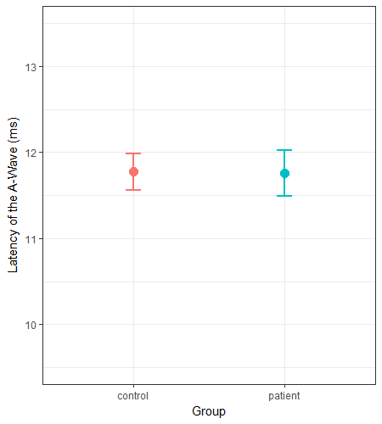
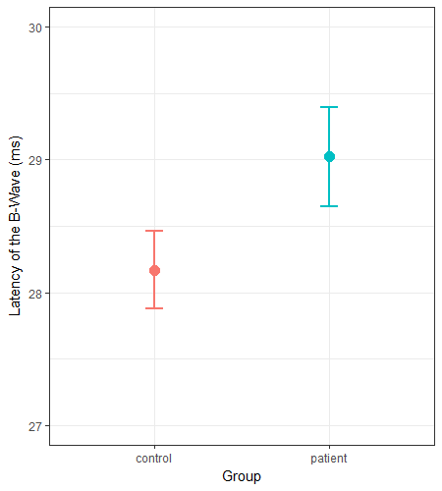
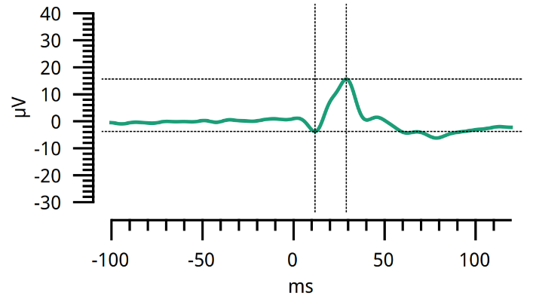
Photoreceptors
Bipolar Cells
Glutamate
a-wave
b-wave
n.s.
**

Slide 2
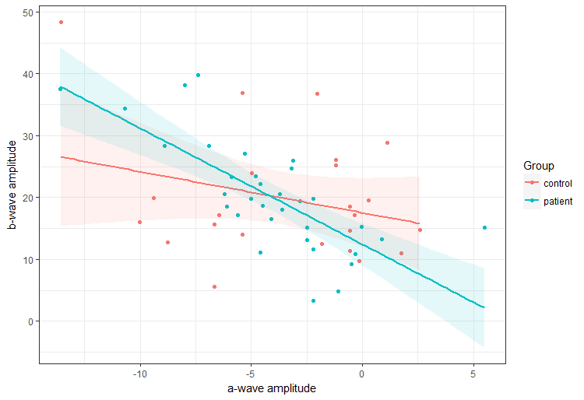
Reliability of Transmission

