Slide 1
CoW-Tree Progress
2026-03-17

Slide 2
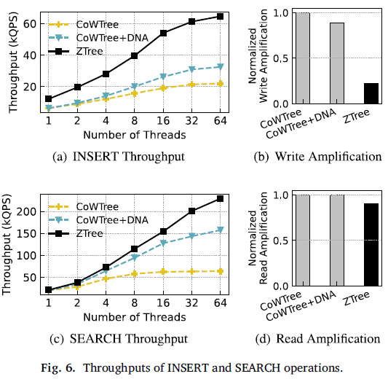
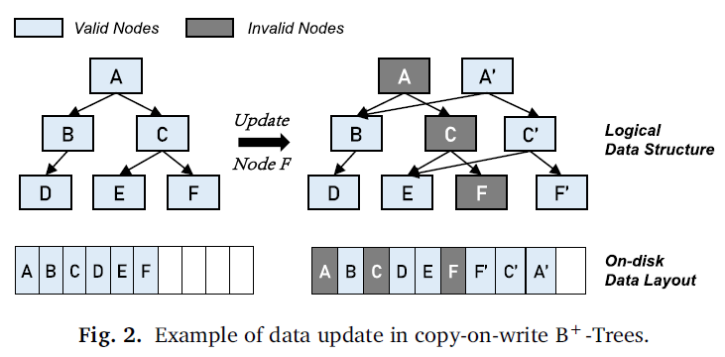
Purpose
“ZTree: Towards an efficient B+-tree on zoned namespace SSDs”

Slide 3
Attempts
Multi-writer model have shown limitation
CAS-based optimistic root publish
Read a snapshot
Construct a candidate root
Validate the root update using CAS at publish time
Validation YES – publish
Validation NO - retry

Slide 4
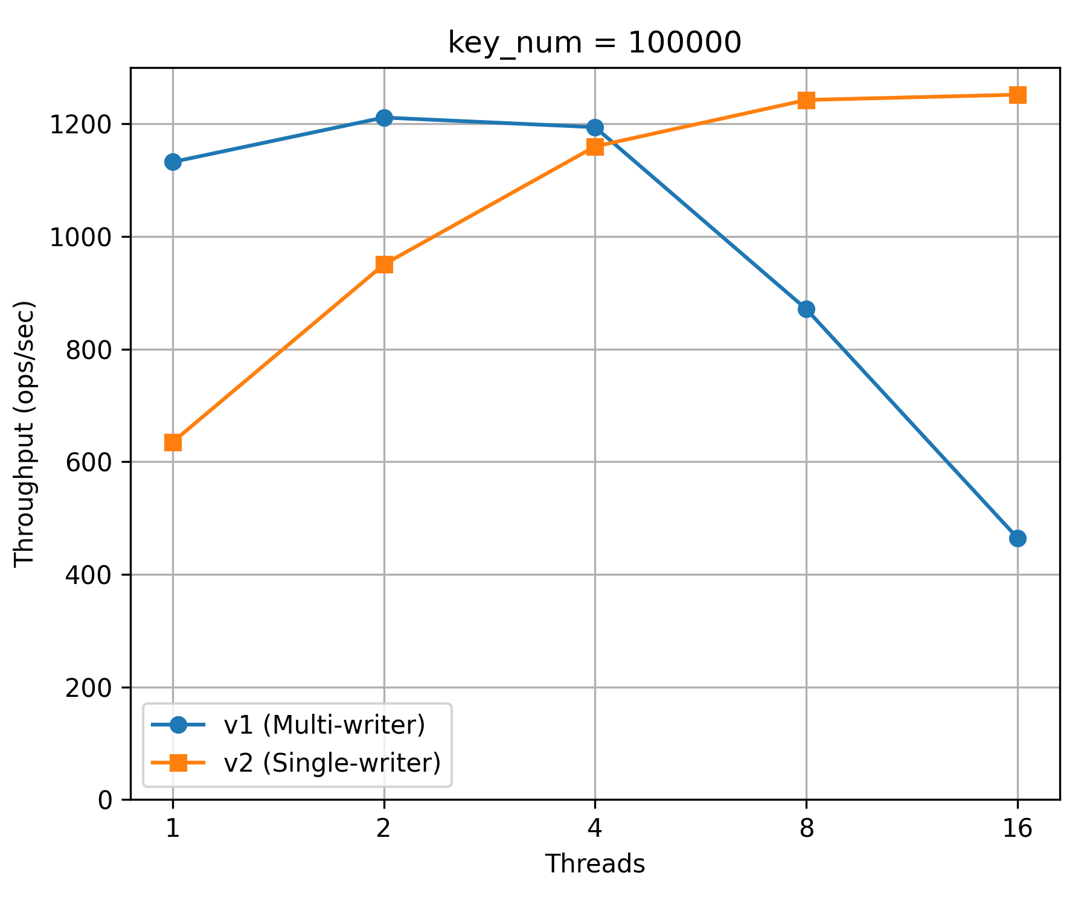
Attempts

Slide 5
Current Approach
Single-writer + batching
Workers enqueue a request and wait for completion
Writer fetches batches from the queue, applies them to the tree, and wakes the requests
Overlay: Updates are merged in memory during batching; only the final root is published and written to disk

Slide 6
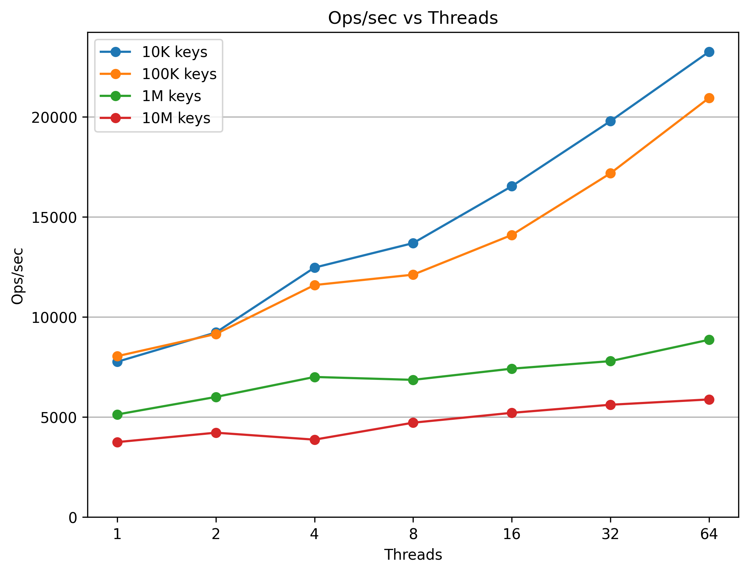
Current Approach
cache hit ratio per threads
 | 1 | 2 | 4 | 8 | 16 | 32 | 64
100K | 98.20 | 98.22 | 98.46 | 98.68 | 98.76 | 99.04 | 99.23
1M | 81.82 | 81.71 | 79.36 | 77.16 | 75.70 | 74.43 | 73.07
10M | 75.09 | 75.10 | 71.41 | 67.64 | 63.89 | 60.33 | 57.12
Cache: 8K sets, 4-way associative
But, not simply more misses; reuse previously captured as
global cache hits shifts to another layer

