Slide 1
Test Design Techniques
Chapter 4
Software Testing
Foundation Of Software Testing
1 Principles
2 Lifecycle
3 Static testing
4 Test design
techniques
5 Management
6 Tools

Slide 2
Contents
1
2
3
Foundation Of Software Testing
4
5
6
Test Design Techniques
The test development process
Categories of test design techniques
Black and White box testing
Black box test techniques
White box test techniques
Experience-based techniques
Choosing a test technique

Slide 3
The test development process
Differentiate between a test design specification, test case specification and test procedure specification.
Compare the terms test condition, test case and test procedure.
Evaluate the quality of test cases in terms of clear traceability to the requirements and expected results.
Translate test cases into a well-structured test procedure specification at a level of detail relevant to the knowledge of the testers.

Slide 4
The test development process
Formality of test documentation
Test analysis: identifying test conditions
Test design: specifying test cases
Test implementation: specifying test procedures or scripts

Slide 5
Contents
1
2
3
Foundation Of Software Testing
4
5
6
Test Design Techniques
The test development process
Categories of test design techniques
Black and White box testing
Black box test techniques
White box test techniques
Experience-based techniques
Choosing a test technique

Slide 6
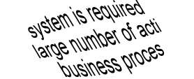
Three types of systematic technique
Static (non-execution)
  examination of documentation,
  source code listings, etc.
Functional (Black Box)
  based on behaviour /
  functionality of software
Structural (White Box)
  based on structure
  of software

Slide 7
Some test techniques
Static
Dynamic
Reviews
etc.
Behavioural
Inspection
Static Analysis
Walkthroughs
Structural
Non-functional
Functional
Desk-checking
etc.
etc.
Usability
Equivalence
Partitioning
Control
Flow
Data
Flow
Performance
etc.
Boundary
Value Analysis
etc.
Statement
Symbolic
Execution
Cause-Effect Graphing
Branch/Decision
Arcs
Random
Definition
-Use
Branch Condition
LCSAJ
Branch Condition
Combination
State Transition

Slide 8
Black box versus white box?
Black box appropriate
at all levels but
dominates higher
levels of testing
White box used
predominately
at lower levels
to compliment
black box
Acceptance
System
Integration
Component

Slide 9
Contents
1
2
3
Foundation Of Software Testing
4
5
6
Test Design Techniques
The test development process
Categories of test design techniques
Black and White box testing
Black box test techniques
White box test techniques
Experience-based techniques
Choosing a test technique

Slide 10
Black Box test design and measurement techniques
Techniques defined in BS 7925-2
  Equivalence partitioning
  Boundary value analysis
  State transition testing
  Cause-effect graphing
  Syntax testing
  Random testing
Also defines how to specify other techniques
Also a measurement
technique?
= Yes
= No

Slide 11
Equivalence partitioning (EP)
  divide (partition) the inputs, outputs, etc. into areas which are the same (equivalent)
  assumption: if one value works, all will work
  one from each partition better than all from one
invalid
valid
invalid
0
1
100
101

Slide 12
Boundary value analysis (BVA)
  faults tend to lurk near boundaries
  good place to look for faults
  test values on both sides of boundaries
invalid
valid
invalid
0
1
100
101

Slide 13
Example: Loan application
2-64 chars.
Customer Name
Account number
Loan amount requested
Term of loan
Monthly repayment
Term:
Repayment:
Interest rate:
Total paid back:
6 digits, 1st
non-zero
£500 to £9000
1 to 30 years
Minimum £10

Slide 14
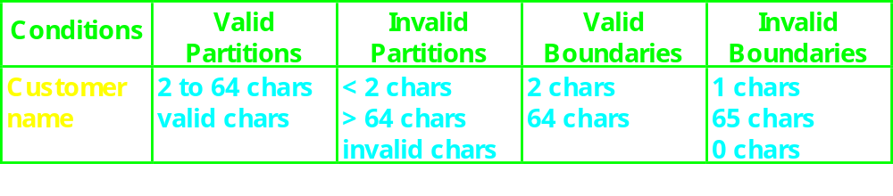
Customer name
Number of characters:
1
2
64
65
invalid
valid
invalid
Valid characters:
A-Z
a-z
Any
other
-’
space

Slide 15
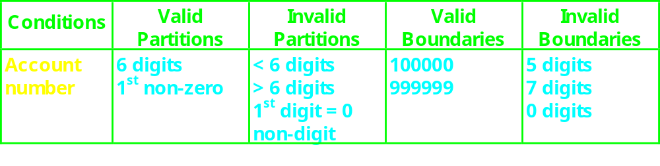
Account number
valid: non-zero
first character:
invalid: zero
number of digits:
5
6
7
invalid
invalid
valid

Slide 16
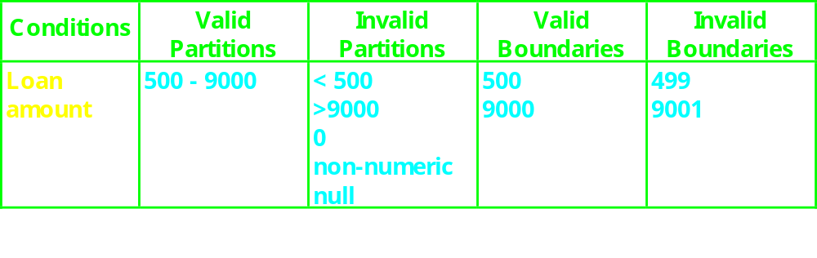
Loan amount
499
500
9000
9001
invalid
valid
invalid

Slide 17
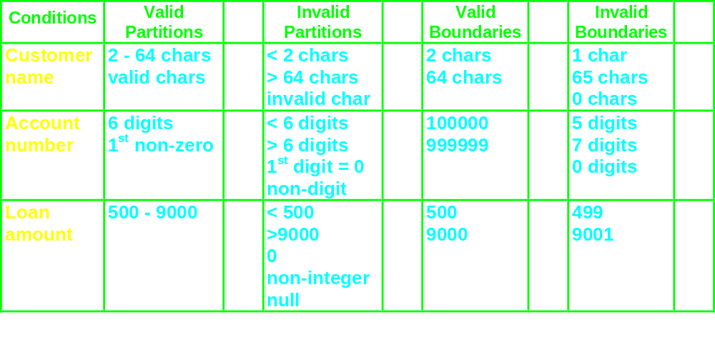
Condition template

Slide 18
Design test cases
Test
Description
Expected Outcome
New Tags
Case
Covered
1
Name: John Smith
Acc no: 123456
Loan: 2500
Term: 3 years
Term: 3 years
Repayment: 79.86
Interest rate: 10%
Total paid: 2874.96
V1, V2,
V3, V4,
V5 .....
2
Name: AB
Acc no: 100000
Loan: 500
Term: 1 year
Term: 1 year
Repayment: 44.80
Interest rate: 7.5%
Total paid: 537.60
B1, B3,
B5, .....

Slide 19
Why do both EP and BVA?
If you do boundaries only, you have covered all the partitions as well
  technically correct and may be OK if everything works correctly!
  if the test fails, is the whole partition wrong, or is a boundary in the wrong place - have to test mid-partition anyway
  testing only extremes may not give confidence for typical use scenarios (especially for users)
  boundaries may be harder (more costly) to set up

Slide 20
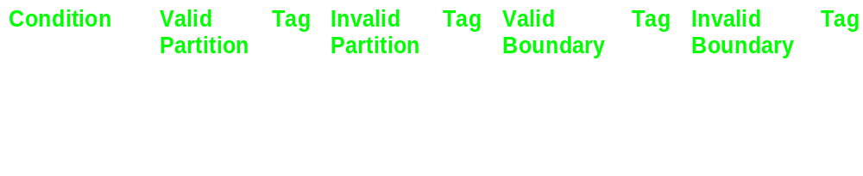
Test objectives?
For a thorough approach: VP, IP, VB, IB
Under time pressure, depends on your test objective
  minimal user-confidence: VP only?
  maximum fault finding: VB first (plus IB?)

Slide 21
Decision tables
explore combinations of inputs, situations or events,
it is very easy to overlook specific combinations of input
start by expressing the input conditions of interest so that they are either TRUE or FALSE
  record found
  file exists
  code valid
  policy expired
  account in credit
  due date > current date

Slide 22
Example: student access
A university computer system allows students an allocation of disc space depending on their projects.
If they have used all their allotted space, they are only allowed restricted access, i.e. to delete files, not to create them. This is assuming they have logged on with a valid username and password.
What are the input and output conditions?

Slide 23
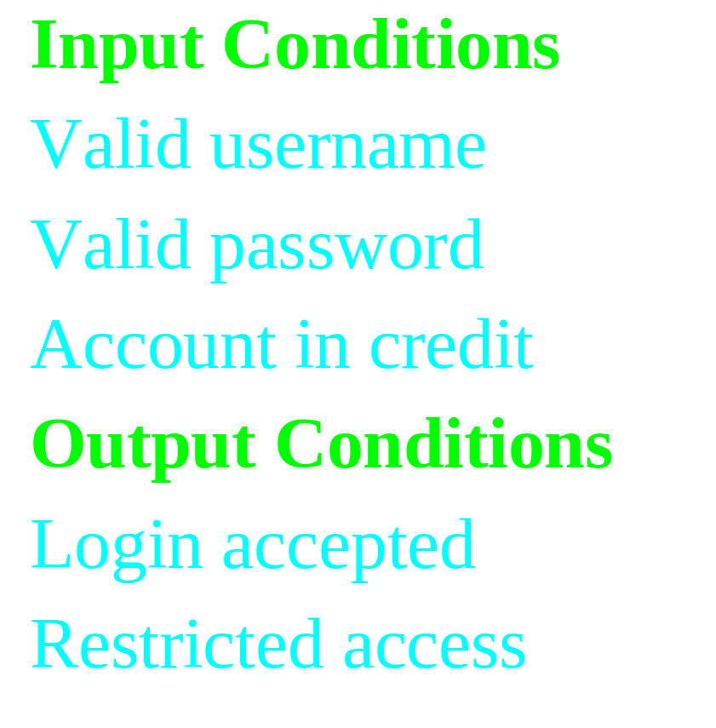
List the input and output conditions
list the ‘input conditions’ in the first column of the table
list the ‘output conditions’ under the input conditions

Slide 24
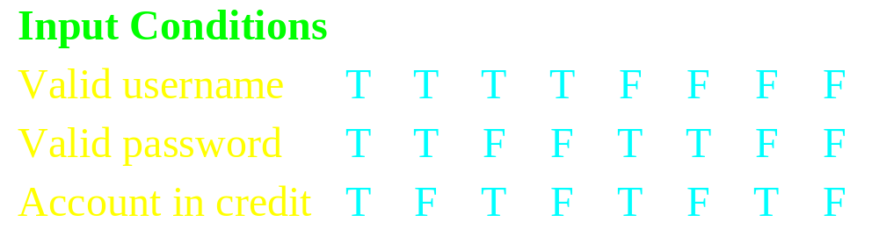
Determine input combinations
add columns to the table for each unique combination of input conditions.
each entry in the table may be either ‘T’ for true, ‘F’ for false.

Slide 25
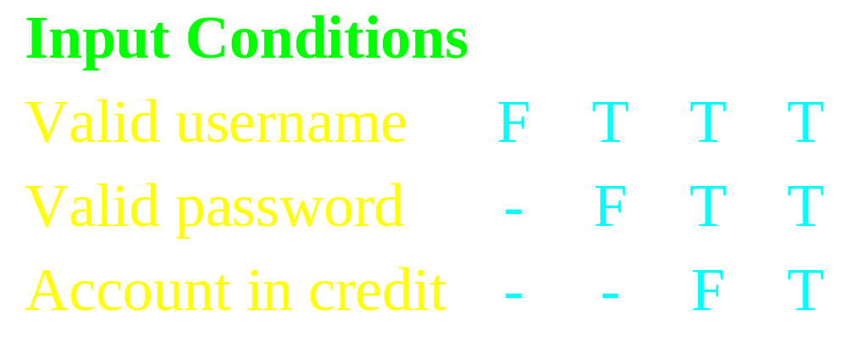
Rationalise input combinations
some combinations may be impossible or not of interest
some combinations may be ‘equivalent’
use a hyphen to denote “don’t care”

Slide 26
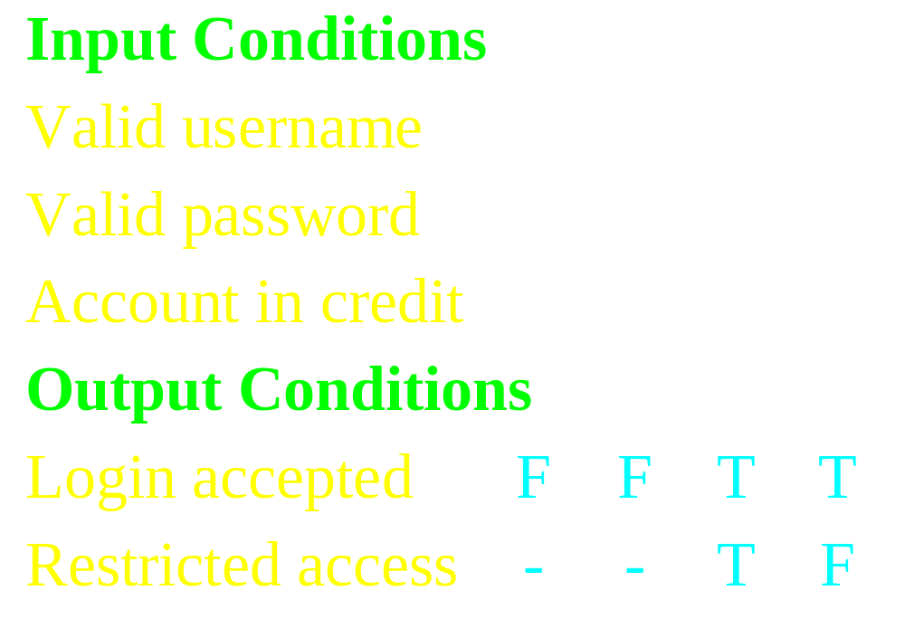
Complete the table
determine the expected output conditions for each combination of input conditions

Slide 27
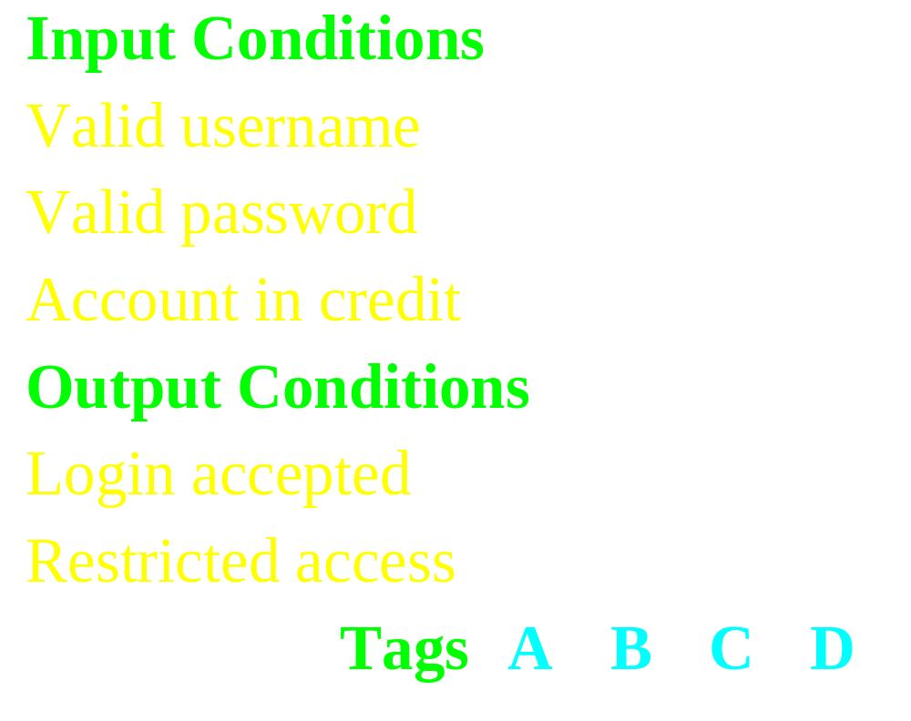
Determine test case groups
each column is at least one test case

Slide 28
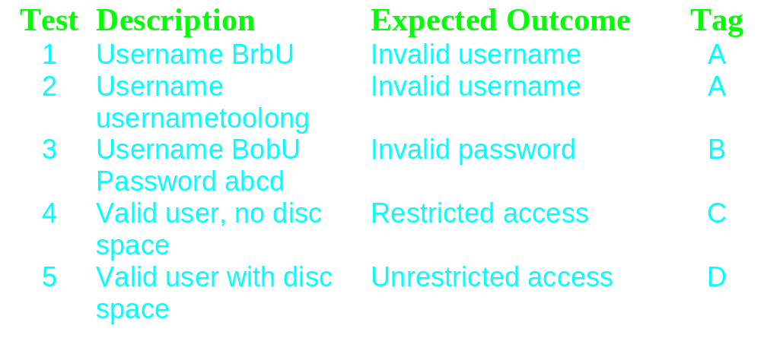
Design test cases
usually one test case for each column but can be none or several

Slide 29
Rationalising outputs
if outputs or effects are mutually exclusive, I.e. T occurs in only one place in each column, we can combine them
for example:
X T F F
is equivalent to:
Y F T F
Z F F T
Output X Y Z

Slide 30
Rationalising dangers
Rationalising is based on assumptions
Assumptions may be wrong!
Assumptions should be stated
Assumptions may change over time
Be aware of the dangers
  Filling in the full table may find errors which will be missed if you rationalise
  It is possible to rationalise too far

Slide 31
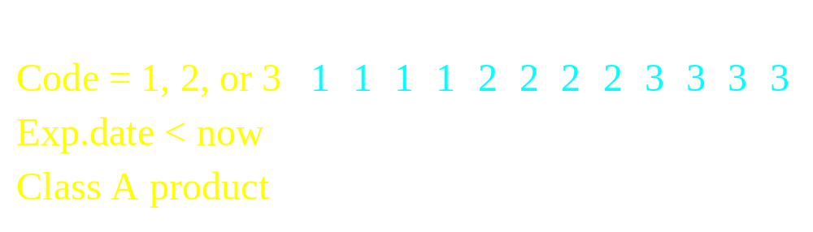
Extending decision tables
Entries can be more than just ‘true’ or ‘false’
  completing table needs to be done carefully
  rationalising becomes more important
E.g.

Slide 32
Decision Tables in relation to EP and BVA
Input value
Output value
FALSE
TRUE

Slide 33
Contents
1
2
3
Foundation Of Software Testing
4
5
6
Test Design Techniques
The test development process
Categories of test design techniques
Black and White box testing
Black box test techniques
White box test techniques
Experience-based techniques
Choosing a test technique

Slide 34
White Box test design and measurement techniques
Techniques defined in BS 7925-2
  Statement testing
  Branch / Decision testing
  Data flow testing
  Branch condition testing
  Branch condition combination testing
  Modified condition decision testing
  LCSAJ testing
Also defines how to specify other techniques
Also a measurement
technique?
= Yes
= No

Slide 35
Using structural coverage
Spec
Enough
tests?
Software
Tests
Results OK?
What's
covered?
More tests
Coverage OK?
More tests
More tests
More tests
More tests
More tests
More tests
More tests
Stronger structural techniques (different structural elements)
Increasing coverage

Slide 36
The test coverage trap
Function exercised,
insufficient structure
better testing
Functional
testedness
Structure exercised,
insufficient function
% Statement % Decision % Condition
Combination
Structural testedness
100% coverage does
not mean 100% tested!
Coverage is not
Thoroughness

Slide 37
Statement coverage
Statement coverage
is normally measured
by a software tool.
percentage of executable statements exercised by a test suite
  number of statements exercised
  total number of statements
example:
  program has 100 statements
  tests exercise 87 statements
  statement coverage = 87%
?
=
Typical ad hoc testing achieves 60 - 75%

Slide 38
Example of statement coverage
Test
case
Input
Expected
output
1
2
3
4
5
read(a)
IF a > 6 THEN
b = a
ENDIF
print b
1
7
7
As all 5 statements are ‘covered’ by
this test case, we have achieved
100% statement coverage
Statement
numbers

Slide 39
Decision coverage
(Branch coverage)
Decision coverage
is normally measured
by a software tool.
percentage of decision outcomes
exercised by a test suite
  number of decisions outcomes exercised
  total number of decision outcomes
example:
  program has 120 decision outcomes
  tests exercise 60 decision outcomes
  decision coverage = 50%
False
=
?
True
Typical ad hoc testing achieves 40 - 60%

Slide 40
Paths through code
1
2
3
4
1
2
1
2
1
2
3
?
?
?
?
?
?

Slide 41
Paths through code with loops
1
2
3
4
5
6
7
8 ….
for as many times as it
is possible to go round
the loop (this can be
unlimited, i.e. infinite)
?

Slide 42
Example 1
Wait
Valid
card?
Wait for card to be inserted
IF card is a valid card THEN
display “Enter PIN number”
IF PIN is valid THEN
select transaction
ELSE (otherwise)
display “PIN invalid”
ELSE (otherwise)
reject card
End
Wait for card to be inserted
Wait for card to be inserted
IF card is a valid card THEN
Wait for card to be inserted
IF card is a valid card THEN
display “Enter PIN number”
Wait for card to be inserted
IF card is a valid card THEN
display “Enter PIN number”
IF PIN is valid THEN
Wait for card to be inserted
IF card is a valid card THEN
display “Enter PIN number”
IF PIN is valid THEN
select transaction
Wait for card to be inserted
IF card is a valid card THEN
display “Enter PIN number”
IF PIN is valid THEN
select transaction
ELSE (otherwise)
display “PIN invalid”
Wait for card to be inserted
IF card is a valid card THEN
display “Enter PIN number”
IF PIN is valid THEN
select transaction
ELSE (otherwise)
display “PIN invalid”
ELSE (otherwise)
reject card
Yes
Display
“Enter..
No
Valid
PIN?
Reject
card
Yes
Select
trans...
No
Display
“PIN in..
End

Slide 43
Example 2
Read
Read A
IF A > 0 THEN
IF A = 21 THEN
Print “Key”
ENDIF
ENDIF
IF A = 21 THEN
ENDIF
IF A > 0 THEN
ENDIF
Print “Key”
Read A
A>0
Yes
A=21
Yes
No
No
Print
End
3
  Cyclomatic complexity: _____
  Minimum tests to achieve:
    Statement coverage: ______
    Branch coverage: _____
1
3

Slide 44
Example 3
Read
Read A
Read B
IF A > 0 THEN
IF B = 0 THEN
Print “No values”
ELSE
Print B
IF A > 21 THEN
Print A
ENDIF
ENDIF
ENDIF
A>0
B=0
No
Yes
Print
No
Yes
A>21
Yes
Print
Print
No
End
4
  Cyclomatic complexity: _____
  Minimum tests to achieve:
    Statement coverage: ______
    Branch coverage: _____
2
4

Slide 45
Example 4
A<0
Yes
Read
Print
No
Read A
Read B
IF A < 0 THEN
Print “A negative”
ELSE
Print “A positive”
ENDIF
IF B < 0 THEN
Print “B negative”
ELSE
Print “B positive”
ENDIF
Note: there
are 4 paths
Print
B<0
Yes
Print
No
Print
End
3
  Cyclomatic complexity: _____
  Minimum tests to achieve:
    Statement coverage: ______
    Branch coverage: _____
2
2

Slide 46
Example 5
A<0
Yes
Read
Print
No
Read A
Read B
IF A < 0 THEN
Print “A negative”
ENDIF
IF B < 0 THEN
Print “B negative”
ENDIF
B<0
Yes
Print
No
End
3
  Cyclomatic complexity: _____
  Minimum tests to achieve:
    Statement coverage: ______
    Branch coverage: _____
1
2

Slide 47
Example 6
A<0
Yes
Read
Print
No
Read A
IF A < 0 THEN
Print “A negative”
ENDIF
IF A > 0 THEN
Print “A positive”
ENDIF
A>0
Yes
Print
No
End
3
  Cyclomatic complexity: _____
  Minimum tests to achieve:
    Statement coverage: ______
    Branch coverage: _____
2
2

Slide 48
Contents
1
2
3
Foundation Of Software Testing
4
5
6
Test Design Techniques
The test development process
Categories of test design techniques
Black and White box testing
Black box test techniques
White box test techniques
Experience-based techniques
Choosing a test technique

Slide 49
Experience-based techniques
Error guessing and fault attacks: Error guessing is a technique that should always be used as a complement to other more formal techniques.
Exploratory testing: is a hands-on approach in which testers are involved in minimum planning and maximum test execution.

Slide 50
Contents
1
2
3
Foundation Of Software Testing
4
5
6
Test Design Techniques
The test development process
Categories of test design techniques
Black and White box testing
Black box test techniques
White box test techniques
Experience-based techniques
Choosing a test technique

Slide 51
Choosing a test technique
The internal factors that influence the decision about which technique to use are:
  Models used
  Tester knowledge/experience
  Likely defects
  Test objective
  Documentation
  Life cycle model

Slide 52
Choosing a test technique
The external factors that influence the decision about which technique to use are:
  Risk
  Customer/contractual requirements
  Type of system
  Regulatory requirements
  Time and budget

Slide 53
Summary: Key Points
1
2
3
Foundation Of Software Testing
4
5
6
Test Design Techniques
The test development process
Categories of test design techniques
Black and White box testing
Black box test techniques
White box test techniques
Experience-based techniques
Choosing a test technique

