Slide 1

Nov.19th, 20th, 21st & 22nd
Cassandra
Subbareddy Jangalapalli
@Cognizant

Slide 2
Agenda
Day1 (Dec.19th)
CAP Theorem
What is Cassandra?
History
Architecture
Node
Rack
Data Center (DC)
Cluster
Key concepts – Hands on
Replication Factory(RF) & Replication Strategies
Key Space
Column Family(CF)
Partition Key(PK)
Clustered Key (CK)
Data types
TTL
Collection types, UDT & UDF.
Data Model design with sample CF
Exercise -1

Slide 3
Agenda
Day2 (Dec.20th)
Key concepts –(Continuation)
Day1 recap & Exercise review
What is hot spot?
Seeds & Coordinators
Consistency levels(CL)
Quorum vs Local Quorum
Commit Log
Memtable
SSTable
Write path of Cassandra
Read path of Cassandra
Hinted Handoffs
Tunable Data Consistency
Read Repair
Strong vs Eventual Consistencies
Consistency knowledge check
Compaction Strategies
Compression Techniques
Tombstones
CQL
Q & A

Slide 4
Agenda
Day3 (Dec.21st)
CQL Commands (Continuation)
Day1& 2 recap & review
YML file configurations & key parameters
Sample Java snippets to connect Cassandra
Issues, Retry & Load balancing Policies
Data Migrations(COPY TO/FROM,SQOOP(DSE), SSTABLELOADER)
Tools(Node, DSE & Cassandra-stress)
DevCenter
OpsCenter
Q & A
Appendix

Slide 5
Day1 (Dec.19th) – Agenda
CAP Theorem
What is Cassandra?
History
Architecture
Node
Rack
Data Center (DC)
Cluster
Who is using Cassandra?
Where to get Cassandra?
Key concepts – Hands on
Replication Factory(RF) & Replication Strategies
Key Space
Column Family(CF)
Partition Key(PK)
Clustered Key (CK)
Data types
TTL
Collection types, UDT, UDF & UDAF
Data Model design with sample CF
Exercise -1

Slide 6
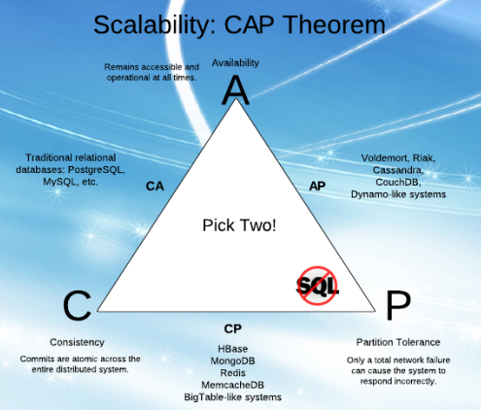
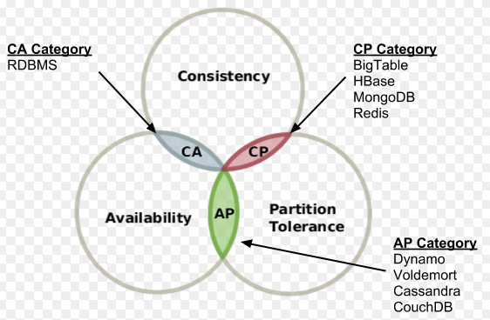
CAP Theorem
→Consistency: All the nodes/servers in the system/cluster should have the same data so anyone using/querying the system will get same copy regardless of which responsible server(s)/node(s) answers/responds to their request.
→Availability: The system always respond to a request (even if it’s NOT the latest data or consistent across the system or just a messaging that system isn’t working or quorum failures)
→Partition Tolerance: The system continues to operate as a whole even if individual server/node fail/down, or can't be reached.., due to any reasons.
http://blog.cloudera.com/blog/2010/04/cap-confusion-problems-with-partition-tolerance/ & https://en.wikipedia.org/wiki/CAP_theorem

Slide 7
What is Cassandra?
→Apache Cassandra is an open source, NoSQL distributed decentralized database (storage system)
→AP NoSQL database (CAP – C is compromised)
→High Availability
→Partition tolerance
→Consistency is eventual consistency
Massive scalability (Cluster can be thousands of nodes )
Fault tolerant (no single point of failure, like master/slave)
CFS is a partitioned row store
What is NoSQL:
Now days called as Not Only SQL, originally referring to "non SQL" or "non relational" database provides a mechanism for storage and retrieval of data that is modeled in means other than the tabular relations used in relational databases. NoSQL databases are increasingly used in big data and real-time applications.
The primary objective of a NoSQL database is to have:
Simplicity of design,
Horizontal scaling, and
Finer control over availability

Slide 8
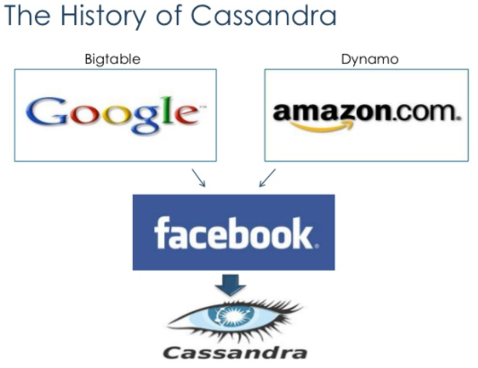
History - Cassandra
→Apache Cassandra was developed at Facebook to power their Inbox Search feature by Avinash Lakshman (one of the authors of Amazon's Dynamo) and Prashant Malik.
→It was released as an open source project on Google code in July 2008.
→In March 2009, it became an Apache Incubator project. On February 17, 2010 it graduated to a top-level project.
→ The current stable release is 3.11.1 /Oct.10,2017
https://en.wikipedia.org/wiki/Apache_Cassandra

Slide 9
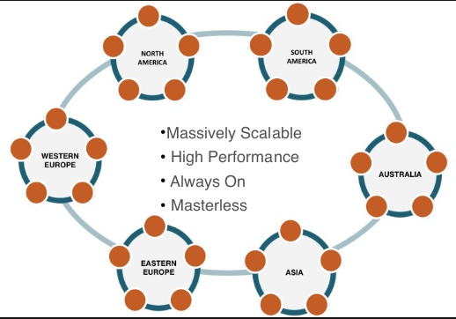
Architecture
→Node: Is single Server/Machine (RAM, Cores,HD,OS,etc..) – where you store your data. It is the basic infrastructure component of Cassandra.
→ Rack: Is a logical set of nodes.
→Data Center (DC): A collection of related nodes. A datacenter can be a physical data center or virtual datacenter. Different workloads should use separate datacenters, either physical or virtual. Replication is set by datacenter.
→Cluster: A cluster contains one or more datacenters.
Designed & built with the understanding that hardware & software failures can happen
Peer-to-Peer Architecture
All nodes are the same
Read/Write Anywhere
Gossip Protocol
Commit Log Captures all Activity
Well suited for cloud deployments.

Slide 10
Why Cassandra?
Gigabyte to Petabyte scalability
Linear performance gains through adding nodes
No single point of failure
Easy replication / data distribution
Multi-data center and Cloud capable
No need for separate caching layer
Tunable data consistency
Flexible schema design
Data compression
CQL language support (like SQL)
Support for key languages and platforms
No need for special hardware or software
Fast writes(ingestion rate is very high)
And many more…

Slide 11
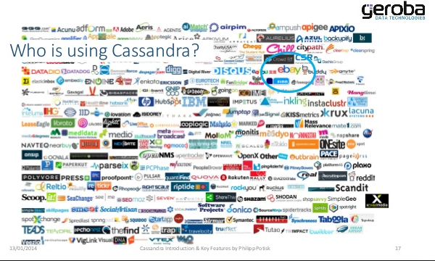
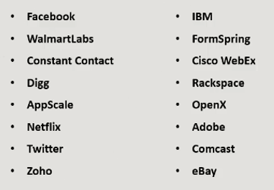
Who is using Cassandra & Where to get it?
Who is using Cassandra?
Where to get Cassandra?
http://cassandra.apache.org/download/
https://www.datastax.com/2012/01/getting-started-with-cassandra

Slide 12
Key concepts – Hands on
Replication Factory(RF) & Replication Strategies: RF is nothing but how many copies to maintain in cluster for specified key space at each DC level.
Key Space: is nothing but a db schema or db name; grouping few Column Families (Tables) into one common key space or is kind of container.
Column Family(CF): is nothing but a table, like rows X columns, and each cell has “Name, value & time stamp”
Partition Key(PK): The partition key determines which node stores the data. It is responsible for data distribution across the nodes. By default first column name as the partition key if not mentioned.
Clustered Key (CK): The additional columns determine per-partition clustering. Clustering is a storage engine process that sorts data within the partition.
Row Key(RK): is another name for the PRIMARY KEY. It is the combination of all the partition and clustering fields, and it will map to just one row of data in a CF.
A compound primary key consists of the partition key and one or more additional columns that determine clustering.
*Note that Cassandra can use multiple columns in a partition key and in clustered key
Ex: PRIMARY KEY(A), PRIMARY KEY(A,B), PRIMARY KEY((A, B), C, D)
https://docs.datastax.com/en/cql/3.1/cql/cql_reference/refLimits.html

Slide 13
Key concepts – Hands on
Replication Strategies: Cassandra has two replication protocols or strategies for data where need to be placed.
RF = 1 means that there is only one copy of each row on one node. RF=2 means two copies of each row, where each copy is on a different node. All replicas are equally important; there is no primary or master replica. Preferred RF is 3 in PROD.
As a general rule, the replication factor should not exceed the number of nodes in the cluster.
→ SimpleStrategy: Use only for a single data center and one rack. If you ever intend more than one datacenter, use the NetworkTopologyStrategy.
→ NetworkTopologyStrategy: Highly recommended for most deployments because it is much easier to expand to multiple datacenters when required by future expansion.
DURABLE_WRITES: is to bypass data written into commit log. By default it is set to TRUE. When set to FALSE, data written to the keyspace bypasses the commit log. Be careful using this option because you will be in risk losing data if crashes/failures. Preferred one is not to set FALSE; set TRUE while creation of key space.

Slide 14
Key concepts – Hands on
Syntax: CREATE KEYSPACE “KeySpace Name”
WITH replication = {'class': ‘Strategy name’, 'replication_factor' : ‘No.Of replicas’};
CREATE KEYSPACE “KeySpace Name”
WITH replication = { 'class' : 'NetworkTopologyStrategy‘ [, '<data center1>' : <integer>, '<data center2>' : <integer>] . . . };
CREATE KEYSPACE “KeySpace Name”
WITH replication = { 'class' : 'NetworkTopologyStrategy‘ [, '<data center1>' : <integer>, '<data center2>' : <integer>] . . . } AND DURABLE_WRITES =??
Examples:
CREATE KEYSPACE sscts WITH REPLICATION = { 'class' : 'org.apache.cassandra.locator.SimpleStrategy', 'replication_factor': '3' } AND DURABLE_WRITES = true;
CREATE KEYSPACE ntscts WITH REPLICATION = { 'class' : 'org.apache.cassandra.locator.NetworkTopologyStrategy', 'dc1': '3' } AND DURABLE_WRITES = true;
CREATE KEYSPACE ntscts2dcs WITH REPLICATION = { 'class' : 'org.apache.cassandra.locator.NetworkTopologyStrategy', 'dc1': '3' , ‘dc2’: ’3’} AND DURABLE_WRITES = true;

Slide 15
Key concepts – Hands on
Syntax: CREATE TABLE IF NOT EXISTS keyspace_name.table_name
( column_definition, column_definition, ...)
WITH property AND property ...
Data Types:
https://docs.datastax.com/en/cql/3.3/cql/cql_reference/cql_data_types_c.html
Examples:
CREATE TABLE ks.test (id int PRIMARY KEY, fname text, lname text, doj, date, creation_time timestamp)
CREATE TABLE customer_service_call (
phone_nbr int, event_type text, insertion_time timestamp,event blob,
PRIMARY KEY (phone_nbr, event_type, insertion_time)
) WITH CLUSTERING ORDER BY (insertion_time DESC);
Exercises:
Try ALTER on all aforesaid examples
DROP KS & CF
And recreate the same to familiarize the concepts; and UPSERT(insert + update) couple of records with TTL , and without TTL.
Create a CF with collection types.(SET, LIST & MAP), try to use UDT or create UDT.
Data Model Discussion how to design the CF for specific use case:
Q1. Need a table to see number of consumers for each ISP at country wide, and state wise within a given country alphabetical order of state. Ensure not have hot spot.

Slide 16
Day1 (Dec.19th) – Agenda Ends
Any Q
?

Slide 17
Day2 (Dec.20th) – Agenda
Key concepts –(Continuation)
Day1 recap & Exercise review
What is hot spot?
Seeds & Coordinators
Consistency levels(CL)
Quorum vs Local Quorum
Commit Log
Memtable
SSTable
Write path of Cassandra
Read path of Cassandra
Hinted Handoffs
Tunable Data Consistency
Read Repair
How to enable Row Cache
Strong vs Eventual Consistencies
Consistency knowledge check
Compaction Strategies
Compression Techniques
Tombstones
CQL
Q & A

Slide 18
Day1 Exercises – Hands on
Try ALTER on all aforesaid examples
DROP KS & CF and recreate to familiarize the concepts.
Design & create a CF and insert couple of records with TTL , and without TTL.
Create a CF with collection types.(SET, LIST & MAP)
Enable Row Cache for a table.
What is TTL, collection types, UDT, UDF, & UDAF??
INSERT INTO ks.cf (c1, c2,c3,....) VALUES (v1, v2, v3,....) USING TTL 86400;
UDT:
https://docs.datastax.com/en/cql/3.1/cql/cql_using/cqlUseUDT.html
UDF & UDAF:
https://docs.datastax.com/en/cql/3.3/cql/cql_using/useCreateFunctionsTOC.html
*To support future capabilities, a column definition of a user-defined or tuple type requires the frozen keyword. Cassandra serializes a frozen value having multiple components into a single value.
CREATE TABLE users ( userid text PRIMARY KEY, first_name text, last_name text, status_id text, emails set<text>, top_scores list<int>, todo map<timestamp, text> ); | CREATE TABLE users ( userid text, first_name text, last_name text, status_id text, emails set<text>, top_scores list<int>, todo map<timestamp, text>, PRIMARY KEY (userid, status_id)) WITH CLUSTERING ORDER BY (status_id DESC) AND caching = '{"keys":"ALL", "rows_per_partition":"10"}'

Slide 19
Day1 Exercises – Hands on
Data Model Discussion how to design the CF for specific use case:
Q1. Business Need a table to see number of consumers for each ISP at country wide, and state wise within a given country alphabetical order of state. Ensure not have hot spot.
CREATE TABLE ISP ( Country_Code asci(2), State_Name text, Isp_Name text, No_of_users bigint, updated_ts timestamp, PRIMARY KEY (Country_Code, State_Name)
) WITH CLUSTERING ORDER BY (State_Name);
?? Does it works??
UPSERT few records - and play around it
INSERT INTO ks.cf (c1, c2,c3,....) VALUES (v1, v2, v3,....) USING TTL 86400;
INSERT INTO ISP (Country_Code, State_Name, Isp_Name, No_of_users, updated_ts)
VALUES (‘US’, ‘TX’,’Verizon’,12345, dateof(now())) USING TTL 86400;
INSERT INTO ISP (Country_Code, State_Name, Isp_Name, No_of_users, updated_ts)
VALUES (‘US’, ‘TX’,’ATT’,67890, toTimestamp(now())) USING TTL 86400; // CQL >2.1
CREATE TABLE ISP ( Country_Code asci(2), State_Name text, Isp_Name text, No_of_users bigint, updated_ts timestamp, PRIMARY KEY (Country_Code, State_Name, Isp_Name)
) WITH CLUSTERING ORDER BY (State_Name);

Slide 20
Hotspots, Seed nodes & Coordinators
Hotspots: Partitions are not even-sized, and some of the partitions are more loaded and accessed than others.
Seed nodes: Its recommended to use the minimum 2 seed nodes for the whole cluster. If its multi-dc, ensure one node from each DC. Refer YAML file “seeds” parameter - preferred number is round_down(sqrt(#nodes in DC)) in cluster.
The ring can operate or boot without a seed; however, you will not be able to add new nodes to the cluster. It is recommended to configure multiple seeds in production system. `
the process of bootstrapping - is to help initialize the cluster, initiate the gossip.
A new node joining to cluster or removing existing node from cluster with help of gossip process.
So once the cluster has the first few nodes, the subsequent nodes bootstrap by first contacting a seed node. Thereafter they exchange information through Cassandra’s Gossip Protocol. The seeds have no use after the cluster is up and running, unless at some point you decide to bring down the whole cluster and delete data and start afresh; at that point you could as well change the seed nodes. Making every node a seed node is not recommended because of increased maintenance and reduced gossip performance
Coordinators: Every node can be a coordinator (as designed by Cassandra). Coordinator is picked by Cassandra per request and the only thing you can change is how it is picked - for example Round-Robin (default) or DC-aware, Latency Aware. This is found in the cassandra.yaml file “request_scheduler”. So in a 10-node cluster, all nodes are capable of being coordinators but one of those nodes is picked by the algorithm specified in the cassandra.yaml file for a given request (of course you could write your own implementation using Java and override the setting).

Slide 21
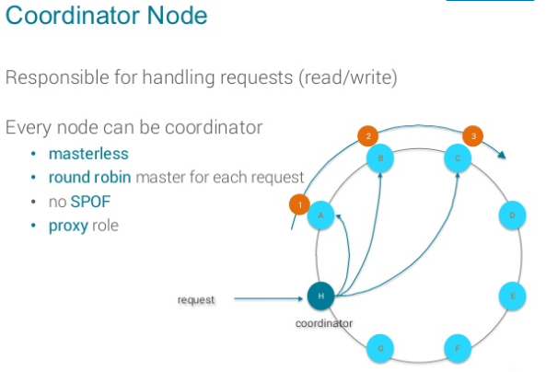
Hotspots, Seed nodes & Coordinators
Coordinators:
Its a node which receive the request from client and send the request to the actual node[hash(key) => token] depending upon the token. So all the nodes acts as coordinator node in cluster.
When data enters Cassandra, the partition key (row key) is hashed with a hashing algorithm, and the row is sent to its nodes by the value of the partition key hash.
The coordinator node is typically chosen by an algorithm which takes "network distance" into account.
http://opensourceconnections.com/blog/2013/09/12/getting-started-with-cassandra-data-partitioning/

Slide 22
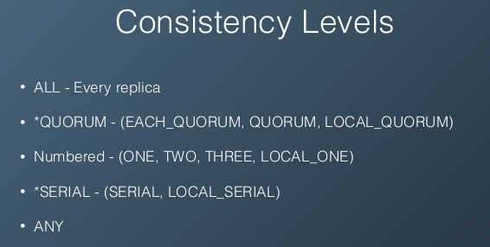
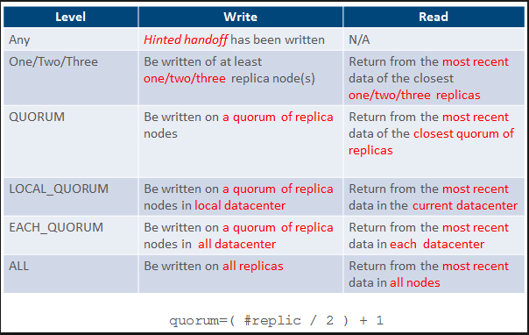
Consistency levels(CL):
Recollect CAP, and consistency is: All the nodes/servers in the system/cluster should have the same data so anyone using/querying the system will get same copy regardless of which responsible server(s)/node(s) answers/responds to their request.
*Cassandra is eventual consistency, not immediate.
http://docs.datastax.com/en/archived/cassandra/2.0/cassandra/dml/dml_config_consistency_c.html

Slide 23
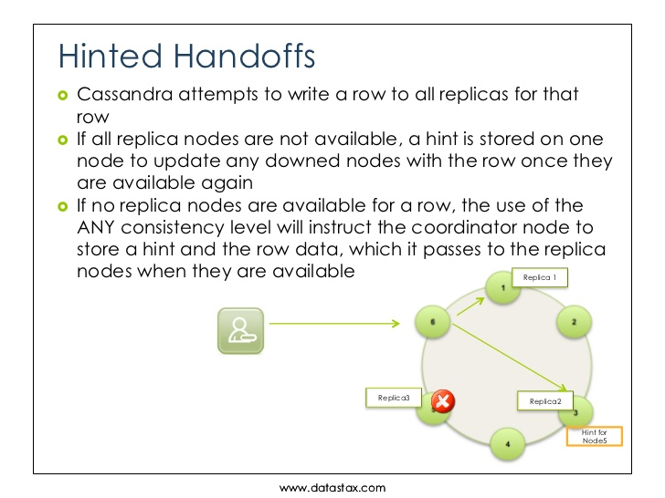
Hinted Handoffs

Slide 24
CL(Q vs LQ vs EQ) and other consistencies
Q(QUORUM): is not Cassandra concept, it is nothing but a majority, dictionary meaning is – “A gathering of the minimal number of members of an organization to conduct business”
A write must be written to the commit log and memtable on a quorum of replica nodes across all datacenters;
Returns the record after a quorum of replicas from all datacenters has responded.
LQ(LOCAL_QUORUM): LOCAL_QUORUM level is calculated based on the replication factor of the same datacenter as the coordinator node. That is, even if the cluster has more than one datacenter, the quorum is calculated only with local replica nodes. It is Strong consistency.
A write must be written to the commit log and memtableon a quorum of replica nodes in the same datacenter as the coordinator. Avoids latency of inter-datacenter communication.
Returns the record after a quorum of replicas in the current datacenter as the coordinator has reported. Avoids latency of inter-datacenter communication.
EQ(EACH_QUORUM): EACH_QUORUM level is calculated based on the replication factor of the each & every datacenter as the coordinator node. That is, if the cluster has more than one datacenter, the quorum is calculated with all data center replica nodes. Strong consistency.
Every datacenter in the cluster must reach a quorum based on that datacenter's replication factor in order for the read or write request to succeed. That is, for every datacenter in the cluster a quorum of replica nodes must respond to the coordinator node in order for the read or write request to succeed.
A write must be written to the commit log and memtable on a quorum of replica nodes in eachdatacenter.
Not supported for reads.
quorum = (sum_of_replication_factors / 2) + 1 sum_of_replication_factors = datacenter1_RF + datacenter2_RF + . . . + datacentern_RF

Slide 25
CL(LQ VS Q vs EQ) and other consistencies
Assuming cluster has 3 data centers with RF 3 in each dc and writing data
ALL: Needs all 9 replicas to succeed. If any node is down the write fails.
EACH_QUORUM: Needs 2 nodes in EACH DC to succeed. In this case 6 total nodes.
QUORUM: Needs 5 nodes from ANY DC to succeed
LOCAL_QUORUM: Needs 2 nodes from the LOCAL DC to succeed
ONE: Needs 1 node from the ANY DC to succeed
TWO: Needs 2 nodes from the ANY DC to succeed
THREE: Needs 3 nodes from the ANY DC to succeed
LOCAL_ONE: Needs 1 node from the LOCAL DC to succeed
ANY: Just has to successfully write a hinted handoff. Which is normally a mechanism used for making sure a write is retried by the database. DO NOT USE/PREFERRED
SERIAL: Like QUORUM. Needs 5 nodes from the ANY DC to succeed. But also has a lot of extra traffic (at least 4x round trips) to enforce order and consistency.
LOCAL_SERIAL: LOCAL_SERIAL is like LOCAL_QUORUM
LOCAL_SERIAL and SERIAL are used for so-called lightweight transactions (LWTs), when replicas need to coordinate between them before applying the change. SERIAL requires all replicas in all data centers to coordinate, and LOCAL_SERIAL - only replicas in the local data center.

Slide 26
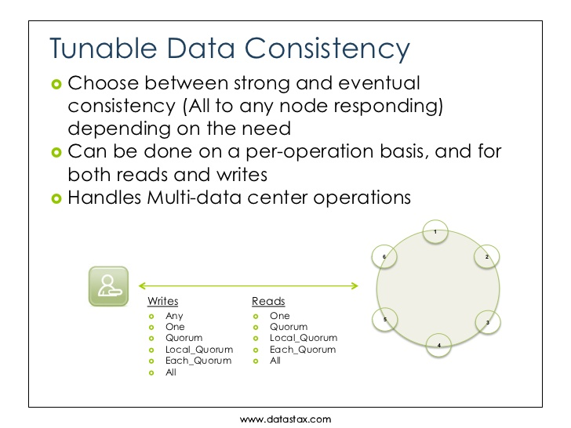
Tunable Data Consistency

Slide 27
Consistency Calculation:
Reliability of read and write operations depends on the consistency used to verify the operation.
Strong consistency can be guaranteed when the following condition is true:
R + W > N
Eventual consistency occurs if the following condition is true:
R + W <= N
Where,
R is the consistency level of read operations
W is the consistency level of write operations
N is the number of replicas(RF)
*Number of nodes is not that important, more important is the RF i.e. how many nodes have the copy of the data.
Strong consistency nothing but immediate consistency.
Knowledge check at below URL:
https://www.ecyrd.com/cassandracalculator/

Slide 28
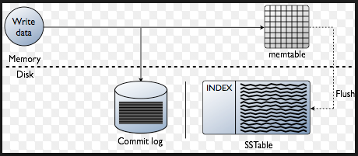
Commit Log, MemTable & SSTable
Cassandra writes are first written to the CommitLog, and then to a per-ColumnFamily structure called a Memtable.
→When a Memtable is full or CommitLog is reached certain threshold, then it is written to disk as an SSTable.
Commit Log: is for data recovery purpose if any failure happens. Ex: If the machine goes down or Cassandra crashes you would lose data on that node. TO avoid losing data, in addition to keeping recent changes in memory Cassandra writes the changes to its CommitLog.
Memtable: A Memtable is basically a write-back cache of data rows that can be looked up by key -- that is, unlike a write-through cache, writes are batched up in the Memtable until it is full, when it is flushed.
SSTable: Cassandra creates a new SSTable when the data of a column family in Memtable is flushed to disk. SSTable stands for Sorted Strings Table a concept borrowed from Google BigTable which stores a set of immutable row fragments in sorted order based on row keys. SSTable files of a column family are stored in its respective column family directory.

Slide 29
Commit Log, MemTable & SSTable
→Memtables and SSTables are maintained per table.
→The commit log is shared among tables.
For each SSTable, Cassandra creates below 10 structures/Files:
1. Data (Data.db): The SSTable data
2. Primary Index (Index.db): Index of the row keys with pointers to their positions in the data file
3. Bloom filter (Filter.db): A structure stored in memory that checks if row data exists in the memtable before accessing SSTables on disk
4. Compression Information (CompressionInfo.db): A file holding information about uncompressed data length, chunk offsets and other compression information
5. Statistics (Statistics.db): Statistical metadata about the content of the SSTable
6. Digest (Digest.crc32, Digest.adler32, Digest.sha1): A file holding checksum of the data file
7. CRC (CRC.db): A file holding the CRC32 for chunks in an a uncompressed file.
8. SSTable Index Summary (SUMMARY.db): A sample of the partition index stored in memory
9. SSTable Table of Contents (TOC.txt): A file that stores the list of all components for the SSTable TOC (Table of Contents)
10. Secondary Index (SI_.*.db): Built-in secondary index. Multiple SIs may exist per SSTable.

Slide 30
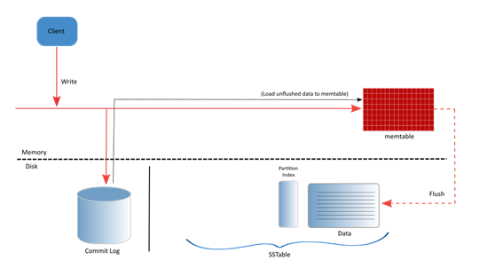
Write path of Cassandra
When a client issues a write operation, Cassandra writes the data into the Commit log as a first step (for durability) and then writes the same data to a in memory representation into the memtable. Once, data is written to the Commit log and the memtable, Cassandra sends the acknowledgement back to the client confirming the write operation (even though the data is not yet placed on the disk permanently).
Below diagram represents the write path of a Cassandra database.

Slide 31
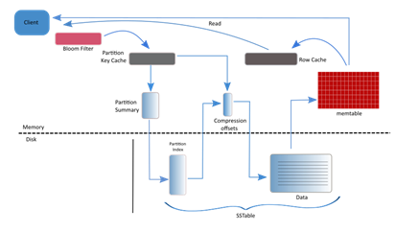
Read path of Cassandra
The read path in Cassandra database is little more complicated (actually way more complicated) than the write path, as there are variety of components involved in reading data from a Cassandra database.
In addition to the components that we have discussed in the 'Write Path' section, we must also be aware of the following components to understand the read path of a Cassandra database.
Row Cache
Bloom Filters
(Partition) Key Cache
Partition Indexes
Partition Summaries
Compression offsets
Let's briefly discuss about the
above mentioned components
before talking more about the
read path in Cassandra.
Row Cache: This is a in memory cache, which stores recently read rows (records). This is an optional component in Cassandra database.
Bloom Filters: Bloom filters helps to point if a partition key may be (exists) in its corresponding SSTable.
(Partition) Key Cache: Key Cache maps recently read partition keys to specific SSTable offset.
Partition Indexes: These are sorted partition keys mapped to their SSTable offsets. Partition Indexes are created as part of the SSTable creation and resides on the disk.
Partition Summaries: This is an off-heap in-memory sampling of the Partition Indexes and is used to speed up the access to index on disk.
Compression offsets: Compaction offsets keeps the offset mapping information for compressed blocks. By default all tables in Cassandra are compressed and when Cassandra needs to read data, it looks into the in-memory compression offset maps and unpacks the data chunks.

Slide 32
Read path of Cassandra
Row Cache: This is a in memory cache, which stores recently read rows (records). This is an optional component in Cassandra database.
Bloom Filters: Bloom filters helps to point if a partition key may be (exists) in its corresponding SSTable.
(Partition) Key Cache: Key Cache maps recently read partition keys to specific SSTable offset.
Partition Indexes: These are sorted partition keys mapped to their SSTable offsets. Partition Indexes are created as part of the SSTable creation and resides on the disk.
Partition Summaries: This is an off-heap in-memory sampling of the Partition Indexes and is used to speed up the access to index on disk.
Compression offsets: Compaction offsets keeps the offset mapping information for compressed blocks. By default all tables in Cassandra are compressed and when Cassandra needs to read data, it looks into the in-memory compression offset maps and unpacks the data chunks.

Slide 33
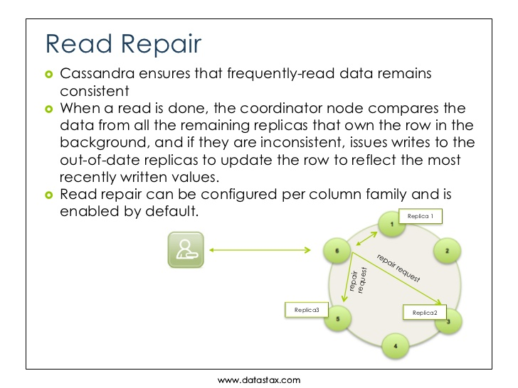
Read Repair

Slide 34
Compaction Strategies:
→The concept of compaction is used for different kinds of operations in Cassandra, the common thing about these operations is that it takes one or more sstables and output new sstables.
→The compaction process merges keys, combines columns, evicts tombstones, consolidates SSTables, and creates a new index in the merged SSTable.
The types of compactions are:
Minor compaction: Triggered automatically in Cassandra. (if it reaches thresholds)
Major compaction: A user executes a compaction over all sstables on the node.(All CFS/KS)
User defined compaction: A user triggers a compaction on a given set of sstables. (specific to CF/table)
Cassandra supports the following compaction strategies, which you can configure using CQL:
SizeTieredCompactionStrategy (STCS)
LeveledCompactionStrategy (LCS)
DateTieredCompactionStrategy (DTCS): It is deprecated in Cassandra 3.0.8/3.8 and later. This strategy is for time series data. Write amplification is when the same data is rewritten over and over instead of just once. Writing data many times over results in increased I/O, decreases disk lifetime, and blocks other processes from using the disk.
TimeWindowCompactionStrategy (TWCS)

Slide 35
Compaction Strategies:
SizeTieredCompactionStrategy (STCS): STCS is the default compaction strategy. This compaction strategy triggers a compaction when multiple SSTables of a similar size are present. Additional of parameters allow STCS to be tuned to increase or decrease the number of compactions it performs and how tombstones are handled.
When to use :This compaction strategy is good for insert-heavy and general workloads.
LeveledCompactionStrategy (LCS): LCS is leveled compaction strategy creates SSTables of a fixed, relatively small size (160 MB by default) that are grouped into levels. Within each level, SSTables are guaranteed to be non-overlapping. Each level (L0, L1, L2 and so on) is 10 times as large as the previous. Disk I/O is more uniform and predictable on higher than on lower levels as SSTables are continuously being compacted into progressively larger levels. At each level, row keys are merged into non-overlapping SSTables in the next level. This process can improve performance for reads, because Cassandra can determine which SSTables in each level to check for the existence of row key data. This compaction strategy is modeled after Google's LevelDB implementation.
When to use : This compaction strategy is the best for read-heavy workloads (because tables within a level are non-overlapping, LCS guarantees that 90% of all reads can be satisfied from a single SSTable) or workloads where there are more updates than there are inserts.
https://docs.datastax.com/en/cql/3.3/cql/cql_reference/cqlCreateTable.html#compactSubprop__compactionSubpropertiesSTCS

Slide 36
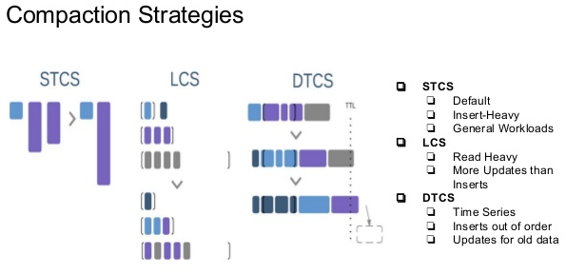
Compaction Strategies:
TimeWindowCompactionStrategy (TWCS): This strategy is an alternative for time series data. TWCS compacts SSTables using a series of time windows. While with a time window, TWCS compacts all SSTables flushed from memory into larger SSTables using STCS. At the end of the time window, all of these SSTables are compacted into a single SSTable. Then the next time window starts and the process repeats. The duration of the time window is the only setting required.
TWCS aims at simplifying DTCS by creating time windowed buckets of SSTables that are compacted with each other using the Size Tiered Compaction Strategy. TWCS uses simple parameters to avoid configuration complexity, and inherits STCS parameters.

Slide 37
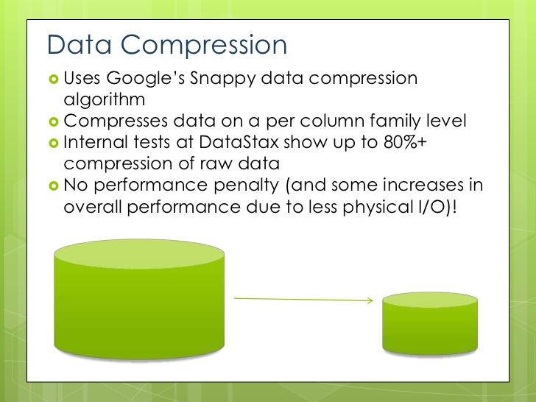
Compression Techniques
Compression maximizes the storage capacity of Cassandra nodes by reducing the volume of data on disk and disk I/O, particularly for read-dominated workloads.
In Cassandra 2.2 and later, the commit log can also be compressed and write performance can be improved 6-12%.
When to compress data Compression is best suited for tables that have many rows and each row has the same columns, or at least as many columns, as other rows.
Cassandra provides the following built-in classes:
LZ4Compressor
SnappyCompressor
DeflateCompressor
Default: LZ4Compressor.
25-33% reduction in data size
25-35% performance improvement on reads
5-10% performance improvement on writes
http://java-performance.info/performance-general-compression/

Slide 38
Tombstones
Tombstones, it’s very common problems with Cassandra. When it get created/appeared:
→When the client issues DELETE statements to Cassandra.
→Inserting null values,
→Inserting collections,
→Expiring data using TTL are common sources of tombstones, and
→Materialized views.
→Tombstones are not necessarily a bad thing that we should avoid at all cost.
→ However it can affect performance, so you’d better be aware when they are generated when designing your data model and queries.
→Large Number of Tombstones Causes Latency and Heap Pressure and it leads performance issues. And nodes may go down, and will may lead cluster down if not handled diligently on time..
→If you use the java driver the query fails if more than 100,000 tombstones are seen; Hope with this knowledge you should be able to limit their generation only when necessary.
https://docs.datastax.com/en/cassandra/3.0/cassandra/dml/dmlAboutDeletes.html
https://opencredo.com/cassandra-tombstones-common-issues/
https://www.beyondthelines.net/databases/cassandra-tombstones/

Slide 39
Day2 (Dec.20th) – Agenda Ends
Any Q
?

Slide 40
Day3 (Dec.21st ) – Agenda
Day2 Review
CQL Commands
YML file configurations
Sample Java snippets to connect Cassandra
Issues, Retry & Load balancing Policies
Data Migrations (COPY TO/FROM,SQOOP(DSE), SSTABLELOADER)
Tools(Node,DSE & Cassandra-stress)
DevCenter
OpsCenter
Q & A
Appendix

Slide 41
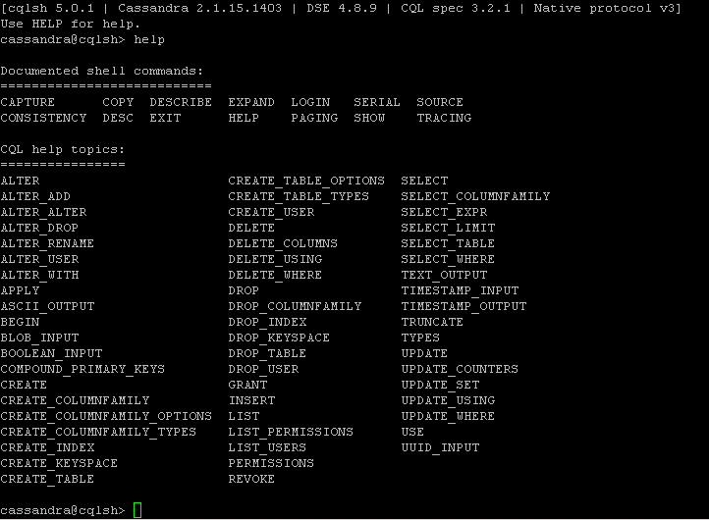
CQL Commands

Slide 42
YAML file configurations
https://docs.datastax.com/en/cassandra/2.1/cassandra/configuration/configCassandra_yaml_r.html

Slide 43
Sample Java snippets to connect Cassandra
Connecting to Cluster & Key Space
Prepare & Bind
Execute & Capture Result Set
Manipulations on Results for further
Cole connections.
Connection pooling:
http://docs.datastax.com/en/developer/java-driver/2.1/manual/pooling/
Load Balancing Policies:
http://docs.datastax.com/en/drivers/python/3.2/api/cassandra/policies.html

Slide 44
Issues, Retry & Load balancing Policies
We do have 3 types of issues in Cassandra:
Invalid Requests (Application issues): Developer is responsible
Time outs (Network issues): Retry
Hot Spots(Load Balancing issues): Right Load balancing policy selection for your use case.

Slide 45
Data Migrations: we do have 3 ways in Cassandra –
1. COPY TO & COPY FROM: Cassandra >=1.1 onwards supplies the COPY command uses for file import/export thru CQL shell.
COPY TO: Syntax: COPY <Table Name> TO ‘File’;
Ex: copy sujan2_event to '/app/cassandra/sujan2_event.txt' WITH DELIMITER='|';
COPY FROM: Syntax: COPY <Table Name> FROM ‘File’;
Ex: copy sujan2_event from '/app/cassandra/test_sujan2_event.txt' WITH DELIMITER='|';
https://docs.datastax.com/en/cassandra/2.1/cassandra/migrating.html?hl=load
https://docs.datastax.com/en/cql/3.1/cql/cql_reference/copy_r.html
2. SQOOP(DSE): DSE >=2.0 onwards includes support for sqoop to move data into Cassandra directly from RDBMS.
https://www.datastax.com/2012/03/how-to-move-data-from-relational-databases-to-datastax-enterprise-cassandra-using-sqoop
https://docs.datastax.com/en/datastax_enterprise/4.8/datastax_enterprise/ana/anaSqpDemo.html
3. SSTABLELOADER:
https://docs.datastax.com/en/cassandra/2.1/cassandra/tools/toolsBulkloader_t.html
https://docs.datastax.com/en/dse/5.1/dse-admin/datastax_enterprise/tools/toolsSStables/toolsBulkloader.html

Slide 46
Tools (Node, DSE & Cassandra-stress)
CQL Commands (Continuation)
YML file configurations
Sample Java snippets to connect Cassandra
Node Tool
DevCenter
OpsCenter
Q & A
Appendix

Slide 47
DevCenter
CQL Commands (Continuation)
YML file configurations
Sample Java snippets to connect Cassandra
Node Tool
DevCenter
OpsCenter
Q & A
Appendix

Slide 48
OpsCenter
CQL Commands (Continuation)
YML file configurations
Sample Java snippets to connect Cassandra
Node Tool
DevCenter
OpsCenter
Q & A
Appendix

Slide 49
Day3 – Agenda Ends
Q & A
??

Slide 50
Subbareddy Jangalapalli(281097)
Subbareddy.Jangalapalli@cognizant.com
Jangalapalli.sr@gmail.com

Slide 51
Appendix
Where to get & learn more?
http://cassandra.apache.org/
http://docs.datastax.com/en/landing_page/doc/landing_page/current.html

Slide 52
External References
Appendix
http://docs.datastax.com/en/landing_page/doc/landing_page/keyConcepts.html
http://docs.datastax.com/en/landing_page/doc/landing_page/dataModeling.html
http://www.slideshare.net/planetcassandra/developer-training-slides-1
http://www.slideshare.net/DataStax/building-highly-available-apps-on-cassandra-robbie-strickland-weather-company-c-summit-2016
http://www.slideshare.net/DataStax/getting-started-with-apache-cassandra-and-apache-zeppelin-duyhai-doan-datastax-c-summit-2016
http://www.slideshare.net/DataStax/presentations
http://www.slideshare.net/DataStax/an-overview-of-apache-cassandra
Many more…on web

Slide 53
Self-learning exercise
Appendix
https://academy.datastax.com/courses/ds101-introduction-cassandra
https://academy.datastax.com/courses/ds201-foundations-apache-cassandra
https://academy.datastax.com/courses/ds220-data-modeling
Hands-on Exercise
Playlist example -
http://docs.datastax.com/en/playlist/doc/

