Slide 1
AHMEDNAGAR JILHA MARATHA VIDYA PRASARAK SAMAJ'S
New Arts, Commerce and Science College, Ahmednagar (Autonomous)
Center for Advanced Studies in Applied Sciences · Department of Computer Science
FINAL YEAR PROJECT · M.SC. COMPUTER SCIENCE II
Shivrakshak Academy
Academy Management System
Police · Army · Navy · MPSC Bharti Pre-Training Institute
PRESENTED BY
GUIDED BY
DATE
Navnath Babasaheb Jangale
Diksha Kiran Kadam
Prof. Bingare M. B. Madam
19 August 2026

Slide 2
CONTENTS
What This Presentation Covers
01
Project Overview
Introduction, problem statement and objectives
02
Scope & Planning
Scope definition, management, phases and charter
03
System Design
Technology stack, architecture, database and modules
04
The Live System
Screens from production, features, benefits and future scope
Shivrakshak Career Academy · Academy Management System
02

Slide 3
01
SECTION ONE
Project Overview
Understanding what the system is, the problems it solves and the
objectives it is built to achieve.

Slide 4
01 · INTRODUCTION
What is the Academy Management System?
A single web platform that runs every operation of a competitive-exam coaching academy.
◈
▤
◉
Complete Digital Platform
Replaces Paper Registers
Connects Every Stakeholder
One connected system for admissions, student records, fees, exams, attendance and communication.
Handwritten admission forms, fee books and attendance registers become secure, searchable cloud records.
Directors, staff, students and parents all work from the same live information, at any time.
Shivrakshak Career Academy · Academy Management System
04

Slide 5
02 · PROBLEM STATEMENT
Challenges in Traditional Academies
▤
▲
◷
✎
Manual Registers
Risk of Data Loss
Parents Left Uninformed
Slow Paperwork
Admission forms, fee books and attendance are all recorded on paper.
Registers are damaged or misplaced and no backup of records exists.
Families never learn about pending fees, absence or exam performance.
Locating one student record takes several minutes of manual searching.
Shivrakshak Career Academy · Academy Management System
05

Slide 6
03 · OBJECTIVES
What the Project Aims to Achieve
◇
▦
◈
◉
Secure Cloud System
Digital Admission
Automated Communication
Effortless Interface
Build a cloud platform where academy data is protected and never lost.
An online form that prints the academy's exact three-page paper format.
Deliver fee, attendance and exam updates to parents automatically.
A Marathi, mobile-first interface that any staff member can operate.
Shivrakshak Career Academy · Academy Management System
06

Slide 7
02
SECTION TWO
Scope & Planning
What the project covers, how the scope is controlled and the phases
through which it was delivered.

Slide 8
04 · SCOPE STATEMENT
What Does This Project Cover?
◉
▶
◐
Target Users
End-to-End Process
Current Exclusions
Built for police, army and competitive-exam coaching academies across Maharashtra.
From online admission and printed forms through exams, attendance and fee settlement.
Biometric hardware, payment gateways and native mobile apps are deferred to a later phase.
Shivrakshak Career Academy · Academy Management System
08

Slide 9
05 · DEFINITION OF SCOPE
In-Scope vs Out-of-Scope
IN-SCOPE
OUT-OF-SCOPE
✓
Public website & online admission form
✕
Biometric / fingerprint hardware
✓
Admin panel — students, fees, notices
✕
Online payment gateway
✓
Online exam system with instant results
✕
Native Android & iOS applications
✓
Attendance & leave management
✕
Hostel room allocation module
✓
WhatsApp reminders to parents
✕
Transport & vehicle tracking
Shivrakshak Career Academy · Academy Management System
09

Slide 10
06 · SCOPE MANAGEMENT
How the Scope Was Controlled
◎
▤
◈
▶
Requirements Gathering
Scope Definition
Scope Verification
Scope Control
Studied the academy's existing paper forms and daily working routine.
Documented every module and feature before development began.
Regular demonstrations to the directors for review and approval.
Each phase was locked before the next one started, preventing drift.
Shivrakshak Career Academy · Academy Management System
10

Slide 11
07 · SCOPE PLANNING
Development Phases
1
2
3
4
Phase 1
Phase 2
Phase 3
Phase 4
Requirement analysis, database design and UI/UX planning
Supabase schema, authentication and row-level security
Next.js frontend, admin panel and student exam portal
Testing, security hardening and Vercel deployment
Shivrakshak Career Academy · Academy Management System
11

Slide 12
08 · PROJECT CHARTER
Charter Overview
PROJECT NAME
Shivrakshak Academy Management System
PROJECT SPONSOR
New Arts, Commerce and Science College, Ahmednagar
PROJECT LEADS
Navnath Babasaheb Jangale · Diksha Kiran Kadam
MILESTONES
1
2
3
4
Design & Planning
Core Modules
Exams & Attendance
Final Release
Shivrakshak Career Academy · Academy Management System
12

Slide 13
03
SECTION THREE
System Design
The technology chosen, how the application is layered and how the
data is structured.

Slide 14
09 · TECHNOLOGY STACK
Tools & Technologies Used
◈
✱
▤
▣
◇
Frontend
Backend
Database
Security
Deployment
Next.js 16
React 19
TypeScript
Tailwind CSS
Next.js API Routes
Server Actions
Node.js
Supabase
PostgreSQL
Row Level Security
Supabase Auth
JWT Sessions
Role-based Access
Vercel
GitHub CI/CD
Supabase Storage
Shivrakshak Career Academy · Academy Management System
14

Slide 15
10 · SYSTEM ARCHITECTURE
Three-Tier Architecture
Public website · Admin panel · Student exam portal
◈
Presentation Tier
Next.js React application
Business rules · Validation · Authentication · PDF generation
✱
Application Tier
Next.js API routes & server actions
Tables · Row Level Security · Document storage · Backups
▤
Data Tier
Supabase PostgreSQL & Storage
Shivrakshak Career Academy · Academy Management System
15

Slide 16
11 · DATABASE DESIGN
Entity Relationship Overview
PostgreSQL on Supabase — every table links back to a single student record, protected by Row Level Security.
FEE PAYMENTS
DOCUMENTS
EXAM ATTEMPTS
ATTENDANCE
STUDENTS
LEAVE REQUESTS
NOTICES
MESS RECORDS
Shivrakshak Career Academy · Academy Management System
16

Slide 17
12 · SYSTEM MODULES
Core Application Modules
▣
Authentication
▦
Admin Dashboard
◉
Student Records
▤
Admission Form
Admin & student login
Live analytics overview
Profiles & documents
Three-page printable form
₹
Fee Management
✎
Online Exams
◷
Attendance
◈
Notices & WhatsApp
Ledger & pending dues
MCQ tests & instant results
Daily records & reports
Alerts to parents
Shivrakshak Career Academy · Academy Management System
17

Slide 18
04
SECTION FOUR
The Live System
The finished product, running in production and in daily use at the
academy today.

Slide 19
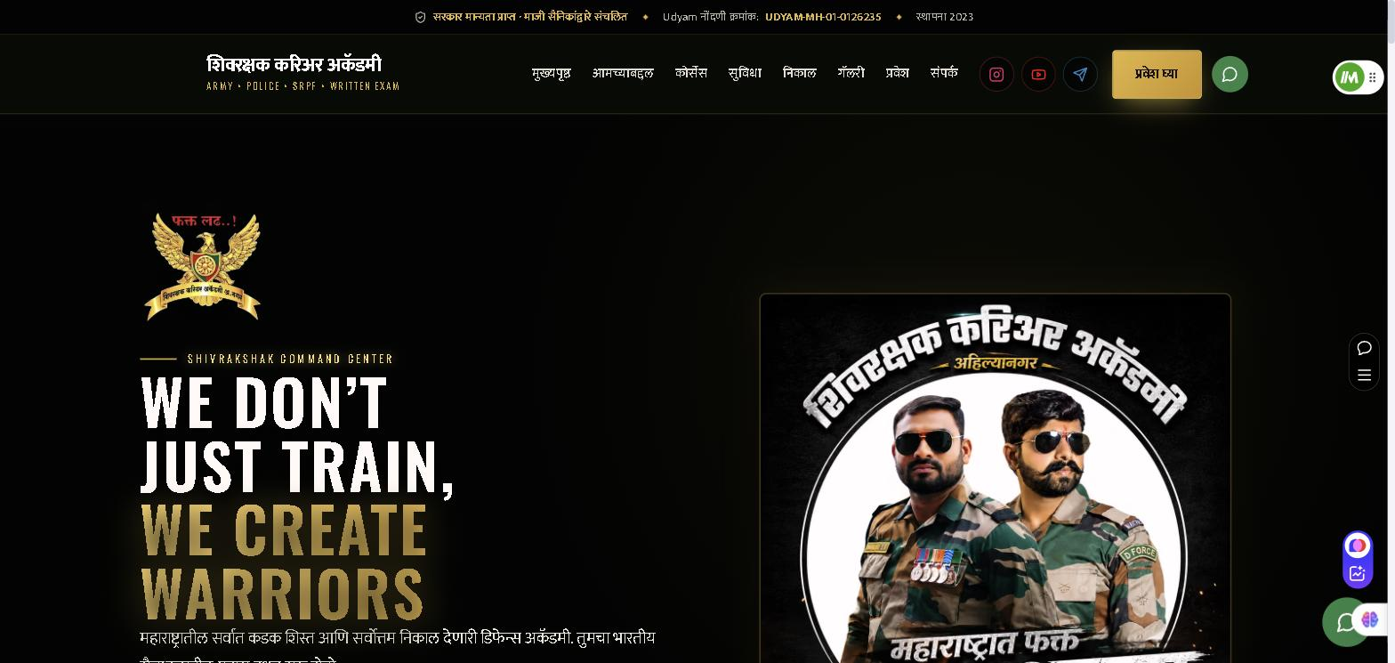
13 · LIVE SYSTEM
Public Website
shivrakshak-academy1-kappa.vercel.app
01
Marathi-First Interface
Every screen is written in Marathi so parents and students read it without help.
02
Admin-Managed Content
Photographs, courses, results and notices are all updated from the admin panel.
03
Built for Mobile
Most visitors arrive on a phone — the layout is designed for that first.
Shivrakshak Career Academy · Academy Management System
19

Slide 20
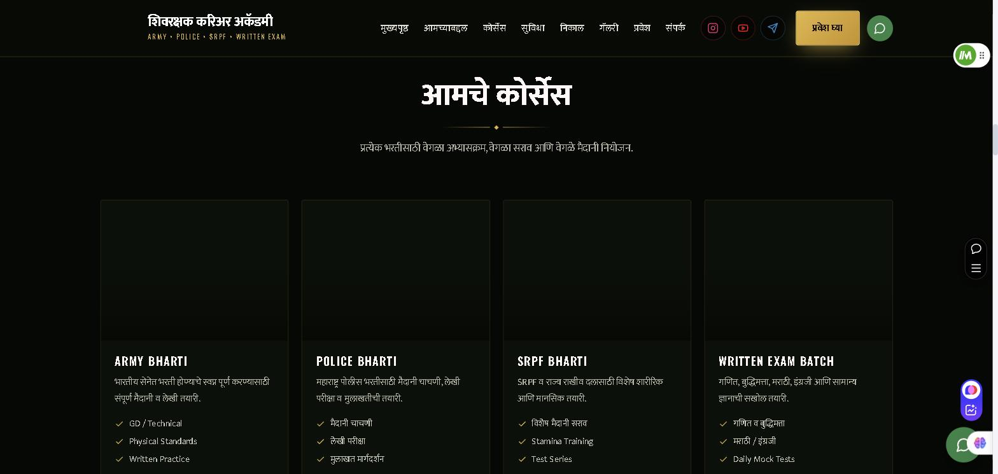
14 · LIVE SYSTEM
Course Catalogue
shivrakshak-academy1-kappa.vercel.app/#courses
01
Four Training Tracks
Army, Police, SRPF and Written Exam batches, each with its own syllabus.
02
Detailed Breakdown
Every course lists the physical and written components it covers.
03
Database-Driven
Courses are stored in Supabase, so new batches appear without a code change.
Shivrakshak Career Academy · Academy Management System
20

Slide 21
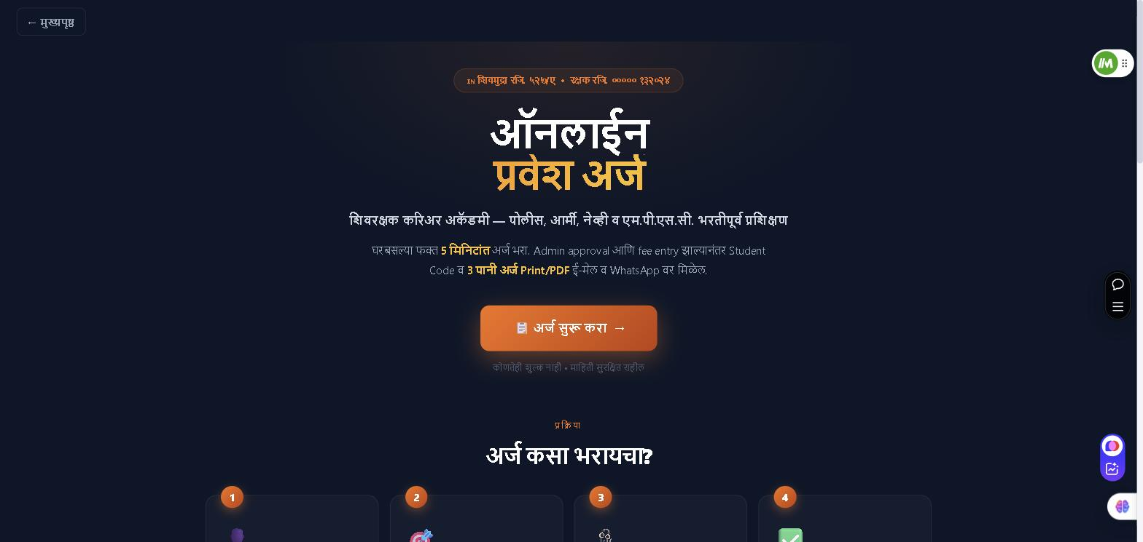
15 · LIVE SYSTEM
Online Admission Form
shivrakshak-academy1-kappa.vercel.app/admission
01
Four Guided Steps
Personal details, course selection, document upload and a final review.
02
Automatic Calculation
Age, course duration and end date are computed as the form is filled.
03
Prints the Real Form
Generates the academy's exact three-page paper form as a PDF.
Shivrakshak Career Academy · Academy Management System
21

Slide 22
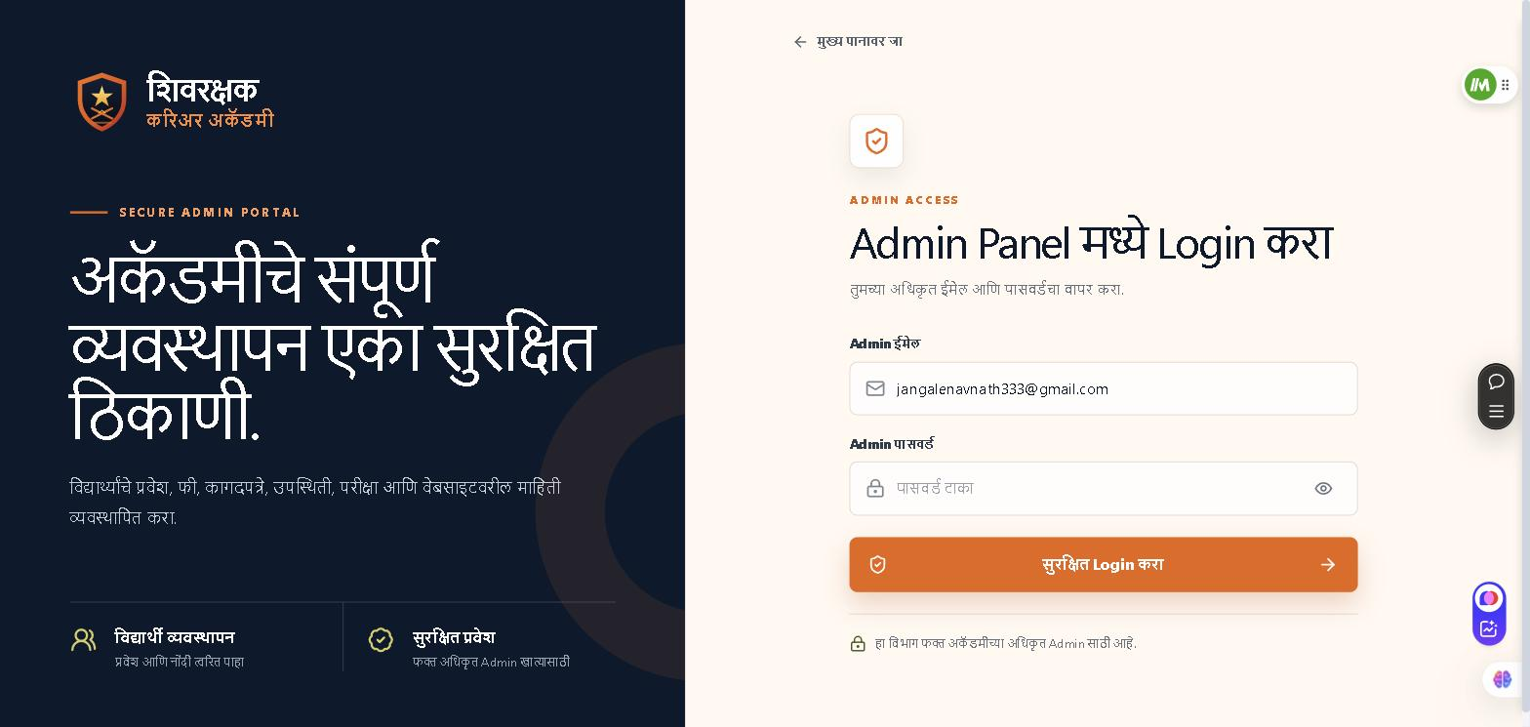
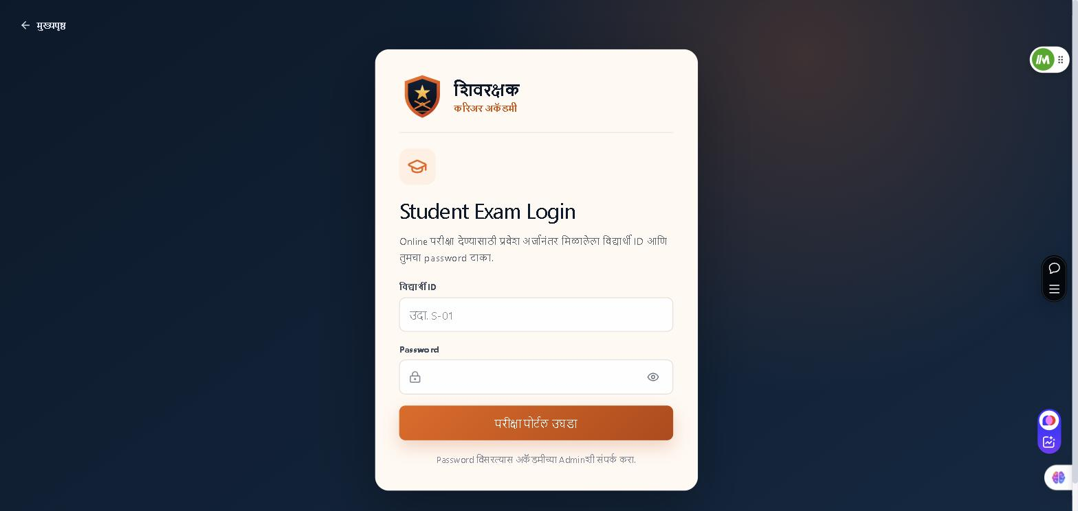
16 · LIVE SYSTEM
Secure Access Portals
/admin/login
/student/login
Admin Portal
Student Exam Portal
Supabase authentication with role checks. Only the academy's authorised account can reach student records.
Students sign in with the ID printed on their admission form and a private password to take online tests.
Shivrakshak Career Academy · Academy Management System
22

Slide 23
17 · CORE FEATURES
What the System Can Do
▤
₹
✎
Online Admission
Fee Ledger
Online Examinations
Digital form that generates the academy's exact three-page printable PDF.
Paid amount and pending balance calculated for every student instantly.
Timed MCQ tests with automatic evaluation and instant result.
◷
◈
▣
Attendance Tracking
Parent Notifications
Role-Based Security
Daily marking with monthly percentage reports per batch.
WhatsApp reminders for pending fees and important notices.
Separate protected access for admin, staff and students.
Shivrakshak Career Academy · Academy Management System
23

Slide 24
18 · SYSTEM COMPARISON
Existing System vs Proposed System
EXISTING SYSTEM
PROPOSED SYSTEM
Admission
Handwritten paper forms
Online form with auto-printed PDF
Fee Records
Manual register & receipts
Digital ledger with live balance
Examinations
Offline written tests only
Online tests with instant results
Attendance
Roll-call in a notebook
Digital dashboard with reports
Parent Contact
Phone calls when remembered
Automated WhatsApp updates
Data Safety
Registers can be lost
Encrypted cloud with backups
Shivrakshak Career Academy · Academy Management System
24

Slide 25
19 · SYSTEM BENEFITS
Why It Matters
100%
3×
0
24/7
PAPERLESS
FASTER
DATA LOSS
AVAILABILITY
Every register replaced by a searchable digital record
Admissions and fee entry completed in a fraction of the time
Automatic cloud backup protects every student record
Records reachable from any device, at any hour
Shivrakshak Career Academy · Academy Management System
25

Slide 26
20 · FUTURE SCOPE
Planned Enhancements
◧
◉
₹
Mobile Application
Face Attendance
Online Payments
Native Android and iOS apps for students and parents.
AI face recognition from a live camera feed at the gate.
UPI and payment-gateway integration for direct fee collection.
▦
◈
▶
Physical Test Records
WhatsApp Business API
Multi-Branch Support
Running, long jump and high jump performance tracking.
Fully automated, template-based official messaging.
A single dashboard managing an academy franchise network.
Shivrakshak Career Academy · Academy Management System
26

Slide 27
CONCLUSION
Bringing Discipline into the Digital Age
Modernises the Academy
Connects Parents
Builds Accuracy & Trust
Every paper register is replaced by a secure, searchable digital record that cannot be lost.
Fee dues, attendance and exam results now reach families the moment they change.
Automated calculation removes human error from every receipt and every ledger entry.
The system is live in production and in daily use at Shivrakshak Career Academy, Ahmednagar.

Slide 28
Thank You
Questions are welcome
Navnath Babasaheb Jangale · Diksha Kiran Kadam
Guided by Prof. Bingare M. B. Madam
M.Sc. Computer Science II · New Arts, Commerce and Science College, Ahmednagar

