Slide 1
AHMEDNAGAR JILHA MARATHA VIDYA PRASARAK SAMAJ'S
New Arts, Commerce and Science College, Ahmednagar (Autonomous)
Center for Advanced Studies in Applied Sciences (CASAS) | Department of Computer Science
Toilet Seva
Public Sanitation Locator & Complaint System
Ahilyanagar Municipal Corporation · M.Sc. Computer Science II
Progressive Web App
Live GPS
Complaint & Photos
Bilingual
26 Toilets Mapped
Live at toilet-seva.netlify.app
Presented By: Jangale Navnath
Guided By: Prof. ______________
Date: ____ / ____ / 2026

Slide 2
01 · Introduction
What is Toilet Seva?
A Progressive Web App that helps citizens of Ahilyanagar find the nearest public toilet on a live map, rate its cleanliness, and lodge a complaint with photographs directly to the Municipal Corporation.
Find
Rate
Report
Live GPS shows the nearest toilet first, with walking distance and directions.
Citizens rate cleanliness and facilities, creating public accountability.
Complaints with photographs reach the Corporation instantly and are tracked.
All 26 public and community toilets from the official Municipal Corporation list of 2026 are mapped.
Toilet Seva
2

Slide 3
02 · Project Purpose
Why Are We Building This?
Public Convenience
Civic Accountability
Digital Governance
Citizens, especially women and travellers, can locate a usable toilet without asking around.
Ratings and photographic complaints give the Corporation real evidence of ground conditions.
Supports the Swachh Bharat Mission through a measurable, data-driven sanitation record.
Goal — every citizen can find a clean toilet nearby, and every complaint reaches the right officer.
Toilet Seva
3

Slide 4
03 · Scope Statement
What Does This Project Cover?
Target Users
End-to-End Process
Current Exclusions
Citizens of Ahilyanagar, and sanitation officers of the Municipal Corporation.
From locating a toilet, through rating and complaint, to resolution by the administration.
No online payment, no IoT sensors, and no integration with other city services in this phase.
Geographic scope is limited to the Ahilyanagar Municipal Corporation area.
Toilet Seva
4

Slide 5
04 · Definition of Scope
In-Scope vs Out-of-Scope
IN-SCOPE
OUT-OF-SCOPE
• Map of all public and community toilets
• Online payment for paid toilets
• Live GPS with nearest-first sorting
• IoT cleanliness sensors
• Walking distance and directions
• Native Android / iOS app (future)
• Star rating and facility details
• Booking or reservation of facilities
• Complaint with up to three photographs
• Integration with other city departments
• Admin dashboard for the Corporation
• Automated cleaning-staff scheduling
• Bilingual Marathi and English interface
• Installable app with offline support
Toilet Seva
5

Slide 6
05 · Problem Statement
Problems Faced by Citizens Today
Toilets are hard to locate
A visitor in an unfamiliar part of the city has no way of knowing where the nearest public toilet is.
No information on condition
Citizens cannot know in advance whether a toilet is open, clean, or has water before walking there.
Complaints go nowhere
There is no simple channel to report a dirty or broken toilet, and no way to track what happened to the report.
No data for the Corporation
Officials have no consolidated record of which facilities are failing and how often.
Result — public facilities remain underused and poorly maintained, and citizens suffer in silence.
Toilet Seva
6

Slide 7
06 · Objectives
What the System Must Achieve
Locate
Inform
Navigate
Show the nearest toilet using live GPS, sorted by walking distance.
Display timing, facilities, accessibility and citizen ratings.
Open turn-by-turn walking directions in one tap.
Report
Administer
Include
Allow a complaint with photographs and location in under a minute.
Give the Corporation a dashboard to track and resolve complaints.
Serve both Marathi and English readers in the same interface.
Toilet Seva
7

Slide 8
07 · System Comparison
Existing Situation vs Proposed System
Aspect
Existing Situation
Proposed System
Finding a toilet
Ask passers-by or search blindly
Live map, nearest shown first
Distance
Unknown
Exact walking distance displayed
Condition
Discovered on arrival
Ratings and facilities shown in advance
Complaint
No formal channel
Photo complaint sent in under a minute
Tracking
Not possible
Status visible until resolved
Records
None
Every complaint stored and searchable
Language
English signage only
Marathi and English together
The system turns an invisible public service into a measurable, accountable one.
Toilet Seva
8

Slide 9
08 · Technology Stack
Tools and Technologies Used
Layer
Technology
Purpose
Frontend
HTML5, CSS3, JavaScript
Single-page responsive interface
App Type
Progressive Web App
Installable, works offline
Maps
Leaflet.js
Interactive map rendering
Map Data
OpenStreetMap
Free map tiles, no licence cost
Location
Geolocation API
Live GPS position and accuracy
Database
Cloud Firestore
Real-time toilet and complaint data
Authentication
Firebase Auth
Secure administrator login
Storage
Firebase Storage
Complaint photographs
Hosting
Netlify
HTTPS hosting with automatic deployment
Toilet Seva
9
Version Control
GitHub
Source code management

Slide 10
09 · System Modules
Main Modules of the System
Location Module
Map Module
Reads live GPS and computes distance to every toilet.
Renders toilets as markers with clustering and popups.
Listing Module
Rating Module
Sorts and filters facilities by distance, type and rating.
Records one rating per device and updates the average.
Complaint Module
Admin Module
Captures type, description, photographs and location.
Dashboard for viewing, resolving and reporting complaints.
Toilet Seva
10

Slide 11
10 · System Architecture
How the System Is Structured
Presentation Layer
Citizen Interface · Map View · Admin Dashboard
▼
Application Layer
Distance Engine · Filtering · Complaint Handler
▼
Data Layer
Cloud Firestore · Firebase Storage · Local Cache
External Services — OpenStreetMap Tiles · Browser Geolocation · Netlify CDN
Toilet Seva
11

Slide 12
11 · Database Design
Main Collections and Fields
Collection
Key Fields
Description
toilets
id, name, englishName, area
One record per public facility
lat, lng
Exact map coordinates
type, divyang, open, timing
Category, accessibility and hours
rating, votes, facilities
Citizen feedback and amenities
complaints
id, toiletId, type, text
Complaint content
photos, deviceId, createdAt
Evidence and origin
status, resolvedAt, resolvedBy
Resolution tracking
ratings
Ratings are updated inside a transaction so simultaneous votes are never miscounted.
toiletId, deviceId, stars
Prevents duplicate voting
Toilet Seva
12

Slide 13
12 · User Workflow
How a Citizen Uses the App
1
2
3
4
5
Open App
▶
See List
▶
Choose
▶
Navigate
▶
Rate / Report
GPS starts
nearest first
check details
walking route
feedback sent
Example
A visitor near Tophkhana opens the app. Within two seconds the list shows "Public Toilet, Tophkhana — 550 m".
One tap on Directions opens the walking route from their exact position.
If the toilet is dirty, they photograph it and submit a complaint before leaving.
Toilet Seva
13

Slide 14
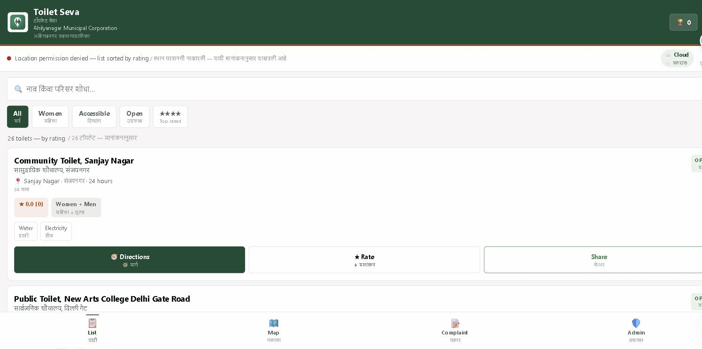
13 · Live Application
The Working System
Visible Here
• Bilingual heading
• 26 facilities loaded
• Filter chips
• Cloud sync indicator
• Rating and facilities
• Directions · Rate · Share
• Bottom navigation
Citizen list view — live at toilet-seva.netlify.app
Toilet Seva
14

Slide 15
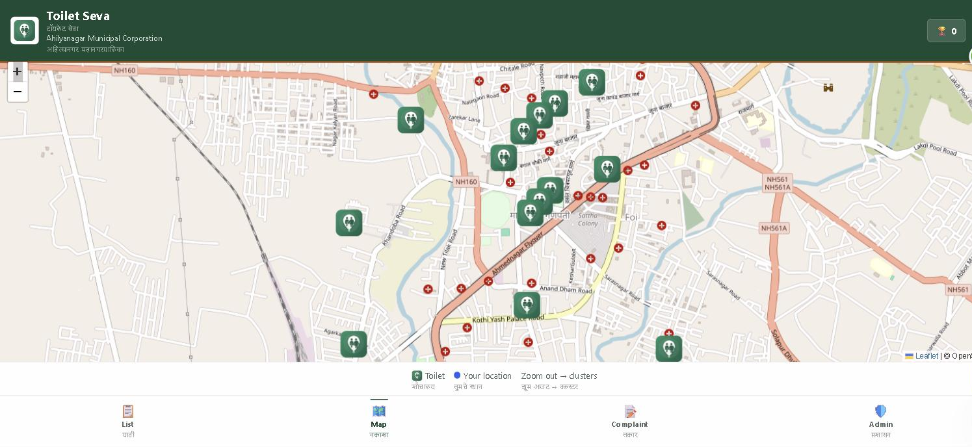
14 · Location and Maps
Finding the Nearest Facility
Map Features
• Leaflet.js + OpenStreetMap
• Live position of the citizen
• Accuracy circle shown
• Clustering when zoomed out
• Popup on every marker
• One-tap walking directions
All 26 facilities plotted on the live map of Ahilyanagar
Distance is computed with the Haversine formula from live GPS, and the list reorders itself as the citizen walks.
Toilet Seva
15

Slide 16
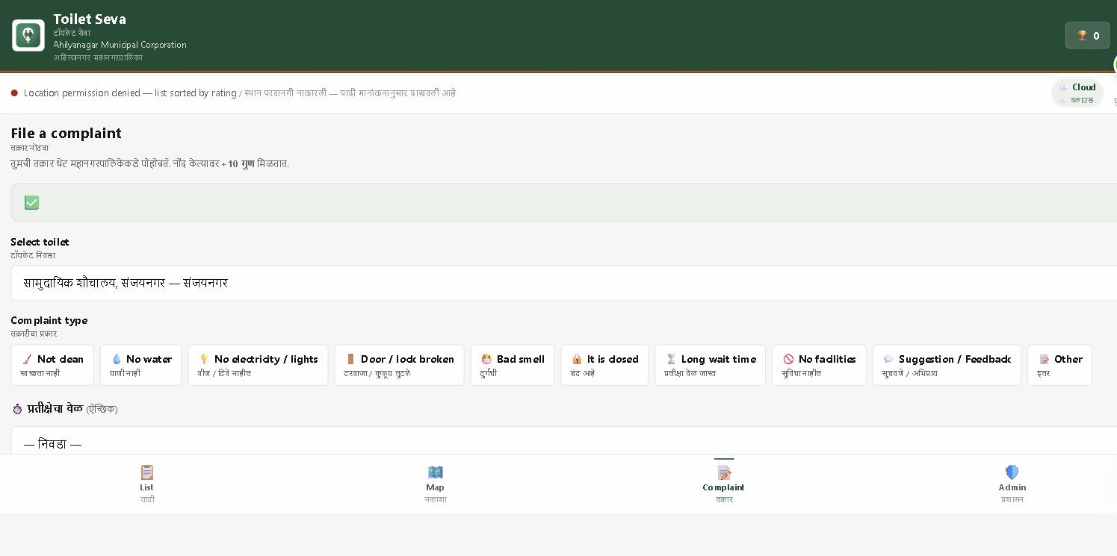
15 · Complaint System
Reporting a Problem
What Is Recorded
• Which facility
• Type — multiple allowed
• Written description
• Up to three photographs
• Waiting time, if relevant
• Location and time, automatic
• Ten points to the citizen
Complaint form with all ten categories, shown in both languages
Toilet Seva
16

Slide 17
16 · Bilingual Interface
Marathi and English Together
Why Both Languages
How It Appears on Screen
Local citizens read Marathi comfortably
Public Toilet, Tophkhana
Visitors and students prefer English
सार्वजनिक शौचालय, तोफखाना
Tophkhana · 24 hours
Both appear at once — no switching needed
English is shown large, Marathi directly below in smaller type — every label, button and message.
Officials can read either version
Facility names are stored in both languages
A single translation system drives the whole interface, so adding a third language later is straightforward.
Toilet Seva
17

Slide 18
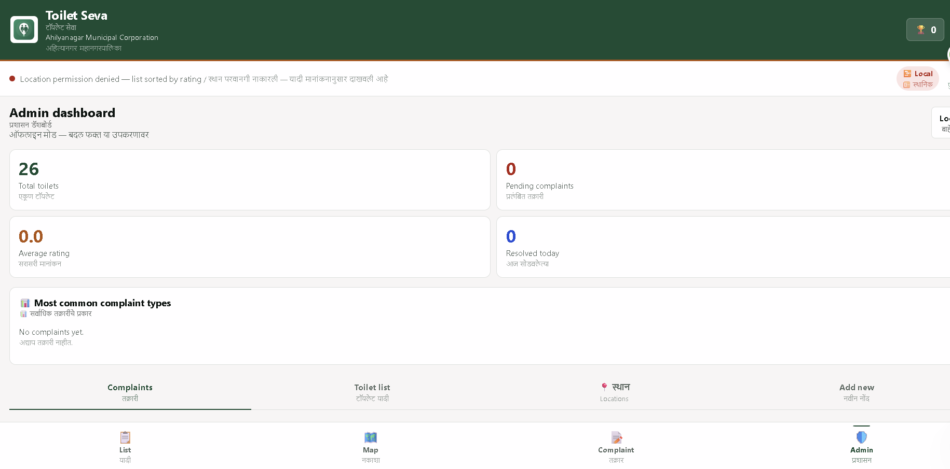
17 · Admin Dashboard
Tools for the Municipal Corporation
Officer Tools
• Live facility and complaint counts
• Complaint queue with photographs
• Open or close any facility
• Location editor — drag the pin
• QR code for every toilet
• Add a new facility
• Secure login, session expires
Administrator dashboard — live statistics and management tabs
Toilet Seva
18

Slide 19
18 · Security
Protecting Data and Access
Database Rules
Toilet data is public to read but only an authenticated officer can modify it. Complaints can be submitted by anyone but read only by officers.
API Key Restriction
The Firebase key is locked to the official domain, so it cannot be reused on any other website.
Authenticated Admin
Administrator access uses Firebase Authentication with expiring session tokens.
Duplicate Prevention
Each device may rate a facility only once, enforced at the database level.
Security rules are enforced on the server, so they cannot be bypassed from the browser.
Toilet Seva
19

Slide 20
19 · Core Features
Key Capabilities of the System
Nearest First
Interactive Map
Directions
Star Ratings
Facilities sorted by live walking distance.
Markers, clustering and live position.
Walking route opens in one tap.
Citizen feedback on every facility.
Photo Complaints
Filters
Installable App
QR Access
Camera or gallery, up to three images.
Women, accessible, open now, top rated.
Add to home screen, works offline.
Scan at the toilet to complain instantly.
Toilet Seva
20

Slide 21
20 · System Benefits
What the City Gains
For Citizens
For Women
For the Divyang
A clean toilet can be found in seconds, at any hour, anywhere in the city.
Facilities with sanitary provision and safety are clearly marked.
Accessible facilities can be filtered and located separately.
For the Corporation
Zero Running Cost
Swachh Bharat
Real evidence of ground conditions, with photographs and dates.
All services used are within their free tiers.
Provides measurable sanitation data for mission reporting.
Toilet Seva
21

Slide 22
21 · Future Scope
Planned Enhancements
Play Store Release
Stage 1
Short term
Package the web app as an Android application
Push Notifications
Stage 2
Short term
Alert officers the moment a complaint arrives
Officer Assignment
Stage 3
Medium term
Route each complaint to the responsible sanitation worker
City Expansion
Stage 4
Long term
Extend to other municipal corporations in Maharashtra
Also planned — a custom domain, multilingual support beyond Marathi, and an open sanitation data portal.
Toilet Seva
22

Slide 23
22 · Conclusion
Summary
Toilet Seva turns a scattered, invisible public service into a mapped, rated and accountable one — at no running cost.
All 26 public and community toilets of Ahilyanagar are mapped with live walking distance.
Citizens can rate a facility and lodge a photographic complaint in under a minute.
The Municipal Corporation receives evidence-based reports through a secure dashboard.
The interface serves Marathi and English readers simultaneously.
Built entirely on free and open technologies, and already live on the internet.
Toilet Seva
23

Slide 24
Thank You
Questions are welcome
toilet-seva.netlify.app
Toilet Seva · Public Sanitation Locator & Complaint System
Jangale Navnath · jangalenavnath333@gmail.com

