Slide 1
Folded Cascode Stage
Small Signal models for building blocks
Jan Genoe
February 2022

Slide 2
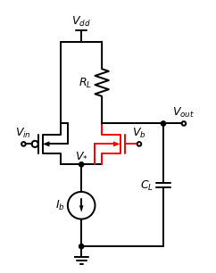
Theoretical folded cascode configuration

Slide 3
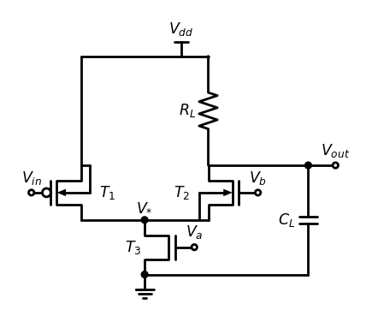
Practical folded cascode amplifier stage configuration

Slide 4
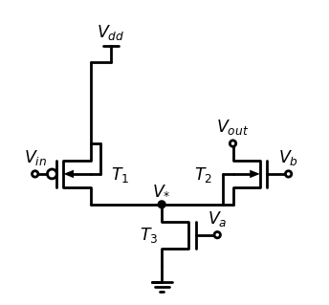
Circuit block under consideration for measuring the folded cascode output impedance

