Slide 1
Spice simulatie
Berekening van elektronische circuits
Jan Genoe
September 2025

Slide 2
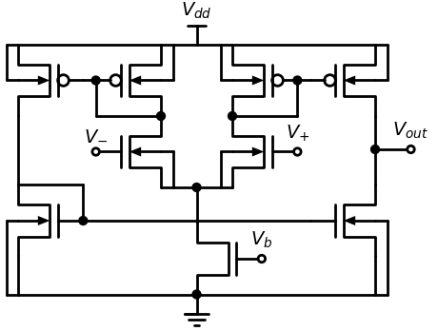
Basisschema van de verschilversterker

Slide 3
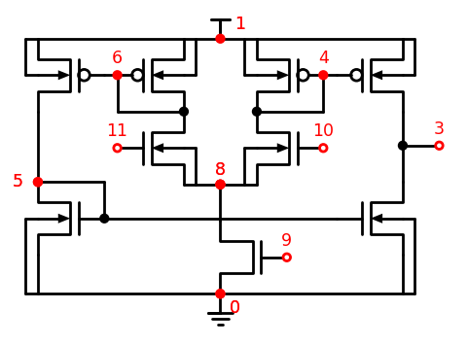
Basisschema van de verschilversterker

Slide 4
Spice beschrijving
* CIRCUIT Spice file van een verschilversterker
VDD 1 0 DC=5.0
VPLUS 10 0 DC=2.5
VMIN 11 0 SIN(2.5 50U 1E6) DC=2.5
VB 9 0 DC=1.5
C3 3 0 5.914fF
C4 4 0 14.737fF
C5 5 0 10.124fF
C6 6 0 14.434fF
C8 8 0 7.919fF
C9 9 0 15.257fF
C10 10 0 1.872fF
C11 11 0 1.688fF
C25 1 5 1fF
MN1 3 5 0 0 NMOS w=1.50u L=0.50u

Slide 5
Spice beschrijving
MN2 0 5 5 0 NMOS w=1.50u L=0.50u
MN3 8 10 4 0 NMOS w=1.50u L=0.50U
MN4 0 9 8 0 NMOS w=4.50u L=0.50U
MN5 6 11 8 0 NMOS w=1.50u L=0.50U
MP1 1 4 3 1 PMOS w=3.50u L=0.50U
MP2 4 4 1 1 PMOS w=3.50u L=0.50U
MP3 1 6 5 1 PMOS w=3.50u L=0.50U
MP4 6 6 1 1 PMOS w=3.50u L=0.50U
.MODEL NMOS NMOS(LEVEL=1 VTO=0.50 KP=90.000E-6 LAMBDA=0.001)
.MODEL PMOS PMOS(LEVEL=1 VTO=-0.45 KP=55.000E-6 LAMBDA=0.001)

Slide 6
nMOS transistors
MN1 3 5 0 0 NMOS w=1.50u L=0.50u
MN2 0 5 5 0 NMOS w=1.50u L=0.50u
MN3 8 10 4 0 NMOS w=1.50u L=0.50U
MN4 0 9 8 0 NMOS w=4.50u L=0.50U
MN5 6 11 8 0 NMOS w=1.50u L=0.50U

Slide 7
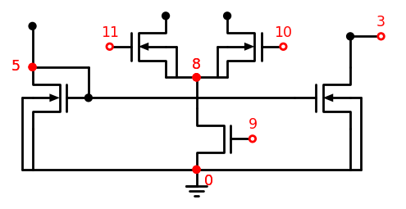
nMOS transistors van de verschilversterker

Slide 8
pMOS transistors van de verschilversterker
MP1 1 4 3 1 PMOS w=3.50u L=0.50U
MP2 4 4 1 1 PMOS w=3.50u L=0.50U
MP3 1 6 5 1 PMOS w=3.50u L=0.50U
MP4 6 6 1 1 PMOS w=3.50u L=0.50U

Slide 9
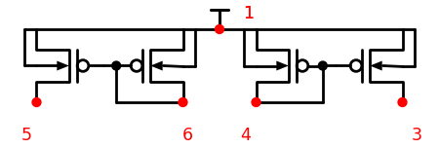
pMOS transistors van de verschilversterker

Slide 10
Eenvoudige transistormodellen
.MODEL NMOS NMOS(LEVEL=1 VTO=0.50 KP=90.000E-6 LAMBDA=0.001)
.MODEL PMOS PMOS(LEVEL=1 VTO=-0.45 KP=55.000E-6 LAMBDA=0.001)

Slide 11
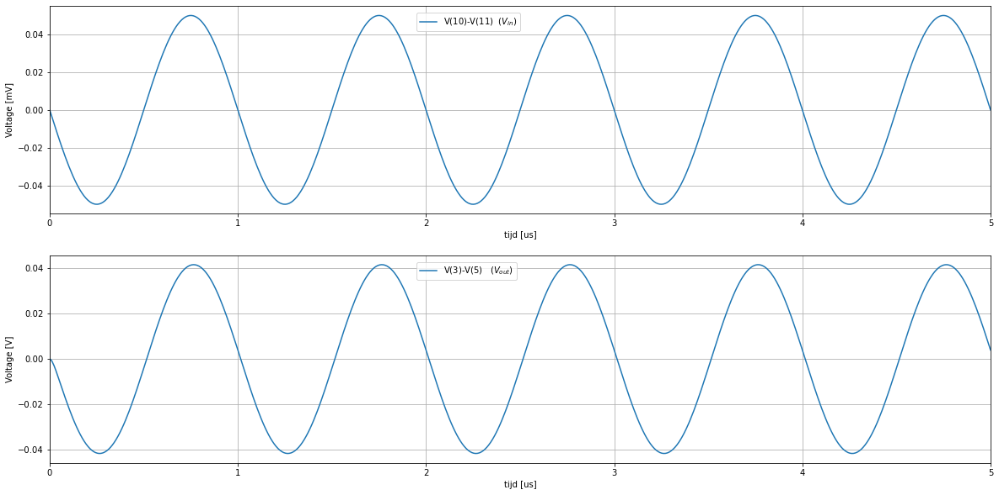
Simulatie

