Slide 2
# Oefening Boost convertor

Slide 3
```{figure} ./images/StepUp1.png
:name: bb
Commercieel boost convertor circuit
```

Slide 4
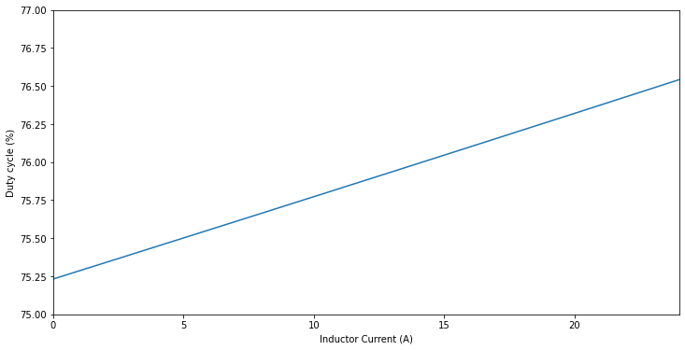

Slide 5
