Slide 1
Participant Manual UnifiedXRMotion vs Meta SDK
Korea Institute of Science and Technology Information (KISTI), XR Laboratory
September 4-10, 2025

Slide 2
Study Purpose & Fairness
Why this study?
Compare authoring workflows for identical outcomes in Unity
Evaluate usability and workload across SDKs
Fairness controls
Matched Unity/projects/scenes
Identical instruction depth & wording
Administrator provides only process‑neutral help

Slide 3
What You Will Do
Tasks
Task A: Full‑body avatar setup (Y Bot)
Task B: Hands‑only setup (custom hand prefabs)
SDK Conditions
UnifiedXRMotion
Meta SDK (Core + Interaction + Movement)

Slide 4
Environment & Materials
You will use
Unity project with prepared template scenes
Two step‑by‑step Manuals (A/B)
Meta Simulator for playback verification
Do before tasks
Open the correct template scenes
Confirm required packages are present

Slide 5
Rules During the Tasks
Please
Follow the Manual steps exactly
Stay within the provided project
Do not
Optimize for speed
Search the web or use outside resources

Slide 6
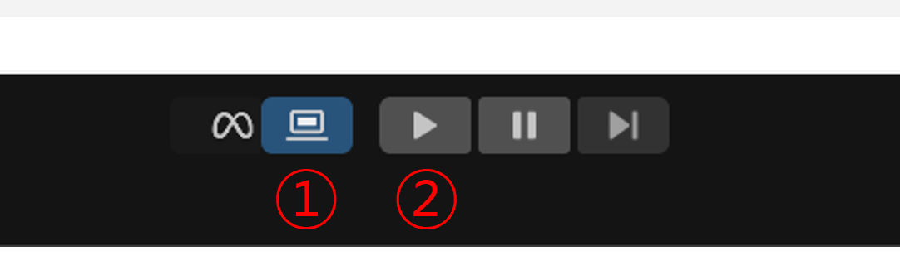
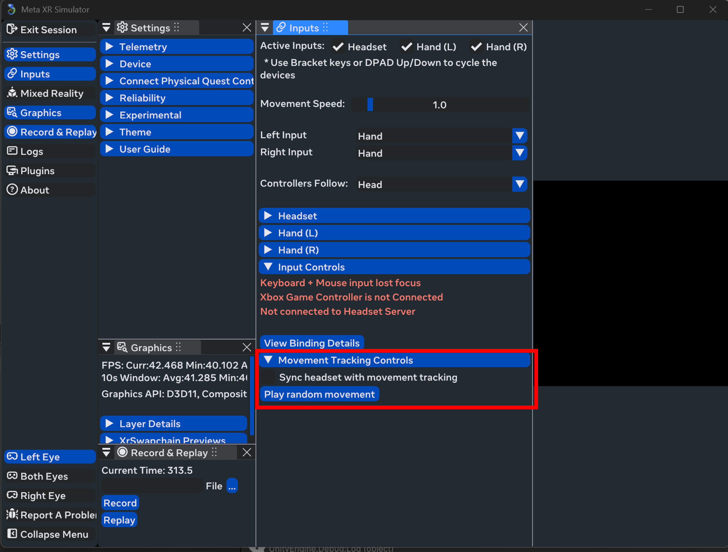
How to Verify Completion
Verification steps
Enable the Meta Simulator
Press Play in Unity
Open Inputs → Movement Tracking Controls
Click Play random movement
Success = Avatar or hands animate as expected

Slide 7
Getting Help (Assistance Policy)
You may ask
Process‑neutral questions (procedure, where to find the Manual)
We will
Remind you to re‑check relevant Manual steps
We will not
Provide SDK‑specific tips or solutions

Slide 8
After Both Tasks
Post‑task measures
NASA‑TLX (workload)
SUS (usability)
Short experience survey

Slide 9
Your Rights
At any time
You may pause or stop without penalty
Questions welcome
Ask clarification before starting

Slide 10
Quick Recap
Remember
Follow Manuals exactly
Don’t optimize for speed or search the web
Verify via Simulator → Play → Movement Controls → Play random movement

