Slide 1
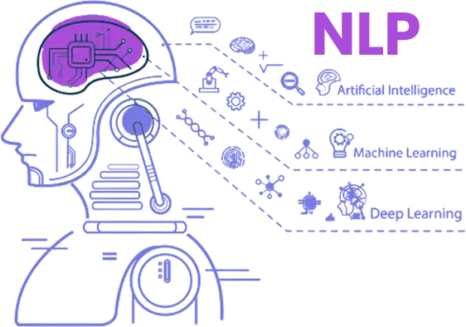

Text Classification Using Bert Model
A
State of the Art Approach.
7CS518 Natural Language Processing
Mohan Sharma, Student ID: 100615283

Slide 2
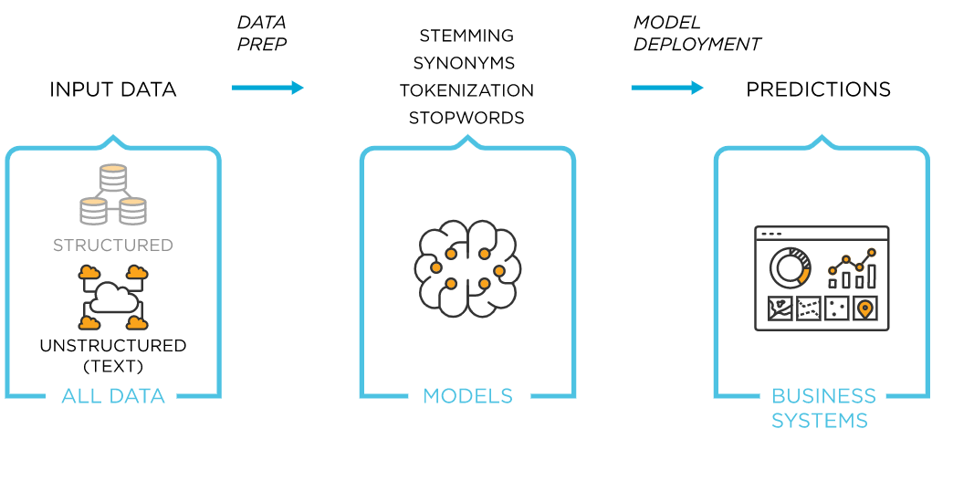
Business Problem : Text Analytics
Text Analytics is the process of deriving insights from the unstructured data ( text etc.) using Text Mining.
> Insights helps companies to design a strategy for the growth of the business System.
Problems : In getting Insights from Text
Minimum inputs
Cost efficient
Pre-Processed
Context Retained
But How?
Figure 1 : NLP Model
By Text Mining Using NLP techniques

Slide 3
Bert Model : Bidirectional Encoder Representations from Transformers
BERT is based on the Transformer architecture & solved most of the issues in the NLP.
Let’s recap issues with pre - existing issue of neural networks. ( RNN, LSTM )
1> Unlike RNNs,LSTM ~ transformers process the entire input all at once & can be trained in parallel.
2> Unlike RNNs,LSTM ~ transformers can work on long-term dependencies i.e lengthy sequences.
3> Unlike RNNs, LSTM ~ transformers has direct access to other steps called “Self-Attention".

Slide 4
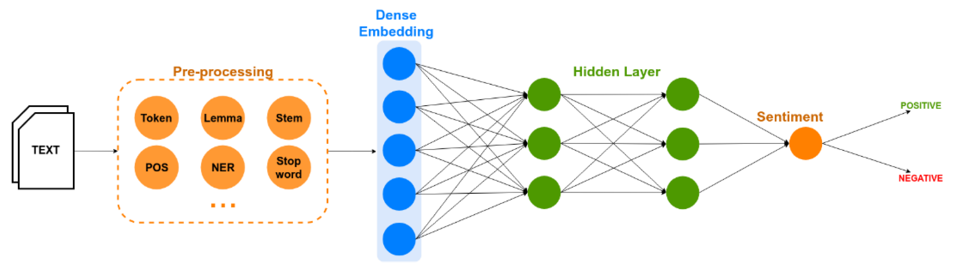
Approach : Text classification with Deep-Learning using Bert
Bert : Deeply bi-directional pre-trained model for Contextualized Embeddings.
Bert Encoded
For Embedded Vectors
Drop-Out Layer
Figure 2 : Text Classification Model

Slide 5
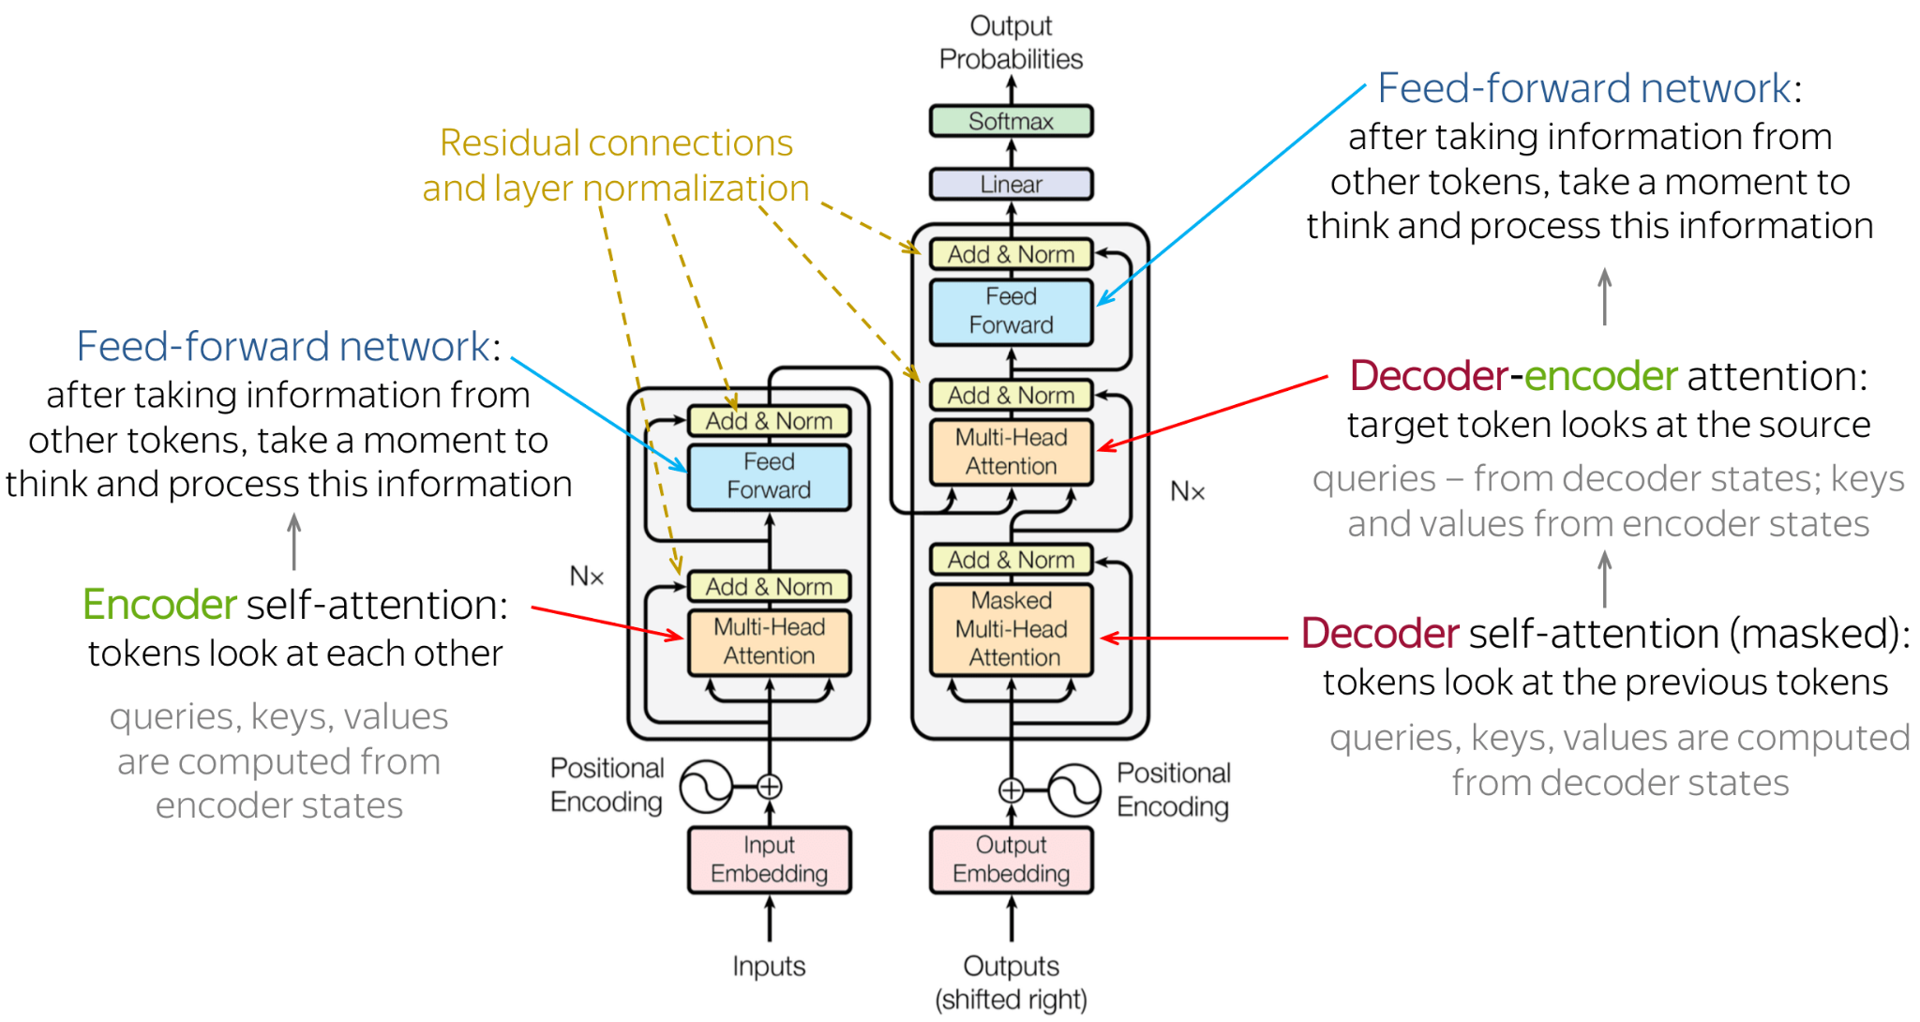
Transformer Architecture & Bert Adoption
Figure 3 : Transformer Architecture

Slide 6
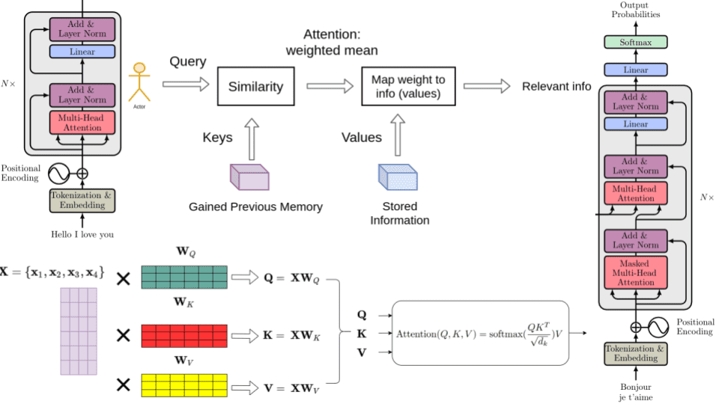
Transformer Working
Encoder Self Attention
Decoder - Encoder Self Attention
Figure 4 : Transformer Internal Working

Slide 7
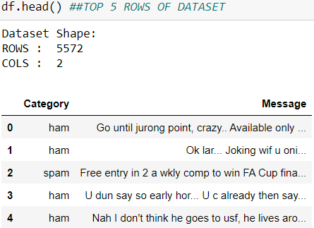
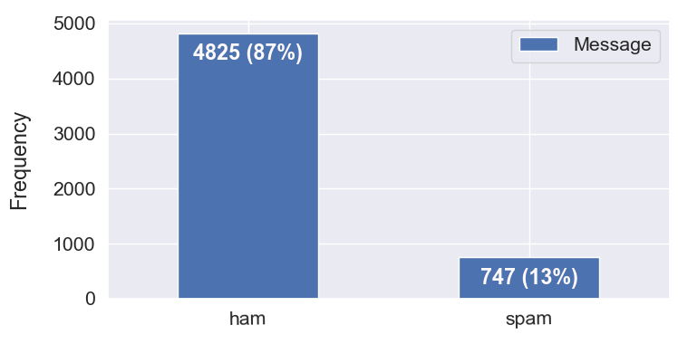
Dataset Selection & EDA
I have chosen a publicly available dataset for assessment :
Link : https://www.kaggle.com/datasets/uciml/sms-spam-collection-dataset
Figure 5 : Dataset Top 5 Rows
Figure 6 : Distribution of the Target Variable

Slide 8
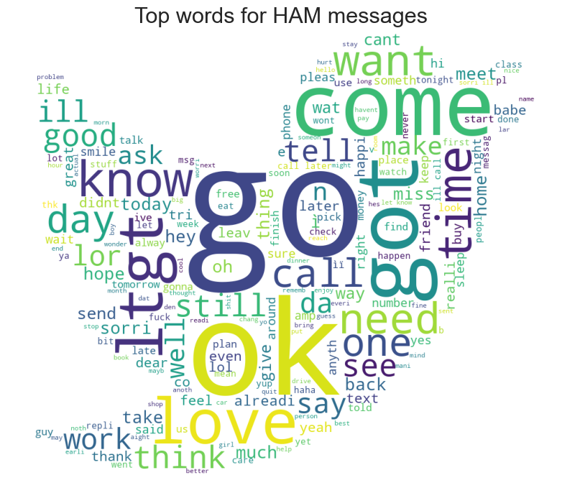
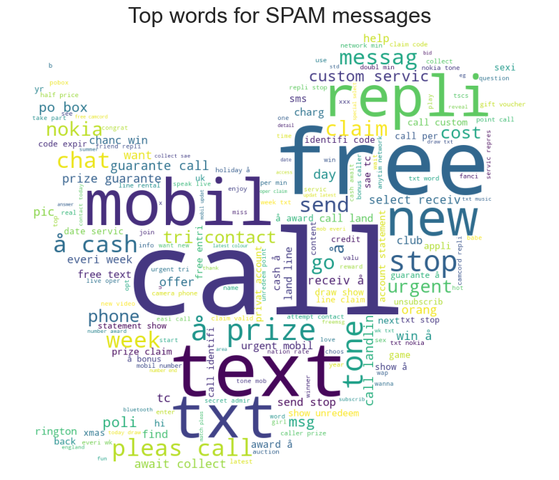
EDA
Top words for Spam & Ham ( Not Spam ) using WordCloud
Figure 7 : Top Words for Not Spam
Figure 8 : Top Words for Spam

Slide 9
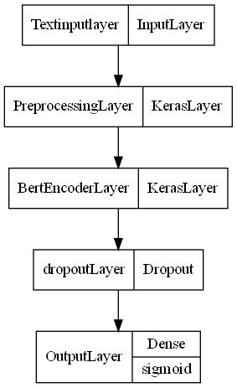
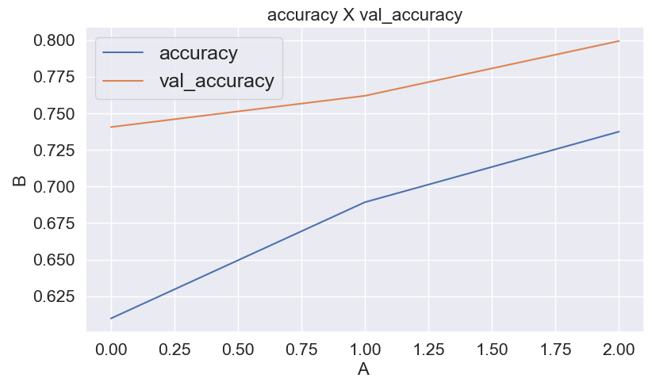
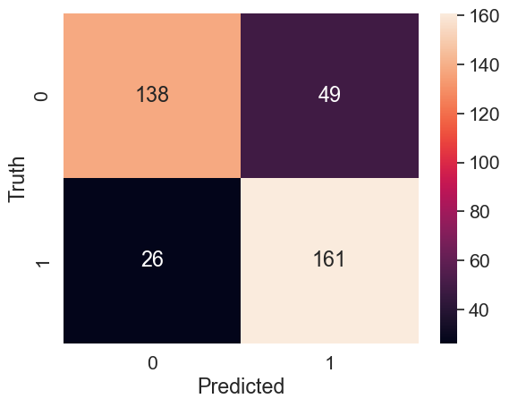
Graph of Keras Neural Network & Result
accuracy: 0.7375
accuracy: 0.7375
With Epoch = 3 & batch Size = 35
Training Accuracy : 74 %
Test Accuracy : 80 %
Figure 9 : Neural Model layers plot
Figure 10 : Neural Model layers plot
Figure 11 : Confusion Matrix

Slide 10
Reflection
BERT is a state-of-the-art language model that has been pre-trained on a massive amount of text data.
Ease to fine-tune models with pre-trained weights even with small labelled data
Ability to handle large amount of unstructured data with high speed
Accuracy
Using Bert
Ability to understand the context of the words in the text

