Slide 1
Lending Club loan project
By Chirag

Slide 2
Project Objective
1.Predict whether a loan will be approved based on applicant details.
2.Helps banks automate and speed up decisions.
3.We will use library of phytons like numpy,pandas ,matplotlib and seaborn.
4.Main thing to find the answer of Loan_Status so,decision making can be more fast for lending club(loan bank).
5.Will also clean the data , understand the data , analysis the data with some command and graph chart and more analysis so that will easy to understand and easy in decision making.

Slide 3
Dataset Overview
Features in dataset include:
Applicant details: Gender, Marital Status, Education, Income
Loan details: Amount, Term, Credit History
Target: Loan_Status

Slide 4
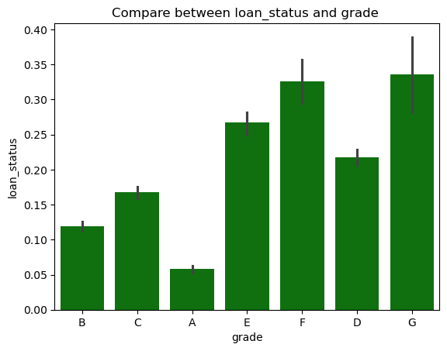
Explain:
Graph shows the comparison between loan_status and grade.

Slide 5
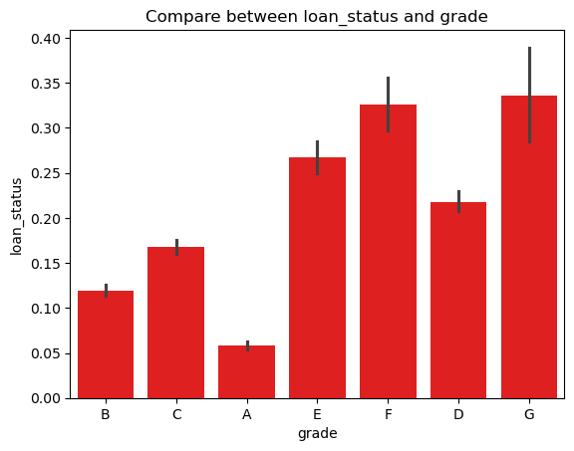
Explain:
Graph shows that the comparison between the loan_status and grade
Just the visualization is different but the comparison is same.

Slide 6
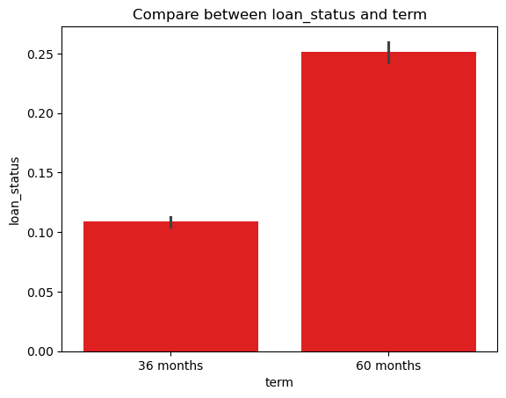
Explain:
Graph shows comparison between loan_status and term of the bank.
And the visualization is also different for a better explanation .

Slide 7
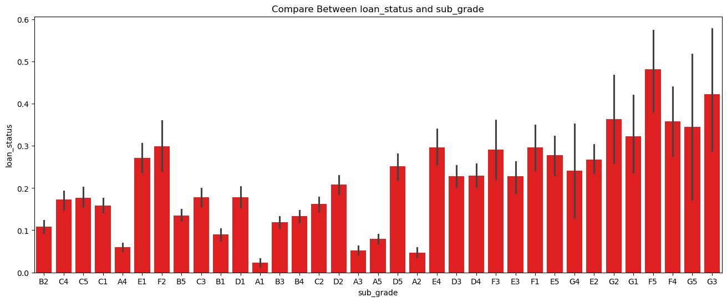
Explain:
This graph show the comparison between loan_status and sub_grade
And the visualization is for a better explanation.

Slide 8
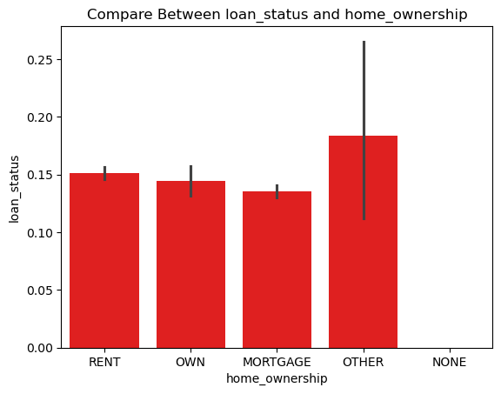
Explain:
This graph show the comparison between loan_status and home_ownership.
And the visualization is for a better explanation.

Slide 9
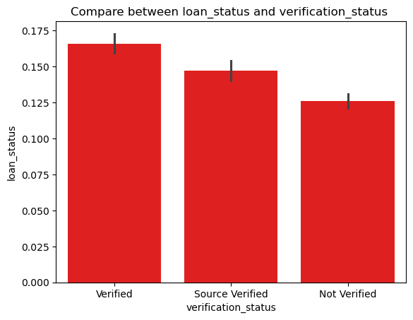
Explain:
This graph show the comparison between loan_status and verification_status.
And the visualization is for a better explanation.

Slide 10
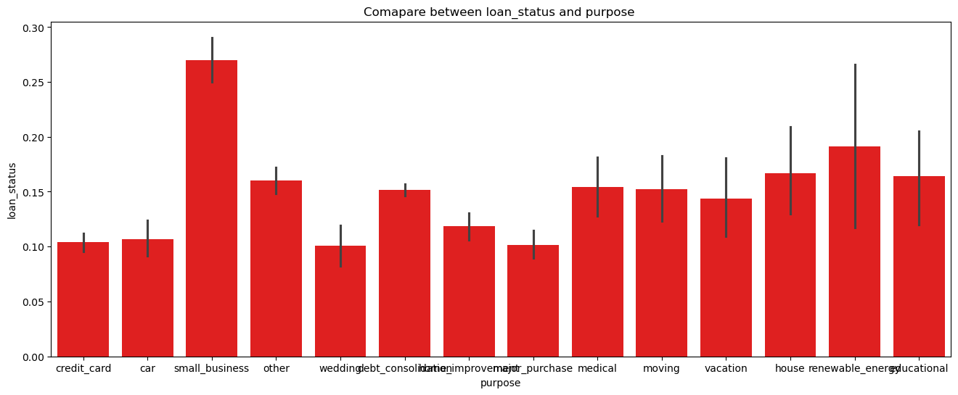
Explain:
This graph show the comparison between loan_status and purpose.
And the visualization is for a better explanation.

Slide 11
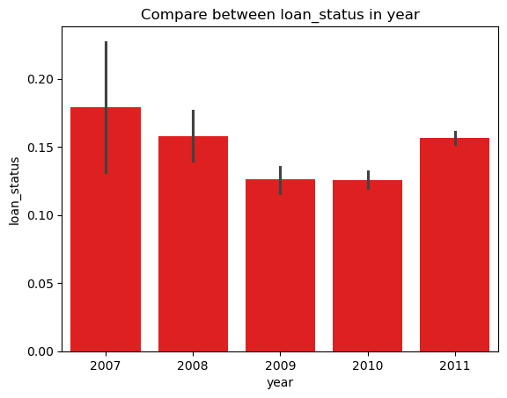
Explain:
This graph show the comparison between loan_status and year.
And the visualization is for a better explanation.

Slide 12
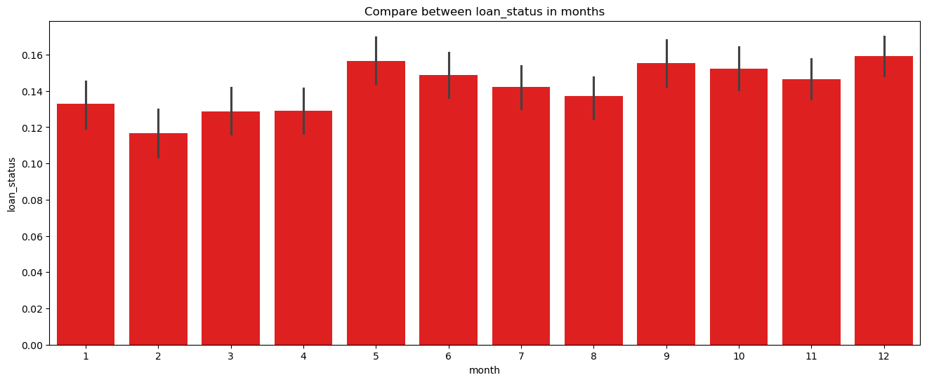
Explain:
This graph show the comparison between loan_status and month.
And the visualization is for a better explanation.

Slide 13
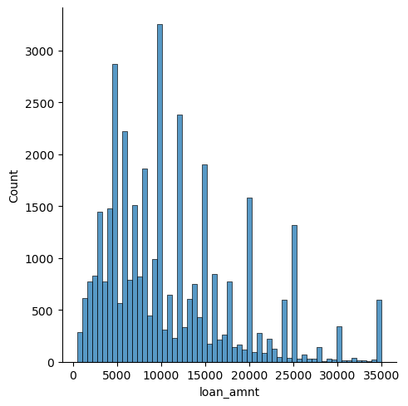
Explain:
This graph show the comparison between count and loan_amnt in histogram.
And the visualization is for a better explanation.

Slide 14
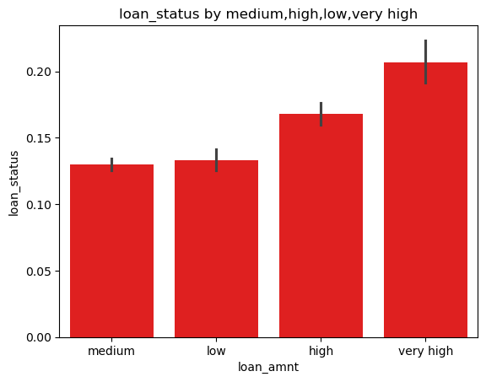
Explain:
This graph show the comparison between loan_status and loan_amnt by medium
Range , low , high and very high range , for a better understanding.
And the visualization is for a better explanation

Slide 15
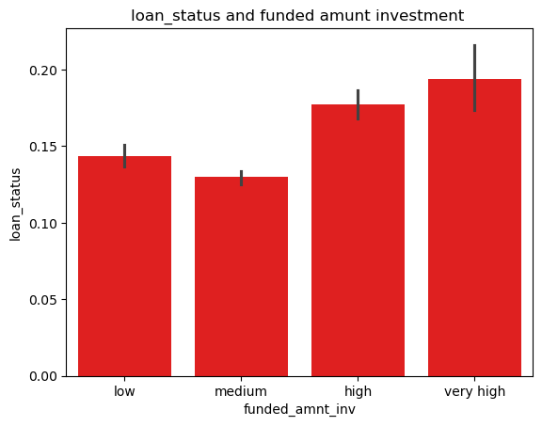
Explain:
This graph show the comparison between loan_status and funded_amnt_inv.
And the visualization is for a better explanation.

Slide 16
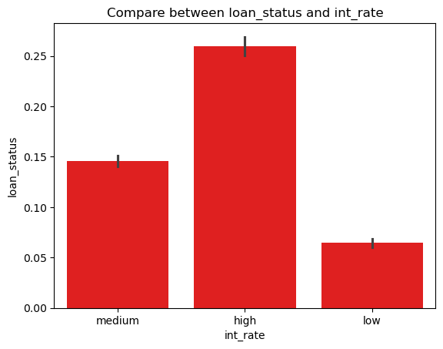
Explain:
This graph show the comparison between loan_status and int_rate.
And the visualization is for a better explanation.

Slide 17
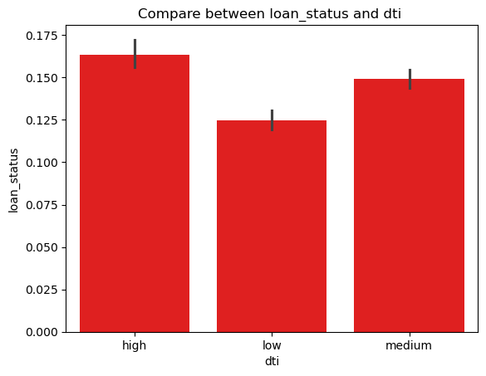
Explain:
This graph show the comparison between loan_status and dti.
And the visualization is for a better explanation

Slide 18
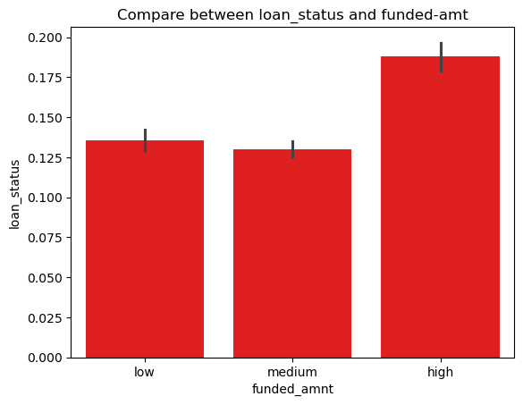
Explain:
This graph show the comparison between loan_status and funded_amnt.
And the visualization is for a better explanation.

Slide 19
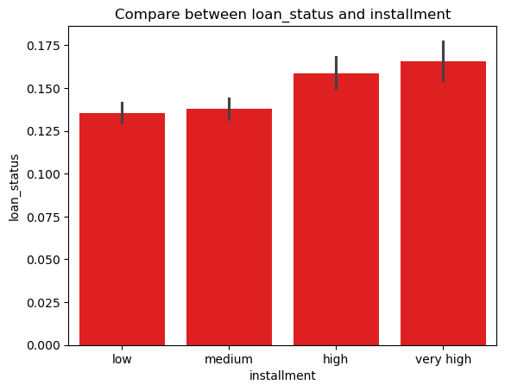
Explain:
This graph show the comparison between loan_status and installment
And the visualization is for a better explanation

Slide 20
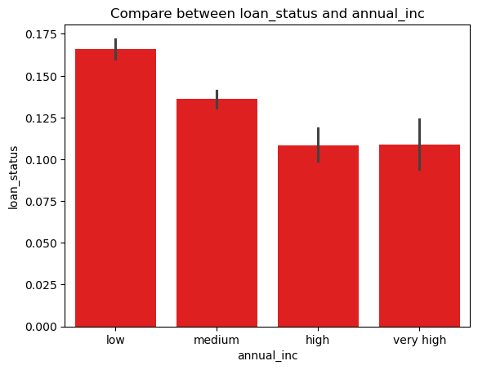
Explain:
This graph show the comparison between loan_status and annual_inc,
And the visualization is for a better explanation.

Slide 21
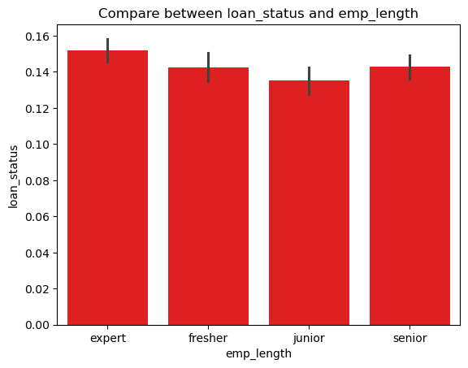
Explain:
This graph show the comparison between loan_status and emp_length
And the visualization is for a better explanation.

Slide 22

Explain:
This graph show the comparison between loan_status and purpose.
And the visualization is for a better explanation.

Slide 23
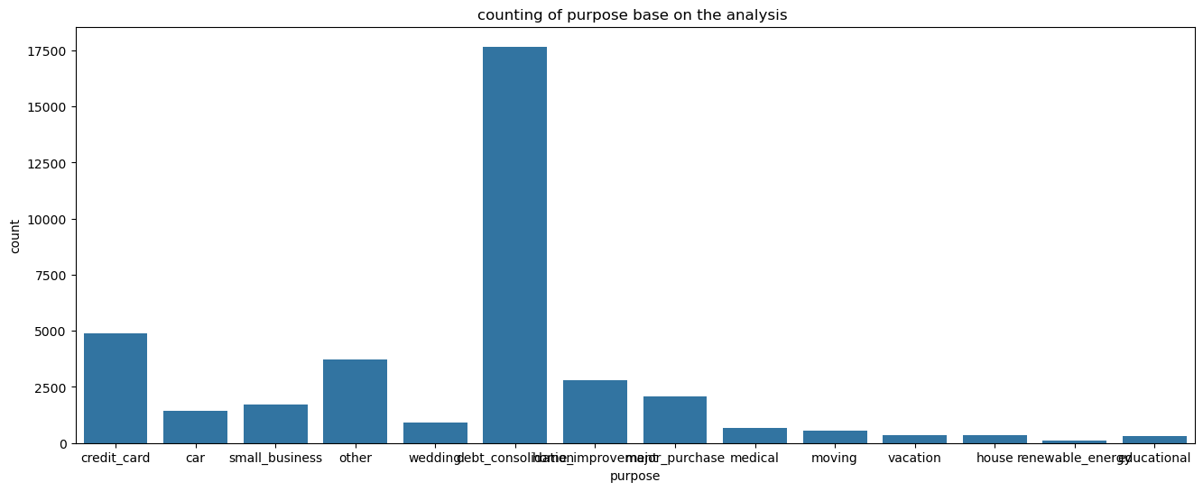
Explain:
This graph show the comparison between count and purpose to check the top 4.

Slide 24
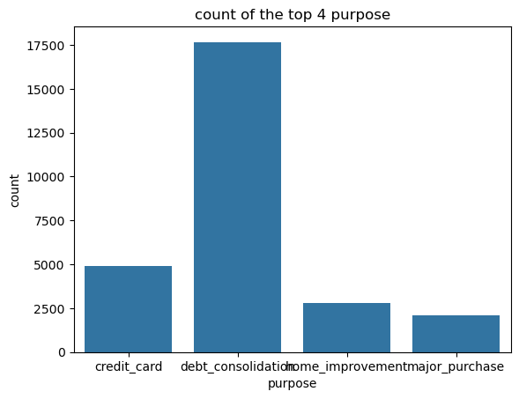
Explain:
This graph show the comparison between count and purpose, we got top 4.

Slide 25
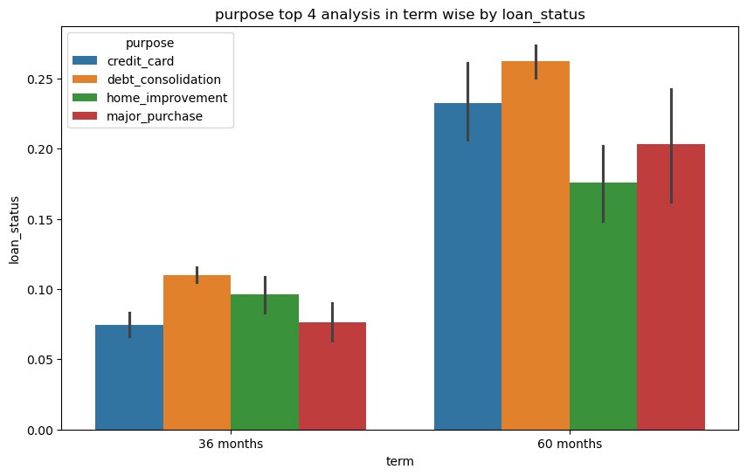
Explain:
We will now compare this top 4
This graph show the comparison between loan_status and term.

Slide 26
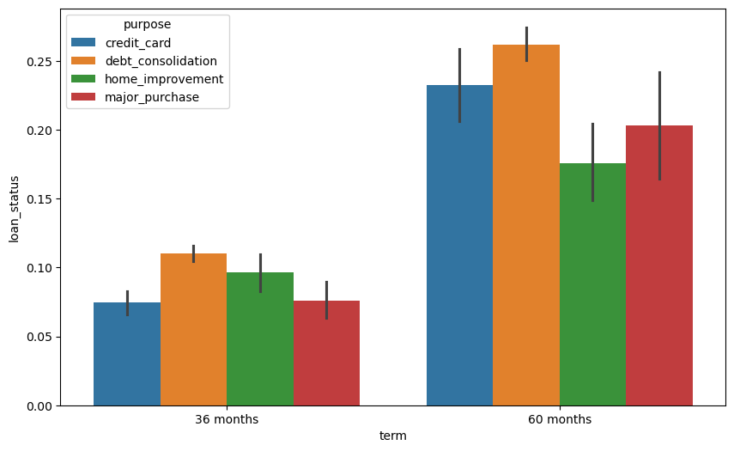
Explain:
We will now compare this top 4
This graph show the comparison between loan_status and term.

Slide 27
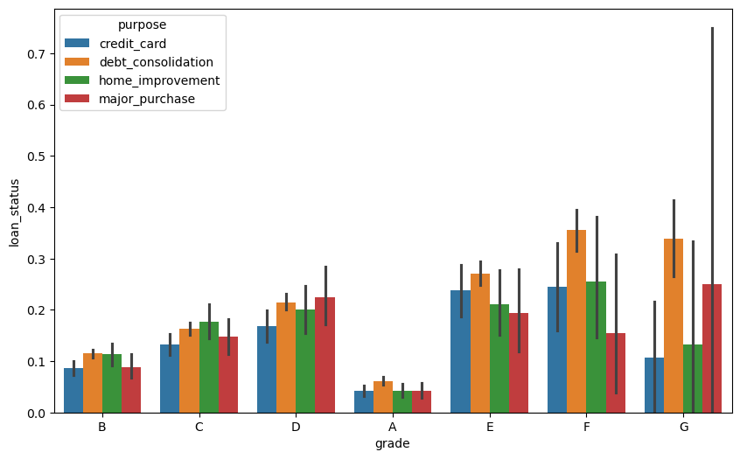
Explain:
We will now compare this top 4
This graph show the comparison between loan_status and grade.

Slide 28
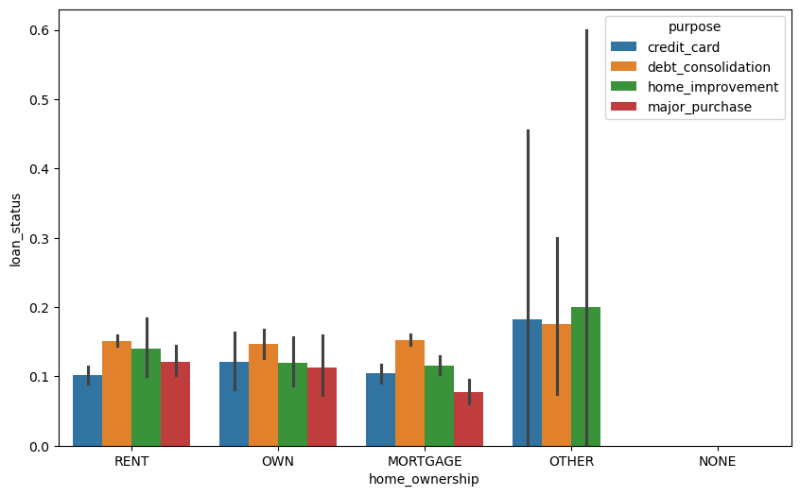
Explain:
We will now compare this top 4
This graph show the comparison between loan_status and home_ownership.
.

Slide 29
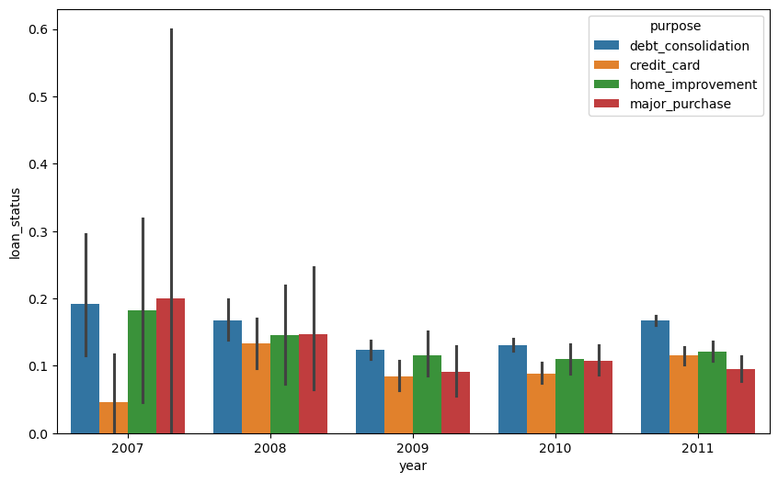
Explain:
We will now compare this top 4
This graph show the comparison between loan_status and year.

Slide 30
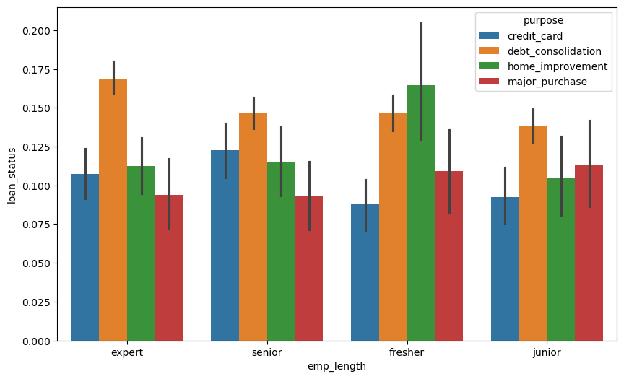
Explain:
We will now compare this top 4
This graph show the comparison between loan_status and emp_length.

Slide 31
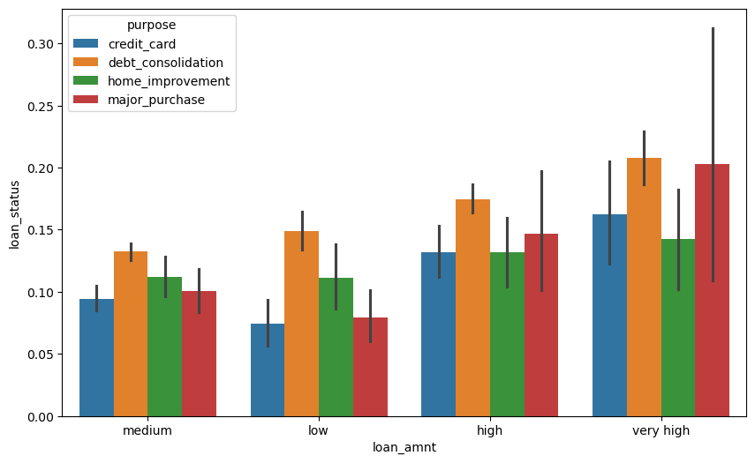
Explain:
We will now compare this top 4
This graph show the comparison between loan_status and loan_amnt.

Slide 32
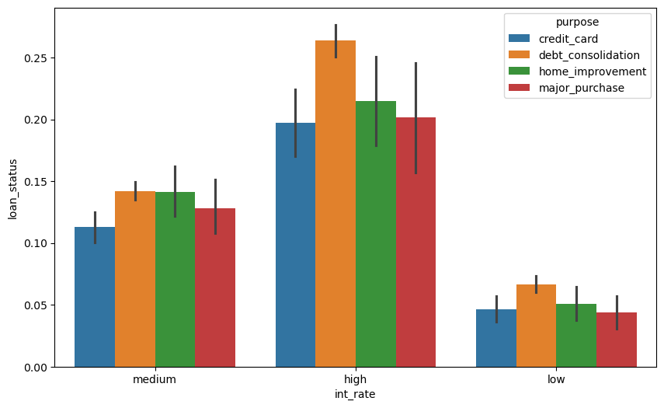
Explain:
We will now compare this top 4
This graph show the comparison between loan_status and int_rate.

Slide 33
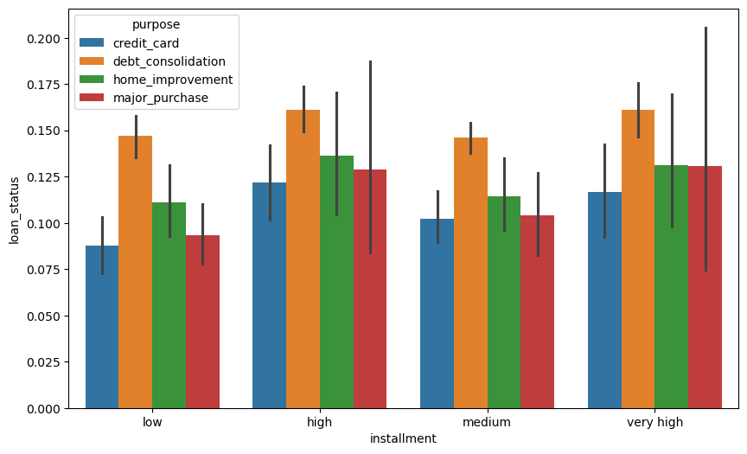
Explain:
We will now compare this top 4
This graph show the comparison between loan_status and installment.

Slide 34
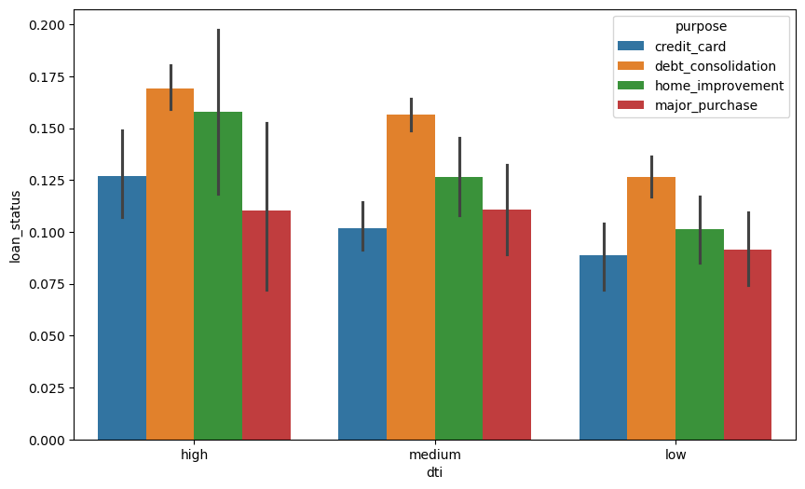
Explain:
We will now compare this top 4
This graph show the comparison between loan_status and dti.

Slide 35
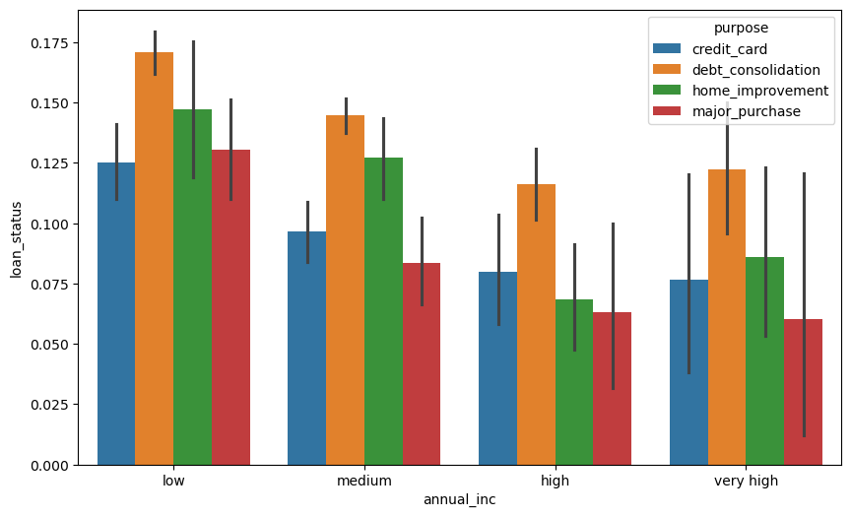
Explain:
We will now compare this top 4
This graph show the comparison between loan_status and annual_inc.

Slide 36
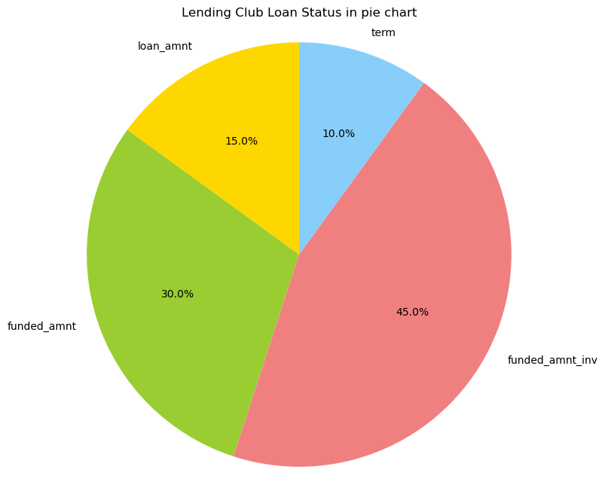
Explain:
It a pie chart for more basic understanding of the lending club.
This pie chart shows the comparison between loan_status ,term,funded_amnt and
Funded_amnt_inv.

Slide 37
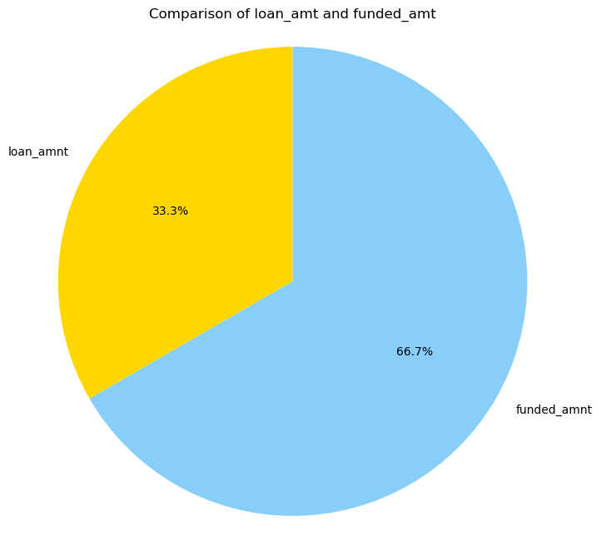
Explain:
It a pie chart for more basic understanding of the lending club.
This pie chart shows the comparison between loan_status and funded_amnt

Slide 38
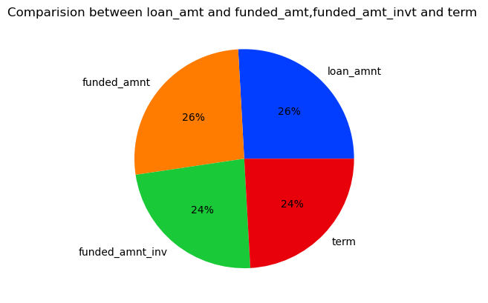
Explain:
It a pie chart for more basic understanding of the lending club.
This pie chart shows the comparison between loan_status ,term,funded_amnt and
Funded_amnt_inv.
Better visualization in pie chart.

Slide 39
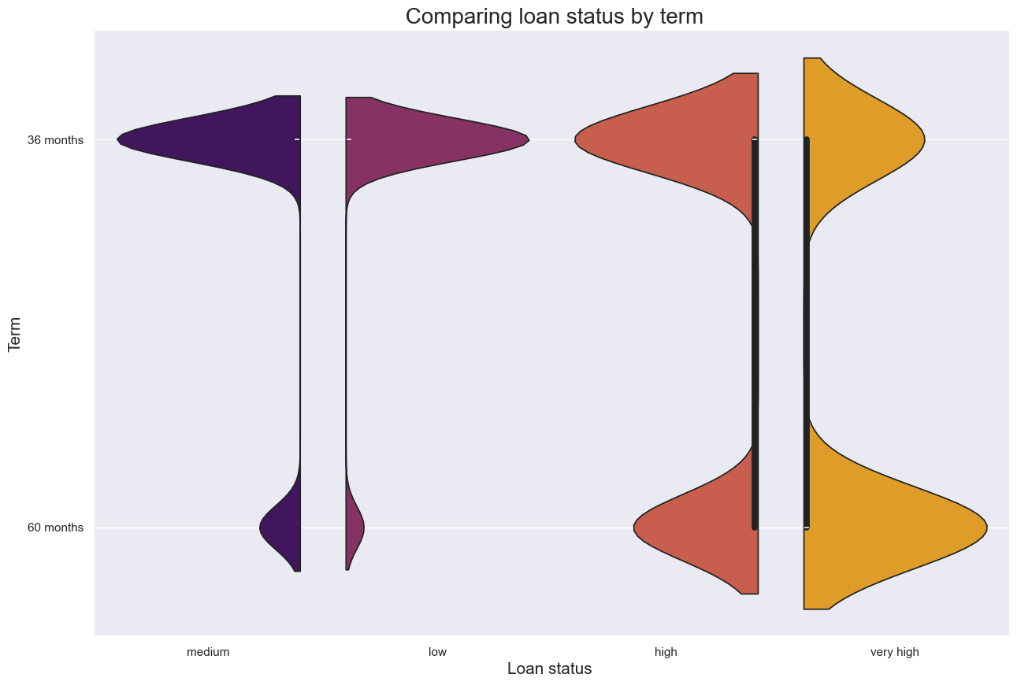
Explain:
It a violin plot for more basic understanding of the lending club.
This pie chart shows the comparison between loan_status and term

Slide 40
Conclusion
This is the lending club loan project (default) .
This project is base on the bank that gave us loan.
In this project we just to analysis the situation around the bank of the loan.
One is the borrower and the other one is the investors.
We have analysis the loan_status very deptly in this project of the lending club .
All the graph we have explain in this project we have made after :
i. Data Understanding
ii. Data Cleaning
iii. Data Analysis
iv. Recommendation
7. Rest the explanation is given in this ppt , thankyou..

