Slide 1
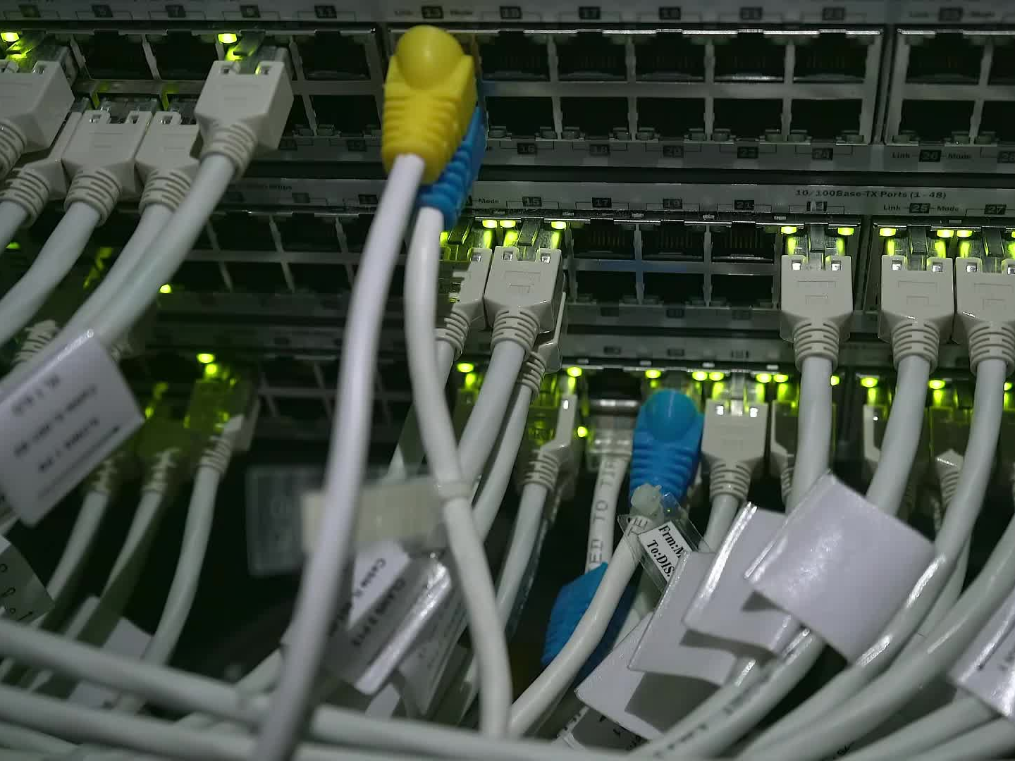
Telecom Customer Churn Project

Slide 2
Project Overview
• Exploratory analysis of telecom customer dataset before predictive modeling.
• Objective: Understand customer demographics, data completeness, and churn-related attributes.
• Dataset: 7043 rows × 21 columns.
• Focus: Data exploration, cleaning, and structure understanding.

Slide 3
Objectives
• Load and inspect the dataset.
• Check missing or duplicate values.
• Analyze gender, partner, dependents, and senior citizen columns.
• Verify data consistency and quality.
• Prepare dataset for future visualization and modeling.

Slide 4
Importing Libraries
import numpy as np
import pandas as pd
import matplotlib.pyplot as plt
import seaborn as sns
Purpose:
• numpy, pandas → data handling
• matplotlib, seaborn → visualization

Slide 5

Loading the Dataset
telecom = pd.read_csv('Telco-Customer-Churn.csv')
✓ Loaded dataset into a pandas DataFrame for analysis.
✓ Verified data structure using shape, info, and describe.

Slide 6
Basic Exploration
• telecom.head() → View first 5 rows
• telecom.tail() → View last 5 rows
• telecom.info(), telecom.describe() → Data types and summary stats
✅ Proper early data checks.
⚠️ Could add telecom.nunique() for unique counts.

Slide 7
Column-Wise Details
• Used telecom['gender'].reset_index() etc.
⚠️ Inefficient method.
✅ Better alternative:
telecom['gender'].value_counts()
→ Easier and cleaner categorical analysis.

Slide 8
Filtering Examples
• telecom.loc[telecom['Partner'] == 'No'] → 3641 without partner
• Gender: 3488 Female, 3555 Male
• Senior Citizen (60+): 1142
• Dependents: Yes 2110 / No 4933
✅ Effective use of conditions.
⚠️ Could simplify using value_counts().

Slide 9
Missing & Duplicate Data
• telecom.isnull().sum() → No missing values ✅
• telecom.count().duplicated() ❌ Wrong
✅ Correct: telecom.duplicated().sum()
→ Checks for duplicate rows correctly.

Slide 10
Mistakes & Corrections
• Wrong: telecom.count().duplicated()
• Correct: telecom.duplicated().sum()
• Wrong: .reset_index() for viewing data
• Correct: .value_counts()
• No visualization included yet — should add plots for better understanding.

Slide 11
Key Findings
• Total customers: 7043
• Female: 3488
• Male: 3555
• Without Partner: 3641
• Senior Citizens: 1142
• Dependents: Yes 2110 / No 4933
• Missing: 0
• Duplicates: 0

Slide 12
Visualization Examples
• Gender Distribution → sns.countplot(telecom['gender'])
• Dependents Split → plt.bar()
• Senior Citizen Ratio → pie chart
💡 Graphs show clear demographic trends in telecom customer base.

Slide 13
Future Work
1️⃣ Visualize churn rates by gender, partner, dependents.
2️⃣ Handle categorical encoding for modeling.
3️⃣ Build churn prediction model (e.g., Logistic Regression).
4️⃣ Create dashboards for insights.

Slide 14
Conclusion
✔ Cleaned and validated telecom dataset.
✔ Checked missing and duplicate values.
✔ Identified key demographics.
✔ Corrected data exploration mistakes.
✅ Strong foundation for further churn prediction analysis.

Slide 15
Repository Structure
📁 Telecom-Churn-Project/
│
├── Telecom Project.ipynb
├── Telco-Customer-Churn.csv
├── README.md
├── images/
└── models/

Slide 16
Thank You
Project by Chirag Jangid

