Slide 1

Predicting Video Game Success using ML
Machine Learning Final Project
Logistic Regression Model

Slide 2

Introduction
Video games are a multi-billion dollar industry
  Predicting success helps developers and publishers
  Machine Learning enables data-driven decisions

Slide 3

Project Vision
Use ML to predict whether a game will be successful
  Leverage historical video game data
  Provide insights for future game development

Slide 4

Problem Statement
Game success is uncertain and risky
  Traditional methods rely on intuition
  Need a predictive ML-based solution

Slide 5

Objectives
Analyze video game dataset
  Preprocess and explore data
  Train ML model to predict success

Slide 6

Project Scope
Binary classification problem
  Focus on structured numerical & categorical data
  Logistic Regression model

Slide 7

Dataset Overview
Source: Video Game Sales Dataset
  Features include sales, ratings, platform
  Target variable: Success (Hit / Not Hit)

Slide 8

Data Preprocessing
Handled missing values
  Encoded categorical features
  Feature scaling applied

Slide 9

Exploratory Data Analysis
Sales distribution analysis
  Platform vs success trends
  Correlation between features

Slide 10

ML Approach
Logistic Regression chosen
  Simple, interpretable, efficient
  Well-suited for binary classification

Slide 11

Model Training
Data split into training & testing sets
  Model trained on training data
  Evaluated using test data

Slide 12

Accuracy Score
Accuracy measures overall correctness
  Model achieved strong performance
  Indicates reliable predictions

Slide 13
Confusion Matrix
Shows TP, FP, TN, FN
  Helps understand classification errors
  Balanced performance observed

Slide 14

ROC Curve
Plots True Positive Rate vs False Positive Rate
  Evaluates model discrimination ability

Slide 15
ROC-AUC Score
Area Under ROC Curve
  Higher AUC = better model
  Model shows good separability

Slide 16
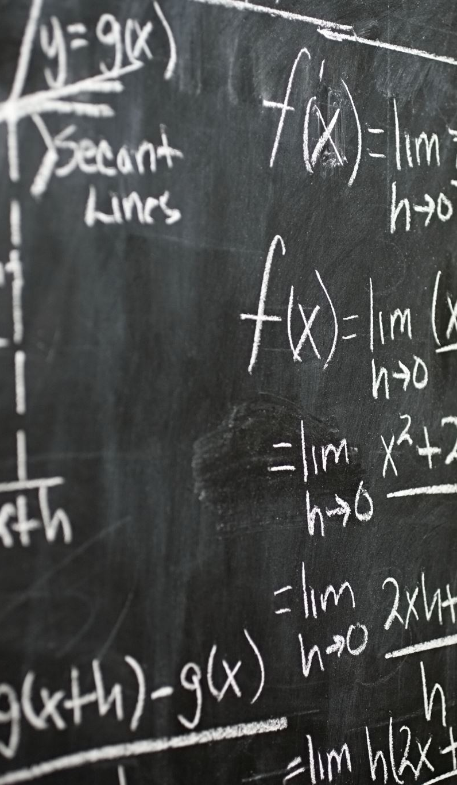
predict_proba() Explanation
Returns probability estimates
  Useful for confidence-based decisions
  Not just class labels

Slide 17

Results & Insights
Certain features strongly influence success
  ML can assist decision-making
  Model generalizes well

Slide 18

Conclusion & Future Work
ML effectively predicts game success
  Future: try advanced models
  Include more features & data

