Slide 1
World Wide Web:
HTTP

Slide 2
ARCHITECTURE
The WWW is a distributed client-server service, in which a client using a browser can access a service using a server. The service provided is distributed over many locations called sites.
The topics discussed in this section include:
Client (Browser)
Server
Uniform Resource Locator (URL)

Slide 3
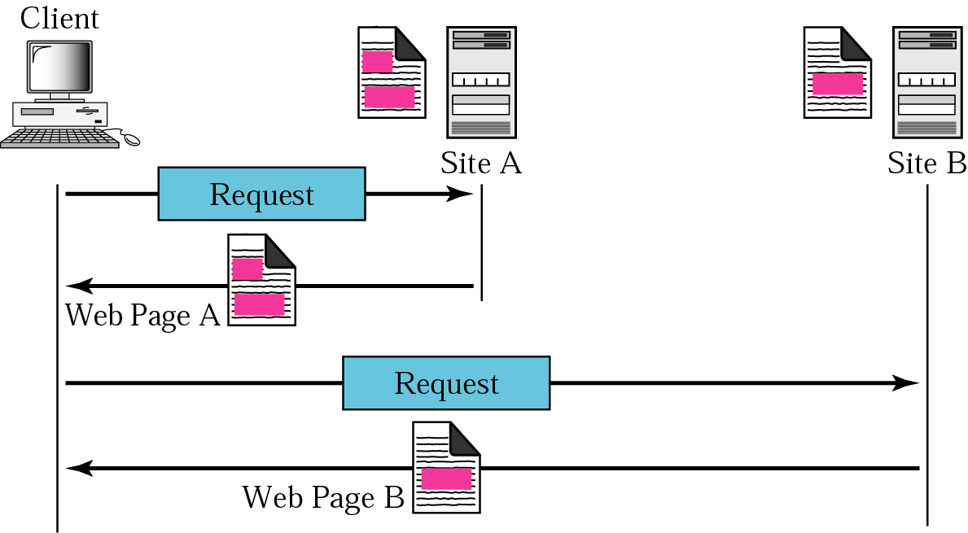
Architecture of WWW

Slide 4
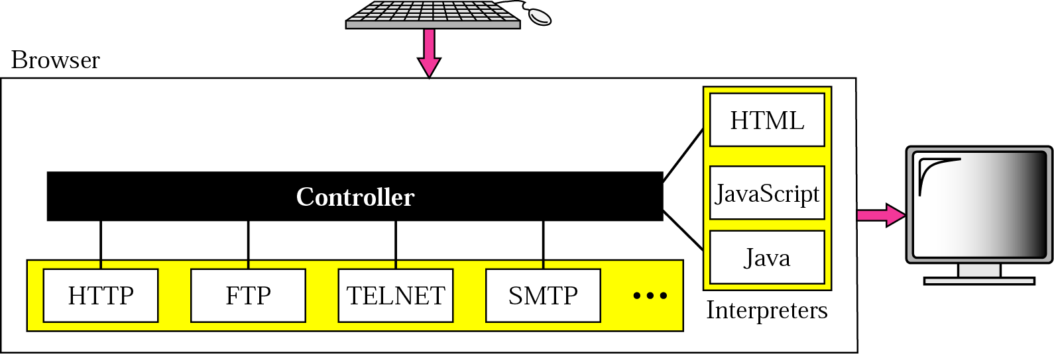
Browser
Consists of three parts: a controller, client protocol, and interpreters
Controller receives input from the keyboard/mouse and uses the client programs to access the web document
It uses one of the interpreters to display the document on the screen
Server
Web page is stored at the server; each time a client request arrives, the corresponding document is sent to the client

Slide 5
Uniform Resource Locator (URL)
URL is a standard for specifying any kind of information on Internet
Protocol is the client/server program used to retrieve the document
Host is the computer on which the information is located
URL can optionally contain the port number of the server
Path is the pathname of the file where the information is located

Slide 6
WEB DOCUMENTS
The documents in the WWW can be grouped into three broad categories: static, dynamic, and active. The category is based on the time the contents of the document are determined.
The topics discussed in this section include:
Static Documents
Dynamic Documents
Active Documents

Slide 7
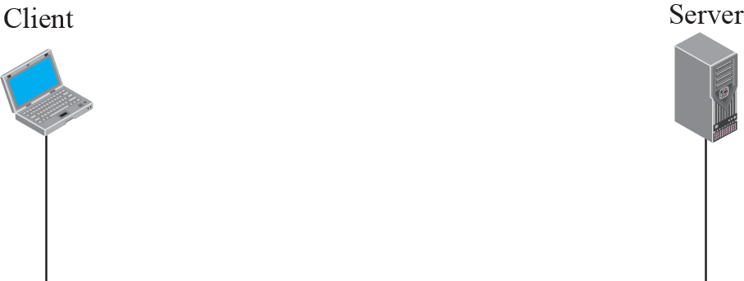
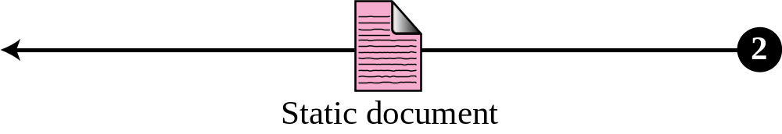
Static document
Fixed-content documents that are created and stored in a server
The client can get only a copy of the document
Hypertext Markup Language (HTML) is a language for creating web pages

Slide 8
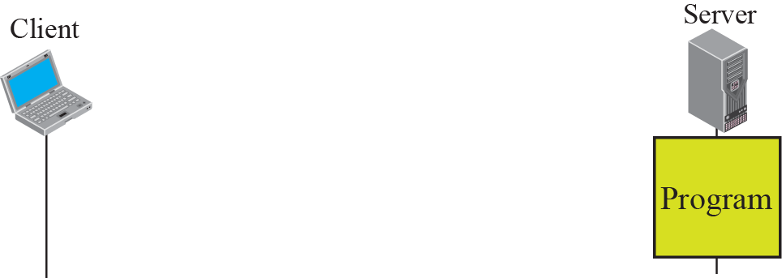
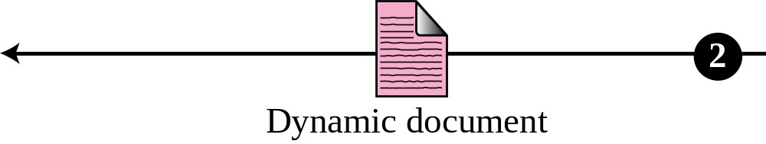
Dynamic document using Common Gateway Interface (CGI)
A dynamic document is created by a web server whenever a browser requests the document
CGI is a set of standards that defines how a dynamic document is written, how data are input to the program, and how output result is used
The whole idea of CGI is to execute a CGI program at the server site that receives input from a form and sends the output to the browser

Slide 9
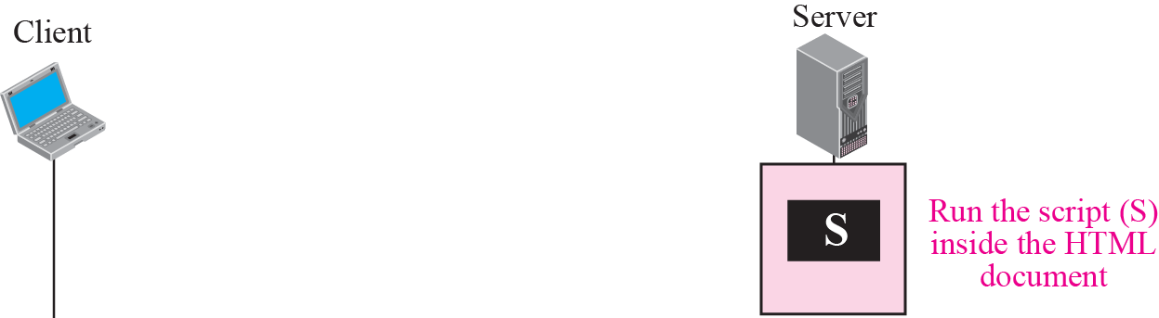
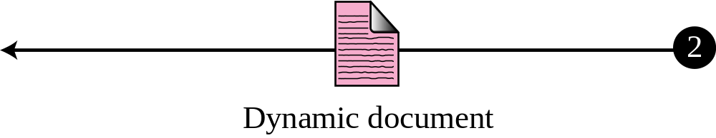
Dynamic document using server-site script
The problem with CGI technology is the inefficiency that results if part of the dynamic document to be created is fixed and a part varies
The solution is to create a file containing the fixed part of the document using HTML and embed a script that can be run by the server to provide the variation
Common technologies are Hypertext Preprocessor (PHP), Java Server Pages (JSP) and Active Server Pages (ASP)

Slide 10
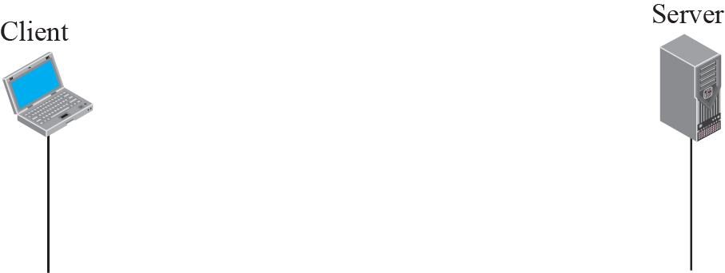
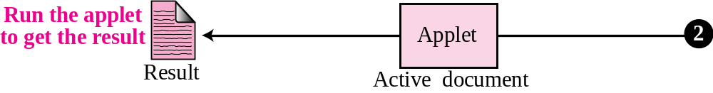
Active document using Java applet
Sometimes, we need a program or a script to be run at the client site
Java is combination of high-level programming language, a run-time environment, and a class library that allows a programmer to write an active document (an applet) and a browser to run it
An applet is a Java program that resides on the server, and is requested and transferred in binary form on the client, that runs it

Slide 11
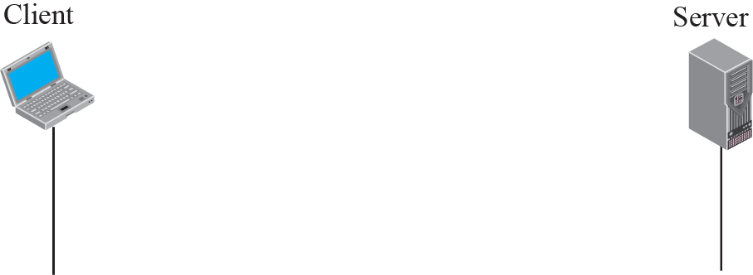
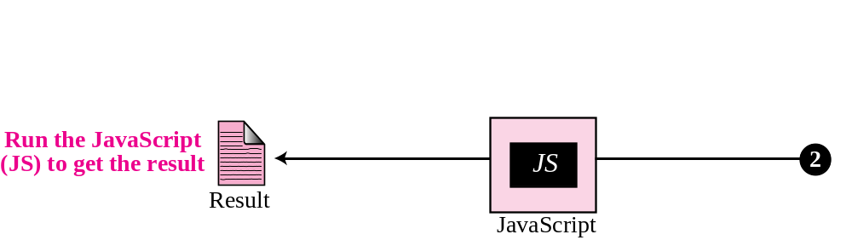
Active document using client-site script
If the active part of the document is small, it can be written in a scripting language; then it can be interpreted and run by the client at the same time
JavaScript is a high-level scripting language developed for this purpose

Slide 12
HTTP
The Hypertext Transfer Protocol (HTTP) is a protocol used mainly to access data on the World Wide Web. HTTP functions like a combination of FTP and SMTP.
HTTP itself is a stateless protocol
HTTP uses the services of TCP on well-known port 80.
The topics discussed in this section include:
HTTP Transaction
Persistent versus Nonpersistent Connection
Proxy Server

Slide 13
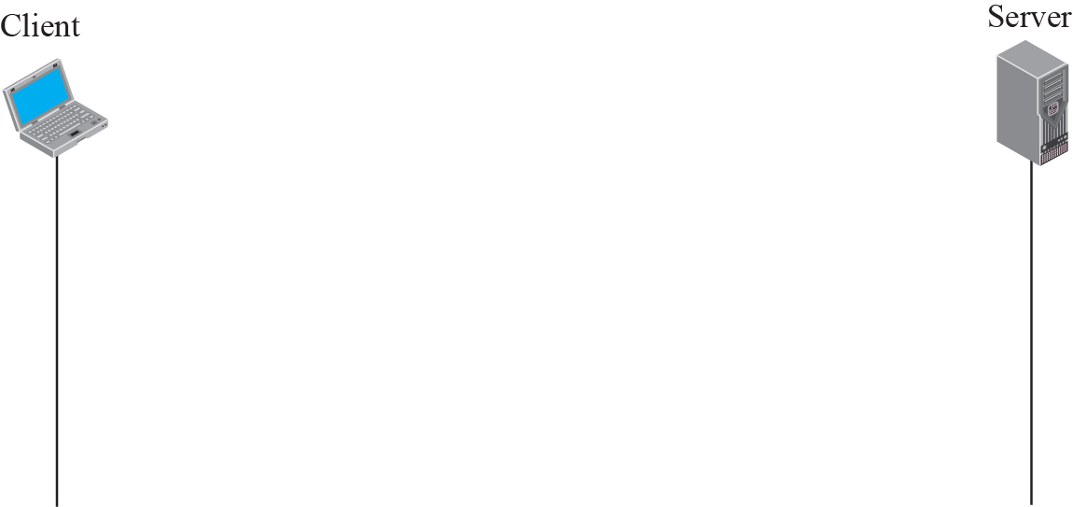
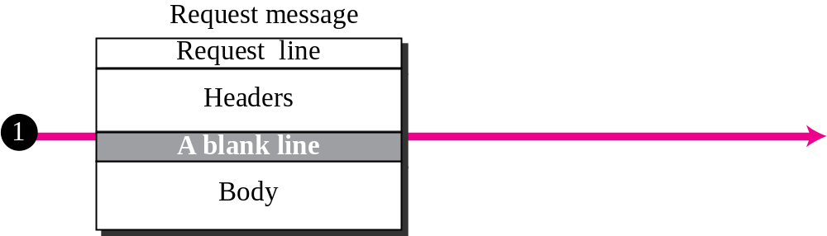
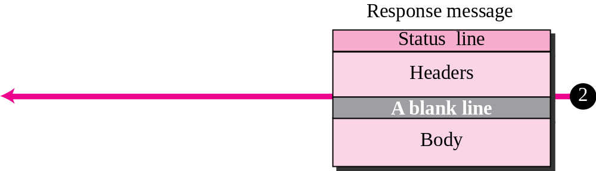
HTTP transaction

Slide 14
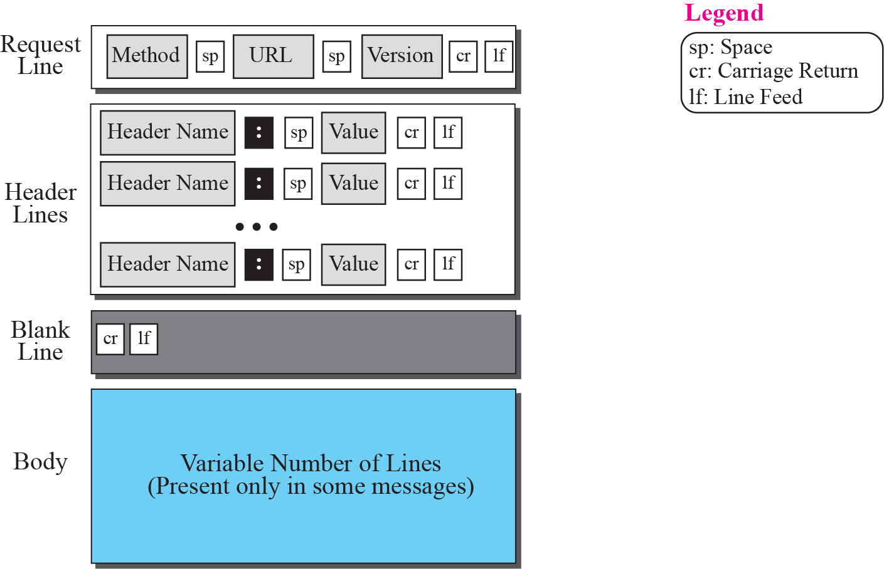
Format of the request message

Slide 15
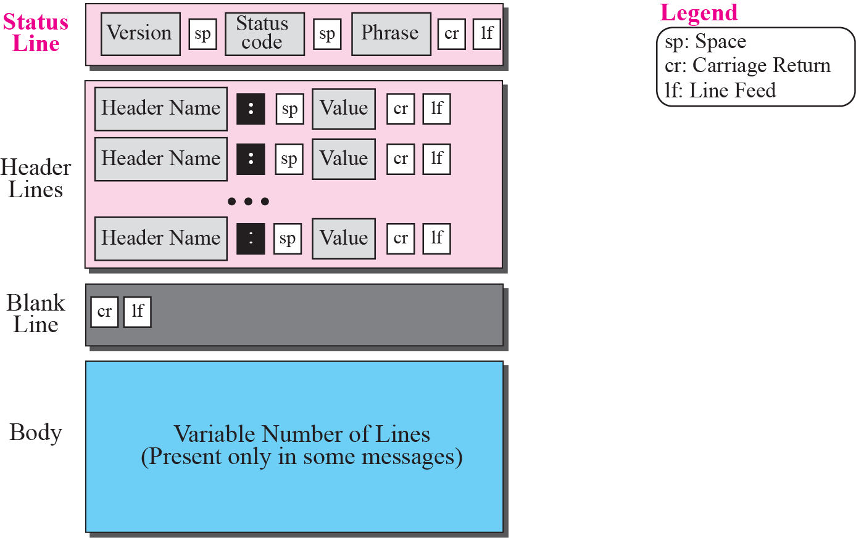
Format of the response message

Slide 16
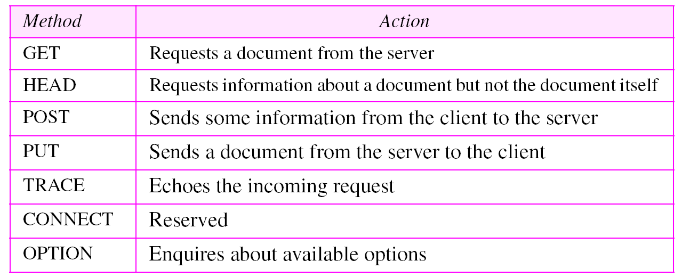
Table 1 Methods

Slide 17
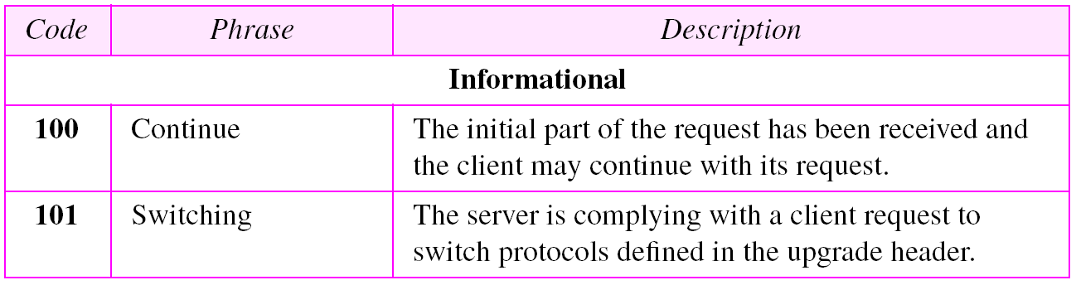
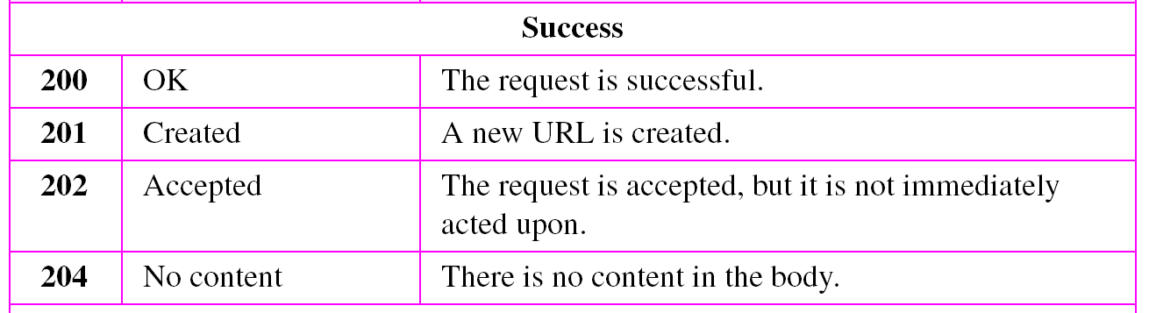
Table 2 Status codes

Slide 18
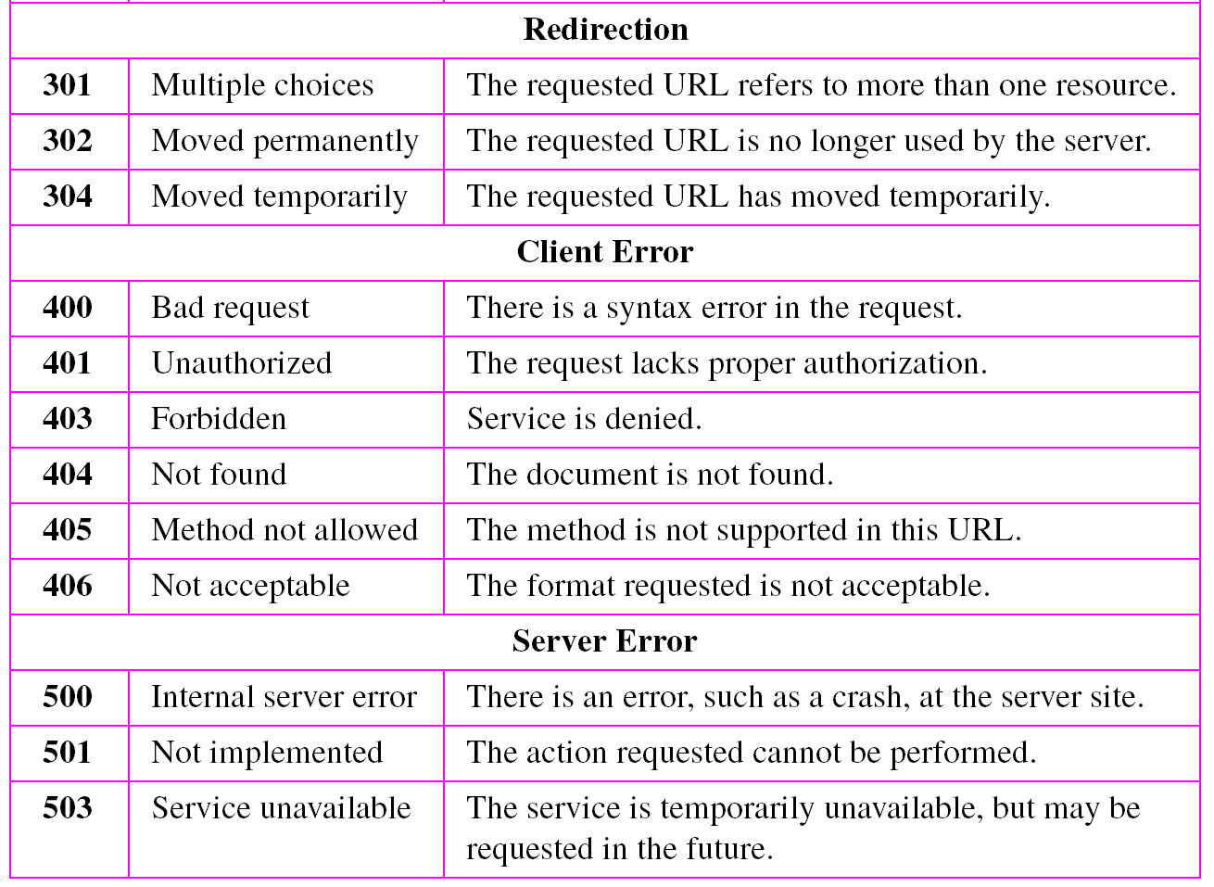
Table 2 Status codes (continued)

Slide 19
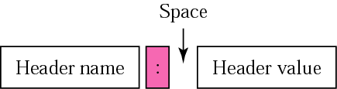
Headers
Header exchanges additional information between client and server
The header can consist of one or more header lines
Four categories of header lines:
  General header – gives general information about the message; present in both request and response message
  Request header – specifies the client’s configuration and client’s preferred document format; present only in request message
  Response header – specifies the server’s configuration and special information about the request; present only in response message
  Entity header – gives information about the body of document; mostly present in response messages, also present in some request messages having a body
Header format

Slide 20
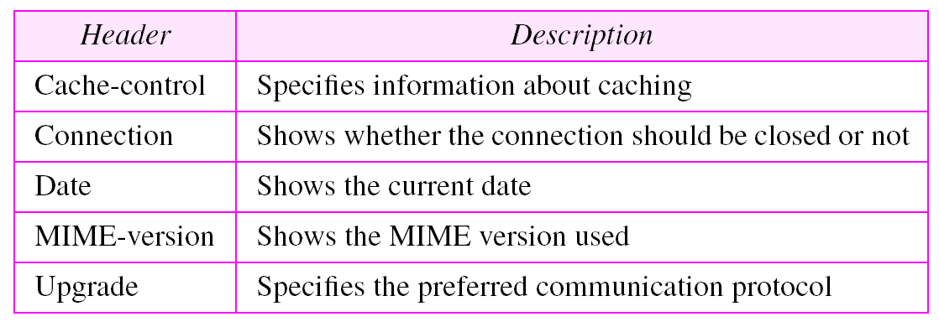
Table 3 General headers

Slide 21
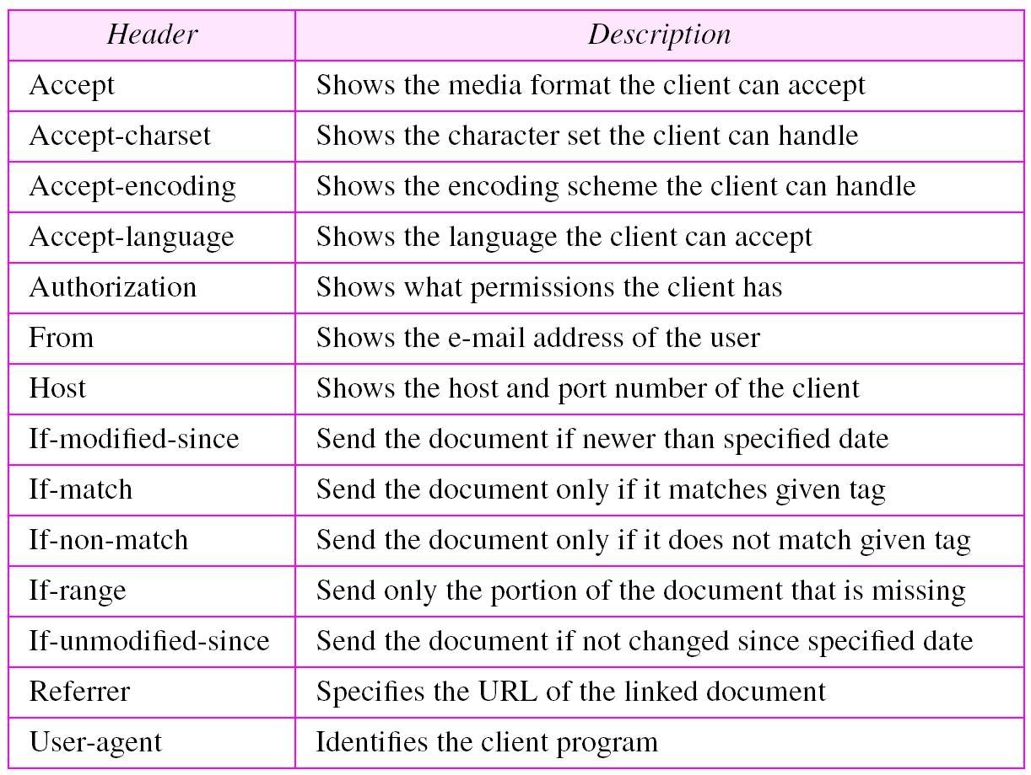
Table 4 Request headers

Slide 22
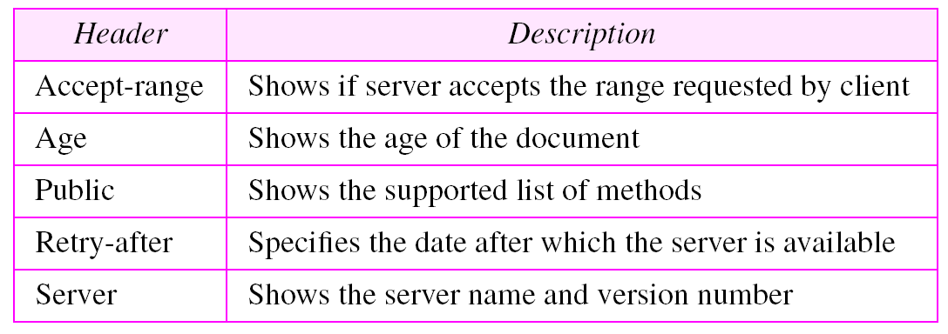
Table 5 Response headers

Slide 23
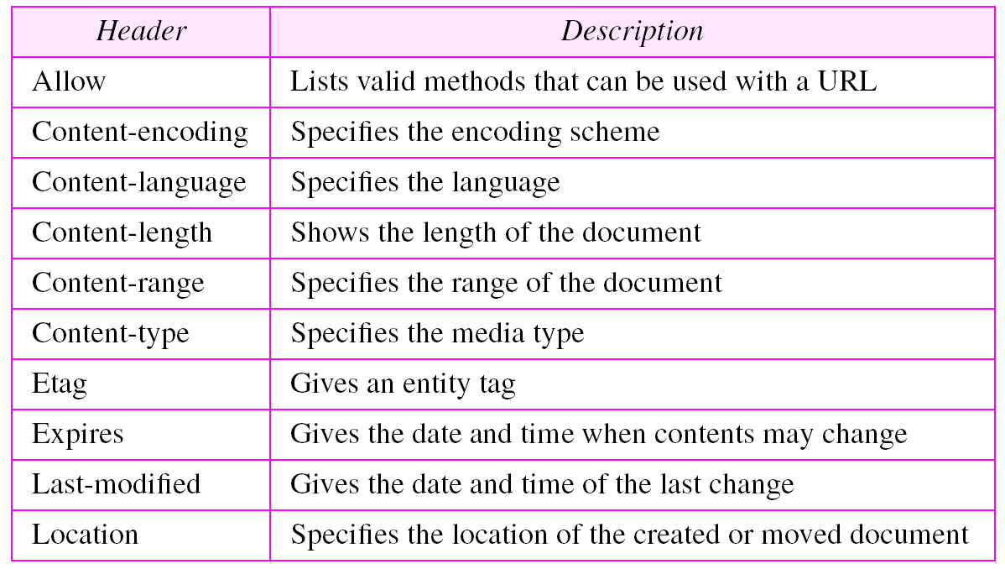
Table 6 Entity headers

Slide 24
Example 1
This example retrieves a document (see Figure on next slide). We use the GET method to retrieve an image with the path /usr/bin/image1. The request line shows the method (GET), the URL, and the HTTP version (1.1). The header has two lines that show that the client can accept images in the GIF or JPEG format. The request does not have a body. The response message contains the status line and four lines of header. The header lines define the date, server, MIME version, and length of the document. The body of the document follows the header.

Slide 25
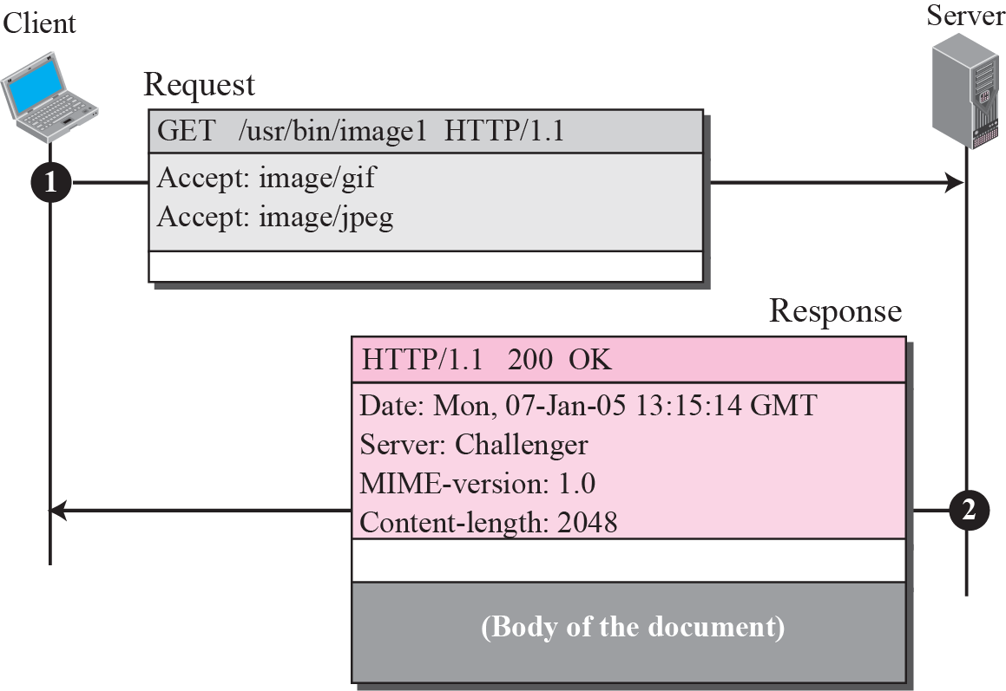
Example 1

Slide 26
Example 2
In this example, the client wants to send data to the server. We use the POST method. The request line shows the method (POST), URL, and HTTP version (1.1). There are four lines of headers. The request body contains the input information. The response message contains the status line and four lines of headers. The created document, which is a CGI document, is included as the body (see Figure on next slide).

Slide 27
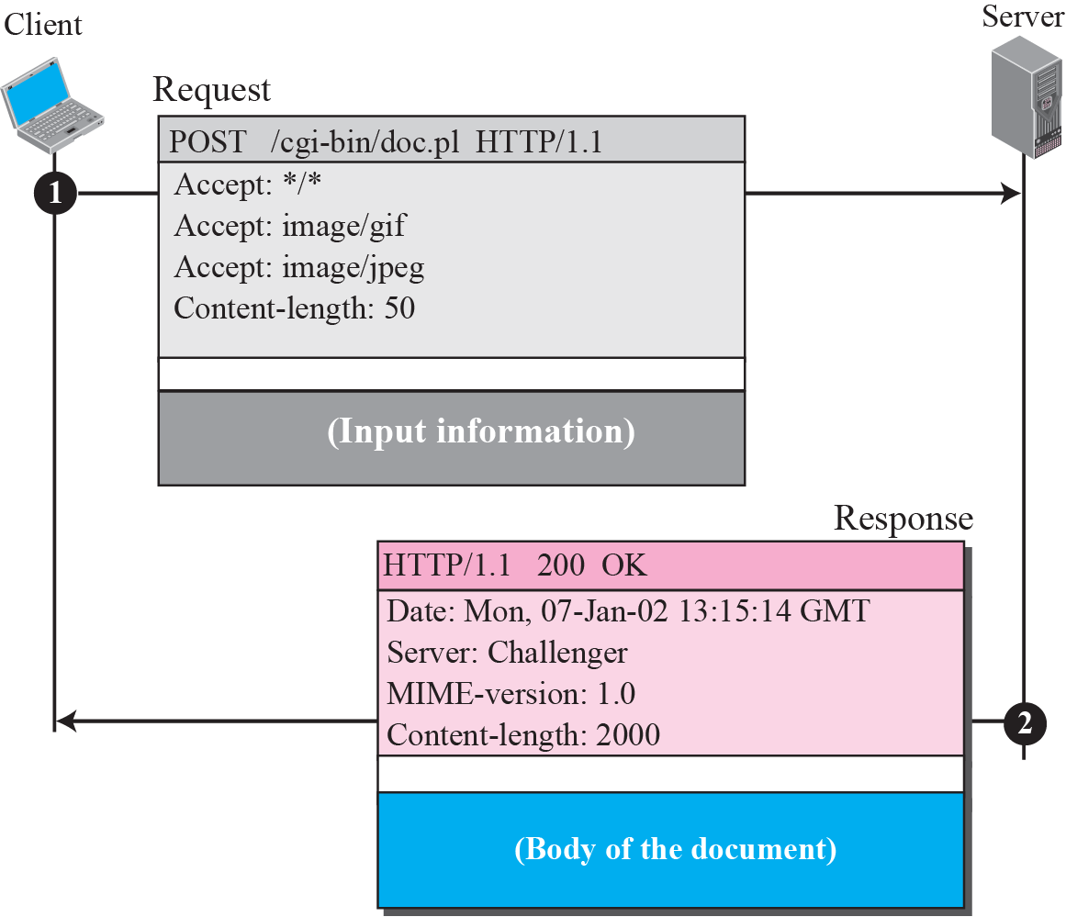
Example 2

Slide 28
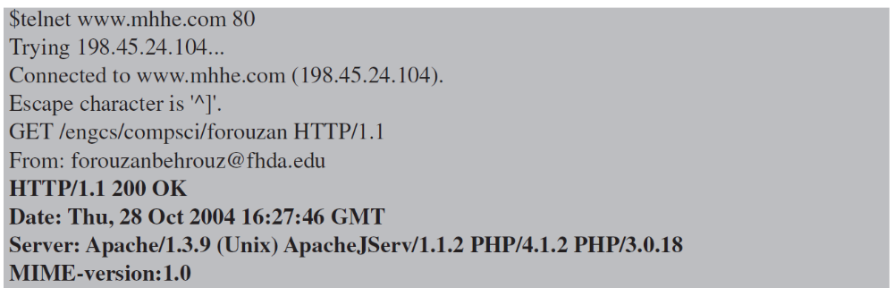
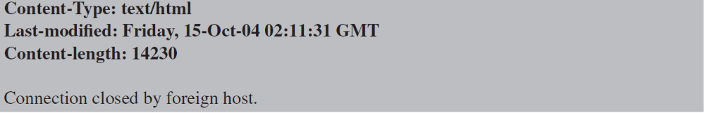
Example 3
HTTP uses ASCII characters. The following shows how a client can directly connect to a server using TELNET, which logs into port 80.

Slide 29
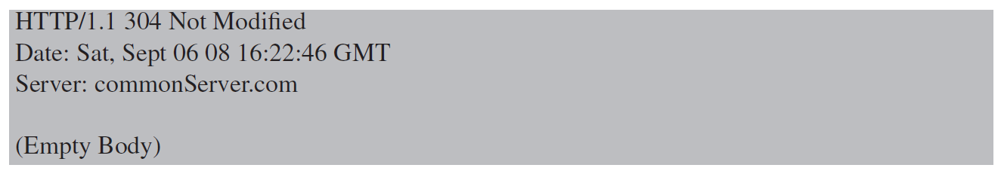
Example 4
The following shows how a client imposes the modification data and time condition on a request.
The status line in the responds shows the file is not modified after the defined point of time. The body of the response message is also empty.

Slide 30
Persistent vs Non-persistent Connection
Non-persistent connection: one TCP connection is made for each request/response
  the client opens a TCP connection and sends a request
  the server sends the response and closes the connection
  the client reads the data until it encounters an end-of-file marker; it then closes the connection
Persistent connection: the server leaves the connection open for more requests after sending a response
  the server can close the connection at the request of the client or if a time-out occurs

Slide 31
Example 5
Figure on next slide shows an example of a nonpersistent connection. The client needs to access a file that contains two links to images. The text file and images are located on the same server.

Slide 32
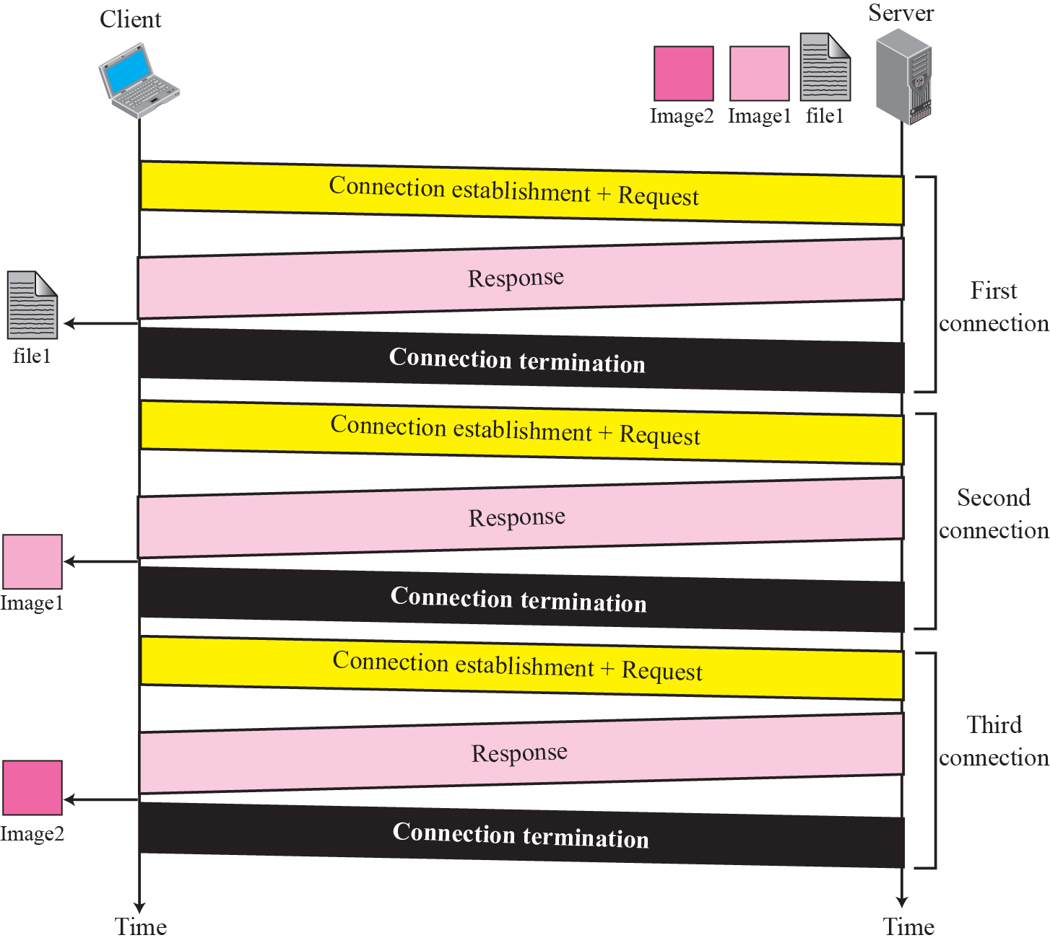
Example 5

Slide 33
Example 6
Figure on next slide shows the same scenario as in previous Example, but using persistent connection.
HTTP version 1.1 specifies a persistent connection by default.

Slide 34
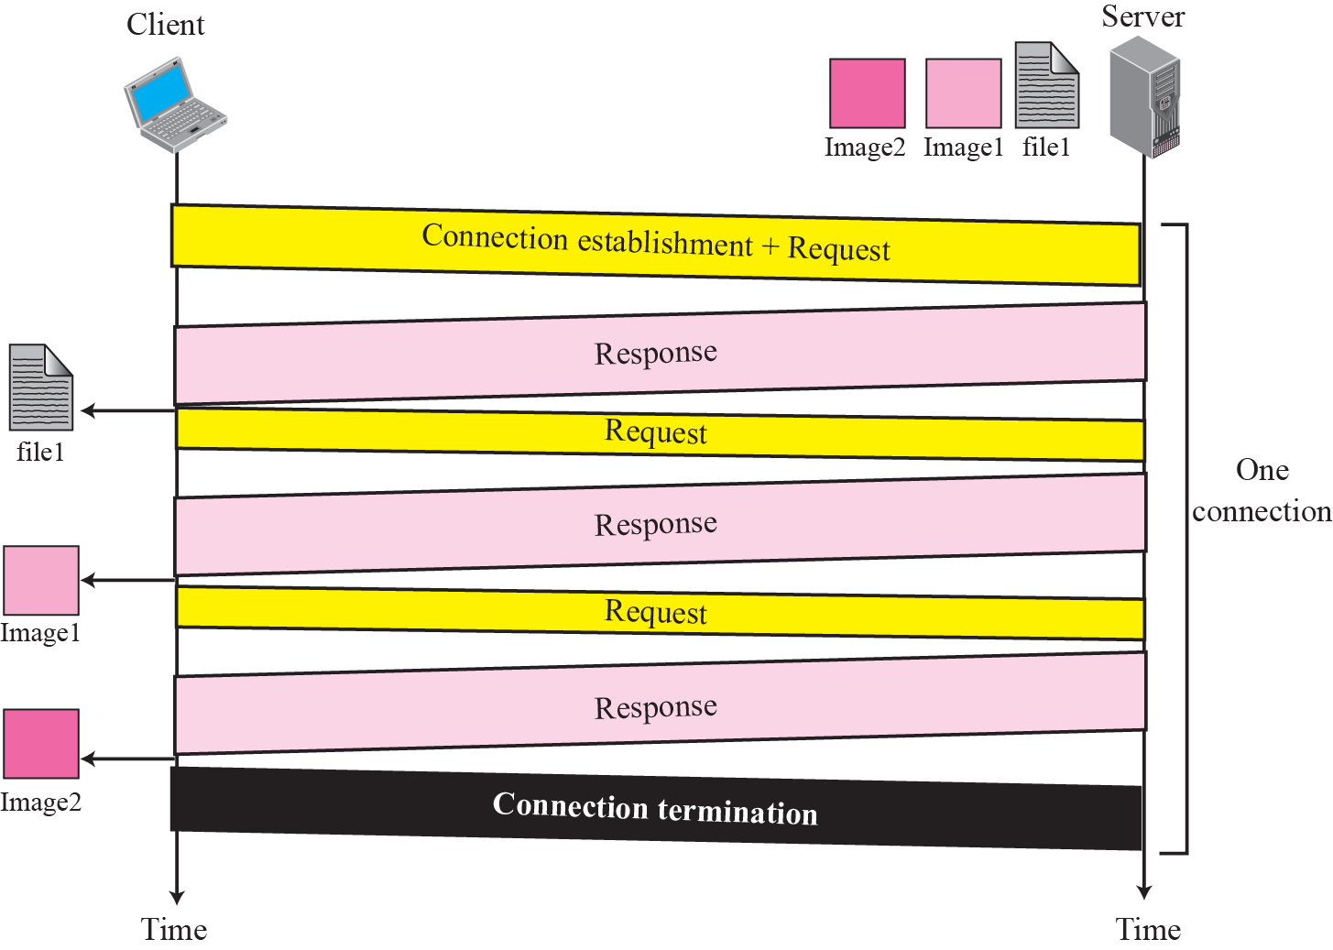
Example 6

Slide 35
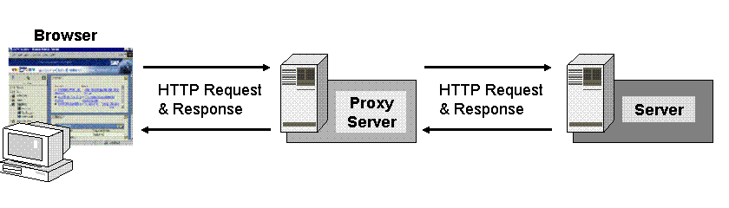
Proxy Server
HTTP supports proxy servers
  the HTTP client sends a request to the proxy server
  the proxy server checks its cache;
  if the response is not stored in the cache, the proxy sends the request to the corresponding server
  incoming responses are sent to the proxy server and stored for future requests from other clients
  client must be configured to access proxy instead of target server

