Slide 1
TCP

Slide 2
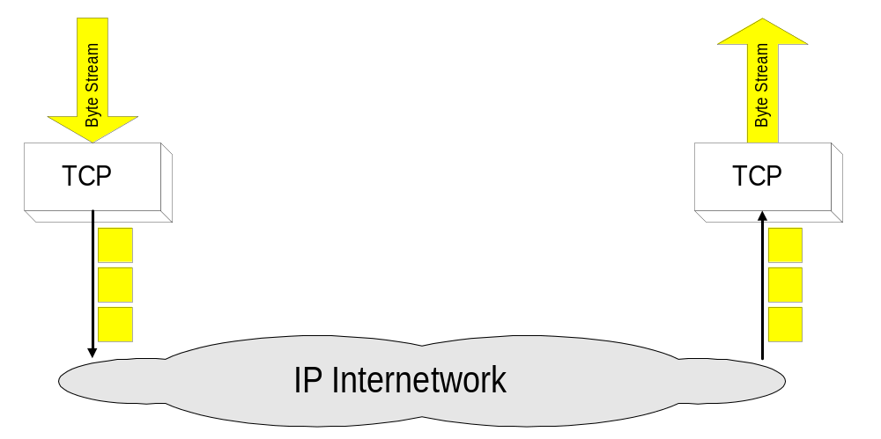
Overview
TCP = Transmission Control Protocol
Connection-oriented protocol
Provides a reliable unicast end-to-end byte stream over an unreliable internetwork.

Slide 3
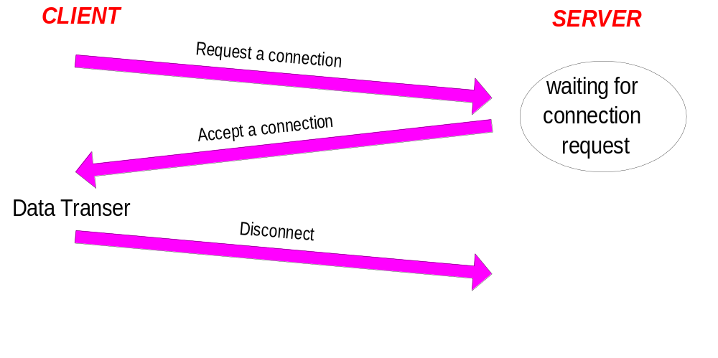
Connection-Oriented
Before any data transfer, TCP establishes a connection:
    One TCP entity is waiting for a connection (“server”)
    The other TCP entity (“client”) contacts the server
The actual procedure for setting up connections is more complex.
Each connection is
full duplex

Slide 4
Reliable
Byte stream is broken up into chunks which are called seg-ments
  Receiver sends acknowledgements (ACKs) for segments
  TCP maintains a timer. If an ACK is not received in time, the segment is retransmitted
Detecting errors:
  TCP has checksums for header and data. Segments with invalid checksums are discarded
  Each byte that is transmitted has a sequence number

Slide 5
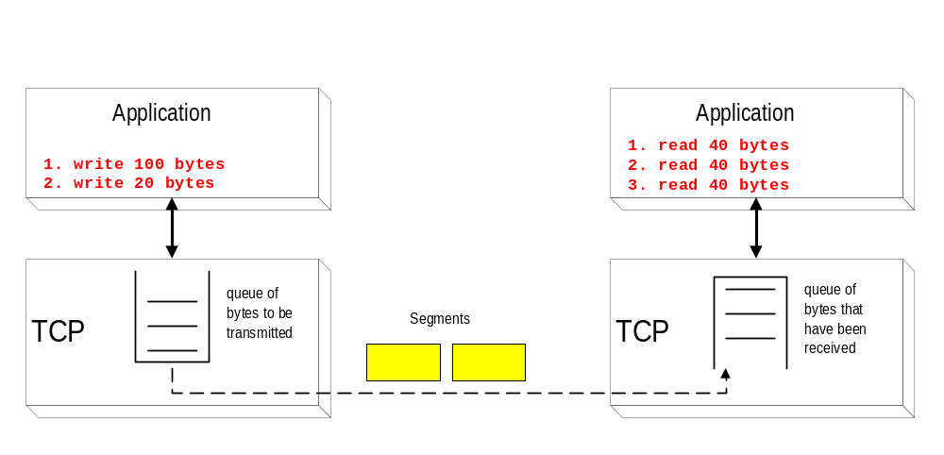
Byte Stream Service
To the lower layers, TCP handles data in blocks, the segments.
To the higher layers TCP handles data as a sequence of bytes and does not identify boundaries between bytes
So: Higher layers do not know about the beginning and end of segments !

Slide 6
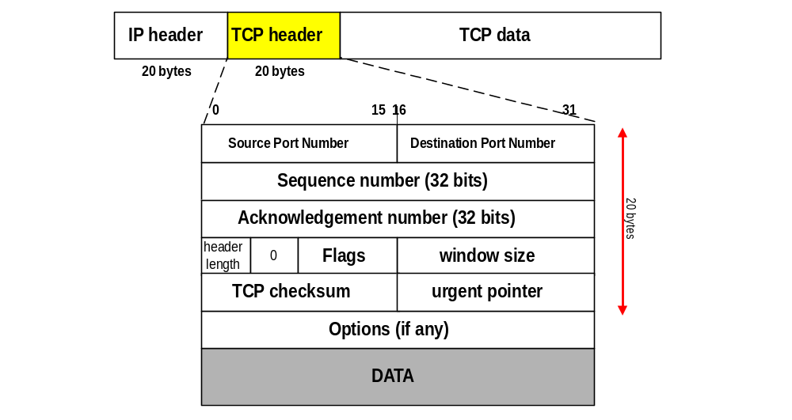
TCP Format
TCP segments have a 20 byte header with >= 0 bytes of data.

Slide 7
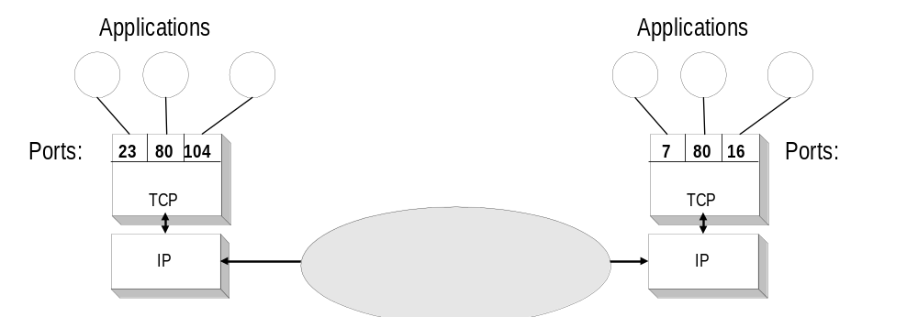
TCP header fields
Port Number:
    A port number identifies the endpoint of a connection.
    A pair <IP address, port number> identifies one endpoint of a connection.
    Two pairs <client IP address, server port number> and <server IP address, server port number> identify a TCP connection.

Slide 8
TCP header fields
Sequence Number (SeqNo):
  Sequence number is 32 bits long.
  So the range of SeqNo is
      0 <= SeqNo <= 2³² -1 ≈ 4.3 Gbyte
  Each sequence number identifies a byte in the byte stream
  Initial Sequence Number (ISN) of a connection is set during connection establishment
  Q: What are possible requirements for ISN ?

Slide 9
TCP header fields
Acknowledgement Number (AckNo):
  Acknowledgements are piggybacked, I.e
    a segment from A -> B can contain an acknowledgement for a data sent in the B -> A direction
  Q: Why is piggybacking good ?
  A hosts uses the AckNo field to send acknowledgements. (If a host sends an AckNo in a segment it sets the “ACK flag”)
  The AckNo contains the next SeqNo that a hosts wants to receive
  Example: The acknowledgement for a segment with sequence numbers 0-1500 is AckNo=1501

Slide 10
TCP header fields
Acknowledge Number (cont’d)
  TCP uses the sliding window flow protocol to regulate the flow of traffic from sender to receiver
  TCP uses the following variation of sliding window:
      no NACKs (Negative ACKnowledgement)
      only cumulative ACKs
Example:
  Assume: Sender sends two segments with “1..1500” and “1501..3000”, but receiver only gets the second segment.
  In this case, the receiver cannot acknowledge the second packet. It can only send AckNo=1

Slide 11
TCP header fields
Header Length ( 4bits):
  Length of header in 32-bit words
  Note that TCP header has variable length (with minimum 20 bytes)

Slide 12
TCP header fields
Flag bits:
  URG: Urgent pointer is valid
      If the bit is set, the following bytes contain an urgent message in the range:
        SeqNo <= urgent message <= SeqNo+urgent pointer
  ACK: Acknowledgement Number is valid
  PSH: PUSH Flag
      Notification from sender to the receiver that the receiver should pass all data that it has to the application.
      Normally set by sender when the sender’s buffer is empty

Slide 13
TCP header fields
Flag bits:
  RST: Reset the connection
      The flag causes the receiver to reset the connection
      Receiver of a RST terminates the connection and indicates higher layer application about the reset
  SYN: Synchronize sequence numbers
      Sent in the first packet when initiating a connection
  FIN: Sender is finished with sending
      Used for closing a connection
      Both sides of a connection must send a FIN

Slide 14
TCP header fields
Window Size:
  Each side of the connection advertises the window size
  Window size is the maximum number of bytes that a receiver can accept.
  Maximum window size is 2¹⁶-1= 65535 bytes
TCP Checksum:
  TCP checksum covers over both TCP header and TCP data (also covers some parts of the IP header)
Urgent Pointer:
  Only valid if URG flag is set

Slide 15
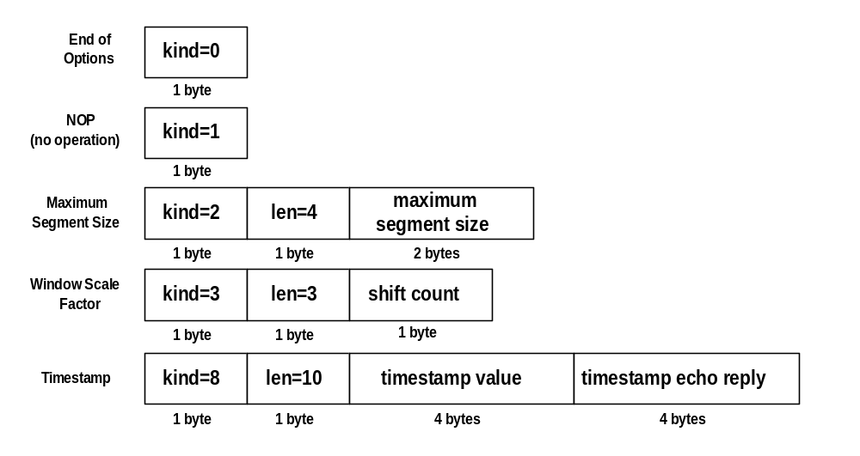
TCP header fields
Options:

Slide 16
TCP header fields
Options:
  NOP is used to pad TCP header to multiples of 4 bytes
  Maximum Segment Size
  Window Scale Options
        Increases the TCP window from 16 to 32 bits, I.e., the window size is interpreted differently
        Q: What is the different interpretation ?
        This option can only be used in the SYN segment (first segment) during connection establishment time
  Timestamp Option
        Can be used for roundtrip measurements

Slide 17
Connection Management in TCP
Opening a TCP Connection
Closing a TCP Connection
Special Scenarios
State Diagram

Slide 18
TCP Connection Establishment
TCP uses a three-way handshake to open a connection:
(1) ACTIVE OPEN: Client sends a segment with
      SYN bit set *
      port number of client
      initial sequence number (ISN) of client
(2) PASSIVE OPEN: Server responds with a segment with
      SYN bit set *
      initial sequence number of server
      ACK for ISN of client
  (3) Client acknowledges by sending a segment with:
      ACK ISN of server (* counts as one byte)

Slide 19
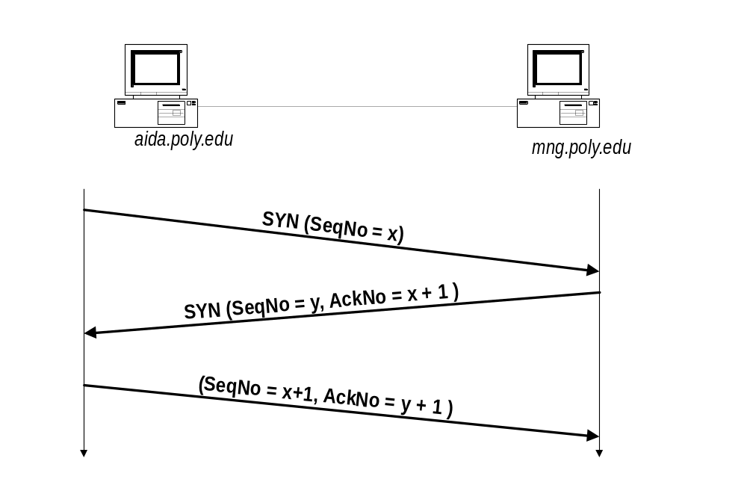
Three-Way Handshake

Slide 20
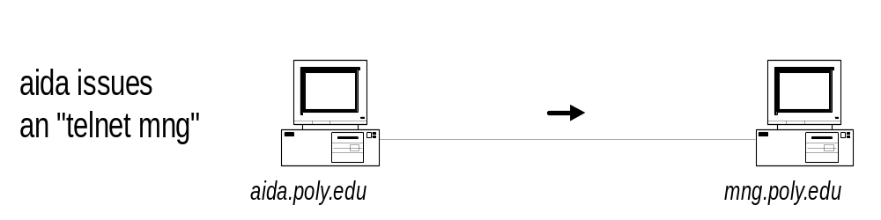
A Closer Look with tcpdump
1 aida.poly.edu.1121 > mng.poly.edu.telnet: S 1031880193:1031880193(0)
win 16384 <mss 1460,nop,wscale 0,nop,nop,timestamp>
2 mng.poly.edu.telnet > aida.poly.edu.1121: S 172488586:172488586(0)
ack 1031880194 win 8760 <mss 1460>
3 aida.poly.edu.1121 > mng.poly.edu.telnet: . ack 172488587 win 17520
4 aida.poly.edu.1121 > mng.poly.edu.telnet: P 1031880194:1031880218(24)
ack 172488587 win 17520
5 mng.poly.edu.telnet > aida.poly.edu.1121: P 172488587:172488590(3)
ack 1031880218 win 8736
6 aida.poly.edu.1121 > mng.poly.edu.telnet: P 1031880218:1031880221(3)
ack 172488590 win 17520

Slide 21
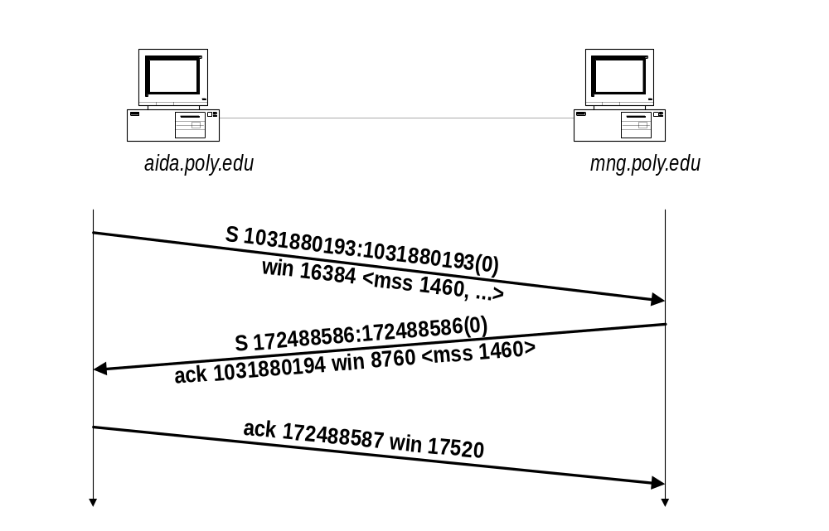
Three-Way Handshake

Slide 22
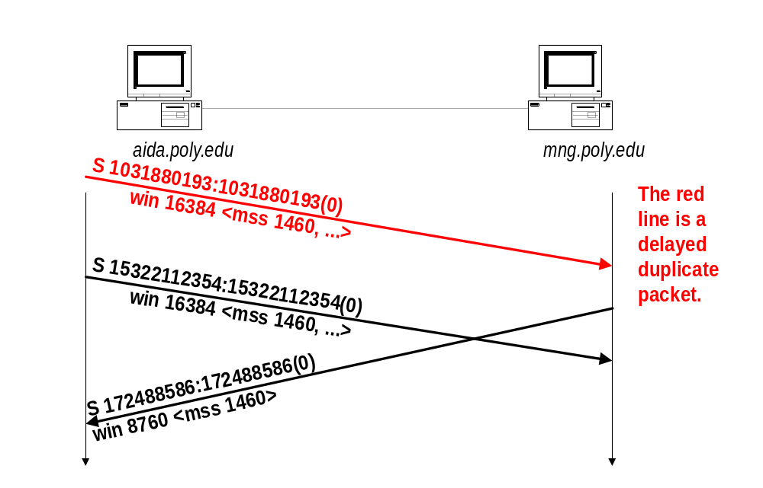
Why is a Two-Way Handshake not enough?
Will be discarded as a duplicate SYN
When aida initiates the data transfer (starting with SeqNo=15322112355), mng will reject all data.

Slide 23
TCP Connection Termination
Each end of the data flow must be shut down independently (“half-close”)
If one end is done it sends a FIN segment. This means that no more data will be sent
Four steps involved:
  (1) X sends a FIN to Y (active close)
  (2) Y ACKs the FIN,
  (at this time: Y can still send data to X)
  (3) and Y sends a FIN to X (passive close)
  (4) X ACKs the FIN.

Slide 24
Connection termination with tcpdump
1 mng.poly.edu.telnet > aida.poly.edu.1121: F 172488734:172488734(0) ack 1031880221 win 8733
2 aida.poly.edu.1121 > mng.poly.edu.telnet: . ack 172488735 win 17484
3 aida.poly.edu.1121 > mng.poly.edu.telnet: F 1031880221:1031880221(0) ack 172488735 win 17520
4 mng.poly.edu.telnet > aida.poly.edu.1121: . ack 1031880222 win 8733

Slide 25
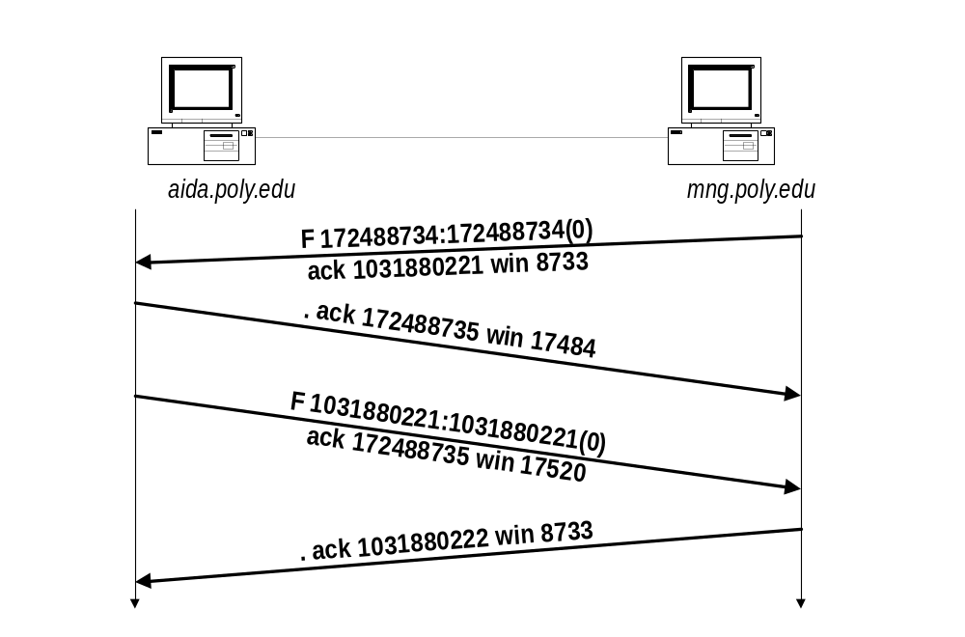
TCP Connection Termination

Slide 26
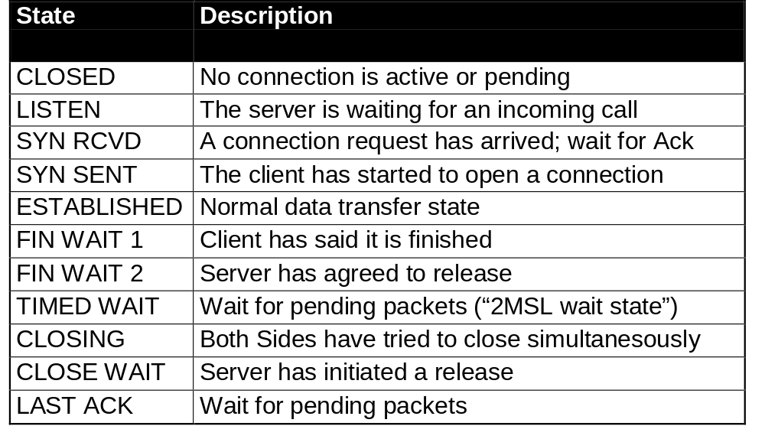
TCP States

Slide 27
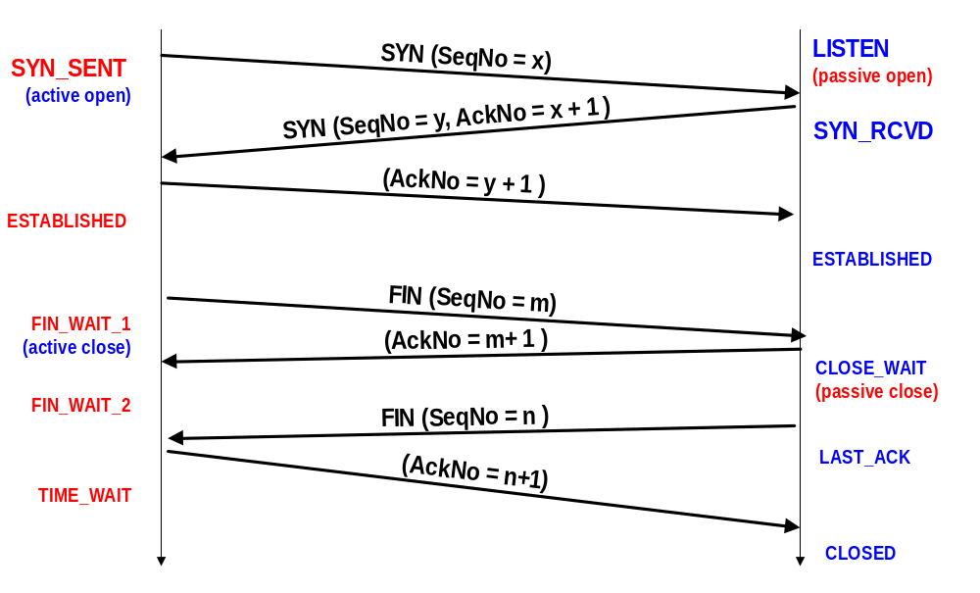
TCP States in “Normal” Connection Lifetime

Slide 28
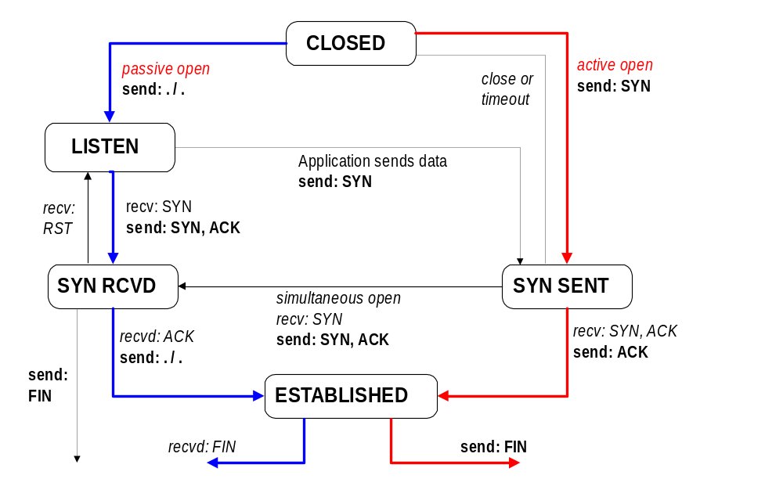
TCP State Transition Diagram
Opening A Connection

Slide 29
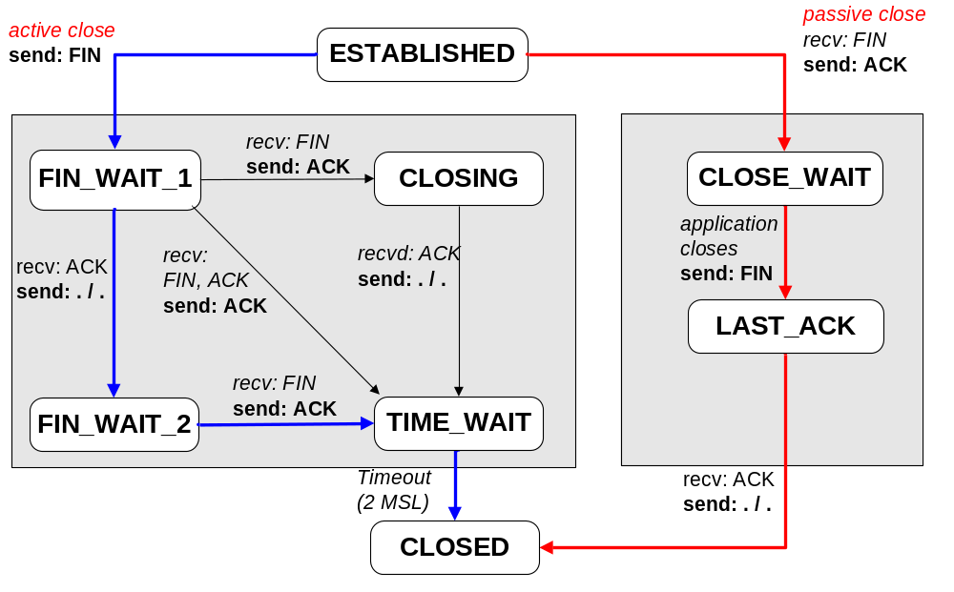
TCP State Transition Diagram
Closing A Connection

Slide 30
2MSL Wait State
2MSL Wait State = TIME_WAIT
When TCP does an active close, and sends the final ACK, the connection must stay in in the TIME_WAIT state for twice the maximum segment lifetime.
2MSL= 2 * Maximum Segment Lifetime
Why?
TCP is given a chance to resent the final ACK. (Server will timeout after sending the FIN segment and resend the FIN)
The MSL is set to 2 minutes or 1 minute or 30 seconds.

Slide 31
Resetting Connections
Resetting connections is done by setting the RST flag
When is the RST flag set?
  Connection request arrives and no server process is waiting on the destination port
  Abort (Terminate) a connection
  Causes the receiver to throw away buffered data. Receiver does not acknowledge the RST segment

