Slide 1
IP - The Internet Protocol

Slide 2
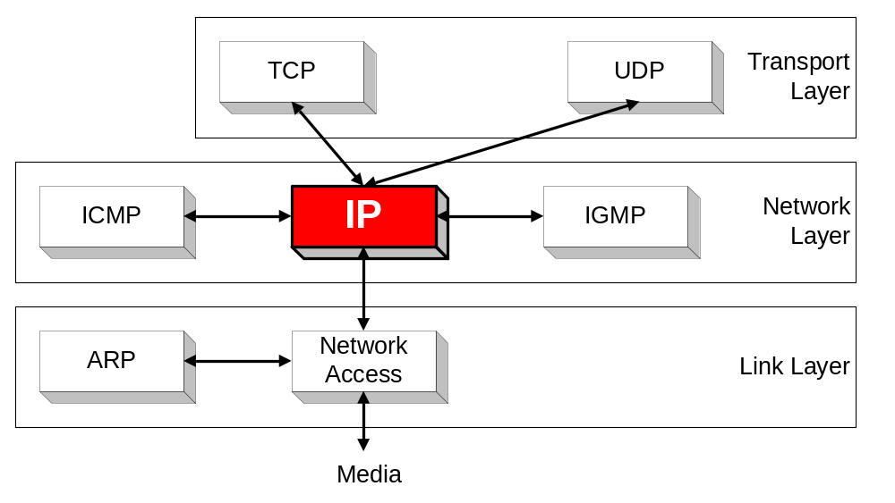
Orientation
IP (Internet Protocol) is a Network Layer Protocol.
IP’s current version is Version 4 (IPv4). It is specified in RFC 891.

Slide 3
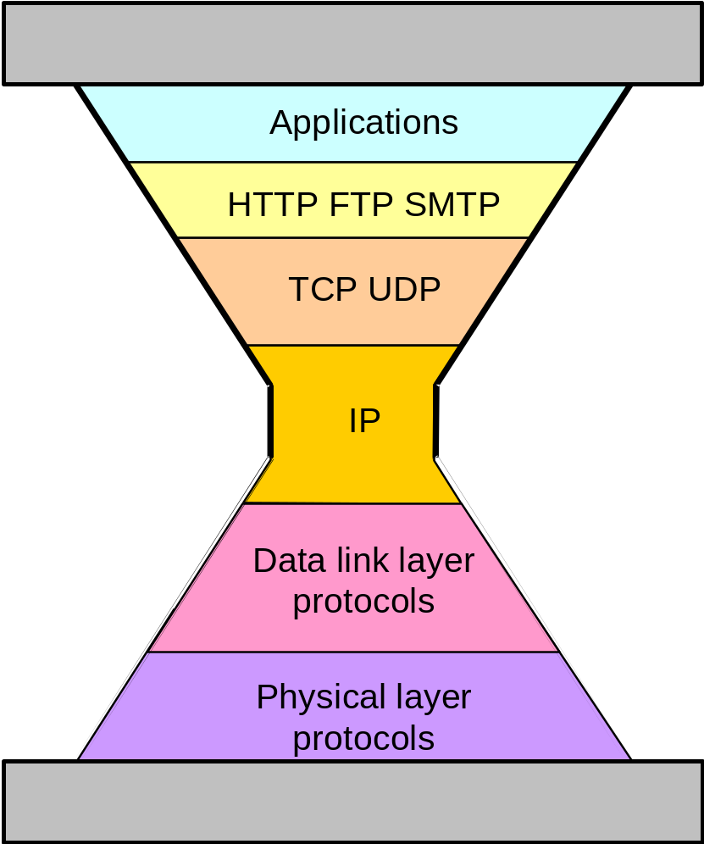
IP: The waist of the hourglass
IP is the waist of the hourglass of the Internet protocol architecture
Multiple higher-layer protocols
Multiple lower-layer protocols
Only one protocol at the network layer.

Slide 4
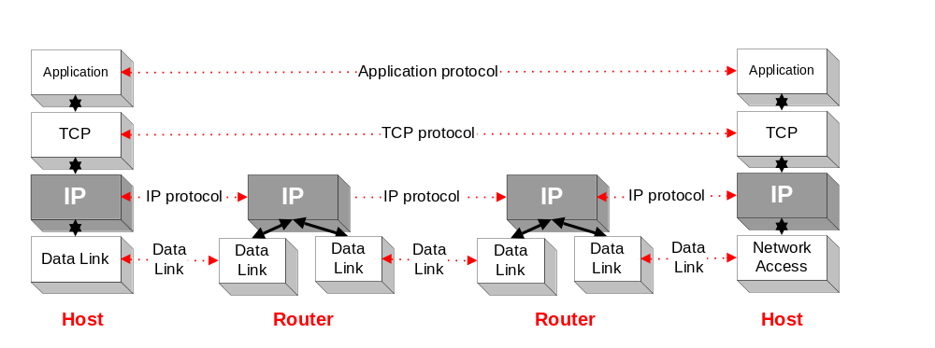
Application protocol
IP is the highest layer protocol which is implemented at both routers and hosts

Slide 5
IP Service
Delivery service of IP is minimal
IP provides an unreliable connectionless best effort service (also called: “datagram service”).
  Unreliable: IP does not make an attempt to recover lost packets
  Connectionless: Each packet (“datagram”) is handled independently. IP is not aware that packets between hosts may be sent in a logical sequence
  Best effort: IP does not make guarantees on the service (no throughput guarantee, no delay guarantee,…)
Consequences:
Higher layer protocols have to deal with losses or with duplicate packets
Packets may be delivered out-of-sequence

Slide 6
IP Service
IP supports the following services:
    one-to-one (unicast)
    one-to-all (broadcast)
    one-to-several (multicast)
IP multicast also supports a many-to-many service.
IP multicast requires support of other protocols (IGMP, multicast routing)
unicast
broadcast
multicast

Slide 7
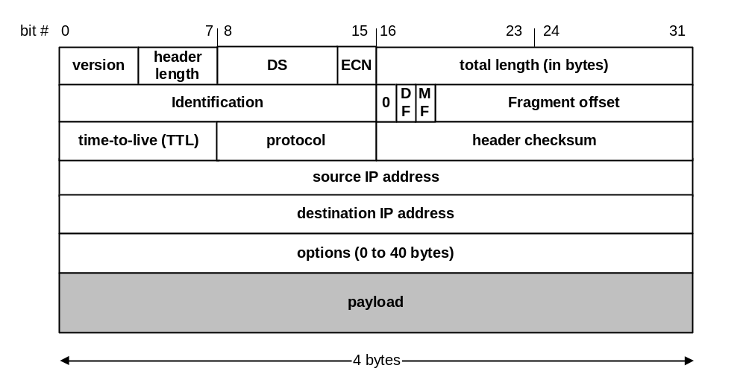
IP Datagram Format
20 bytes ≤ Header Size < 2⁴ x 4 bytes = 60 bytes
20 bytes ≤ Total Length < 2¹⁶ bytes = 65536 bytes

Slide 8
IP Datagram Format
Question: In which order are the bytes of an IP datagram transmitted?
Answer:
    Transmission is row by row
    For each row:
        1. First transmit bits 0-7
        2. Then transmit bits 8-15
        3. Then transmit bits 16-23
        4. Then transmit bits 24-31
This is called network byte order or big endian byte ordering.
Note: Many computers (incl. Intel processors) store 32-bit words in little endian format. Others (incl. Motorola processors) use big endian.

Slide 9
Big endian vs. small endian
Conventions to store a multibyte work
Example: a 4 byte Long Integer Byte3 Byte2 Byte1 Byte0
Little Endian
Stores the low-order byte at the lowest address and the highest order byte in the highest address.
Base Address+0 Byte0
Base Address+1 Byte1
Base Address+2 Byte2
Base Address+3 Byte3
Intel processors use this order
Big Endian
Stores the high-order byte at the lowest address, and the low-order byte at the highest address.
Base Address+0 Byte3
Base Address+1 Byte2
Base Address+2 Byte1
Base Address+3 Byte0
Motorola processors use big endian.

Slide 10
Fields of the IP Header
Version (4 bits): current version is 4, next version will be 6.
Header length (4 bits): length of IP header, in multiples of 4 bytes
DS/ECN field (1 byte)
  This field was previously called as Type-of-Service (TOS) field. The role of this field has been re-defined, but is “backwards compatible” to TOS interpretation
  Differentiated Service (DS) (6 bits):
    Used to specify service level (currently not supported in the Internet)
  Explicit Congestion Notification (ECN) (2 bits):
    New feedback mechanism used by TCP

Slide 11

Service type or differentiated services

Slide 12

Types of service

Slide 13

Default types of service

Slide 14
Fields of the IP Header
Identification (13 bits): Unique identification of a datagram from a host. Incremented whenever a datagram is transmitted
Flags (3 bits):
  First bit always set to 0
  DF bit (Do not fragment)
  MF bit (More fragments)
  Will be explained later→ Fragmentation

Slide 15
Fields of the IP Header
Time To Live (TTL) (1 byte):
  Specifies longest paths before datagram is dropped
  Role of TTL field: Ensure that packet is eventually dropped when a routing loop occurs
  Used as follows:
  Sender sets the value (e.g., 64)
  Each router decrements the value by 1
  When the value reaches 0, the datagram is dropped

Slide 16
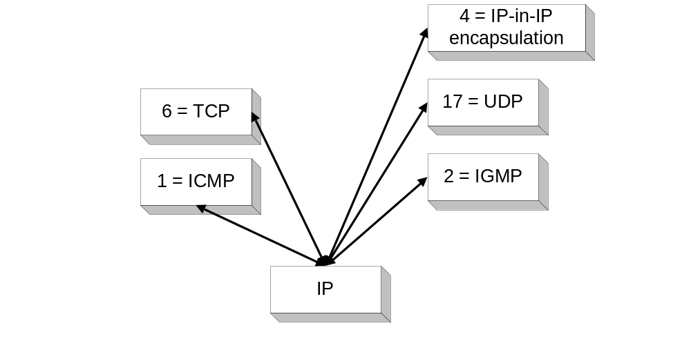
Fields of the IP Header
Protocol (1 byte):
    Specifies the higher-layer protocol.
    Used for demultiplexing to higher layers.
Header checksum (2 bytes): A simple 16-bit long checksum which is computed for the header of the datagram.

Slide 17

Example of checksum calculation in IPv4

Slide 18

Taxonomy of options in IPv4

Slide 19
Fields of the IP Header
Options:
    Security restrictions
    Record Route: each router that processes the packet adds its IP address to the header.
    Timestamp: each router that processes the packet adds its IP address and time to the header.
    (loose) Source Routing: specifies a list of routers that must be traversed.
    (strict) Source Routing: specifies a list of the only routers that can be traversed.
Padding: Padding bytes are added to ensure that header ends on a 4-byte boundary

Slide 20
Maximum Transmission Unit
Maximum size of IP datagram is 65535, but the data link layer protocol generally imposes a limit that is much smaller
Example:
  Ethernet frames have a maximum payload of 1500 bytes
  → IP datagrams encapsulated in Ethernet frame cannot be longer than 1500 bytes
The limit on the maximum IP datagram size, imposed by the data link protocol is called maximum transmission unit (MTU)
MTUs for various data link protocols:
  Ethernet: 1500 FDDI: 4352
  802.3: 1492 ATM AAL5: 9180
  802.5: 4464 PPP: negotiated

Slide 21
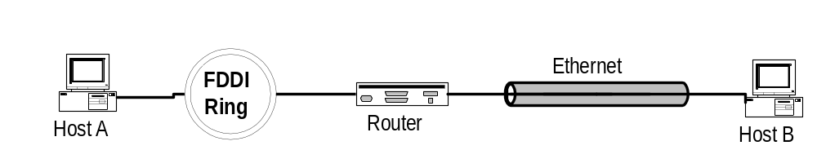
IP Fragmentation
What if the size of an IP datagram exceeds the MTU?
IP datagram is fragmented into smaller units.
What if the route contains networks with different MTUs?
MTUs: FDDI: 4352 Ethernet: 1500
Fragmentation:
  IP router splits the datagram into several datagram
  Fragments are reassembled at receiver

Slide 22
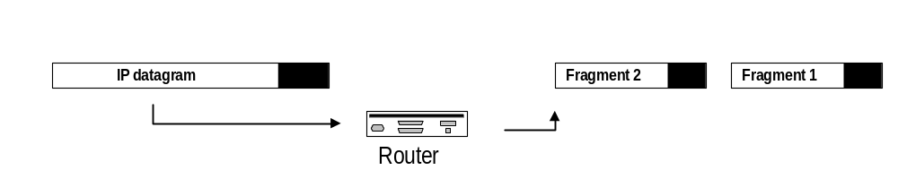
Where is Fragmentation done?
    Fragmentation can be done at the sender or at intermediate routers
    The same datagram can be fragmented several times.
    Reassembly of original datagram is only done at destination hosts !!

Slide 23
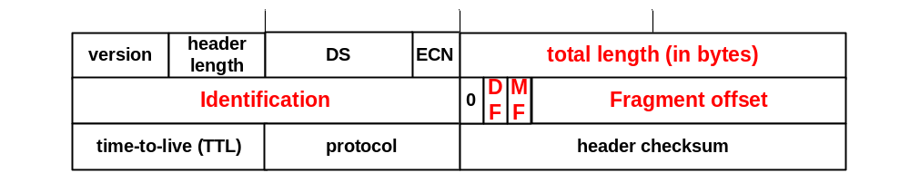
What’s involved in Fragmentation?
The following fields in the IP header are involved:
Identification When a datagram is fragmented, the identification is the same in all fragments
Flags
DF bit is set: Datagram cannot be fragmented and must be discarded if MTU is too small
MF bit set: This datagram is part of a fragment and an additional fragment follows this one

Slide 24
What’s involved in Fragmentation?
The following fields in the IP header are involved:
Fragment offset Offset of the payload of the current fragment in the original datagram
Total length Total length of the current fragment

Slide 25

Fragmentation example

Slide 26

Detailed fragmentation example

Slide 27
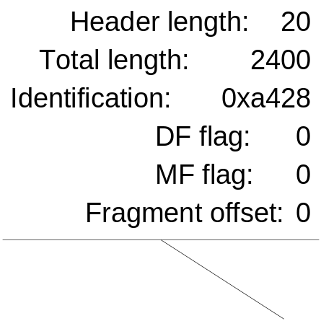
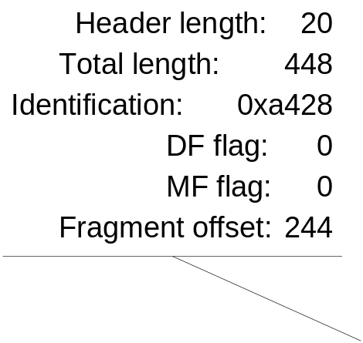
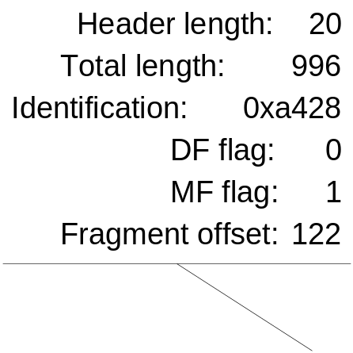
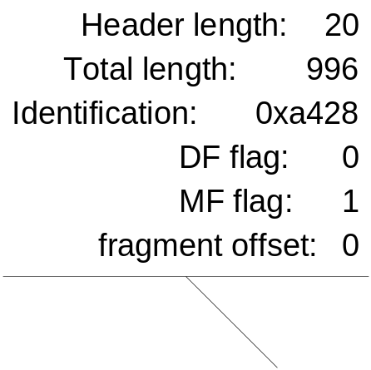
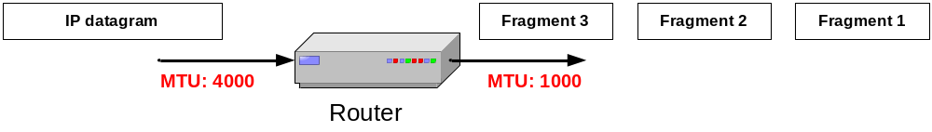
Example of Fragmentation
A datagram with size 2400 bytes must be fragmented according to an MTU limit of 1000 bytes

Slide 28
Determining the length of fragments
To determine the size of the fragments we recall that, since there are only 13 bits available for the fragment offset, the offset is given as a multiple of eight bytes. As a result, the first and second fragment have a size of 996 bytes (and not 1000 bytes). This number is chosen since 976 is the largest number smaller than 1000–20= 980 that is divisible by eight. The payload for the first and second fragments is 976 bytes long, with bytes 0 through 975 of the original IP payload in the first fragment, and bytes 976 through 1951 in the second fragment. The payload of the third fragment has the remaining 428 bytes, from byte 1952 through 2379. With these considerations, we can determine the values of the fragment offset, which are 0, 976 / 8 = 122, and 1952 / 8 = 244, respectively, for the first, second and third fragment.

Slide 29
Example 1
An IPv4 packet has arrived with the first 8 bits as shown:
01000010
The receiver discards the packet. Why?
Solution
There is an error in this packet. The 4 leftmost bits (0100) show the version, which is correct. The next 4 bits (0010) show an invalid header length (2 × 4 = 8). The minimum number of bytes in the header must be 20. The packet has been corrupted in transmission.

Slide 30
Example 2
In an IPv4 packet, the value of HLEN is 1000 in binary. How many bytes of options are being carried by this packet?
Solution
The HLEN value is 8, which means the total number of bytes in the header is 8 × 4, or 32 bytes. The first 20 bytes are the base header, the next 12 bytes are the options.

Slide 31
Example 3
In an IPv4 packet, the value of HLEN is 5, and the value of the total length field is 0x0028. How many bytes of data are being carried by this packet?
Solution
The HLEN value is 5, which means the total number of bytes in the header is 5 × 4, or 20 bytes (no options). The total length is 40 bytes, which means the packet is carrying 20 bytes of data (40 − 20).

Slide 32
Example 4
An IPv4 packet has arrived with the first few hexadecimal digits as shown.
0x45000028000100000102 . . .
How many hops can this packet travel before being dropped? The data belong to what upper-layer protocol?
Solution
To find the time-to-live field, we skip 8 bytes. The time-to-live field is the ninth byte, which is 01. This means the packet can travel only one hop. The protocol field is the next byte (02), which means that the upper-layer protocol is IGMP.

Slide 33
Example 5
A packet has arrived with an M bit value of 0. Is this the first fragment, the last fragment, or a middle fragment? Do we know if the packet was fragmented?
Solution
If the M bit is 0, it means that there are no more fragments; the fragment is the last one. However, we cannot say if the original packet was fragmented or not. A non-fragmented packet is considered the last fragment.

Slide 34
Example 6
A packet has arrived with an M bit value of 1. Is this the first fragment, the last fragment, or a middle fragment? Do we know if the packet was fragmented?
Solution
If the M bit is 1, it means that there is at least one more fragment. This fragment can be the first one or a middle one, but not the last one. We don’t know if it is the first one or a middle one; we need more information (the value of the fragmentation offset).

Slide 35
Example 7
A packet has arrived with an M bit value of 1 and a fragmentation offset value of 0. Is this the first fragment, the last fragment, or a middle fragment?
Solution
Because the M bit is 1, it is either the first fragment or a middle one. Because the offset value is 0, it is the first fragment.

Slide 36
Example 8
A packet has arrived in which the offset value is 100. What is the number of the first byte? Do we know the number of the last byte?
Solution
To find the number of the first byte, we multiply the offset value by 8. This means that the first byte number is 800. We cannot determine the number of the last byte unless we know the length.

Slide 37
Example 9
A packet has arrived in which the offset value is 100, the value of HLEN is 5, and the value of the total length field is 100. What are the numbers of the first byte and the last byte?
Solution
The first byte number is 100 × 8 = 800. The total length is 100 bytes, and the header length is 20 bytes (5 × 4), which means that there are 80 bytes in this datagram. If the first byte number is 800, the last byte number must be 879.

Slide 38
Example 10
Figure 20.13 shows an example of a checksum calculation for an IPv4 header without options. The header is divided into 16-bit sections. All the sections are added and the sum is complemented. The result is inserted in the checksum field.

